Slide 1
Data libraries as a collaborative tool across Monte Carlo codes
Maria Grazia Pia
INFN Genova, Italy
Mauro Augelli¹, Marcia Begalli², Mincheol Han³, Steffen Hauf⁴, Chan-Hyeung Kim³, Markus Kuster⁴, Maria Grazia Pia⁵, Lina Quintieri⁶, Paolo Saracco⁵, Hee Seo³, Manju Sudhakar⁵, Georg Weidenspointner⁷, Andreas Zoglauer⁸
¹ CNES,France - ² State University Rio de Janeiro, Brazil – ³ Hanyang University, Korea ⁴ Technische Universität Darmstadt, Germany – ⁵ INFN Sezione di Genova, Italy ⁶ INFN Laboratori Nazionali di Frascati, Italy – ⁷ MPE and MPI Halbleiterlabor,Germany ⁸ University of California at Berkeley, USA
SNA + MC 2010
Joint International Conference on
Supercomputing in Nuclear Applications + Monte Carlo 2010

Slide 2
Data libraries
Compilations of evaluated theoretical or experimental data
Essential tool for Monte Carlo simulation
Simulation results are as good as the data on which they are based
well, sometimes they can be worse…
Largely shared across different Monte Carlo codes
Can be a powerful instrument for the community
to study modeling systematic
to exchange physics knowledge across Monte Carlo codes
Relatively limited documentation of their validation in the literature
Sometimes even of their content…

Slide 3
Ongoing activities
Validation of current data libraries
EADL (Evaluated Atomic Data Library)
EEDL (Evaluated Electron Data Library)
ENSDF (Radioactive decay data)
Evaluation of improvements to current data libraries
Evaluation of atomic parameter collections
Available in the literature
New data libraries
Proton and α ionisation
Electron ionisation
Software tools for data library management
G3: Information Technology and its Applications II, Data management tools: computational evolutions and benchmarks

Slide 4
EADL Evaluated Atomic Data Library
To date, the most complete collection of atomic parameters relevant to Monte Carlo transport
For Z = 1-100, all subshells:
Subshell data
Number of electrons
Binding and kinetic energies
Average radius
Level widths
Average number and energies of released electrons and X-rays
Average energy left to residual atom
Radiative and non-radiative transition probabilities
S. T. Perkin, et al.,Tables and Graphs of Atomic Subshell and Relaxation Data Derived from the LLNL Evaluated Atomic Data Library (EADL), Z = 1-100, UCRL-50400, Vol. 30, LLNL (1991)

Slide 5
Atomic binding energies
Inner shells
Evaluated through experimental measurements of characteristic X-ray energies
E = subshell binding energy difference
In progress: evaluation through direct experimental data
Outer shells
Ionisation energy (AKA ionisation potential): direct experimental measurements
Evaluated indirectly through their effects on electron impact cross section calculations compared to experimental data

Slide 6
Sources
Data libraries/collections
Experimental data
EADL
Geant4
Lotz
Carlson
MCNP, Penelope 2008
~Geant4
Table of Isotopes 1978
EGS4, EGSnrc, Geant4
Table of Isotopes 1996
EGS5
X-ray Data Booklet
Review
Des Lattes et al., X-ray transition energies: new approach to a comprehensive evaluation, Rev. Mod. Phys. 75, 35–99 (2003)
NIST Physics Reference Data
See references therein
High precision evaluated experimental data
Bibliography in forthcoming publication

Slide 7
KL3 transition
Lotz
Full set of results in a forthcoming publication

Slide 8
KN3 transition
EADL

Slide 9
Ionisation energies
Difference w.r.t. NIST Reference (experimental) Data
Full set of results in a forthcoming publication

Slide 10
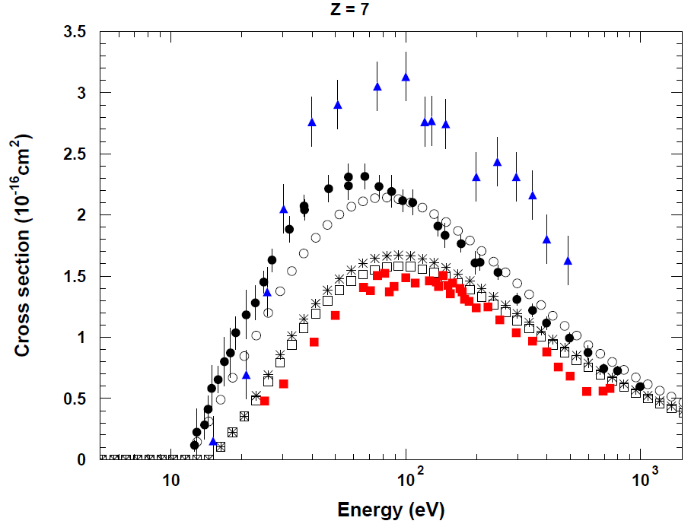
Effect of atomic parameters on ionisation cross sections
Comparison with experimental data
BEB cross section
○ with EADL binding energies
* with Lotz binding energies
□ with EADL (inner shells) b.e. and NIST ionisation energy
Statistical analysis to distill sound conclusions
Significant effect of outer shell binding energies on ionisation cross section value
Limited effect of different electron kinetic energies
Full set of results and references to experimental data in a forthcoming publication
See I2: Low Energy Electrons and Photons, Design, development and validation of electron ionisation models for nano-scale simulation

Slide 11
EADL radiative transition probabilities
EADL
Calculations based on Hartree-Slater method by Scofield
GUPIX database (commercial)
Calculations based on Hartree-Fock method by Scofield
Validation w.r.t. experimental data collected by Salem
K and L transitions
Experimental data span several decades
Data quality is largely variable
One can draw sound conclusions only based on rigorous statistical analysis
Hartree-Fock method produces significantly more accurate results
Further details in I2: Low Energy Electrons and Photons
Conceptual challenges and computational progress in x-ray simulation

Slide 12
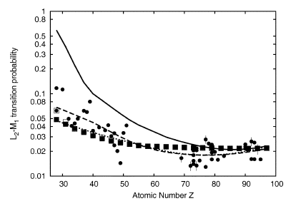
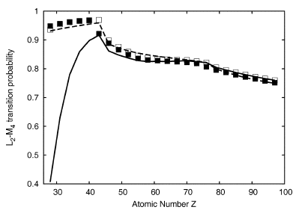
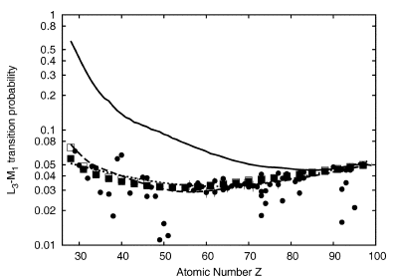
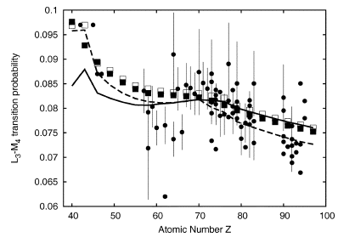
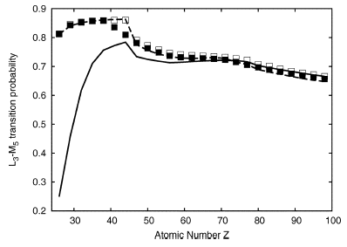
Inconsistencies in EADL
□ Scofield Hartree-Slater
EADL
L₂M₁
L₂M₄
L₃M₁
L₃M₅
L₃M₄
Discrepancies of EADL values w.r.t. experimental data were documented in R. D. Bonetto, A. C. Carreras, J. Trincavelli, G. Castellano,“L-shell radiative transition rates by selective synchrotron ionization”, J. Phys. B, vol. 37, pp. 1477–1488, 2004

Slide 13
EADL improvement
The current version of EADL dates back to 1991
It would profit from some rejuvenation
State-of-the-art binding energies
Other data collections exhibit better accuracy w.r.t. experimental data
Are they complete?
What effect on other electromagnetic calculations?
State-of-the-art radiative transition probabilities
Based on Hartree-Fock calculations
We could retrieve Hartree-Fock calculations in the literature only for a small set of transitions
Are further theoretical calculations needed?
V&V prior to release

Slide 14
EEDL Evaluated Electron Data Library
Elastic scattering
Ionisation
Bremsstrahlung
Excitation
Cross sections
Spectra
Angular distributions
Average energy to the residual atom
Z = 1-100
Electron energy: 10 eV – 100 GeV
Data from theoretical calculations
S. T. Perkins, D. E. Cullen and S. M. Seltzer, Tables and Graphs of Electron-Interaction Cross Sections from 10 eV to 100 GeV Derived from the LLNL Evaluated Electron Data Library (EEDL), Z = 1-100, UCRL-50400, Vol. 31, LLNL(1991)

Slide 15
Validation of EEDL ionisation cross sections
Limited validation of EEDL cross sections in the literature
“Comparing our K-shell ionization cross section to the compiled experimental data of Tawara and Kato and Long et al., we find that the uncertainties in our data appear to be ≤30 to 40% at low energies. The error might be as large as a factor of 2 above several hundred MeV for intermediate-Z elements because of the uncertainty in the onset in energy of the density effect. Errors in the outer subshells are probably at least as much.”
Systematic validation of EEDL ionisation cross sections w.r.t. a large collection of experimental data
181 experimental data sets for 57 atoms
Evaluation of possible alternatives in the low energy range (below 1 keV)
Further details in I2: Low Energy Electrons and Photons
Design, development and validation of electron ionisation models for nano-scale simulation

Slide 16
Results
First validation of EEDL
ionisation cross sections
below 1 keV
% elements for which EEDL is compatible at 95% CL
with at least one data set
Systematics
Dependence of the results on the type of measurement
Single ionisation
Absolute measurement

Slide 17
New data library for electron ionisation cross sections
New data library in progress
Electron impact ionisation cross sections at low energies (<1 keV)
Binary-Encounter-Bethe model
Deutsch-Märk model
Supported by extensive experimental validation
Further details in
I2 Low Energy Electrons and Photons: Design, development and validation of electron ionisation models for nano-scale simulation
Paper in preparation
Example of data library values
compared to EEDL and Penelope electron impact cross sections

Slide 18
New data library for proton/α ionisation cross sections
RSICC’s collaboration is kindly acknowledged
K and L shell ionisation
Theoretical models
ECPSSR model and variants
Hartree-Slater corrections
“united atom” approximation
specialized for high energies
PWBA
Empirical models
Paul and Sacher
Paul and Bolik
Kahoul et al.
Miyagawa et al.
Orlic et al.
Sow et al.
Example: K shell ionization by proton impact on Cu

Slide 19
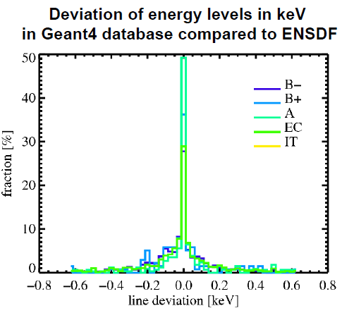
Review of radioactive decay data
ENSDF Evaluated Nuclear Structure Data Files
half lives
decay branches
energy levels and level intensities
of the decaying nucleus
The current database used by Geant4 does not include references to the origin of the individual datasets or their actuality
Work in progress to compare Geant4 radioactive decay datasets and the current version of ENSDF
Further experimental activity to validate the simulation
Further details in F4: Monte Carlo Applications III (Others)
Radioactive decay simulation with Geant4: experimental benchmarks and developments for X-ray astronomy applications

Slide 20
Conclusions
Significant investment in
validating
improving
extending
physics data libraries for Monte Carlo simulation
The Monte Carlo community would profit from a collaborative common effort
to review existing data libraries
to create new data libraries, to facilitate exchanges of physics models across Monte Carlo codes

