Slide 1


Future facilities for hadron spectroscopy
ATHOS 2012 - June 20-22, 2012 Camogli, Italy

Slide 2
Outline
Theoretical background;
Experimental approaches;
Low energy sector;
Open-Charm and Charmonium range;
Exotic states

Slide 3
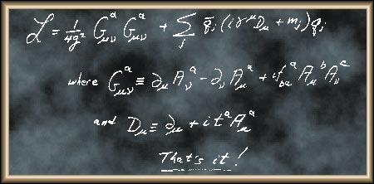
Quantum Chromodynamics
From F.A. Wilczek QCD Lecture
The QCD Lagrangian is, in principle, a complete description of the strong interaction.
There is just one overall coupling constant g, and six quark-mass parameters m_{j} for the six quark flavors
But,
it leads to equations that are hard to solve

Slide 4
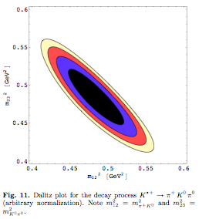
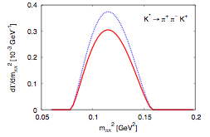
Theoretical approaches
The Lagrangian formulation of the strong interaction is without doubt more elegant:
it starts from basic principles
but
calculations can be obtained only with numerical methods → precise Lattice Gauge Calculations require larger and larger computing power;
Several constants of QCD, the masses of the six quarks (u, d, s, c, b, t) and the scale parameter Λ(QCD) must be supplied from outside.
Effective field theories and potential models replace the non-Abelian gauge-invariant ﬁeld Lagrangian by a phenomenological approach with hadronic degrees of freedom allowing more transparency in the calculations.
With those attempts more experimental observables like branching fractions, cross-sections may be predicted.
[GeV]²
m²_{π}⁰_{K}⁰
m²_{π}⁺_{K}⁰
[GeV]²
Dalitz plot and decay width for the channel
K ^{∗+}⟶ π⁺K⁰π⁰
Science 322 (2008) 1224
[arXiv:0906.3599 [hep-lat]].
The agreement with the measured masses is at the few% level.
EPJA39:205,2009
arXiv:0807.4686 [hep-ph]

Slide 5
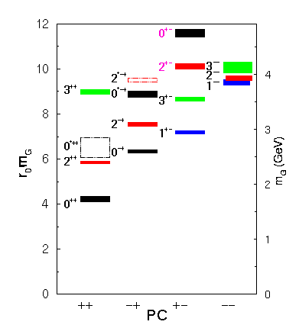
Hadron spectrum
Due to the non-Abelian characteristic of strong interaction also gluons can contribute to hadron structure. If we restrict to the meson sector we can have the following categories:
Mesons
qq
Multiquarks
(qq)(qq)
Hybrids
(qq) g
Glueballs
gg
The identification of the whole spectrum of glueballs might be the key to understand the mechanism of mass creation by the strong interaction.
C. Morningstar and M. Peardon, Phys. Rev. D 60, 034509 (1999)

Slide 6

The experimental situation
In the past years many steps forward in the field were possible thanks to the variety of facilities available all over the world.
Main non-qq candidates
f₀(980) | 4q state - molecule
f₀(1500) | 0⁺⁺ glueball candidate
f₀(1370) | 0⁺⁺ glueball candidate
f₀(1710) | 0⁺⁺ glueball candidate
η(1410); η(1460) | 0⁻⁺ glueball candidate
f₁(1420) | hybrid, 4q state
π₁(1400) | hybrid candidate 1⁻⁺
π₁(1600) | hybrid candidate 1⁻⁺
π (1800) | hybrid candidate 0⁻⁺
π₂(1900) | hybrid candidate 2⁻⁺
π₁(2000) | hybrid candidate 1⁻⁺
a₂’(2100) | hybrid candidate 1⁺⁺
Nowadays confirmation of predictions, together with unexpected results, are still coming out mainly from e⁺ e⁻ collider

Slide 7
Exotic hadrons
The identification of exotic states is an important key to understand
hadron spectrum and the process of mass generation.
qq
1
--
1
-+
Mesons
10
2
c
q
c
(qq)(qq)
q
c
Multiquarks
i
t
t
h
o
g
x
i
E
(qq) g
l
Hybrids
c
1
i
t
o
x
Glueballs
gg
E
10
-2
0
2000
4000
In the light meson energy range exotic
states overlap with conventional states
MeV/
c
2

Slide 8
Exotic hadrons
The identification of exotic states is an important key to understand
hadron spectrum and the process of mass generation.
qq
1
--
1
-+
Mesons
10
2
c
q
c
(qq)(qq)
q
c
Multiquarks
i
t
t
h
o
g
x
i
E
(qq) g
l
Hybrids
c
1
i
t
o
x
Glueballs
gg
E
10
-2
0
2000
4000
MeV/
c
2
In the charmonium energy region
the density of states is lower and
also the overlap

Slide 9
Experimental facilities
Hadron spectroscopy has made considerable progresses in the last years by moving to higher energy regions.
Large data sets have been collected by several experiments:
e⁺e⁻ interactions at the Υ(4S) energy:
  BaBar, BELLE, CLEO 2
e⁺e⁻→ charmonium energy:
  CLEO-c, BES-II, BES-III
pp Tevatron collider:
  CDF, D0
pp collision:
  LHC experiments
Notes:
studying states with at least one charm quark

Slide 10
OpenCharm and Charmonium spectroscopy
c
New charm spectroscopy data came from:
    B decays (lower spin favored)
    inclusive e⁺e⁻→ cc (all spins allowed)
B-meson decay
D⁻
b
W⁻
u,d
B
s
u,d
D_{S}⁺
c
Direct formation e⁺e⁻⟶ cc
e⁻
c
e⁺
γ
New charmonium spectroscopy data came from:
    Direct formation
    Associate chramonium production
    C = +
    B decays
    two photon collisions
    J ≠ 1
    initial state radiation
c
D^{(*)}
Associate production e⁺e⁻⟶J/Ψ X_{cc}
e⁻
c
J/Ψ
c
B-meson decay
c
g
D^{(*)}
X_{cc}
e⁺
γ
c
b
W⁻
c
c
D^{(*)}
B
s
u,d
K^{(*)}
γγ-collisions
u,d
e⁺
e⁺
Initial State Radiation
π
γ∗
γ
X_{cc}
e⁻
π
γ∗
cc
e⁻
e⁻
e⁺
J/Ψ

Slide 11
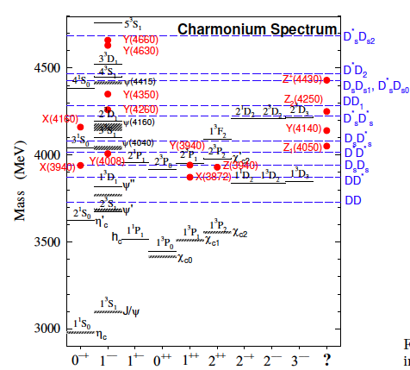
Mesons
XYZ
Without entering into the details of each state some general consideration can be drawn.
masses are barely known;
often widths are just upper limits;
few final states have been studied;
statistics are poor;
quantum number assignment is possible for few states;
some resonances need confirmation…
There are problems of compatibility Theory - Experiment
Arxiv:09010.3409v2 [hep-th]
Notes:
The Charmonium spectrum. The solid lines are quark model predictions,
the shaded lines are the observed conventional charmonium states,
the horizontal dashed lines represent various D*s ¯D*s thresholds,
and the (red) dots are the newly discovered charmonium-like
states placed in the column with the most probable
spin assignment. The states in the last column do not fit
elsewhere and appear to be truly exotic.

Slide 12
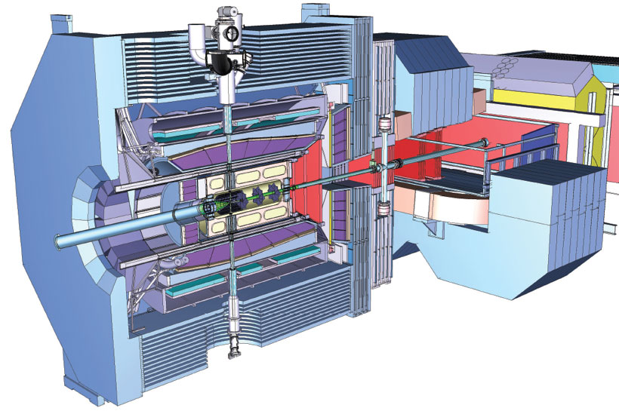
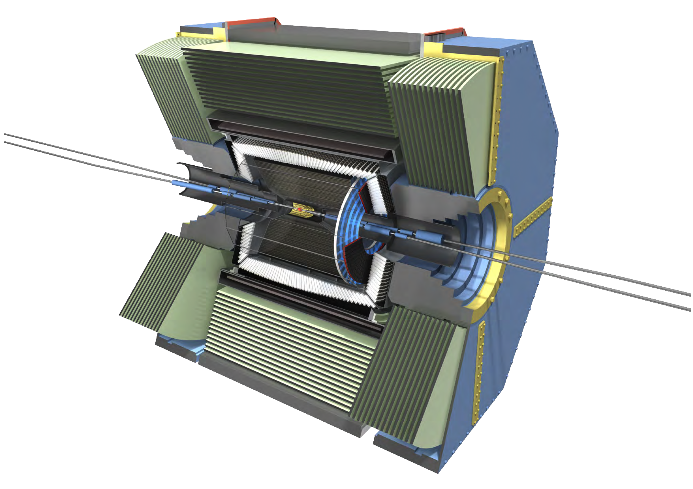
New Experiments
The specifications for the next generation experiment in hadron spectroscopy are:
hermetic detectors for both charged and neutral particles, with excellent resolution and particle identification capability;
beam energy high enough to have a sufficient phase space for the production;
high statistics are needed together with sensitivity to production cross sections at the sub-nanobarn level;

Slide 13








add Hall D
(and beam line)
12 GeV CEBAF
Upgrade magnets and power supplies
CHL-2
Beam Power: 1MW
Beam Current: 90 µA
Max Pass energy: 2.2 GeV
Max Enery Hall A-C: 10.9 GeV
Max Energy Hall D: 12 GeV
Enhance equipment in existing halls
18

Slide 14
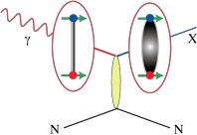
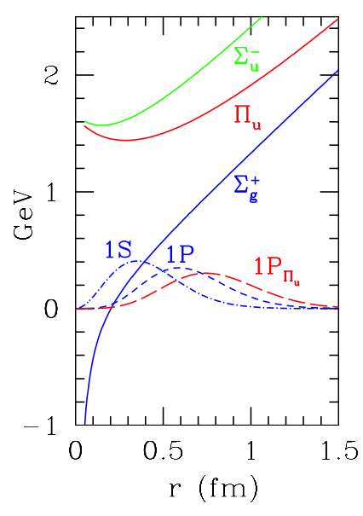
Meson photoproduction
According to the predictions of the flux-tube model [PRD31(1985)2910] adding a gluon to a qq pair it is possible to create new hybrid states. The higher the excitation the more units of angular momentum are carried.
Photon beams are expected to be particularly good for the production of exotic hybrids.
The photon can behave as a virtual vector meson in contrast with S=0 probes which do not excite exotic combinations.
[RL 90 (2003)161601]
excited states
High flux photon beams of sufficient quality and energy have not been available, so there are no data on the photoproduction of mesons with masses below 3 GeV.
ground state
Furthermore, adding longitudinal polarization to the photons one can distinguish the naturality of the intermediate state making selection on the angle between the polarization vector and the hadronic production plane. This capability will help to isolate the exotic waves in the analysis.

Slide 15

GlueX experiment
GlueX is an ideal experiment to conduct a search for light quark exotics and provide complementary data on the spectrum of light quark mesons.
Located in the new Hall D of the upgraded (12 GeV) JLab, it could perform spectroscopy of hadronic states below 3 GeV.
The photon beam will impinge on a liquid-hydrogen target located within a 2 T superconducting solenoid.
photon fluxes of 10⁷ to 10⁸ s⁻¹
The GlueX spectrometer has been designed for large and uniform acceptance for both charged and neutral particle final states, while providing the requisite resolution and particle identification capabilities for spectroscopy.

Slide 16
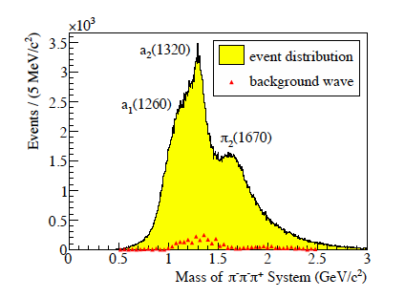
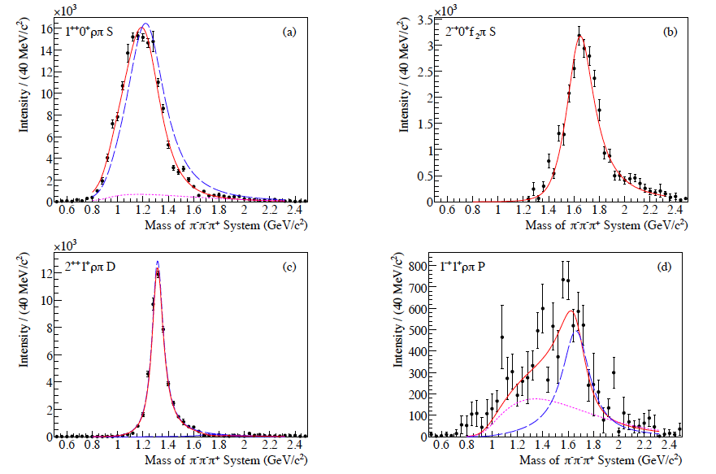
π₁(1600)
π₁(1600) is the best hybrid candidates in the low energy region. Recently COMPASS collected 420.000 diffractive events π⁻+Pb→X + (Pb)_{reco} @190 GeV/c
↳ π⁻π⁻π⁺
PRL104(2010) 241803
acceptance-corrected intensities of the three most prominent waves and of the exotic one
Notes:
COMPASS collected data also on Hidrogen and in the final state pi-pi0pi0 but PWA is ongoing
no pi1(1600) -> pi+ pi- pi+ by CLAS at 6GeV

Slide 17
π₁(1600)
An example of GlueX capability to reconstruct a J^{PC} = 1⁻⁺ wave mixed with six non-exotic waves in the channel γp⟶π⁺π⁻π⁺n
The signal fraction is only 2.5% .
The linear polarization of the photon provides important inputs for constraining the PWA
AIP Conf.Proc. 1374 (2011) 282-285
The statistics corresponds to few days of data taking
Notes:
Presented at the MENU2010 conference
compass measured 1.7% exotic wave

Slide 18
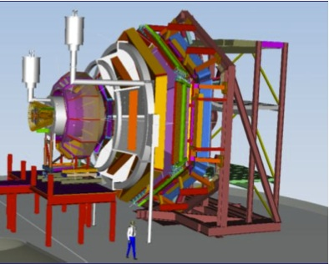
CLAS12 experiment
CLAS12 is the upgrade of the existing detector in Hall B. The primary goal is the study of nucleon structure via GPDs &TMDs. An hadron spectroscopy program is also foresee.
By measuring cross-section and single, double polarization observables on a wide kinematic range interesting results can be obtained on barionic resonances and constraints for PWA of mesonic channel can be determined.
PRC76(2007) 025208
The energy upgrade will allow to explore additional baryons beyond light quark sector (Ξ, Ω,...).
Ξ⁻production
Notes:
Circular polarized photons were available at CEBAF form the very beginning. Now linearly polarized photons are available at CLAS.
FroST (Frozen Spin Target) it’s a butanol froze target
CLAS12 will have a cherenkov to identify kaons

Slide 19

SuperB Factories
Next generation of asymmetric Super B factory ≡
L= 10³⁶ cm⁻² s⁻¹ >100 times the one of the present B-factory
Machines are challenging and based on new accelerating scheme: “crab waist”
luminosity > 10³⁶ possible !
Two SuperB factories will be built in this decade.
Both projects have been funded.

Slide 20
Scientific Program
B factories: is SM with CMK right?
  Success of B-Factories: confirmation of CKM mechanism of CP-violation
  SM works well in the flavour sector
Super B Factories: is there physics beyond the SM ?
  Still room for corrections from New Physics at O(10%)
  Hints of NP: tensions between results from B-factories
(sin2β (+2.2σ), ε_{K} (−1.7σ) , Br(B→τ ν) −(3.2σ))
[CP asymmetry in Bs sector (3.1σ)]
  Much larger dataset is needed
Physics motivation is complementary to LHC:
  if LHC finds NP, precision flavour physics is compulsory
  if LHC finds no NP, high-statistics B/τ decays would be a unique way to search for new physics far beyond the TeV scale
Spectroscopy is not the primary goal but B factories have demonstrated their potential ➔higher luminosity ➔higher statistics

Slide 21
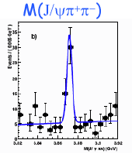
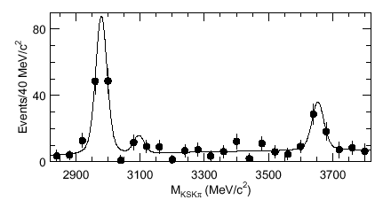
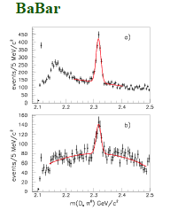
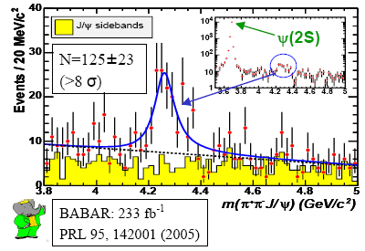
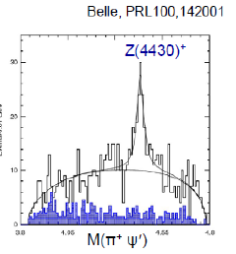
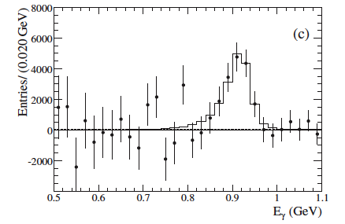
Spectroscopy Highlights from the B Factories
X(3872)(Belle)
D_{S}(2317)
η_{c}(2S) (Belle)
Y(4260)(BaBar)
η_{b}(1S) (BaBar)
21

Slide 22
Future Super Flavour Factories
 | SuperB | Super KEKB
Peak Luminosity | >10³⁶ | 0.8 x 10³⁶
Integrated Luminosity | 75 ab⁻¹ | 50 ab⁻¹
Site | Tor Vergata | KEKB Laboratory
Collisions | end 2016 | 2015
Polarization | 80% electron beam | No
Low energy running | 10³⁵ @ charm threshold | No
Approval status | Approved | Approved

Slide 23
Large Crossing Angle, Small x Size
1) Head-on,
Short bunches
Overlap region
2) Large crossing angle,
long bunches
(1) and (2) have same Luminosity, but (2) has longer bunches and smaller σ_{x}
σ_{x}
σ_{z}
σ_{x}
σ_{z}
Vertical waist has to be a function of x:
Z = 0 for particles at –σ_{x} (- σ_{x}/2θ at low current)
Z = σ_{x}/θ for particles at + σ_{x} (σ_{x}/2θ at low current)
Large Piwinski angle:
Φ = tg(θ)σ_{z}/σ_{x}
y waist can be moved
along z with a sextupole
on both sides of IP
at proper phase
“Crab Waist”
β_{Y}

Slide 24
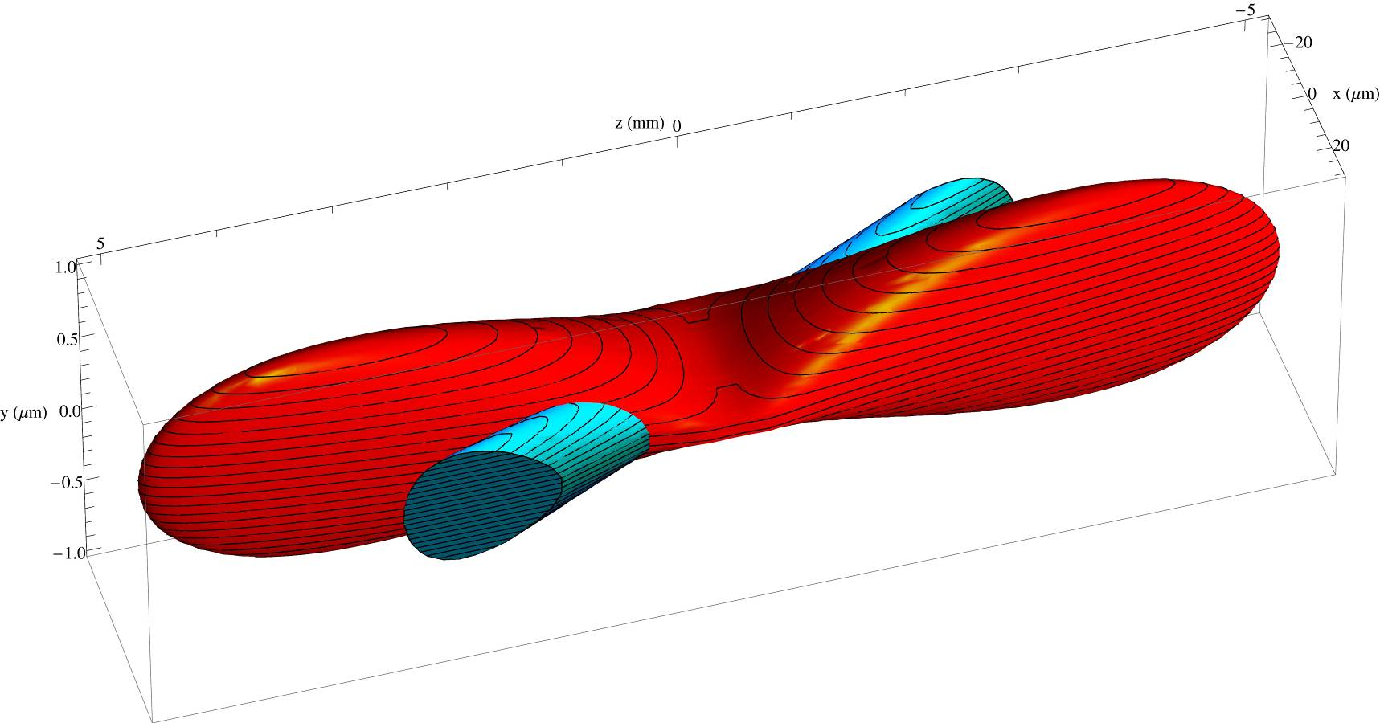
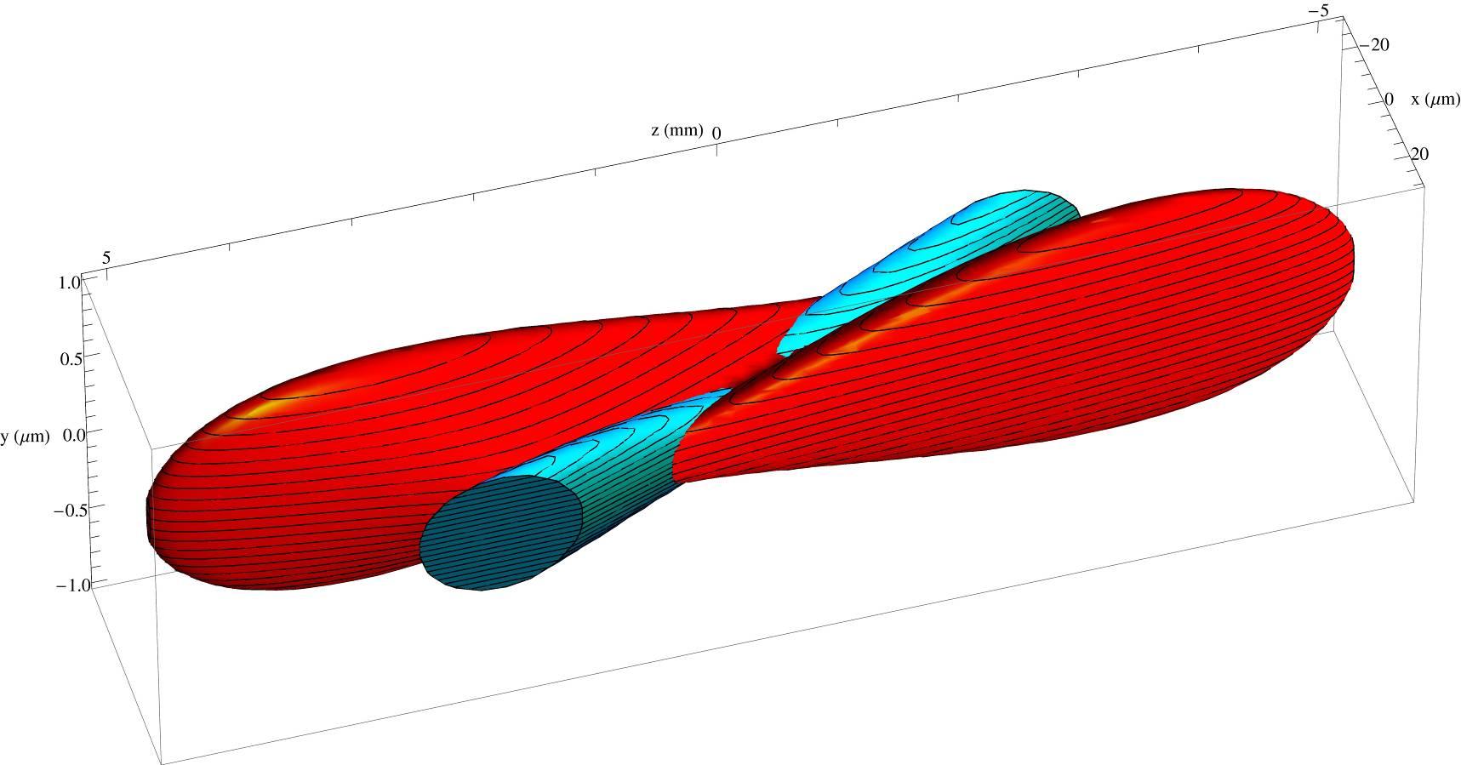
Crab-Waist Scheme
Crab sextupoles OFF: Waist line is orthogonal to the axis of other beam
Raimondi, Shatilov, Zobov http://arxiv.org/abs/physics/0702033
Crab sextupoles ON: Waist aligned with path of other beam
particles at higher ß do not see full field of other beam
no excessive beam-beam parameter due to hourglass effect
Notes:
Large crossing-angle scheme elliminates parasitic bunch crossings, but introduces beam-beam betatron coupling resonances

Slide 25
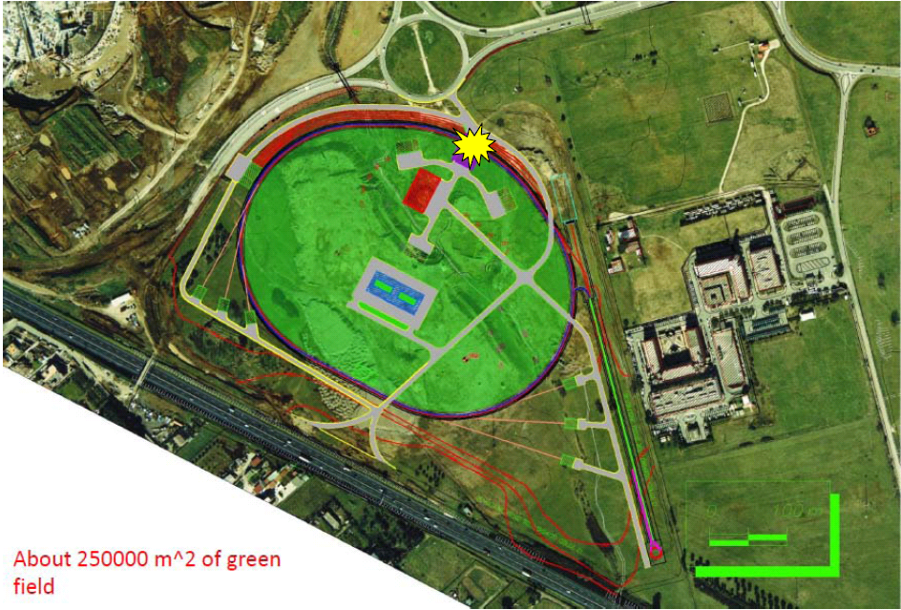
SuperB Site at Tor Vergata
Possible photon beamlines
Campus of Tor Vergata
about 30000 m² available

Slide 26

SuperB Luminosity Model
75 ab⁻¹

Slide 27
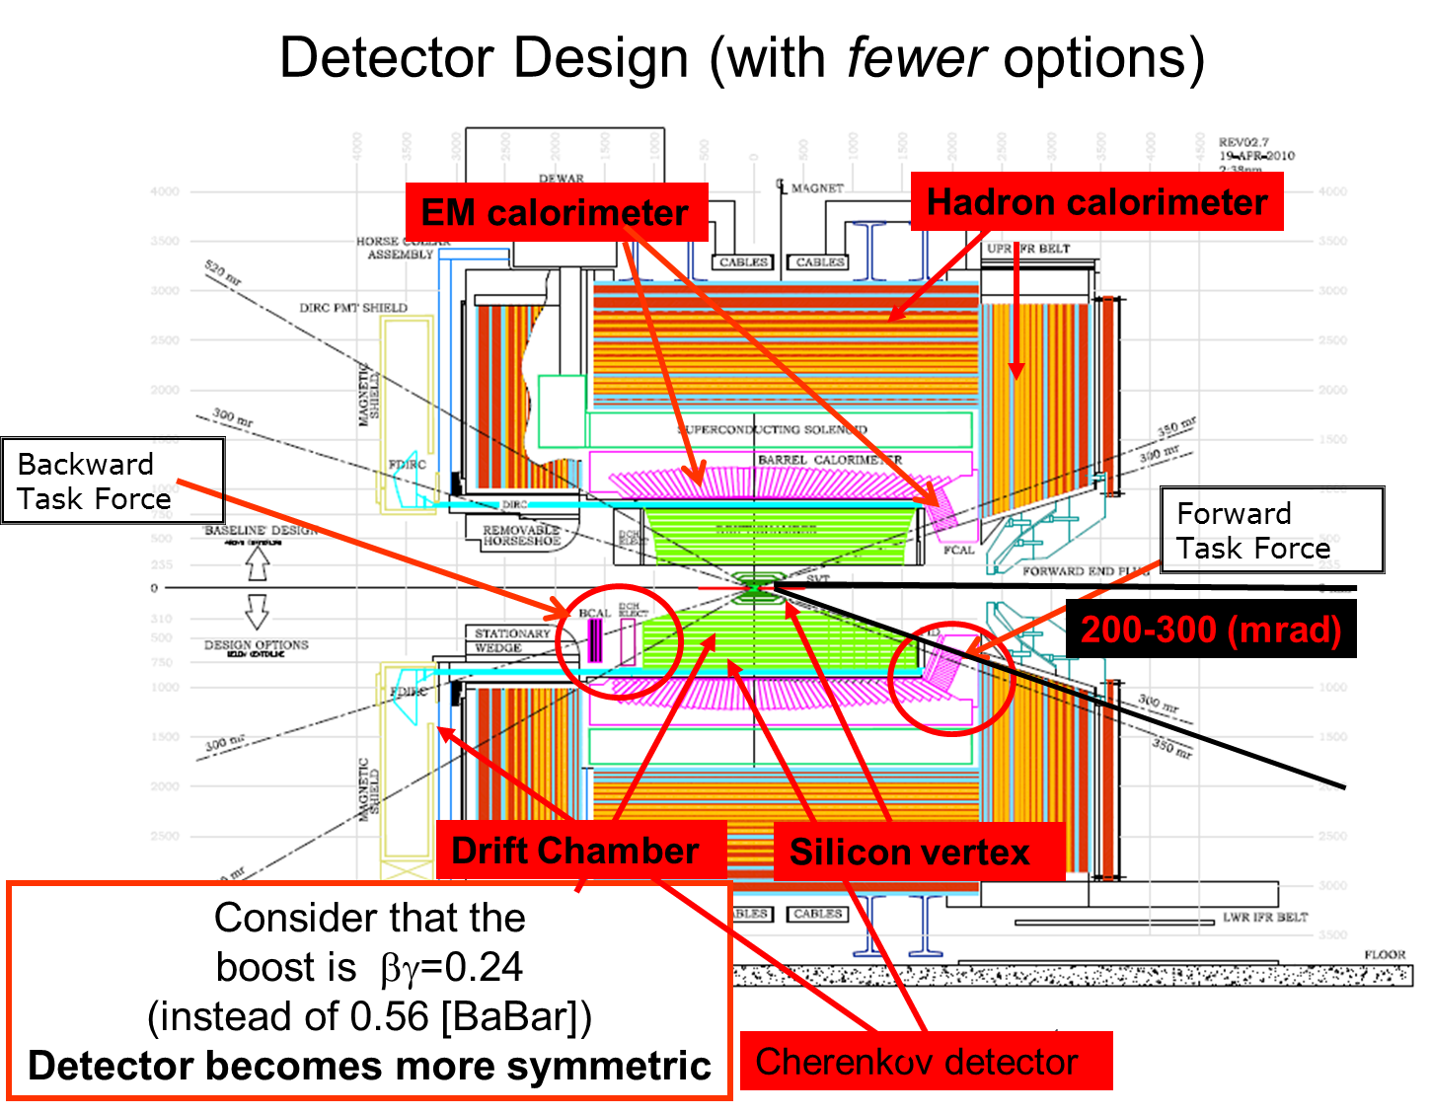

Slide 28
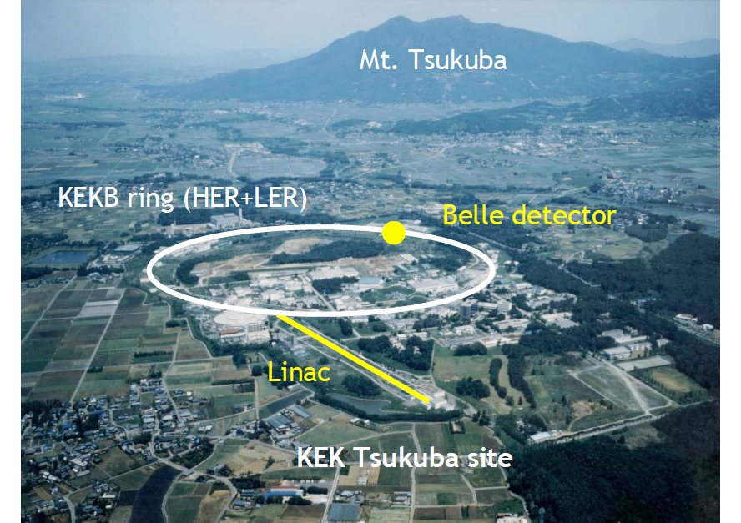
SuperKEKB
Super

Slide 29
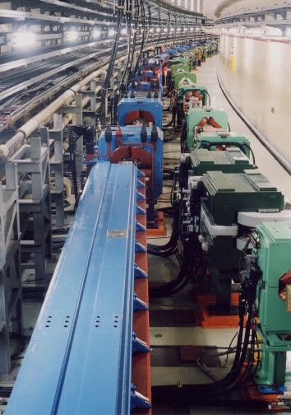


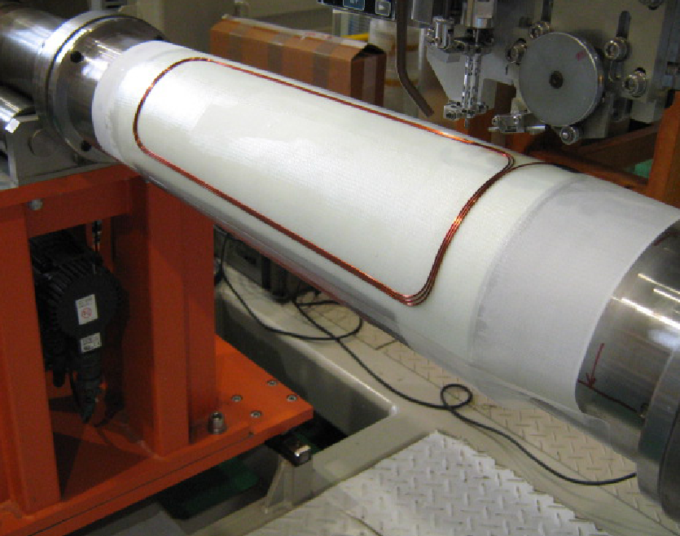
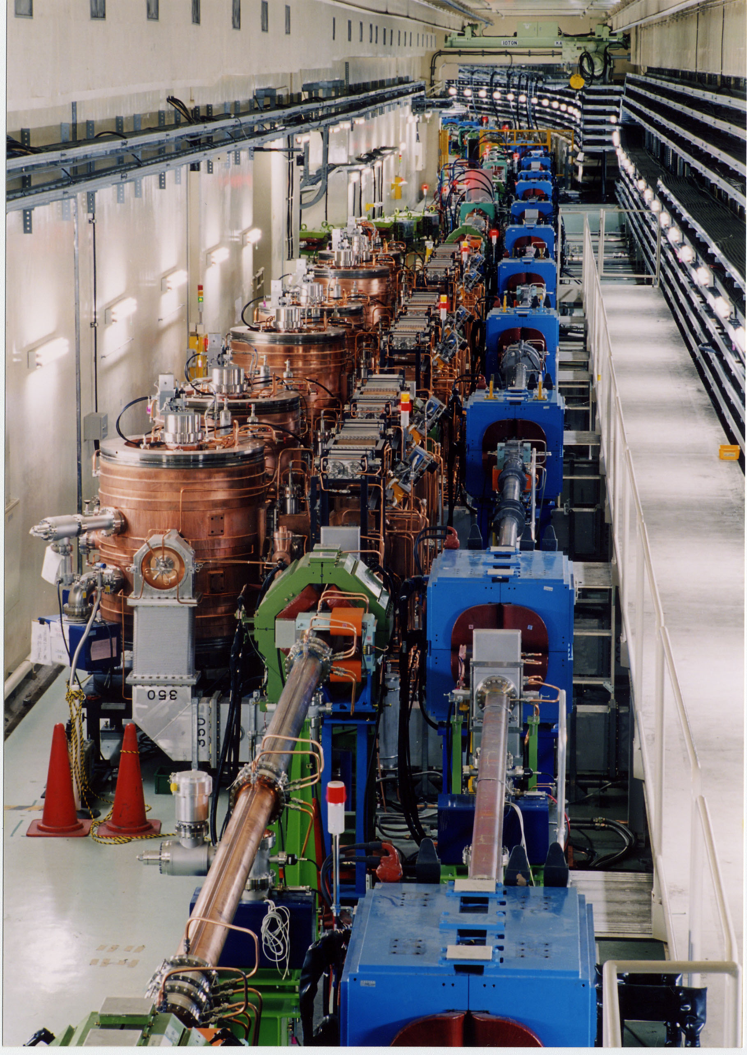


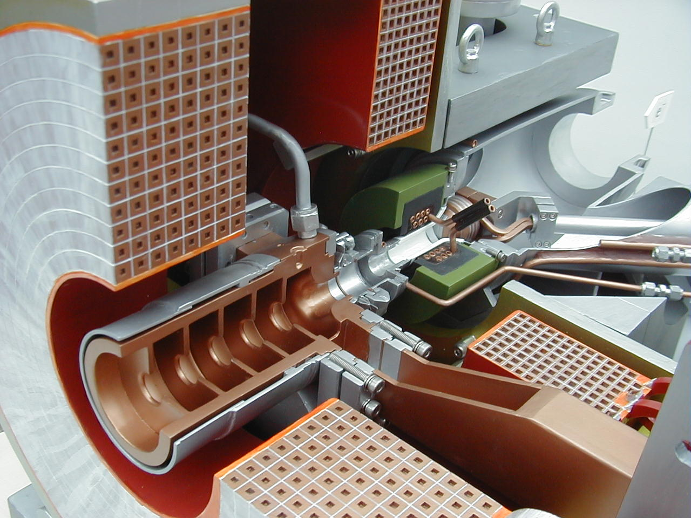
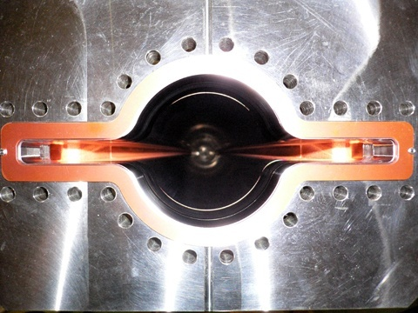
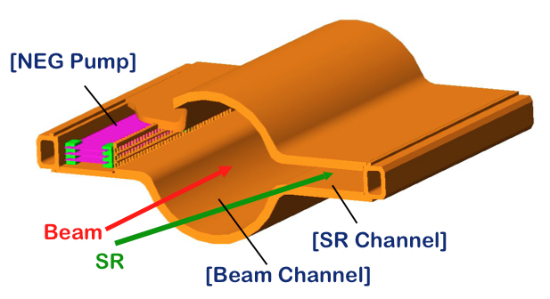
e+ 4 GeV 3.6 A
Colliding bunches
Belle II
New IR
e- 7 GeV 2.6 A
New superconducting /permanent final focusing quads near the IP
New beam pipe
& bellows
Replace short dipoles with longer ones (LER)
Add / modify RF systems for higher beam current
Inject low emittance positrons
Redesign the lattices of both rings to reduce the emittance
Positron source
Damping ring
New positron target / capture section
TiN-coated beam pipe with antechambers
Low emittance gun
Inject low emittance electrons
x 40 Increase in Luminosity
Notes:
To increase Luminosity: reduce emittance wit focusing quads
increase crossing angle
increase current 3.6 A e+; 2.6 A e- new RF systems
new beam pipe

Slide 30
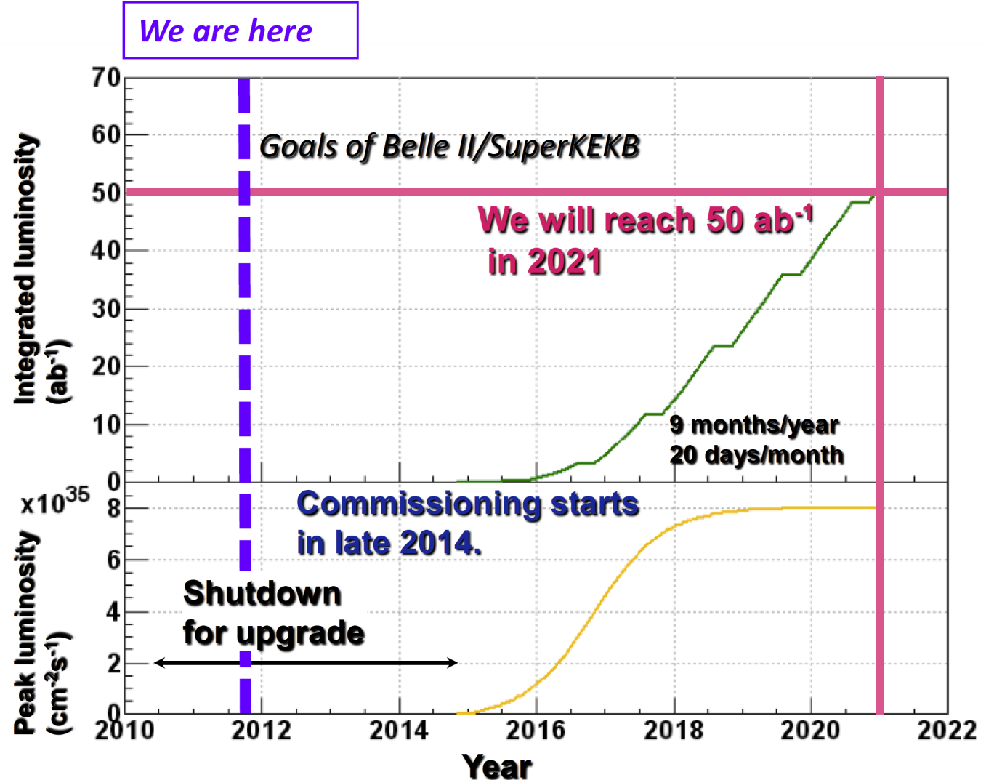
SuperKEKB luminosity profile
5ab⁻¹ in 2016
50ab⁻¹ in 2020
Notes:
From S. Olsen QWG Darmstadt last year

Slide 31
Belle II Detector
K_{L} and muon detector:
Resistive Plate Counter (barrel outer layers)
Scintillator + WLSF + MPPC (end-caps, inner 2 barrel layers)
EM Calorimeter:
CsI(Tl), waveform sampling (barrel)
Pure CsI + waveform sampling (end-caps)
Particle Identification
Time-of-Propagation counter (barrel)
Prox. focusing Aerogel RICH (fwd)
electron (7GeV)
Beryllium beam pipe
2cm diameter
Vertex Detector
2 layers DEPFET + 4 layers DSSD
positron (4GeV)
Central Drift Chamber
He(50%):C2H6(50%), Small cells, long lever arm, fast electronics

Slide 32
Hadron spectroscopy at LHC
Among LHC experiment the one having more capabilities in the hadron spectroscopy sector is LHCb.
Preliminary measurements of the ψ(2S) differential cross-section have been performed with 35 pb⁻¹
Observation of X(3872): new measurement of mass of cross-section
Search of the X(4140) seen by CDF
New analysis are under way and results are expected:
  J/ψ and polarization in bins of p_{T} and y
  ϒ(2S) and ϒ(3S) production cross-section
  Determination of the X(3872) quantum numbers
  Confirmation of the Z±(4430) seen only by Belle and Z_{b}
  Discovery of new states?

Slide 33
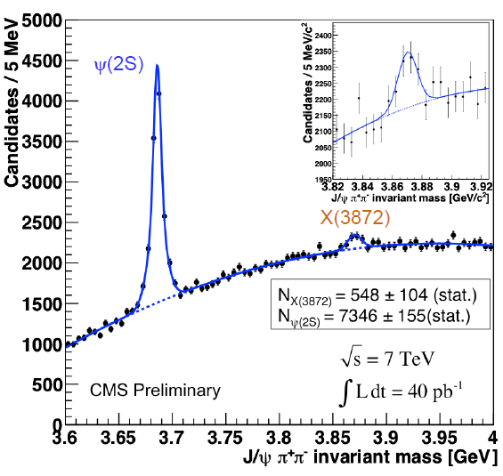
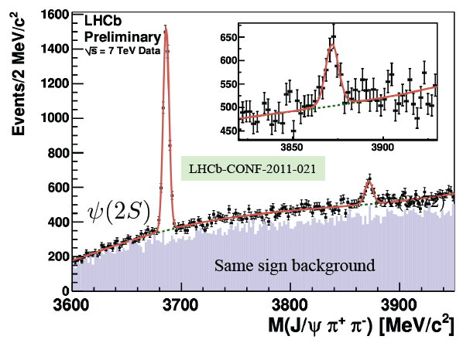
The X(3872) @ LHC
M_{X (3872)} = 3871.96 ± 0.46 (stat) ± 0.10 (syst)MeV/c 2

Slide 35
e⁺e⁻ vs pp
_
e⁺e⁻ → ψ(2S)
p p→ χ_{1,2}
→ γχ_{1,2}
→ γJ/ψ
→ γγJ/ψ
→ γe⁺e⁻
→ γγe⁺e⁻
e⁺e⁻ interactions:
  - Only 1⁻⁻ states are formed
  Other states only by secondary
  decays (moderate mass resolution
  related to the detector ~ 10MeV)
100
CBall
E835
χ_{c1}
1000
_
CBall ev./2 MeV
pp reactions:
E 835 ev./pb
  Most states directly formed
  (very good mass resolution; p-beam can be efficiently cooled Δp/p ~ 10⁻⁴)
3500
3510
3520 MeV
E_{CM}
_
pp → η_{c}) = 1.2 10⁻³
Br(e⁺e⁻ →ψ’) ·Br(ψ’ → γη_{c}) = 2.5 10⁻⁵
Br(

Slide 36
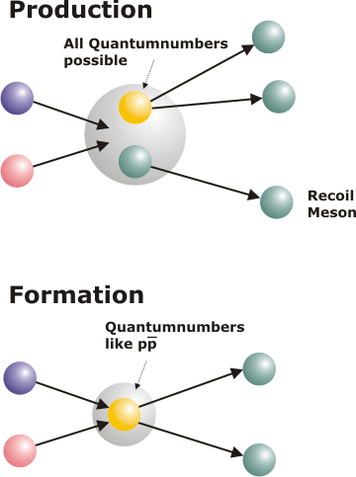
Spectroscopy with antiprotons
Two are the mechanisms to access particular final states:
p
G
p
H
p
H
Production
_
_
_
p
M
p
M
p
M
all J^{PC} available
Even exotic quantum numbers
can be reached σ ~100 pb
Exotic states are produced with rates similar to qq
conventional systems
All ordinary quantum numbers
can be reached σ ~1 μb
p
p
p
Formation
_
G
_
H
_
H
p
p
p
only selected J^{PC}

Slide 37

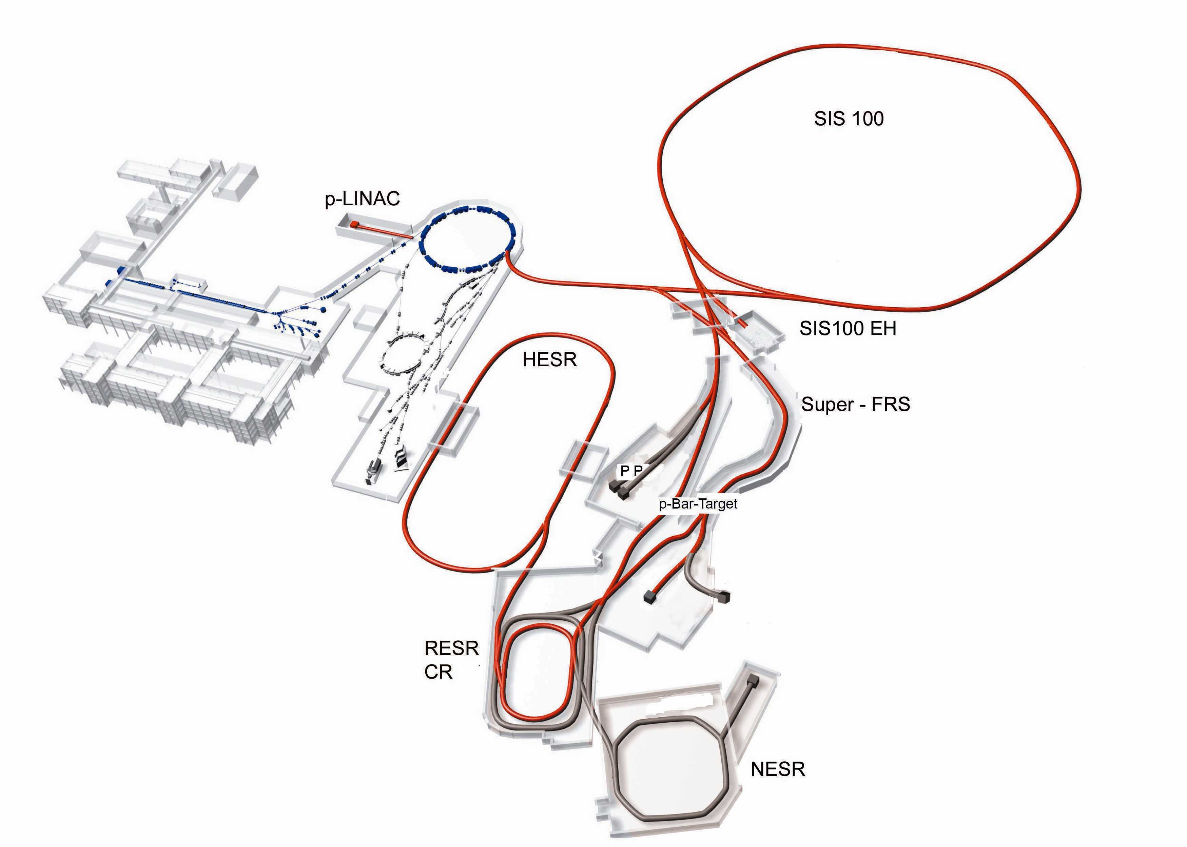
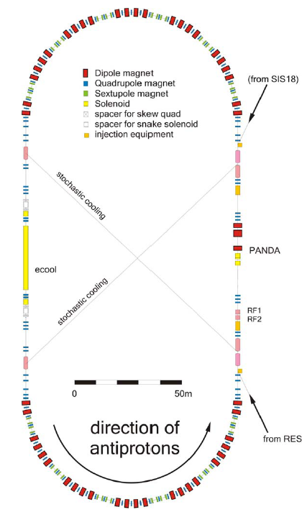
Facility for Antiproton and Ion Research
Antiproton production
Proton Linac 70 MeV
Accelerate p in SIS18 / 100
Produce p on Cu target
Collection in CR, fast cooling
Accumulation in RESR
Storage and usage in HESR
SIS 18
UNILAC
FRS
ESR
Super
FRS
Existing
New
50 m
HESR: Storage ring for p
Injection of p at 3.7 GeV/c
Slow synchrotron (1.5-15 GeV/c)
Luminosity up to L~ 2x10³² cm⁻²s⁻¹
Beam cooling (stochastic & electron)
from RESR

Slide 38

12 m

Slide 40
Antiproton power
p-beams can be cooled → Excellent resonance resolution
Resonance cross section
e⁺e⁻: typical mass res. ~ 10 MeV
Fermilab: 240 keV
HESR: ~30 keV
Measured rate
Beam
CM Energy
The production rate of a certain final state ν
is a convolution of the
BW cross section
and the beam energy distribution function f(E,ΔE):
The resonance mass M_{R} total width Γ_{R} and product of branching ratios into the initial and final state B_{in}B_{out} can be extracted by measuring the formation rate for that resonance as a function of the c.m. energy E.

Slide 41
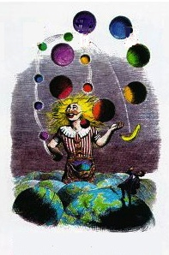
PANDA playground
p Momentum [GeV/c]
Meson spectroscopy
  light mesons
  charmonium
  exotic states
    glueballs
    hybrids
    molecules/multiquarks
  open charm
Baryon/antibaryon production
Charm in nuclei
Strangeness physics
  Hyperatoms
  S = -2 nuclear system
    Ξ⁻ nuclei
    ΛΛ hyepernuclei
e.m. processes
0
2
4
6
8
10
12
15
ΛΛ
ΣΣ
ΞΞ
ΩΩ
DD
Λ_{c}Λ_{c}
Σ_{c}Σ_{c}
Ξ_{c}Ξ_{c}
Ω_{c}Ω_{c}
D_{s}D_{s}
qqqq
ccqq
nng,ssg
ccg
nng,ssg
ccg
ggg,gg
ggg
light qq
π,ρ,ω,f₂,K,K*
cc
J/ψ, η_{c}, χ_{cJ}
1
2
3
4
5
6
Mass [GeV/c²]

Slide 42
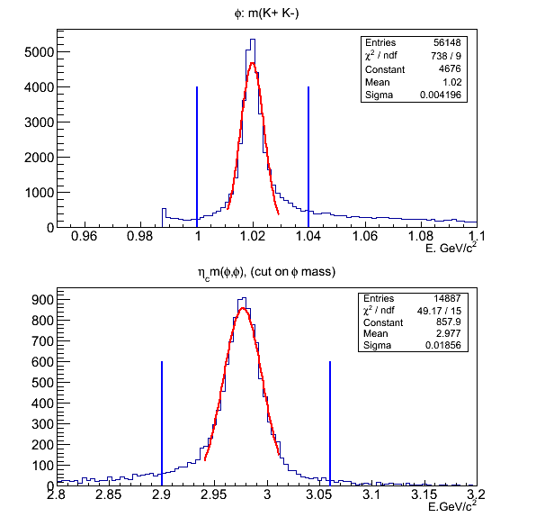
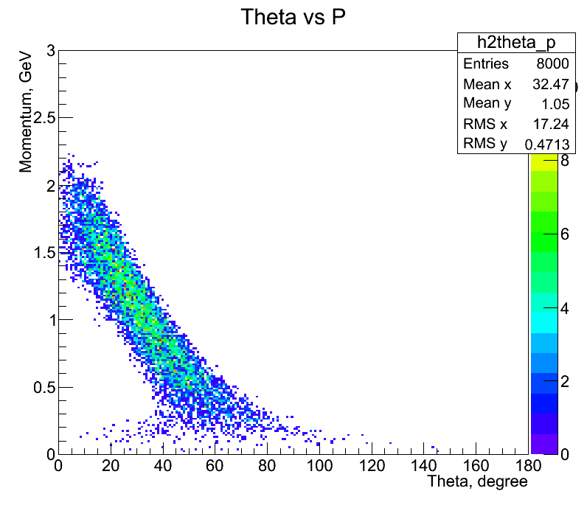
η_{C} production
σ(φ)=4.2 MeV/c²
σ(η_{C})=19 MeV/c²
Full realistic simulation with background mixing. Efficiency 11.6%

Slide 43
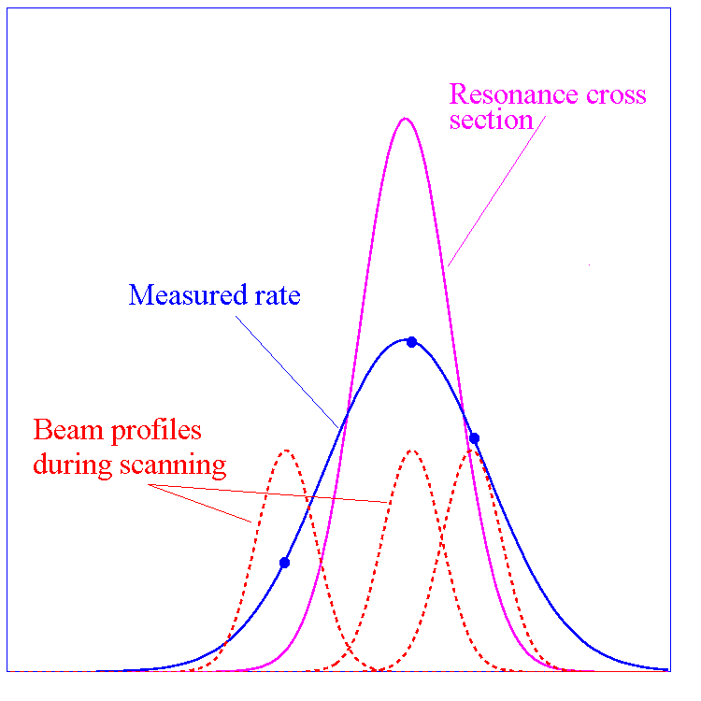
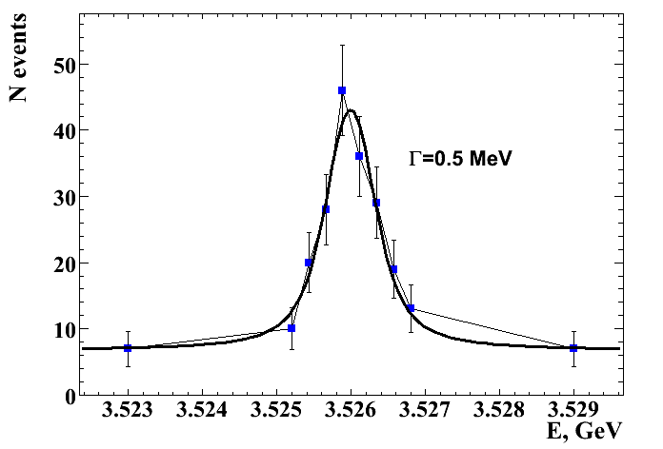
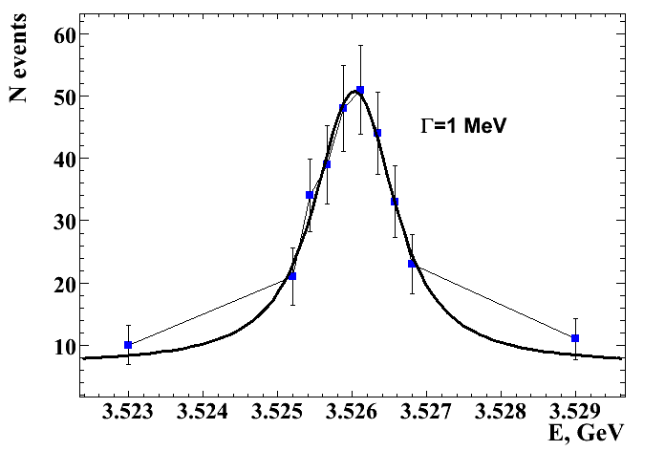
Charmonium states width
Thanks to the precise HESR momentum definition, widths of known states can be precisely measured with an energy scan.
Energy scan of 10 values around the h_{c} mass, width upper limit is 1MeV;
each point represents a 5 day data taking in high luminosity mode, for the channel: h_{c}⟶η_{c}γ⟶φφγ⟶4Kγ
with a S/B 8:1
This holds for all known states in the charmonium region
δp/p 10⁻⁴ ⟶ Γ 100 KeV
δp/p 10⁻⁵ ⟶ Γ 10 KeV
Γ _{R,MC}[MeV] | Γ _{R,reco}[MeV] | ΔΓ_{R}[MeV]
1 | 0.92 | 0.24
0.75 | 0.72 | 0.18
0.5 | 0.52 | 0.14
Sensitivity

Slide 44
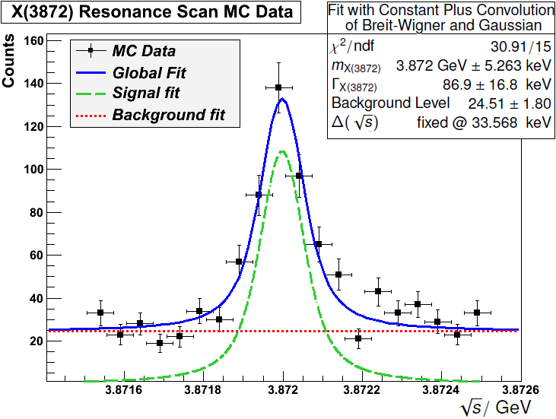
X(3872) energy scan
Input parameters:
m = 3.872 GeV/c²
Γ = 1 MeV/c²
→ Unfolding beam profile
(Δp/p = 3 · 10⁻⁵)
Mass resolution ~ 5 keV/c²
Width precision ~ 10-20%
each data point 2 days data taking only statistical errors are included

Slide 45
Heavy-light D_{sJ} systems
Up to now the widths of the new discovered D_{sJ} state are only constrained by upper limits of few MeV due to detector resolution.
the p momentum spread in the HESR will allow the measurement of the D_{sJ} widths in a threshold scan of the reaction
pp → D_{s} D_{sJ}
Fit of the excitation function obtained from the reconstructed signal events
Notes:
D*_{s0}±(2317)-> D⁺_{s}+π⁰
PDG quota Γ < 3.8 MeV/c²

Slide 46
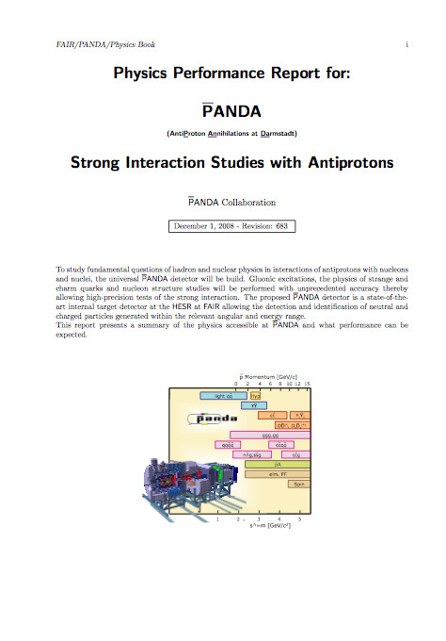
The PANDA Physics Book
PANDA Collaboration put big effort in realizing the “Physics Performance Report”.
More than 200 pages have been produced to describe all the aspects of the scientific program.
Detailed simulations have been performed to evaluate detector performance on many benchmark channels.
arXiv:0903.3905 [hep-ex]

Slide 47
Summary
Lattice QCD and QCD-motivated quark potential models describe the properties of the hadron spectrum quite well for the ground states.
In the last few years many expected states have been found and their measured properties are in good agreement with the model’s predictions.
There is an accumulation of mesons with mass in the region between 3800 MeV/c² and 4700 MeV/c² that are not easily explained.
These states are relatively narrow although many of them are well above open-charm thresholds. Many of them have partial widths for decays to charmonium + light hadrons that are at the ~MeV scale, which is much larger than typical cc charmonium meson states.
At least 3 states: X(3872), Y(4260), Z(4430) are strong candidates for being exotics.
There are some problems with the theory when dealing with highly excited states.
Notes:
Richard Bergh's Nordic Summer Evening, 1899-1900

Slide 48
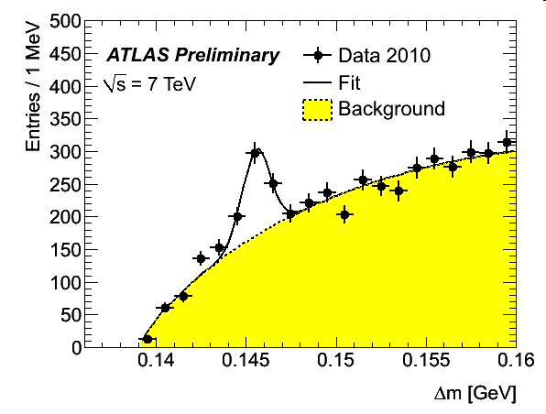
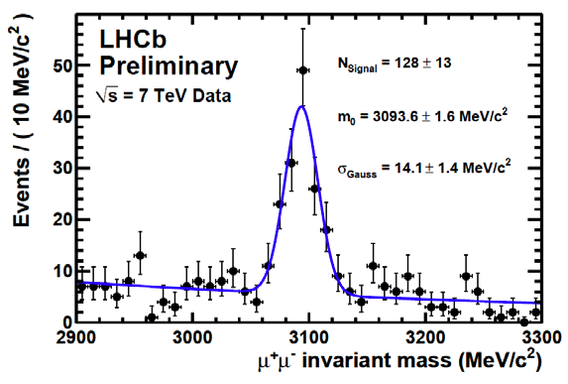


Summary
We can expect in the future further results from e⁺e⁻ machines SuperB, SuperBelle, BES… but without big surprises e⁺e⁻ possibilities have
  been fully exploited
7 TeV
LHC experiments (mainly LHCb) will provide some results…. but they are not tailored for this physics
D⁰ peak region
The Jlab 12 GeV upgrade foresees a dedicated program of spectroscopy with the aim of finding sub GeV hybrids...in this energy range there are big interference problems
7 TeV
J/ψ peak region
We have the renascence of antiproton facility with FAIR at Darmstadt…here the antiproton storage ring has been designed primarily for hadron spectroscopy

Slide 49
Backup
Slides

Slide 50
What PANDA can do for charm physics?
States below DD threshold
  The study of the h_{c} remains of very high priority. The width can be determined precisely with an energy scan of the resonance
  The study of the η_{c} and η′_{c} has to be completed. Small splitting from the ψ′ have to be understood. Width and decay modes must be measured.
The energy region above open charm threshold is the most interesting for the future and will have to be explored in great detail:
  find all missing states, measure their properties.
  explain nature of existing states (X(3872), Y(3940) ...)
  study radiative and strong decays, e.g. ψ(4040)→D*D* and ψ(4160)→D*D* , multi amplitude modes which can test the mechanisms of the open-charm decay.
At 2×10³²cm⁻²s⁻¹ accumulate 8 pb⁻¹/day (assuming 50 % overall efficiency) ⇒ 10⁴÷10⁷ (cc) states/day.
Total integrated luminosity 1.5 fb⁻¹/year (at 2×10³²cm⁻²s⁻¹, assuming 6 months/year data taking).

Slide 51
η_{C} mass
Ψ(1S,2S) /J/ψ→ϒη_{C}
There are big discrepancies between the measurements either for the mass and the width.
Recent works of CLEO-c (arXiv:0805.0252) and BESIII (arXiv:1111.0398) point out that there are interferences between η_{C} and the background that may affect resonance line shape.
This could be true also for the η’_{C} where a precise measurement of the mass is not yet available
Notes:
I punti blu sono le misure fatte nel canale γη_{χ} δι δεχαδιμεντο δελλα ϑ/ψ ο δελλε ψ(1Σ,2Σ)

Slide 52
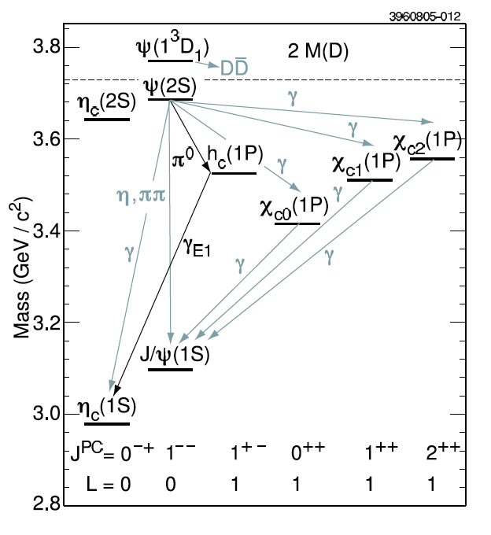

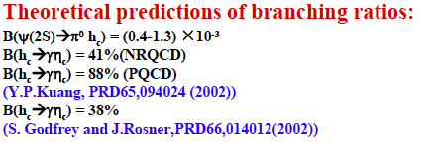
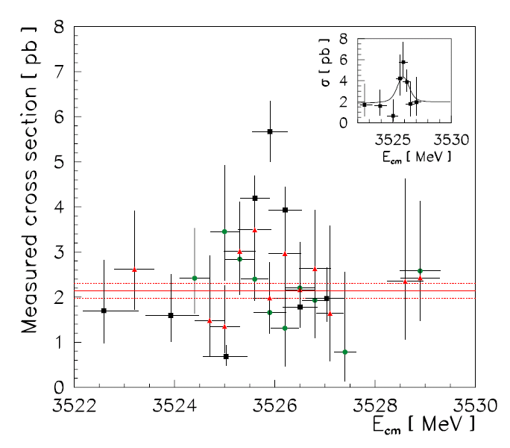
h_{C}(¹P₁) charmonium state
The process ψ’→π⁰h_{c} is the only way to produce h_{c} from ψ’ decay ➔ Limited phase space
From the assumption of a small V_{SS} interaction it was expected
0
There were attempt to produce h_{c} in pp annhilitation at Fermilab
(E760,E835) but the statistic was very poor.

Slide 53
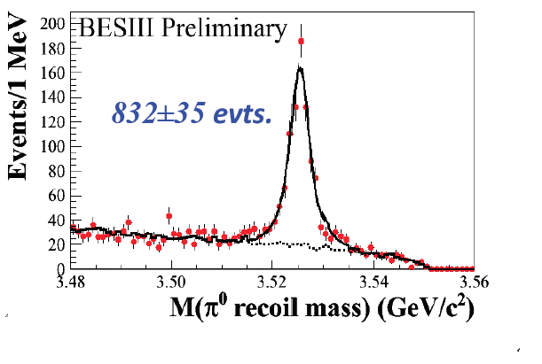
h_{C}(¹P₁) charmonium state
ψ’→π⁰h_{c} first measurements were detecting only the π⁰ ➔ h_{c} mass from kinematics.
Then E₁-tagged analysis to see h_{c} → ϒη_{C}
Recently BESIII has also measured 16 η_{C}
hadronic decay channels performing a full exclusive analysis.
Mass = 3525.31±0.11±0.15 MeV
Width = 0.70±0.28±0.25 MeV
Center of gravity of P-states

