Slide 1
Analysis Tools:
Discussion Session - Experiment
Conveners:
Dave Ireland, Ryan Mitchell

Slide 2
Key Issues:
How do we best use theoretical guidance to analyse data?
What are the capabilities of modern computational hardware?
How do we decide when we have found new physics?
What can theorists expect from experiments?

Slide 3
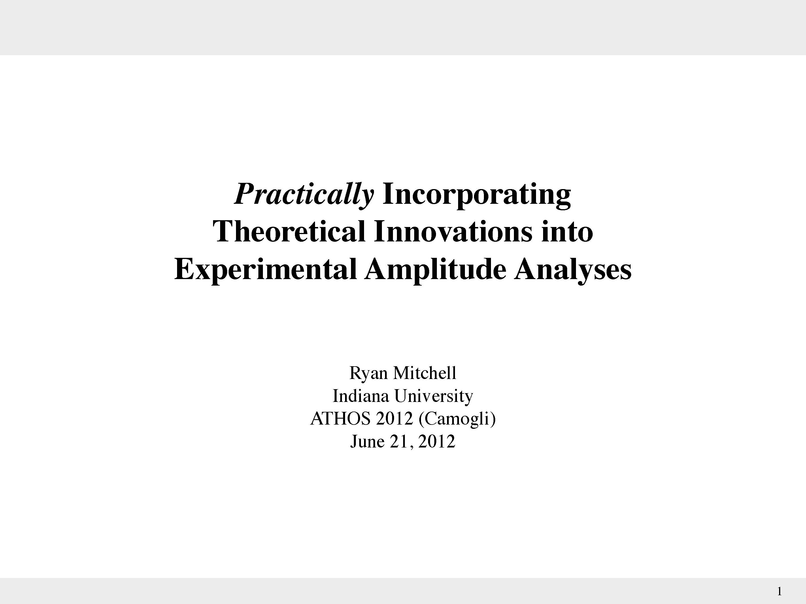

Slide 4
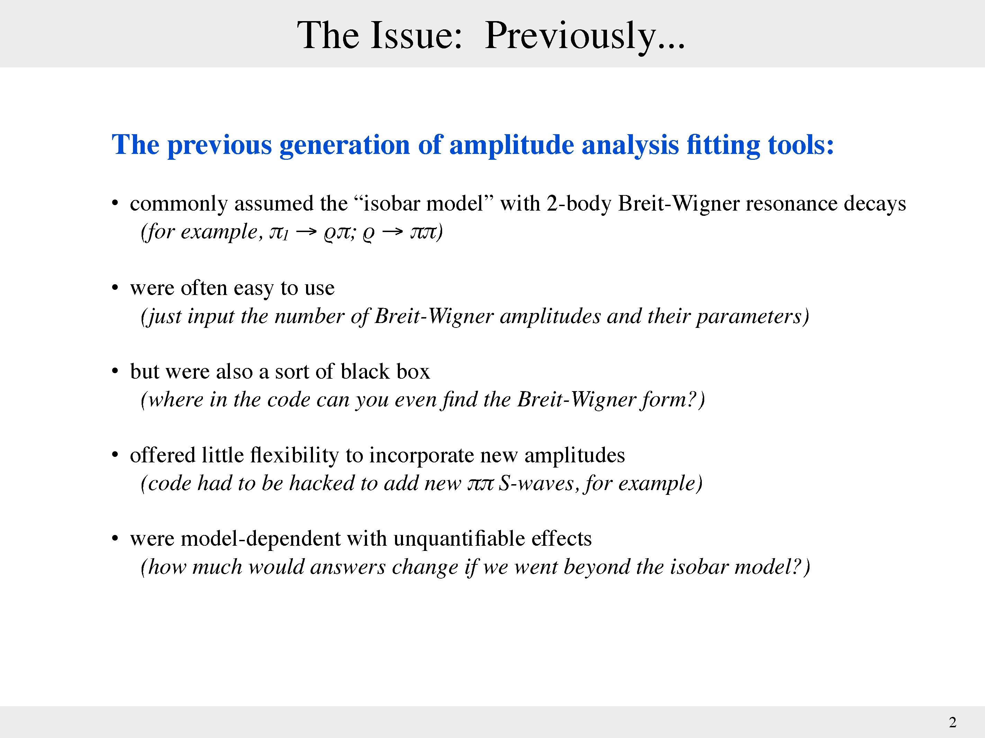

Slide 5
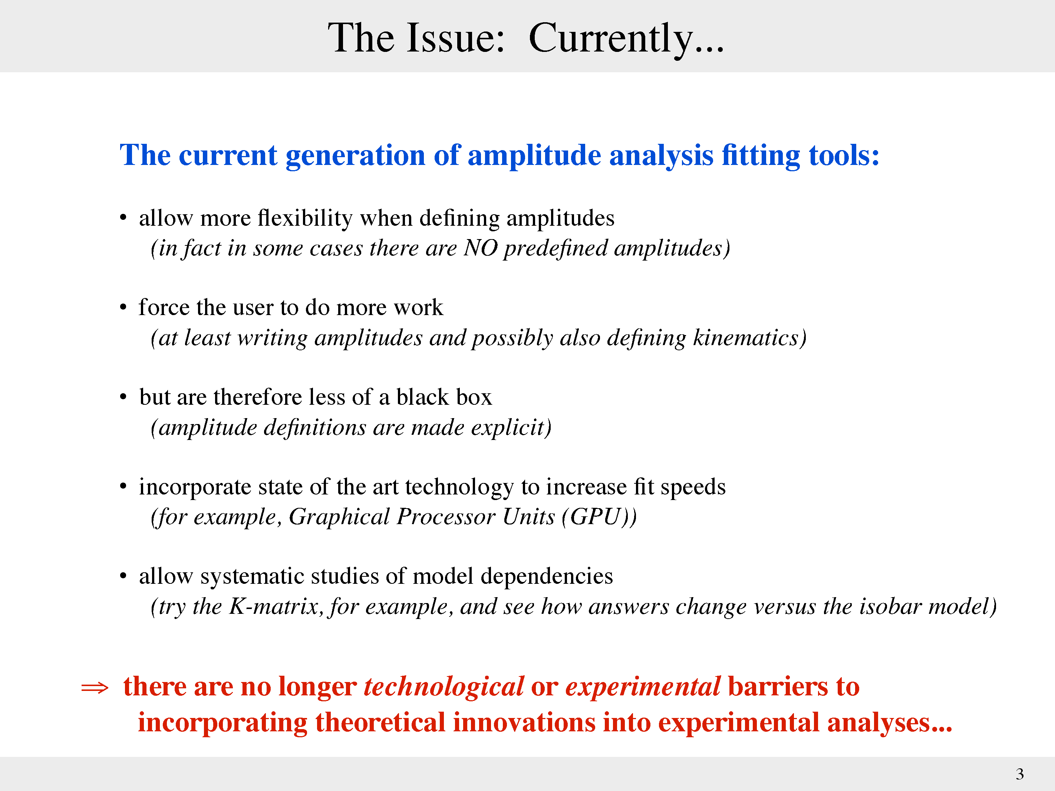

Slide 6
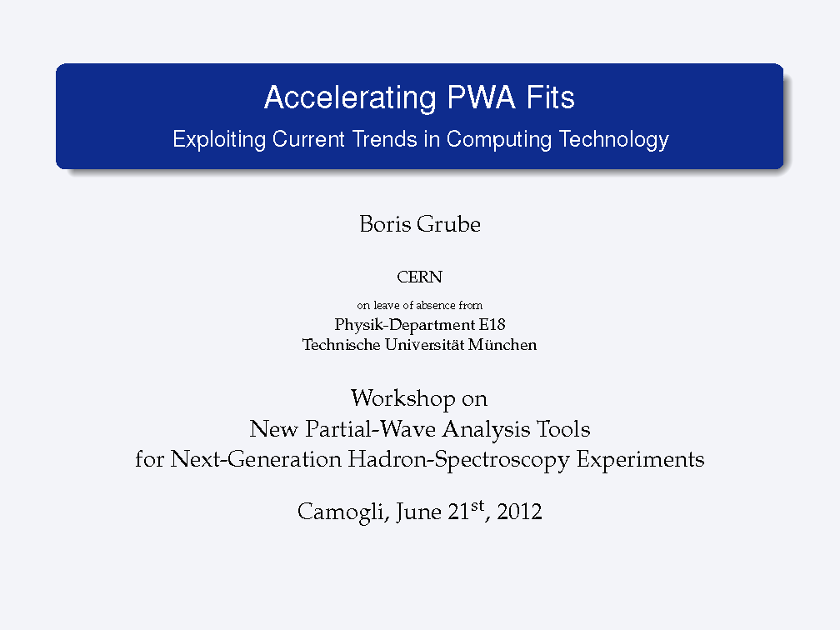

Slide 7
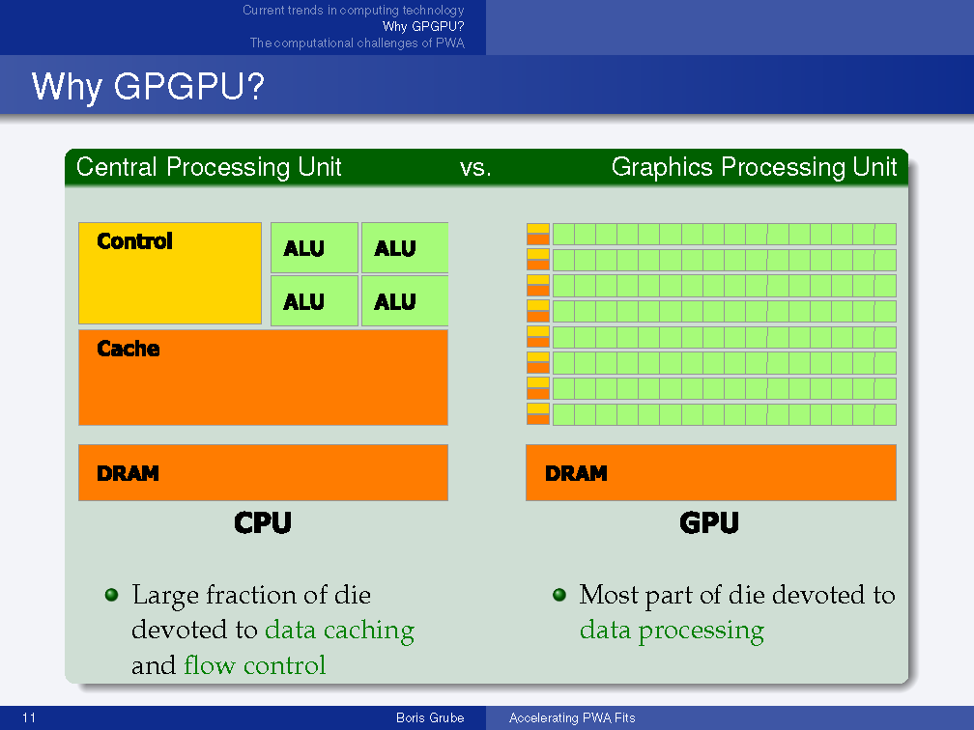

Slide 8
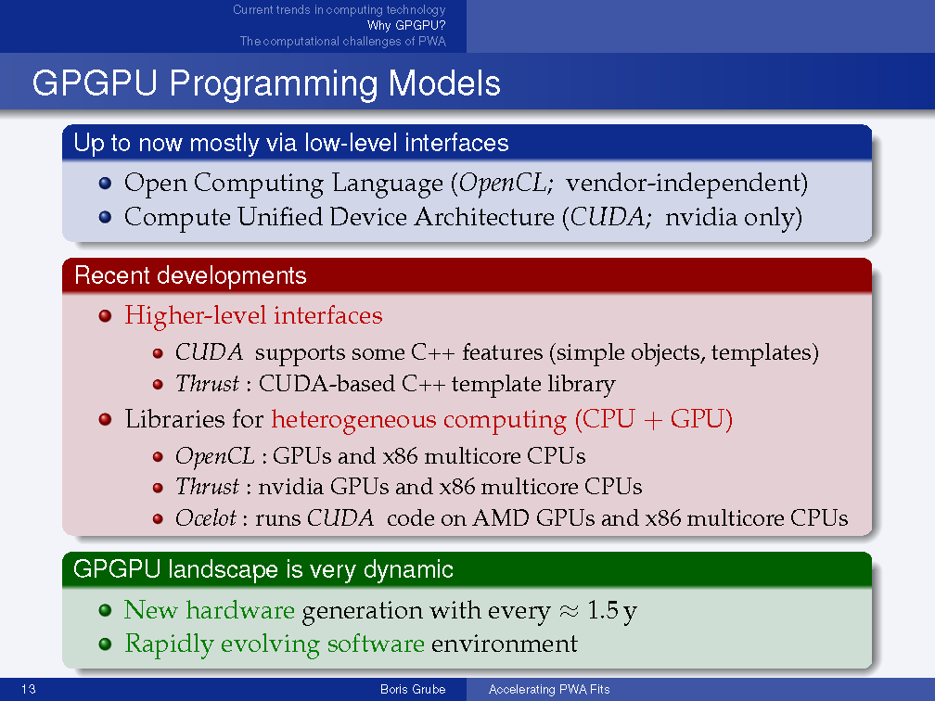

Slide 9
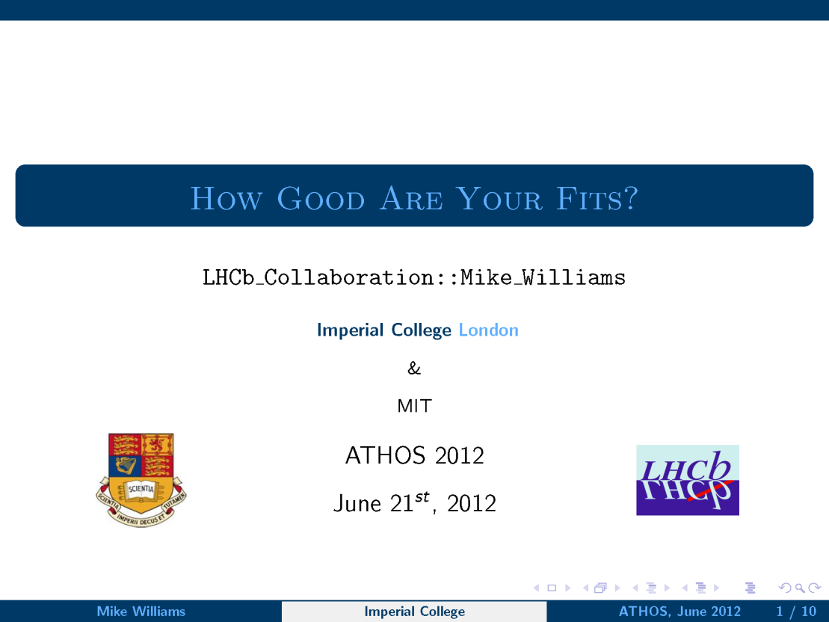

Slide 10
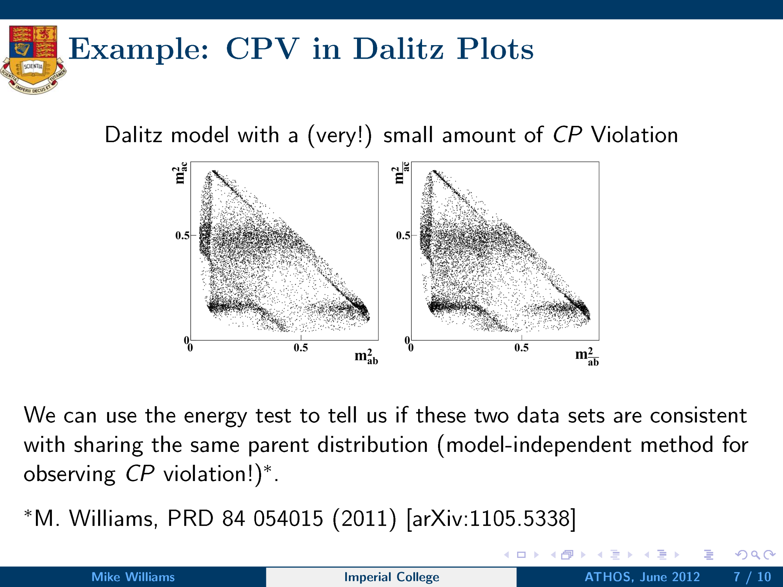

Slide 11
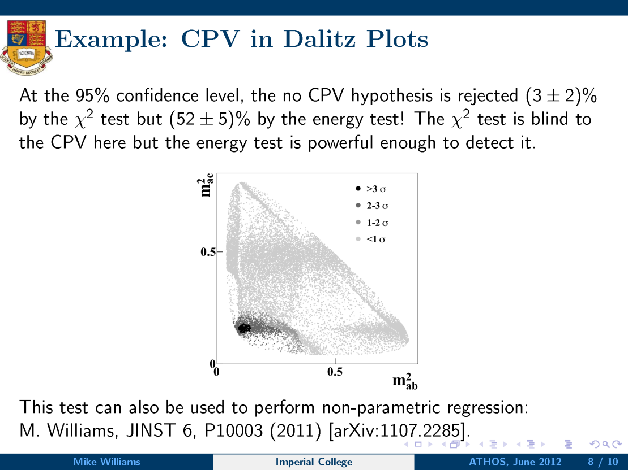

Slide 12
Additional comments…
GPUs and other hardware developments are “game-changing” for PWA fitting
“Modern” computing strategies should be considered

Slide 13
Discussion:
How do we best use theoretical guidance to analyse data?
What are the capabilities of modern computational hardware? Future requirements ?
How do we decide when we have found new physics?

