Slide 1
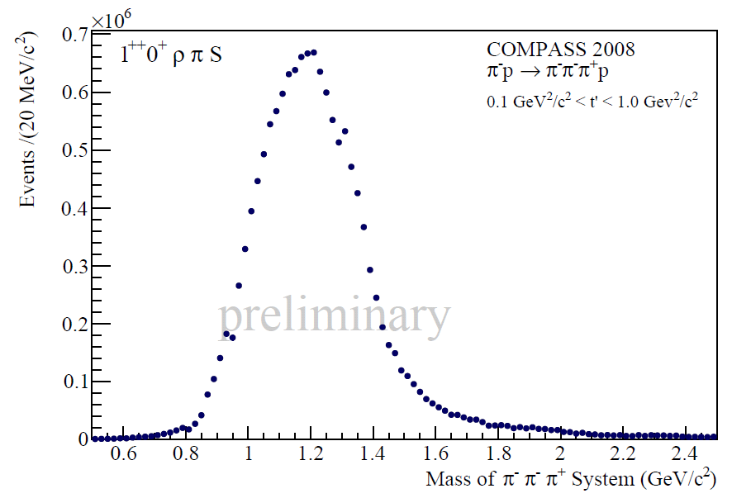
Discussion Session - Experiments

Slide 2
Discussion Session - Experiments
Conveners: C. Bini and B. Ketzer
Recent results on pi-pi amplitudes at BES III (10’+5’)
B. Liu (Institute of High Energy Physics)
Search for exotics in three pion production at COMPASS (10’+5’)
S. Neubert (TU-Munchen)
Search for exotics in three pion production at CLAS (10’+5’)
P. Eugenio (Florida State University)
Discussion (45’)

Slide 3
Status of Analyses
Isobar model analysis
isobar parameterizations: r, (pp)S
rank of fit, full vs partial coherence
leakage, acceptance, resolution
t dependence
estimation of systematic error
Signals for exotic mesons
diffraction, pbarp: ρπ, ηπ, η’π, f₁π, b₁π
photoproduction: none
Scalar sector:
low-mass scalars
glueball vs ordinary qqbar

Slide 4
What is needed in the future?
Go beyond isobar model:
where does the model fail!?
include non-resonant production (dynamical effects, e.g. Deck)
understand a₁!
multi-particle final states
coupled-channel analysis
final state interactions, unitarity
understand production mechanism: bins in t, s, polarization, probes
higher statistics, enlarge phase space
Tools, etc.
common PWA framework across different experiments
plugin for amplitudes
validation of software
computing: fitting procedures, GPUs, etc.
access to data

