Slide 1
Overview of Meson Spectroscopy Experiments and Data
Curtis A. Meyer
Carnegie Mellon University

Slide 2
Outline
Meson Spectroscopy and QCD
Glueballs
Lattice QCD and Gluonic Excitations
Experimental Evidence
Summary

Slide 3
Spectroscopy and QCD
QCD is a theory of quarks and gluons, where our current understanding is that most of the hadronic mass originates from the color forces and the gluonic fields.
To a great extent, we can understand the spectrum of mesons as simple quark-antiquark systems, with no need to invoke gluons.
Understanding the role of glue in both the meson and the baryon spectrum, and how it impacts our ``naïve’’ spectroscopy is needed.
One important aspect of this is the search for states with explicit gluonic contents: glueballs and hybrids.

Slide 4
Spectroscopy and QCD
Quark-model Classification of Mesons
Quarkonium
Spin: S=S_{q1}+S_{q2} ½ + ½ =(0,1)
q
q
Orbital Angular Momentum: L=0,1,2,…
Reflection in a mirror:
Parity: P=-(-1)^{(L)}
S_{q1}=1/2
Particle<->Antiparticle:
Charge Conjugation: C=(-1)^{(L+S)}
S_{q2}=1/2
Total Spin: J=L+S
L=0, S=0 : J=0 J^{PC} = 0⁻⁺ L=0, S=1 : J=1 J^{PC} = 1⁻⁻
L=1 , S=0 : J=1 J^{PC} = 1⁺⁻ L=1, S=1 : J=0,1,2 J^{PC} = 0⁺⁺ 1⁺⁺ 2⁺⁺
L=2 , S=0 : J=1 J^{PC} = 2⁻⁺ L=2, S=1 : J=1,2,3 J^{PC} = 1⁻⁻ 2⁻⁻ 3⁻⁻
… …
0⁺⁺ 0⁺⁻ 0⁻⁺ 0⁻⁻ 1⁺⁺ 1⁺⁻ 1⁻⁺ 1⁻⁻ 2⁺⁺ 2⁺⁻ 2⁻⁺ 2⁻⁻ 3⁺⁺ 3⁺⁻ 3⁻⁺ 3⁻⁻ …
0⁺⁺ 0⁺⁻ 0⁻⁺ 0⁻⁻ 1⁺⁺ 1⁺⁻ 1⁻⁺ 1⁻⁻ 2⁺⁺ 2⁺⁻ 2⁻⁺ 2⁻⁻ 3⁺⁺ 3⁺⁻ 3⁻⁺ 3⁻⁻ …
0⁺⁺ 0⁺⁻ 0⁻⁺ 0⁻⁻ 1⁺⁺ 1⁺⁻ 1⁻⁺ 1⁻⁻ 2⁺⁺ 2⁺⁻ 2⁻⁺ 2⁻⁻ 3⁺⁺ 3⁺⁻ 3⁻⁺ 3⁻⁻ …
Quark-model Quantum Numbers
Exotic Quantum Numbers

Slide 5
Spectroscopy and QCD
Experimental Spectrum
Quarkonium
q
q
I=0
I=1
Two I=0 per I=1

Slide 6
Spectroscopy and QCD
Quarkonium
Consider the three lightest quarks
9 Combinations
q
q
Nonets
s
u
d
d
u
s
Ideal Mixing: θ=35.26º
These two states can mix:

Slide 7
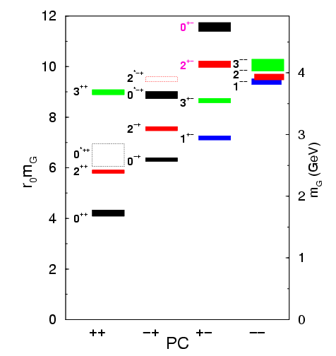
Lattice QCD Glueball Predictions
Gluons can bind to form glueballs
EM analogue: massive globs
of pure light.
Lattice QCD predicts masses
The lightest glueballs have
“normal” quantum numbers.
Glueballs will Q.M. mix
The observed states will
be mixed with normal
mesons.
Strong experimental evidence
For the lightest state.

Slide 8
Identification of Glueballs
Lightest Glueball predicted near two states of same Q.N..
“Over population” Predict 2, see 3 states
Glueballs should decay in a flavor-blind fashion.
Production Mechanisms:
Certain are expected to by Glue-rich, others are
Glue-poor. Where do you see them?
Proton-antiproton
Central Production
J/ψ decays

Slide 9
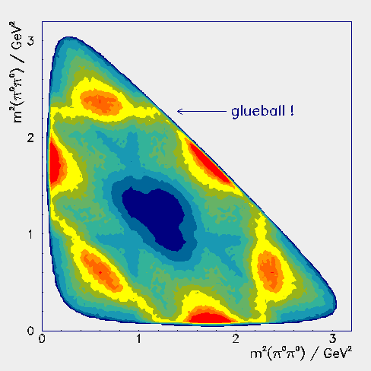
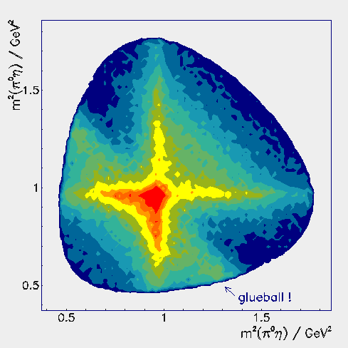
Crystal Barrel Results
Discovery of the f₀(1500)
f₀(1500) a ππ, ηη, ηη’, KK, 4π
Solidified the f₀(1370)
f₀(1370) a 4π
Crystal Barrel Results
Discovery of the a₀(1450)
Establishes the scalar nonet
700,000 π⁰π⁰π⁰ Events
250,000 ηηπ⁰ Events
f₂(1565)+σ
f₀(1500)
f₂(1270)
f₀(980)
f₀(1500)

Slide 10
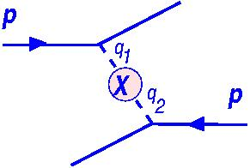
Wa102 Results
CERN experiment colliding protons
on a hydrogen target.
Central Production Experiment
Comprehensive data set and a coupled channel analysis.

Slide 11
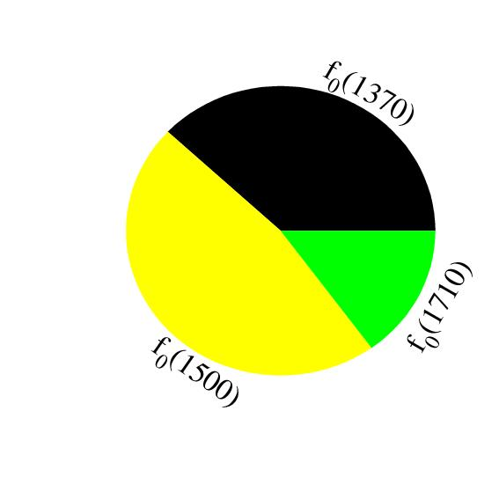
Experimental Evidence
Scalar (0⁺⁺) Glueball and two
nearby mesons are mixed.
f₀(1710)
f₀(1500)
a₀(1450)
K*₀(1430)
f₀(1370)
Glueball
spread
over 3
mesons
a₀(980)
f₀(980)
Are there other glueballs?

Slide 12
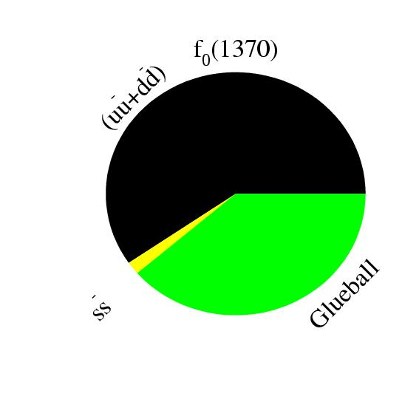
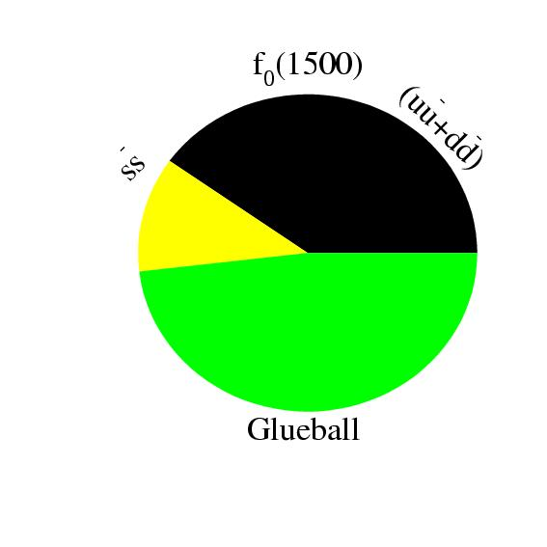
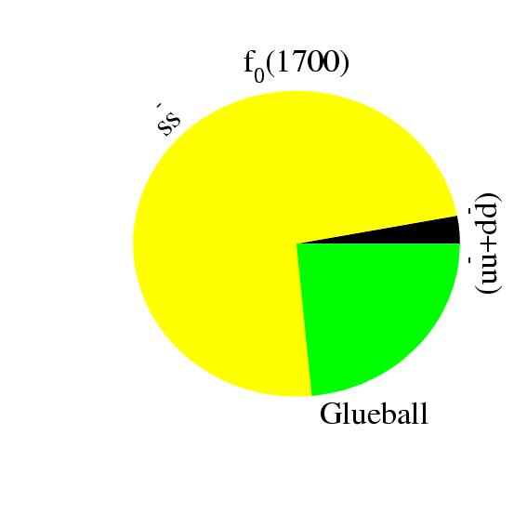
Glueball-Meson Mixing
meson
meson
1
meson
meson
Glueball
r₂
meson
meson
Glueball
r₃
meson
flavor blind? r
Solve for mixing scheme

Slide 13
Higher Mass Glueballs?
Part of the BES-III program will be to search for glueballs in radiative J/ψ decays. Part of the PANDA program at GSI.
Lattice predicts that the 2⁺⁺ and the 0⁻⁺ are the
next two, with masses just above 2GeV/c^{2.}
Radial Excitations of the 2⁺⁺ ground state
L=3 2⁺⁺ States + Radial excitations
f2(1950), f2(2010), f2(2300), f2(2340)…
2’nd Radial Excitations of the η and η’,
perhaps a bit cleaner environment! (I would
Not count on it though….)
I expect this to be very challenging.

Slide 14
Gluonic Excitations
ground-state
flux-tube
m=0
excited flux-tube
m=1
Gluonic Excitations provide an
experimental measurement of
the excited QCD potential.

Slide 15
Spectroscopy and QCD
Lattice QCD Predictions

Slide 16
Spectroscopy and QCD
Experimental results on mixing:
Quarkonium
q
q
Lattice QCD suggests non-ideal mixing in:
0⁻⁺ ground state and radial
1⁻⁻ ³D₁ ground state.
1⁺⁺ ground state
1⁻⁺ exotic

Slide 17
Spectroscopy and QCD
Lattice QCD Predictions
States with non-trivial glue in their wave function.

Slide 18
Spectroscopy and QCD
Lattice QCD Predictions
Beyond the normal meson spectrum, there are predictions for states with exotic quantum numbers
Lattice QCD calculation of the light-quark meson spectrum
2.5Gev
2.0GeV
Exotic QN
0⁺⁻
1⁻⁺
2⁺⁻
Normal QN
Several nonets predicted
Notes:
What are gluonic excitations and why are we looking for them? Lattice QCD predictions for the mesons and in particular, a class of mesons with non-quark-antiquark quantum numbers. Also not that mixing angles are predicted. GlueX needs to measure particle J(PC), masses, widths and decay modes to be able to map these out.

Slide 19
Spectroscopy and QCD
Lattice QCD Predictions
``Constituent gluon’’ behaves like it has J^{PC} = 1⁺⁻
Lightest hybrid nonets: 1⁻⁻, (0⁻⁺,1⁻⁺, 2⁻⁺)
The 0+- and two 2+- exotic nonets:
also a second 1⁻⁺ nonet.
p-wave meson plus a ``gluon’’.
2.5Gev
2.0GeV
0⁺⁻
1⁻⁺
2⁺⁻
Several nonets predicted
Notes:
What are gluonic excitations and why are we looking for them? Lattice QCD predictions for the mesons and in particular, a class of mesons with non-quark-antiquark quantum numbers. Also not that mixing angles are predicted. GlueX needs to measure particle J(PC), masses, widths and decay modes to be able to map these out.

Slide 20
Spectroscopy and QCD
Quarkonium
The angular momentum in the flux
tube stays in one of the daughter
mesons (an (L=1) and (L=0) meson).
L_{flux}
Exotic Quantum Number Hybrids
L_{flux}
π₁→ πb₁ , πf₁ , πρ , ηa₁
η₁→π(1300)π , a₁π
b₂ → a₁π , h₁π , ωπ , a₂π
h₂ → b₁π , ρπ , ωη
b₀ → π(1300)π , h₁π
h₀ → b₁π , h₁η
Mass and model
dependent
predictions
1⁻⁺
Populate final states with
π±,π⁰,K±,K⁰,η, (photons)
2⁺⁻
The channels we are looking at for PWA.
Other interesting channels for PWA.
0⁺⁻

Slide 21
Experimental Evidence
The most extensive data sets to date are from the BNL E852 experiment. There is also data from the VES experiment at Protvino and some results from the Crystal Barrel experiment at LEAR. Results from the COMPASS experiment at CERN are available . There are also results from the CLEO-c experiment. Finally, there are null results from CLAS.
BNL E852, VES, COMPASS
Crystal Barrel
CLEO-c, BES-III
CLAS
WA102, COMPASS

Slide 22
Experimental Evidence
The most extensive data sets to date are from the BNL E852 experiment. There is also data from the VES experiment at Protvino and some results from the Crystal Barrel experiment at LEAR. Results from the COMPASS experiment at CERN are available . There are also results from the CLEO-c experiment. Finally, there are null results from CLAS.
π₁(1400) Width ~ 0.3 GeV, Decays: only ηπ
weak signal in πp production (scattering??)
strong signal in antiproton-deuterium.
π₁(1600) Width ~ 0.30 GeV, Decays ρπ,η’π,(b₁π)
Seen in πp production, (E852,VES,COMPASS)
Seen in χ_{c} decays. There is some controversy
around the ρπ decay mode. Not observed in
CLAS.
π₁(2000) Weak evidence in preferred hybrid
modes f₁π and b₁π only seen in E852.

Slide 23
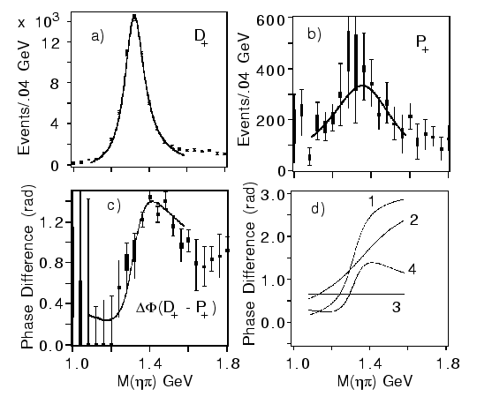
Experimental Evidence for Hybrids
Mode Mass Width Production
ηπ⁻ 1370±15+50-30 385±40+65-105 1⁺
ηπ⁰ 1257±20±25 354±64±60 1⁺
ηπ 1400 310 seen in annihilation
π₁(1400)
E852 + CBAR (1997)
While everyone seems to agree that there is intensity in the P⁺ exotic wave, there are a number of alternative (non-resonant) explanations for this state.
Unlikely to be a hybrid based on its mass. Also , the only observed decay should not couple to a member of an SU(3) octet. It could couple to an SU(3) decuplet state (e.g. 4-quark).

Slide 24
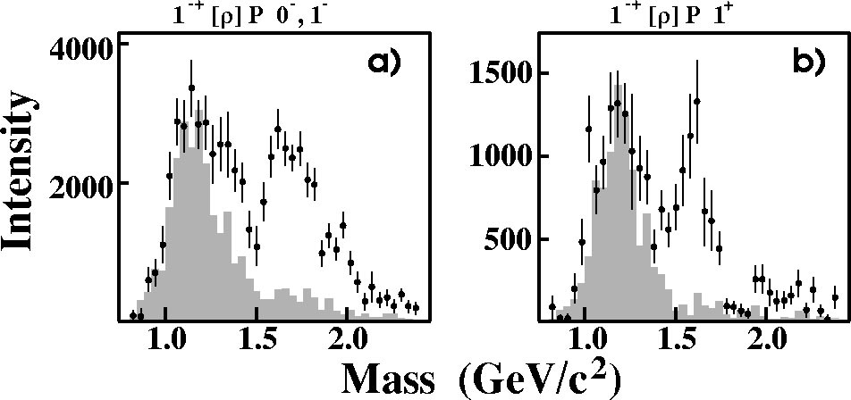
E852 Experiment
Natural-parity exchange: 0⁺,1⁻,2⁺,…
Unnatural-parity exchange: 0⁻,1⁺,2⁻,…
π₁(1600)
Unnatural exchange
Natural exchange
π₁(1600)
M = 1598 ±8+29-47 MeV/c²
Γ = 168±20+150-12 MeV/c²
Leakage from other
partial waves.
Only quote results from the 1⁺ (natural parity) exchange.

Slide 25
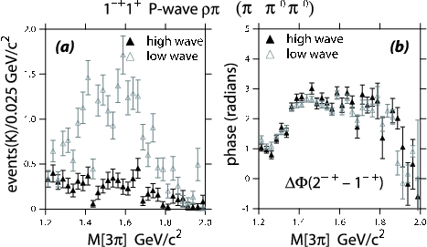
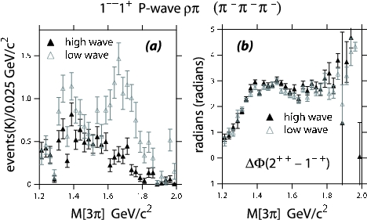
New Analysis
Dzierba et. al. PRD 73 (2006)
10 times statistics in each of two channels.
π⁻p→pπ⁻π⁰π⁰
(3000000 Events)
π⁻p→pπ⁻π⁻π⁺
(2600000 Events)
Get a better description of the data via moments comparison.
Intensity for the exotic 1⁻⁺ wave goes away.
Phase motion between the 1⁻⁺ and the 2⁺⁺ wave is not affected.
No Evidence for the π₁(1600)

Slide 26
New Analysis
Where does the intensity go?
PDG: π₂(1670) Decays
3π 96%
f₂π 56%
ρπ 31%
Always Include:
(0⁺)π₂(1670)→f₂π(L=0)
(1⁺)π₂(1670)→f₂π(L=0)
(1-)π₂(1670)→f₂π(L=0)
(0⁺)π₂(1670)→f₂π(L=2)
(1⁺)π₂(1670)→f₂π(L=2)
Modified wave set:
Leave out
(1⁺)π₂(1670)→ρπ(L=1)
(1⁺)π₂(1670)→ρπ(L=3)
(0⁺)π₂(1670)→ρπ(L=3)
Most of the strength in the exotic π₁(1600) is better described by known decays of
the π₂(1670).

Slide 27
COMPASS Experiment
(420,000 Events)
(180 GeV pions)
1 ⁻⁺ Exotic Wave
π₁(1600) m=1660 Γ=269 π₂(1670) m=1658 Γ=271
arXiv:0910.5842
42 Partial waves included, exotic is dominantly 1⁺ production.

Slide 28
CLAS Experiment
γp→nπ⁺π⁺π⁻
E_{γ} = 4.8 – 5.4 GeV
83000 Events after all cuts
Overall Acceptance < 5%
Baryons “removed” by hard kinematic
cuts.
PWA
No evidence of π₁(1600)→ρπ,
(13.5 nb upper limit).

Slide 29
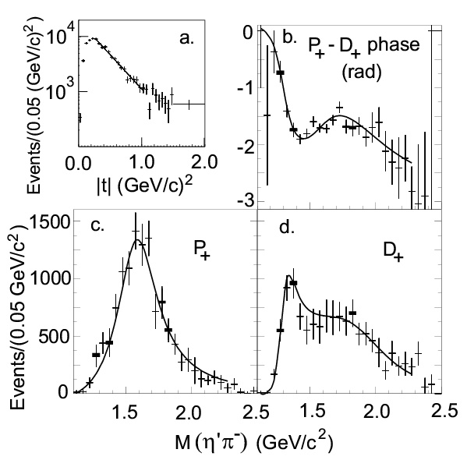
E852 Experiment
π⁻p → η’π⁻p
Data are dominated by 1⁻⁺, 2⁺⁺ and 4⁺⁺ partial waves.
Data are dominated by natural parity exchange.
(~6000 Events)
π₁(1600)
M = 1597±10+45-10 MeV/c²
Γ = 340±40±50 MeV/c²
The exotic wave is the dominant
wave in this channel.

Slide 30
COMPASS
2⁺⁺
Δphase
2⁺⁺ - 1⁻⁺
1⁻⁺

Slide 31
E852 Experiment
π⁻ p→ωπ⁰π⁻p
(~145,000 Events)
π₁(1600)→b₁π
M = 1664±8±10 MeV/c²
Γ = 185±25±38 MeV/c²
Seen in both natural and
unnatural parity exchange.
The unnatural dominates
m^{ε}=0⁻
1⁻⁺b₁π
m^{ε}=1⁺
1⁻⁺b₁π
2⁺⁺ωρ
4⁺⁺ωρ
π₁(2000)→b₁π
M = 2014±20±16 MeV/c²
Γ = 230±32±73 MeV/c²
Seen primarily in natural
parity exchange.
The natural dominates
Δφ(1⁻⁺ - 2⁺⁺)
Δφ(1⁻⁺ - 4⁺⁺)
Δφ(2⁺⁺ - 4⁺⁺)
Solid curves are a two-pole 1⁻⁺ solution.
Dashed curves are a one-pole 1⁻⁺ solution.

Slide 32
E852 Experiment
π⁻ p→ηπ⁺π⁻π⁻p
(~69000 Events)
1⁺⁺f₁π⁻
π₁(1600)→f₁π
M = 1709±24±41 MeV/c²
Γ = 403±80±115 MeV/c²
Natural parity exchange
ΔΦ(1⁻⁺ - 2⁻⁺)
2⁻⁺f₁π⁻
ΔΦ(1⁻⁺ - 1⁺⁺)
π₁(2000)→f₁π
M = 2001±30±92 MeV/c²
Γ = 333±52±49 MeV/c²
Natural parity exchange
1⁻⁺f₁π⁻
ΔΦ(1⁺⁺ - 2⁻⁺)
Black curves are a two-pole 1⁻⁺ solution.
Red curves are a one-pole 1⁻⁺ solution.

Slide 33
Experimental Evidence
The most extensive data sets to date are from the BNL E852 experiment. There is also data from the VES experiment at Protvino and some results from the Crystal Barrel experiment at LEAR. Results from the COMPASS experiment at CERN are available . There are also results from the CLEO-c experiment. Finally, there are null results from CLAS.
π₁ I^{G}(J^{PC})=1⁻(1⁻⁺)
π₁(1600) Width ~ 0.30 GeV, Decays ρπ,η’π,(b₁π)
Seen in πp production, (E852,VES,COMPASS)
Seen in χ_{c} decays. There is some controversy
around the ρπ decay mode. Not observed in
CLAS.
2.5Gev
K₁ I^{G}(J^{PC})= ½ (1⁻)
2.0GeV
η’₁ I^{G}(J^{PC})=0⁺(1⁻⁺)
η₁ I^{G}(J^{PC})=0⁺(1⁻⁺)
π₁(2000) Weak evidence in preferred hybrid
modes f₁π and b₁π only seen in E852.
0⁺⁻
1⁻⁺
2⁺⁻
No signal for η₁ or η₁’.
No signal for 2⁺⁻ or 0⁺⁻

Slide 34
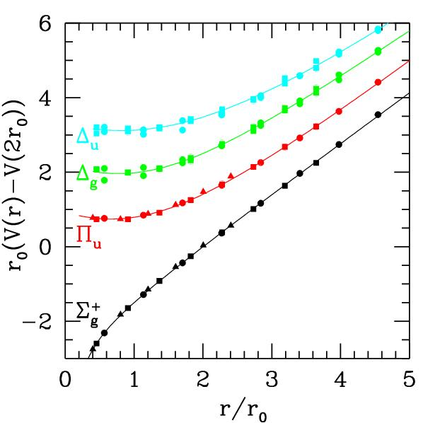
Exotics and QCD
In order to establish the existence of gluonic excitations,
We need to establish the existence and nonet nature of the 1⁻⁺ state.
We need to establish at other exotic QN nonets – the 0⁺⁻ and 2^{+-.}
Decay Patterns are Crucial
Coupled Channel PWA Needed.
Very Large Data Sets Expected
The challenge is carrying out a PWA
with huge statistics and good theoretical
underpinnings to the method.

Slide 35
Future Prospects:
COMPASS at CERN collected a large data set in 2009. Analysis is underway.
BES III in China has been running for a few years. Analysis on χ decays are looking for light-quark exotics. Searching for Glueballs.
GlueX at Jefferson Lab will use photo-production to look for exotic mesons at Jefferson Lab. First physics in 2015.
PANDA at GSI will use antiprotons to search for charmed hybrid states. Also looking for Glueballs.
CLAS12 at Jefferson Lab will look at low-multiplicity final states in very-low Q**2 reactions.

Slide 36
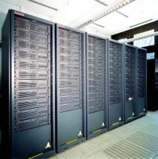
Conclusions
The quest to understand confinement
and the strong force is starting to make
great leaps forward.
Advances in theory and computing have
allowed us to start to understand the
meson spectrum and the role of glue.
Definitive experiments to confirm or refute our expectations on the role of glue are running and under construction.
The synchronized advances in LQCD and experiment will allow us to understand the role of glue in QCD and confinement.

