Slide 1
Theory discussion session summary
(mostly mesons)
J.R.Peláez
U. Complutense, Madrid

Slide 2
S. Eidelman

Slide 3
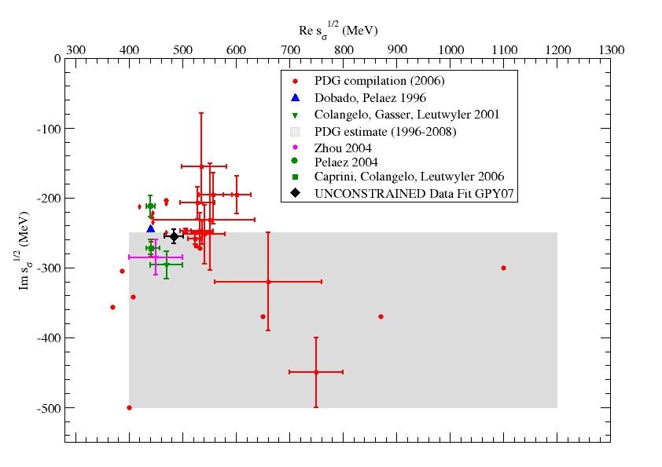
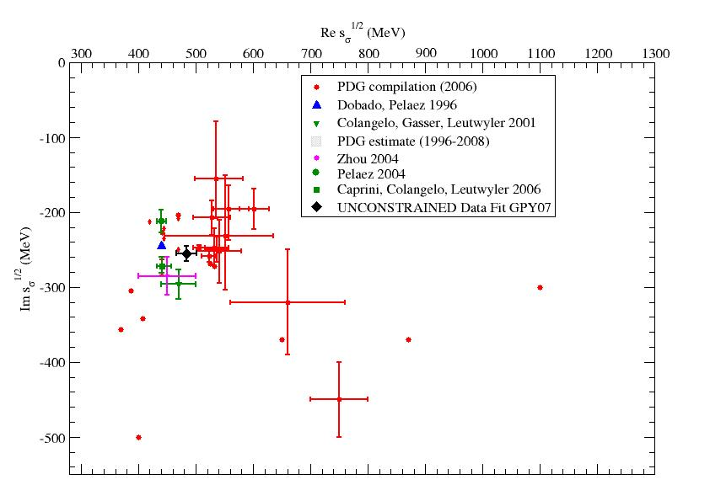
DRAMMATIC AND LONG AWAITED CHANGE ON “sigma” RESONANCE !!
Is f0(500) or “sigma”
in PDG 2012
M=400-1200 MeV
Γ=500-1000 MeV
M=400-550 MeV
Γ=400-700 MeV
The f0(600) or “sigma”
in PDG 1996-2010
M=400-1200 MeV
Γ=500-1000 MeV

Slide 4
And minor correction for the f0(980) mass & more conservative uncertainties

Slide 6
On the use of BW and other stuff
You can use whatever you want to fit your data….
But my kids can also draw a perfect line interpolating all your data without learning anything about Physics.
And their χ² , will be better than yours…!
More seriously… see M. Williams talk
BUT: If you want to extract POLES or RESONANCE properties you need the correct analytic structure, unitarity, etc… otherwise it might be easily VERY WRONG

Slide 7
Use of dispersive approaches eliminates model dependence
Also in PDG 2012

Slide 8
This actually corresponds to the red points in this transparency from S. Edelman

Slide 9
B. Mousssallam

Slide 10
S. Schneider

Slide 11
E. Klempt

Slide 12
A. Polosa

Slide 13
Items for further discussion
Adam/Fox: Use of Regge theory/duality for sum rules and checks
(FESR, for instance)
For Simon: What would be needed to get the Kappa as
“well established” in the PDG
For Simon/Bachir: What do you expect from ϒϒ->ππ
For Klempt/Polosa: Klempt Claimed that 4q states need
qqbar seed, but not discussed by Polosa.
D. Bugg: Suggests providing simple but “correct” parametrizations
Krewald: Need for systematic uncertainties on theoretical side too

Slide 14
On the use of BW and other stuff
Thus, if you insist in using whatever you want to fit your data….
It might be useful to make it public and available for others because you want to parametrize the data somehow so that anybody can use it, compare to it, etc…
Fine… but.
REFRAIN from making Physical or POLE interpretations unless you are sure your parametrizations make sense in the complex plane (analyticity), are unitary, etc…

Slide 15
Not every bump is a resonance
and
not every resonance is a bump
Moorhause 60s
From S. Krewald’s talk
Let’s reinforce the interaction between
theoreticians and experimentalists

