Slide 1
Dynamical Coupled Channel Approach for Meson Production Reaction
T. Sato Osaka U./KEK
contents
Motivation
Analysis of meson production reaction and dynamical coupled channel model
extracting resonance parameters
Resonance mass and width
Role of reaction dynamics on resonance properties
N* and neutrino reaction
Summary

Slide 2
motivation
Q: Why we investigate N*, what is key N* quantity?
A1 masses and coupling constants are fundamental quantity
that characterize low energy hadron physics
well defined resonance parameters:
pole(mass) and residue(coupling constants)
A2 reveal how QCD is realized in low energy hadron physics
In practice, we test spectrum, form factors predicted from effective theory of QCD
nature of excited baryon can be significantly affected by the reaction dynamics

Slide 3
to proceed
Determine high precision partial wave amplitude F(W) from accurate and complete experiments
data are incomplete and have errors
Extract resonance poles and residues from F(W) for complex W by using analytic continuation of F(W)
analytic continuation can be done within known analytic structure
of each approaches
Our dynamical coupled channel approach
reduce errors in extracting nucleon resonances by interpolating
data by using dynamical reaction model
implement essential element of non-perturbative QCD as much as we can
extract resonance pole,residue
provide interpretations of the extracted resonance parameters

Slide 4
Analysis of meson production reaction and dynamical coupled-channels (DCC) model

Slide 5


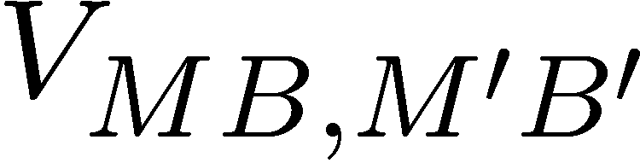
Dynamical coupled-channels (DCC) model for meson production reactions
Matsuyama, Sato, Lee, Phys. Rep. 439,193 (2007)
start from Hamiltonian of meson-baryon system
Excited baryon
continuum
interaction
→ Solve scattering equation(3dim) that satisfies three-body unitarity
Meson cloud
Confined core

Slide 6


s-channel
u-channel
t-channel
contact
π, ρ, σ, ω,..
N
N, Δ
coupled-channels effect
ρ, σ
π
Δ
π
π
N
N
Δ
π
Δ
N*_{bare}
coupled-channels effect

Slide 7
Dynamical Coupled-Channels analysis
Fully combined analysis of γN , πN → πN , ηN , KΛ, KΣ reactions !!
2006-2009
6 channels
(γN,πN,ηN,πΔ,ρN,σN)
< 2 GeV
< 1.6 GeV
< 2 GeV
―
―
―
2010-2012
8 channels
(γN,πN,ηN,πΔ,ρN,σN,KΛ,KΣ)
< 2.1 GeV
< 2 GeV
< 2 GeV
< 2 GeV
< 2.2 GeV
< 2.2 GeV
# of coupled
channels
    πp → πN
    γp → πN
    π-p → ηn
    γp → ηp
    πp → KΛ, KΣ
    γp → KΛ, KΣ
Kamano, Nakamura, Lee, Sato, 2012

Slide 8
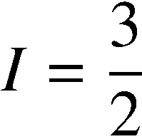
Partial wave amplitudes of pi N scattering
Real part
preliminary
Kamano, Nakamura, Lee, Sato, 2012
Previous model
(fitted to πN → πN data only)
[PRC76 065201 (2007)]
Imaginary part

Slide 9




KY production reactions
Kamano, Nakamura, Lee, Sato, 2012
preliminary
1732 MeV
1757 MeV
1792 MeV
1845 MeV
1879 MeV
1879 MeV
1985 MeV
1966 MeV
1966 MeV
2031 MeV
2059 MeV
2059 MeV

Slide 10
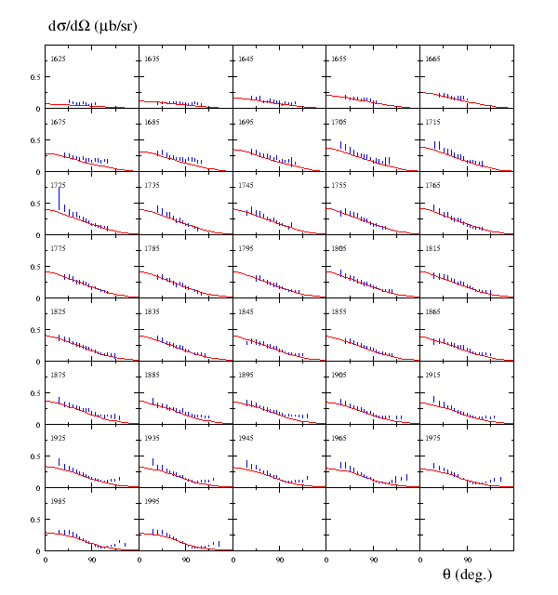

Kamano, Nakamura, Lee, Sato, 2012

Slide 11
Extracting resonance parameters

Slide 12
Method of analytic continuation
Suzuki, Sato, Lee, Phys. Rev. C79, 025205 (2009)
Phys. Rev. C 82, 045206 (2010)
deform the path of momentum integral for complex E
find pole of T-matrix choosing appropriate sheets for each channels
On-shell momentum
Singularity of meson exchange interaction

Slide 13
Mass, width and form factors of resonances
A1 masses and coupling constants are fundamental quantity
that characterize low energy hadron physics

Slide 14

Spectrum of N* resonances
Kamano, Nakamura, Lee, Sato ,2012
Real parts of N* pole values
preliminary
Ours
PDG 4*
 | PDG | Ours
N* with 3*, 4* | 18 | 16
N* with 1*, 2* | 5
PDG 3*
L_{2I 2J}

Slide 15

Width of N* resonances
preliminary
Kamano, Nakamura, Lee, Sato 2012

Slide 16


N-N* form factors at Resonance poles
Suzuki, Julia-Diaz, Kamano, Lee, Matsuyama, Sato, PRL104 065203 (2010)
Suzuki, Sato, Lee, PRC82 045206 (2010)
Nucleon - 1st D13 e.m. transition form factors
Real part
Imaginary part
Form factors(complex numbers) are derived from the residue of the amplitude at resonance pole.
Identified with exact solution of fundamental theory (QCD)

Slide 17
Role of reaction dynamics on resonance properties
‘A2 reveal how QCD is realized in low energy hadron physics’

Slide 18
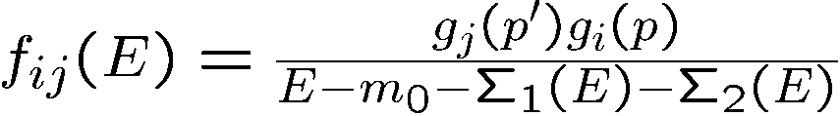
Resonance in coupled channel reaction
Interesting example on the number of resonances in coupled channel reaction
suppose a excited baryon couples with two meson-baryon channel
one obtains poles on several sheets(uu,up,pu,pp)
usually, only one pole on nearest sheet from physical sheet is relevant . That is used to characterize resonance
In some case, more than one poles become relevant and they can be seen as resonances
B1
B2
M1
M2

Slide 19
Toy model: Suzuki,Sato,Lee PRC79 025205(2009)
1 physical 2 physical sheet
Im (E)
threshold 1
threshold 2
A
Re (E)
B
1 unphysical 2 physical sheet
1 unphysical 2 unphysical sheet
Single excited state(bare) couples with two continuum channels
→ Two poles are generated on up(narrow) and uu(broad) sheet can be observed as resonances

Slide 20
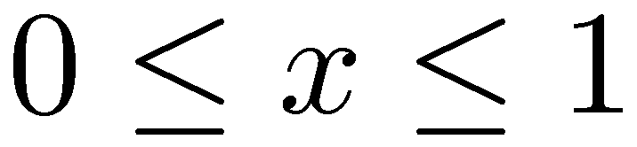
Pole positions of P11
Suzuki, Julia-Diaz, Kamano, Lee, Matsuyama, Sato, PRL104 065203 (2010)
ηN threshold
πΔ threshold
1357 – 76 i
1364 – 105 i
Im E (MeV)
1820 – 248 i
1999 – 321 i
3 resonance pole out of 2 excited(bare) N* (6-channel model)
mass shift of excited states from coupling with scattering state

Slide 21
Interpretation of form factor

Slide 22
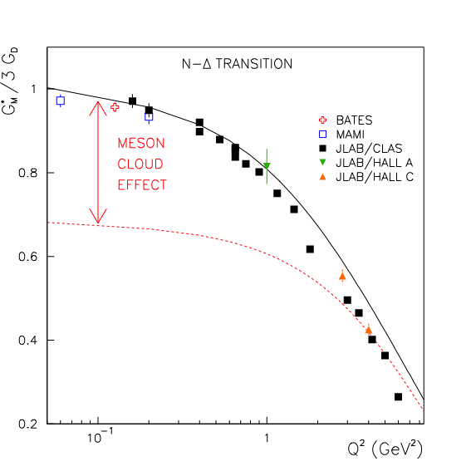
G_{M}(Q²) for γ N → Δ (1232) transition
Note:
Most of the available static
hadron models give G_{M}(Q²)
close to “Bare” form factor.
Full
Bare

Slide 23
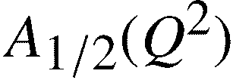
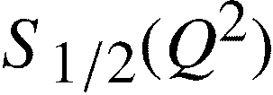
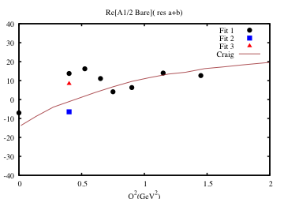
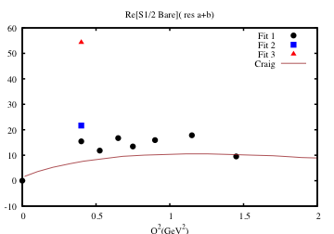

γ p → Roper e.m. transition
“Bare” form factor
determined from
our DCC analysis (2010).
“Static” form factor from
DSE-model calculation.
(C. Roberts et al, 2011)

Slide 24
Collaborators
J. Durand (Saclay)
B. Julia-Diaz (Barcelona)
H. Kamano (RCNP,JLab)
T.-S. H. Lee (ANL,JLab)
A. Matsuyama(Shizuoka)
S. Nakamura (YITP,Kyoto,JLab)
B. Saghai (Saclay)
T. Sato (Osaka)
C. Smith (Virginia, Jlab)
N. Suzuki (Osaka)
K. Tsushima (Adelaide,JLab)

Slide 25
Toward construction of unified model of lepton-nucleus interaction from a few hundred MeV to GeV region
Y. Hayato(ICRR, U. of Tokyo), M. Hirai(Tokyo Science U.),H. Kamano(RCNP,Osaka U.),S. Kumano(KEK),S. Nakamura(YITP,Kyoto U.),K. Saio(Tokyo Science U.),T. Sato(Osaka U.),M. Sakuda(Okayama U.)
➔ A new collaboration at J-PARC branch of KEK theory Center
http://j-parc-th.kek.jp/html/English/e-index.html

Slide 26


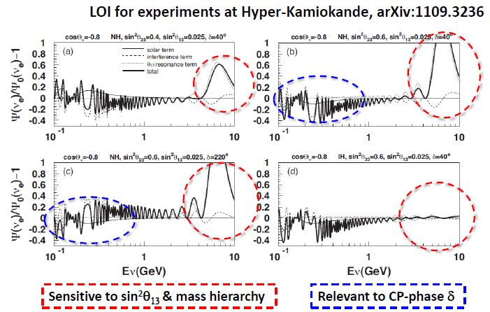
Lepton-nucleus interactions in the new era of large θ₁₃
spring 2012: theta_13 from Daya Bay, RENO
mass hirarchy and CP-phase δ.

Slide 27
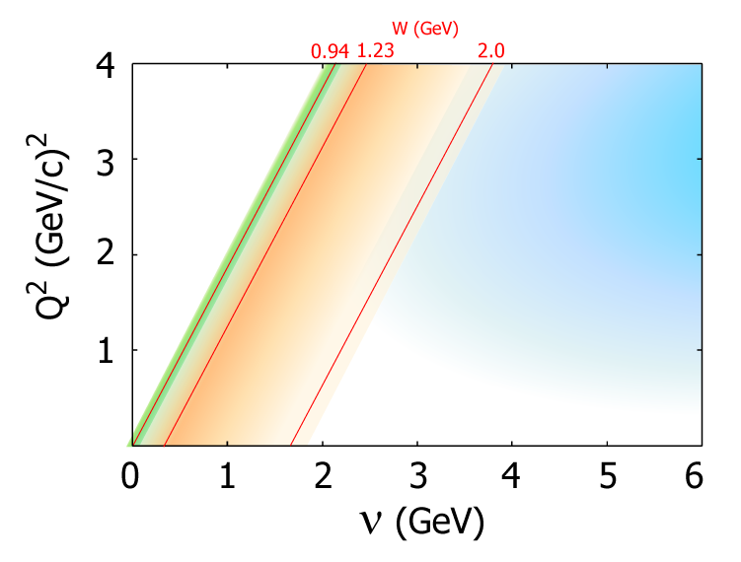
Less than 10% accuracy of the neutrino cross sections is
required for the determination of mass hirarchy and CP-phase δ.
Neutrino experiments probe overlapping region among
Quasi-elastic(QE), Resonance(RES), and Deep-inelastic scattering (DIS).
QE
DIS
RES
T2K
Atmospheric

Slide 28
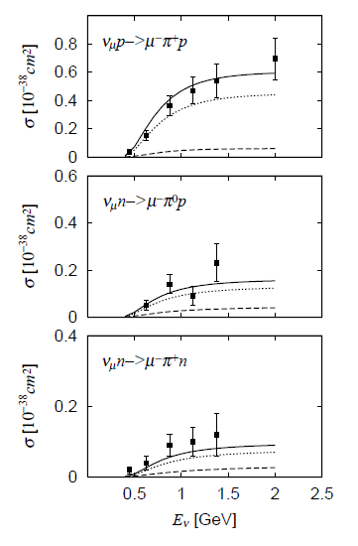
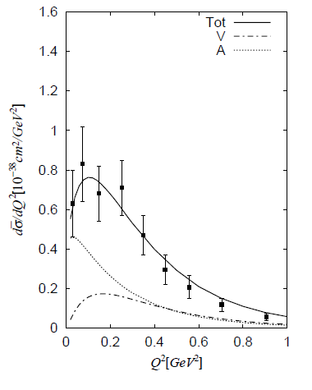
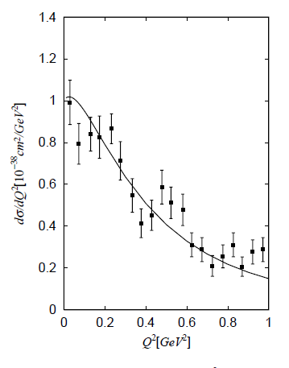
Neutrino reaction in resonance region W<2GeV
Reaction model for the delta(1232) region is available
Sato,Uno,Lee PRC67(2003) CC
Matsui,Sato,Lee PRC72(2005) NC, PV(e,e’)
available neutrino reaction data are explained

Slide 29
Above Delta region, only single pion production reaction has been studied
Rein Sehgal AP133(80)
Alvarez-Ruso et al. PRC57(98)
Lin et al. PRC52(95)
Paschos et al. PRD65(02)
Lalakulich et al. PRD71(05), PRD74(06)
Leitner et al. PRC79(09)
+ non-resonance
Hernandez et al. PRD76 (07),PRD81(10)
Lalakulich et al. arXiv 1007.0925
Opportunity to apply development of meson production reaction for neutrino reactions

Slide 30

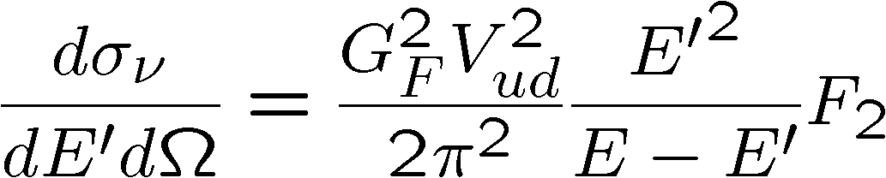
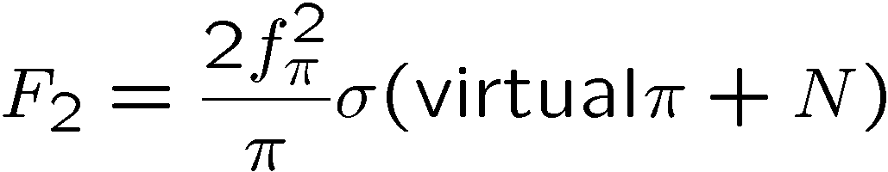
Forward neutrino induced meson production reaction in nucleon resonance region : the first application of coupled channel approach
Objective: * benchmark for the future full meson production model
* eta,kaon production rate for back ground estimation of proton decay analysis
Use PCAC for
,
Tot (including 2pi)
single pi
SL model (single pi via Delta)
eta
K

Slide 31
Next Tasks
By extending the ANL-Osaka collaboration (since 1996)
Complete the extraction of resonance parameters including N-N* form factors
Analysis on the structure of major resonances(S11,D13)
3. Make predictions for J-PARC projects on πΝ -> ππΝ, ΚΛ…
4. Complete model of weak meson production reaction

Slide 32
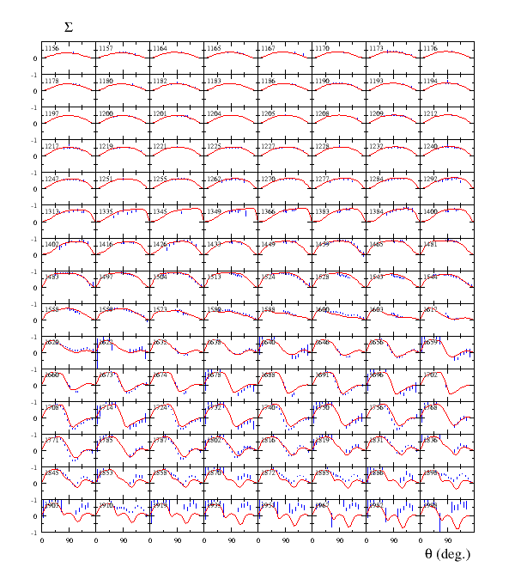

Kamano, Nakamura, Lee, Sato, 2012

Slide 33
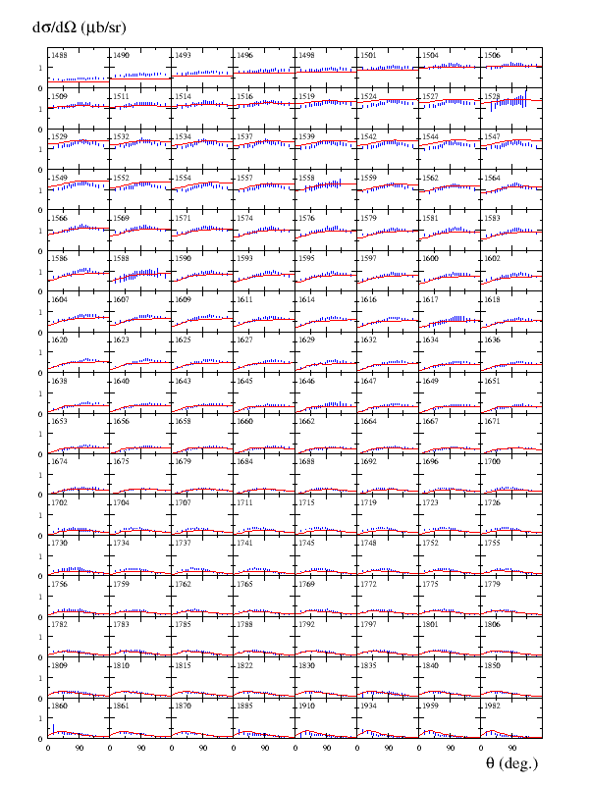

Kamano, Nakamura, Lee, Sato, 2012

Slide 34

Single pion photoproduction
Kamano, Nakamura, Lee, Sato, 2012
Angular distribution
Photon asymmetry
1137 MeV
1232 MeV
1334 MeV
1137 MeV
1232 MeV
1334 MeV
1462 MeV
1527 MeV
1617 MeV
1462 MeV
1527 MeV
1617 MeV
1729 MeV
1834 MeV
1958 MeV
1729 MeV
1834 MeV
1958 MeV
Kamano, Nakamura, Lee, Sato, 2012
Previous model (fitted to γN → πN data up to 1.6 GeV) [PRC77 045205 (2008)]

Slide 35
Electromagnetic Helicity Amplitude

Slide 36
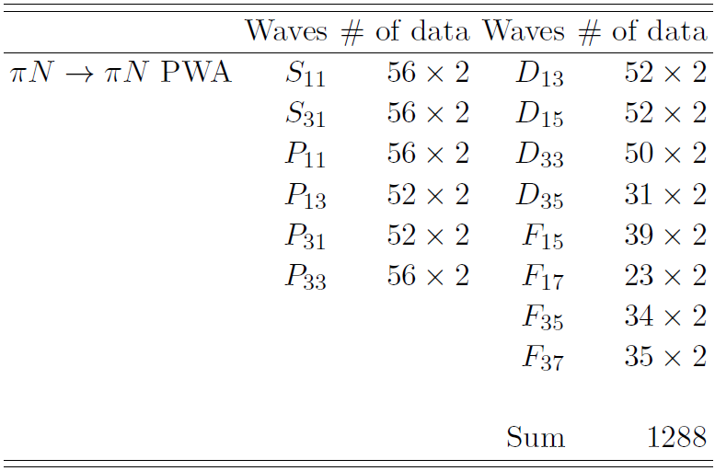
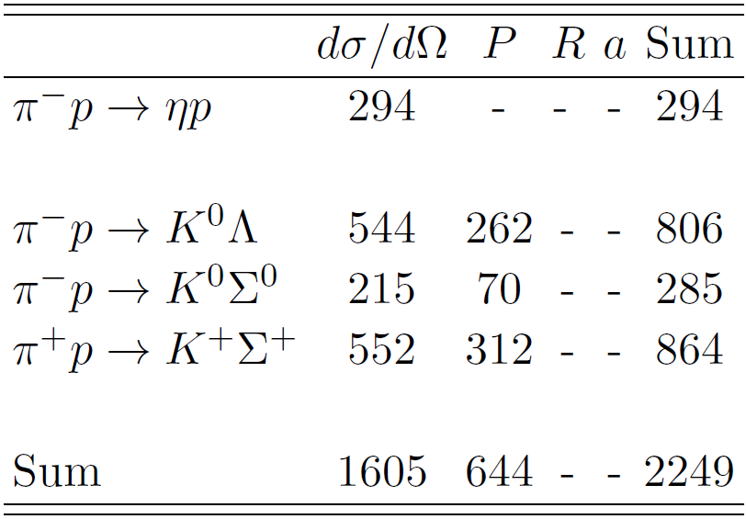
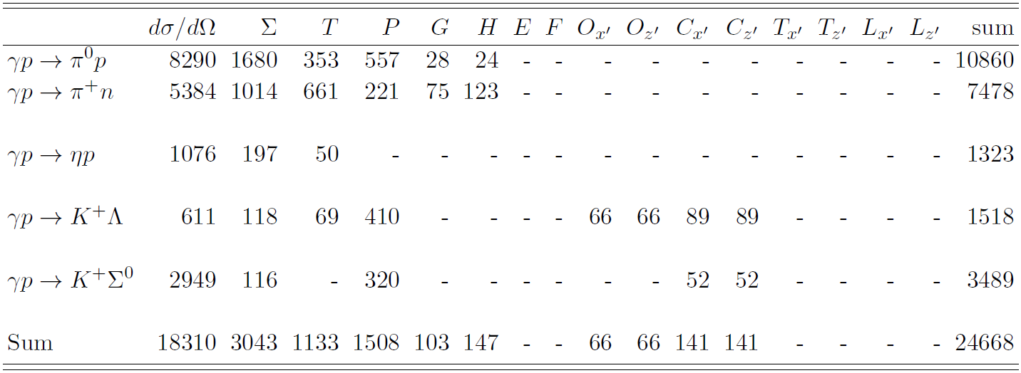
Analysis Database
Pion-induced
reactions
(purely strong
reactions)
SAID
~ 28,000 data points to fit
Photo-
production
reactions

Slide 37
Parameters :
1. Bare mass M
2. Bare vertex N* -> MB (C , Λ )
N = 14 [ (1 + 8 2 ) n ], n = 1 or 2
= about 200
Determined by χ -fit to about 28,000 data points
N*
N*,MB
N*,MB
N*
N*
2

Slide 38
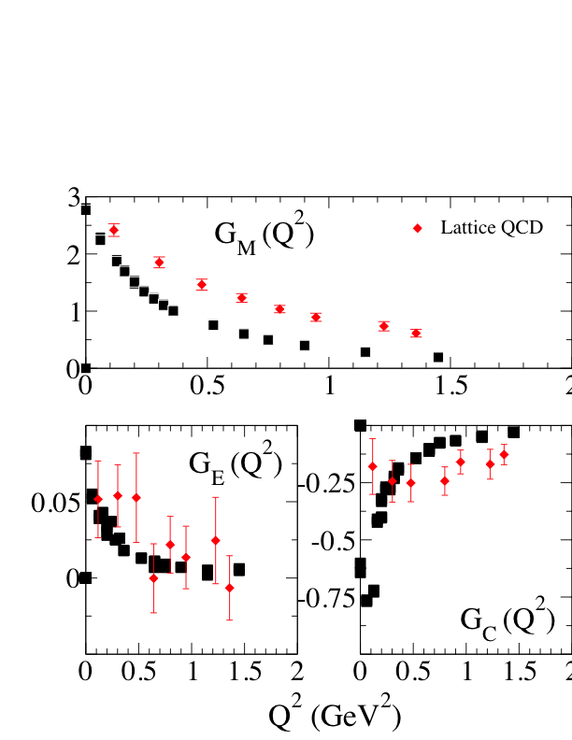
γ N → Δ(1232) form factors
compared with Lattice QCD data (2006)
DCC

