Slide 1
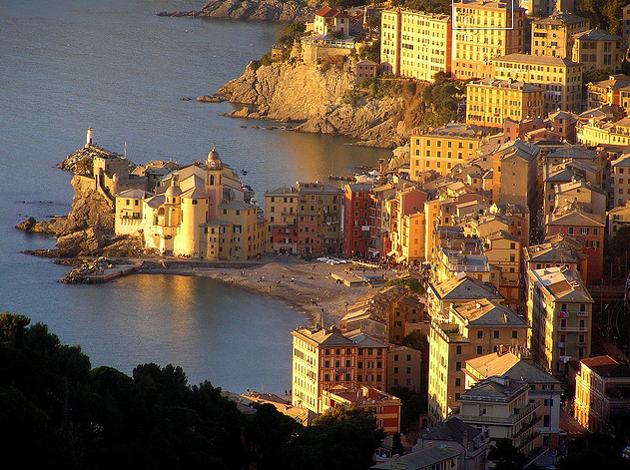
Neutron-Target Data for Pion Photoproduction
Igor Strakovsky The George Washington University
• Single Pion PhotoProd
• Proton Multipoles
• FSI for γn◊π⁻p
• CLAS γn→π⁻p data for PWA
• Neutron Multipoles
• Summary & Prospects
ATHOS2012, Camogli, Italy, June 2012

Slide 2
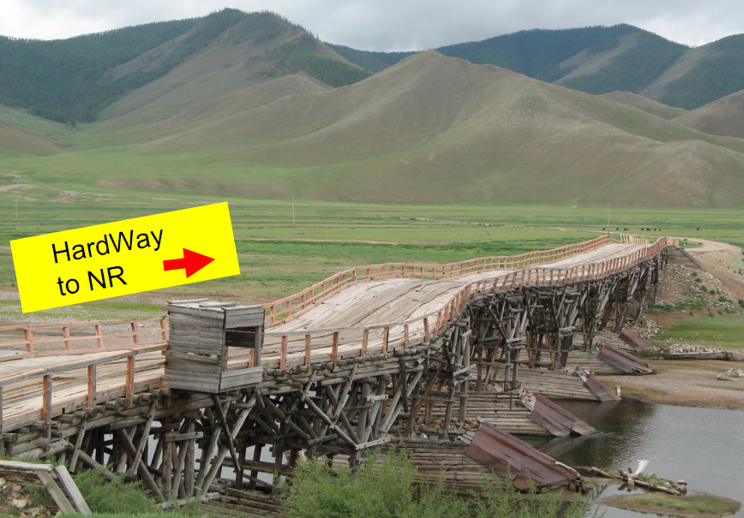
Phenomenology for non-strange Resonances
.
theory
UP
phenomenology
experiment
ATHOS2012, Camogli, Italy, June 2012

Slide 3
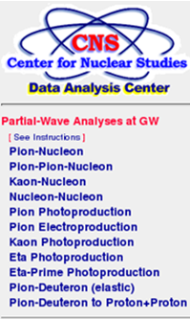
PWA for non-Strange Baryons & SAID Database
Originally: PWA arose as the technology to determine amplitude of the reaction via
fitting scattering data which is a non-trivial mathematical problem
[Solution of ill-posed problem
− Hadamard, Tikhonov, et al]
Below 4 GeV
Resonances appeared as a by-product
[Bound states objects with quantum
numbers and mass, lifetime, etc]
31,402
[W = 1320 to 1930 MeV ]
241,214 evts
That is the strategy of the
GW/VPI πN PWA since 1987
5,267
38,162
26,554
113,900
9,086
6,235
1,030
1,914
6,083
For π→2π, we use log-likelihood
while for the rest − least-squares
technologies
ATHOS2012, Camogli, Italy, June 2012

Slide 4
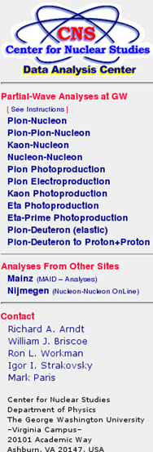
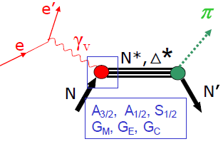
N* and Δ* States coupled to πN [SAID: http://gwdac.phys.gwu.edu/]
• GW SAID N* program consists of πN→πN γN→πN γ*N→πN
As was established by Dick Arndt on 1997
• Assuming dominance of 2-hadronic channels
[πN elastic & π⁻p→ηn], we parameterize γ∗N→πN in terms of πN→πN amplitudes
• One of the most convincing ways to study Spectroscopy of N* & Δ*
is πN PWA
• Non-strange objects in the PDG Listings come mainly from:
Karlsruhe-Helsinki, Carnegie-Mellon-Berkeley, &
GW/VPI
• The main source of EM couplings is the GW/VPI analysis
⁺
ATHOS2012, Camogli, Italy, June 2012

Slide 5
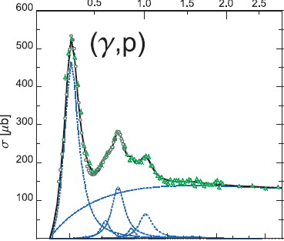
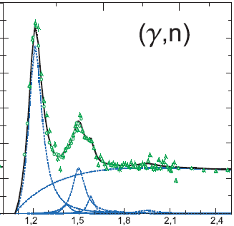
SAID for Pion Photoproduction [W. Chen, et al, arXiv:1203.4412 [hep-ph]
• Energy dependent GB12 and associated SES
• E = 145 – 2700 MeV [W = 1080 – 2460 MeV]
• PWs = 60 [E & M multipoles] [J < 6]
• Prms = 210
• Constraint: M = (Born + Α)(1+iT_{πN}) + ΒT_{πN} + (C+iD)(ImT_{πN}-|T_{πN}|²)
Born [no free parameters to fit]
πN-PWA [no theoretical input]
Reaction | Data (Dpol) | χ²
γp→π⁰p | 14,612 (3 %) | 32,449
γp→π⁺n | 8,510 (5 %) | 16,520
γn→π⁻p | 3,058 (0 %) | 6,396
γn→π⁰n | 364 (0 %) | 1,201
Total | 26,554 | 56,566
23,122 data
• 1st generation - (‘60−‘90)
10k data [85% bremsstrahlung data]
30% data is polarized
[limited coverage, broad energy binning]
• 2nd generation ('90−'10) → SAID fits
25k data [60% tagged data]
30% data is polarized
Dearth of neutron data
• 3rd generation ('10+)
New data will come from JLab, MAMI-C,
SPring-8, CB-ELSA, MAX-lab, & LNS
3,422 data
Much less known, 15%
ATHOS2012, Camogli, Italy, June 2012

Slide 6
Recent SAID results for Pion
Photoproduction
GB12: included recent CLAS π⁻p dσ/dΩ [W. Chen, et al, arXiv:1203:4412 [hep-ph]
CM12: CM parameterization for T_{πN} [R. Workman, et al, arXiv:1202.0845 [hep-ph]
SN11: included recent GRAAL π⁻p & π⁰n Σ
LEPS π⁰p dσ/dΩ [R. Workman, et al, Phys Rev C 85, 025201 (2012)]
M = (Born + A)(1 + iT_{πN}) + BT_{πN} + (C + iD)(ImT_{πN} -|T_{πN}|²)
SP09: included recent CLAS π⁺n dσ/dΩ [M. Dugger, et al, Phys Rev C 79, 065206 (2009)]
M = (Born + α_{R})(1 + iT_{πN}) + α_{R}T_{πN} + higher terms
Solution | Energy Limit (MeV) | χ²/N_{Data} | N_{Data}
GB12 | 2700 | 2.09 | 26,179
CM12 | 2700 | 2.01 | 25,814
SN11 | 2700 | 2.08 | 25,553
SP09 | 2700 | 2.05 | 24,912
FA06 | 3000 | 2.18 | 25,524
SM02 | 2000 | 2.01 | 17,571
SM95 | 2000 | 2.37 | 13,415
• The overall SAID χ² has remained
stable against the growing database,
which has increased
by a factor of 2 since 1995
[most of this increase coming from data
from photon-tagging facilities].
Forum for MAX-IV Ring, Lund, Nov 2011
ATHOS2012, Camogli, Italy, June 2012

Slide 7
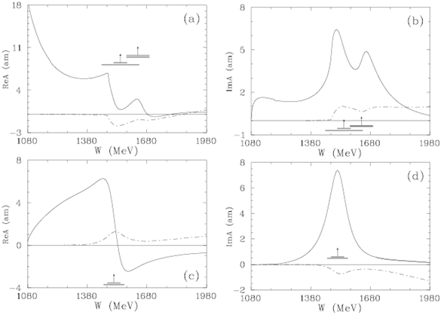
Recent SAID parameterization for Pion Photoproduction
[R. Workman, et al, Phys Rev C 85, 025201 (2012)]
•
• Terms A – D were parametrized
in terms of polynomials with the
correct threshold behavior.
• The Born and Phenomenological
A & B contributions are generally
found to cancel – effectively
reducing the Born at high
energies.
• C and D terms contributions
grows with πN reaction Xsection.
• Amplitude satisfy Migdal-Watson’s
[A.B. Migdal, JETP, 1, 2 (1955);
K.M. Watson, Phys Rev 95, 228 (1954)]
theorem below the 2π threshold
allowing for a smooth departure
from constraint at high energies.
Re
_{p}E₀₊
^{1/2}
Im
C+D
_{p}E₂₋
^{1/2}
Forum for MAX-IV Ring, Lund, Nov 2011
ATHOS2012, Camogli, Italy, June 2012

Slide 8
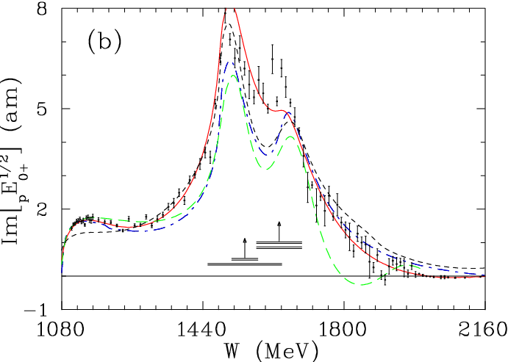
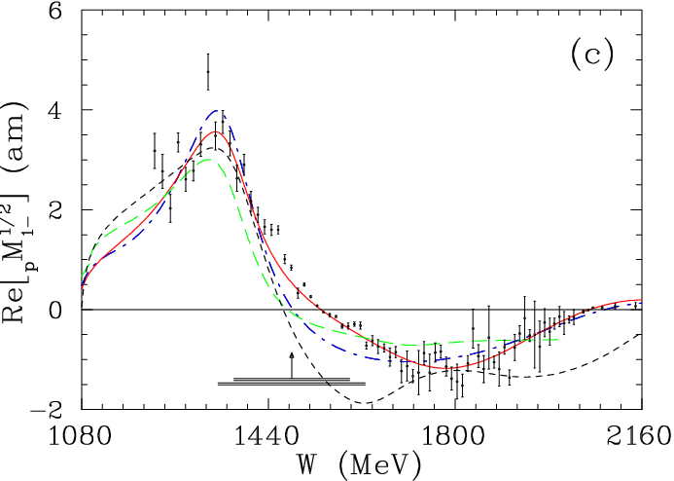
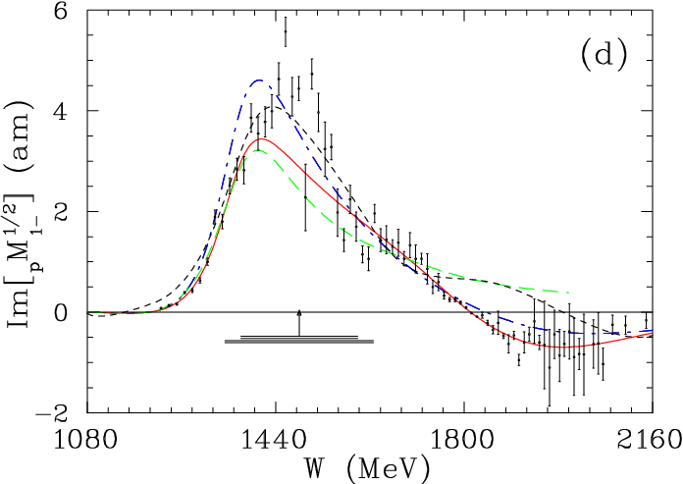
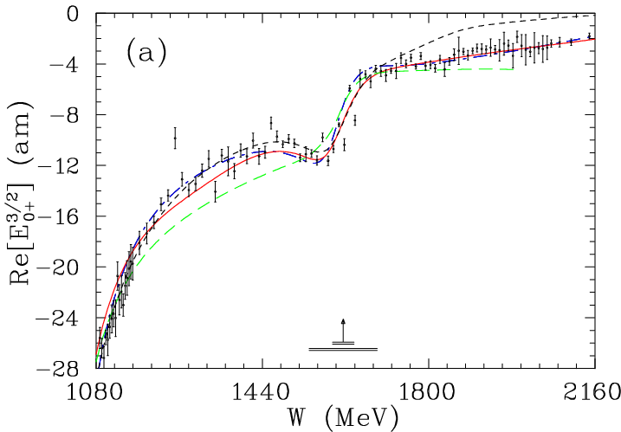
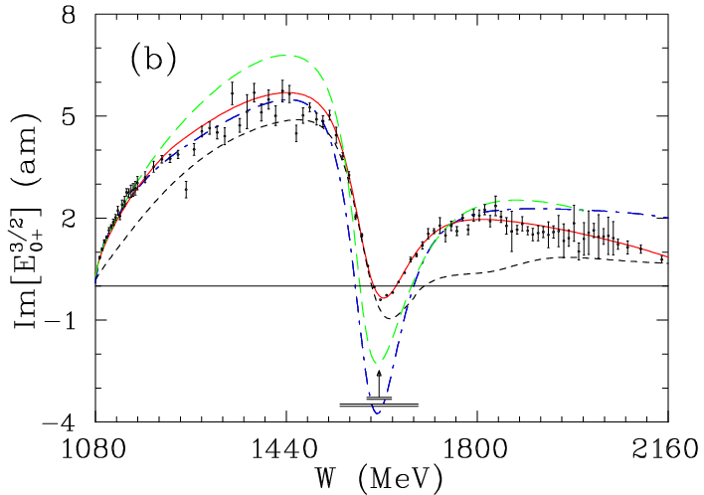
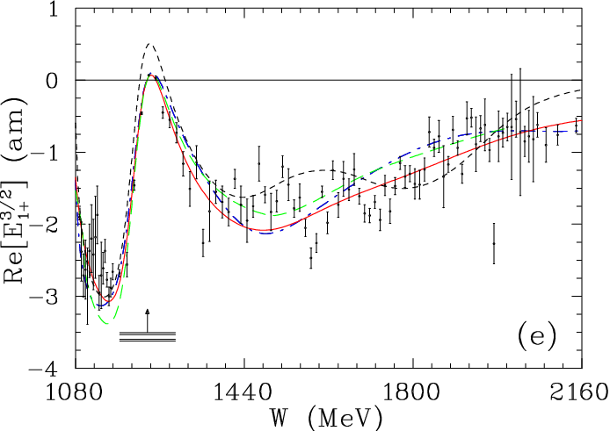
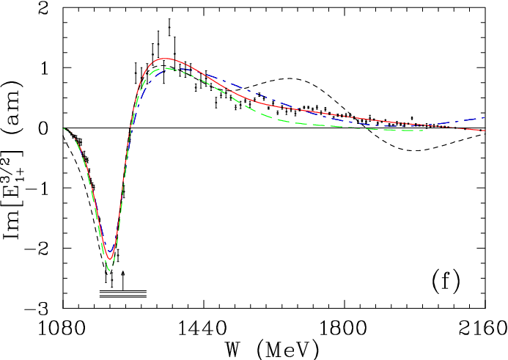
Proton Multipoles from CM12 [R. Workman, W. Briscoe, M. Paris, IS, arXiv:1202.0845 – to be published in Phys Rev C 85 (2012)]
• Overall: the difference between MAID07 or BoGa and SAID-CM12 is rather small but…
Resonances may be essentially different
S₁₁
A_{1/2} = 128.4±4.0 [66, 105±10]
A_{1/2} = 55±30 [33, 33±7]
P₁₁
A_{1/2} = −56±1 [−61, -61±8],
CM12
SN11
BoGa
MAID07
P₃₃
A_{1/2} = −139±2 [−140, -131±4]
A_{3/2} = −262±3 [−265, -254±5]
S₃₁
A_{1/2} = 29±3 [66, 52±5]
BW for πN SP06
• Significant changes have occurred at high energies
• Comparisons to earlier SAID fits and fit from the Mainz & BoGa
groups show that the new CM12 solution is much more satisfactory
at higher energies
• Subjective variables for SES are
• Energy binning
• Strength of constraints
• Which PW to be searched
MAID07
BoGa
MAID07: D. Drechsel, et al, Eur Phys J A 34, 69 (2007)
BoGa: A. Anisovich, et al, Eur Phys J A 48, 15 (2012)
ATHOS2012, Camogli, Italy, June 2012

Slide 9
Single Pion Photoproduction
• Only with good data on both proton and neutron targets, one can hope to
disentangle the isoscalar & isovector EM couplings of the various N*& Δ*
resonances, [K.M. Watson, Phys Rev 95, 228 (1954);
R.L. Walker Phys Rev 182, 1729 (1969)]
as well as the isospin properties of the non-resonant background amplitudes.
• The radiative decay width of the neutral baryons may be extracted from
π⁻ & π⁰ photoproduction off a neutron, which involves a bound neutron
target and requires the use of a model-dependent nuclear (FSI) corrections.
• The lack of γn→π⁻p & γn→π⁰n data does not allow us to be as confident
about the determination of neutron couplings relative to those of the
proton.
.
ATHOS2012, Camogli, Italy, June 2012

Slide 10
γ n→π ⁻p Experiment
• The existing γn→π⁻p database contains mainly differential cross sections
(17% of which are from polarized measurements).
• Many of these are old bremsstrahlung measurements with limited angular
coverages and large energy binnings (E_{γ} = 100 – 200 MeV).
In several cases, the systematic uncertainties have not been given.
• At lower energies (E_{γ} < 700 MeV or so), there are data sets for the inverse
π⁻ photoproduction reaction: π⁻p→γn.
This process is free from complications associated with a deuteron target.
• However, the disadvantage of using π⁻p→γn is the 5 to 500 times larger cross
section for π⁻p→ π⁰n →γγn.
• The new CLAS cross section set has quadrupled the world database for
γn→π⁻p above E_{γ} = 1 GeV.
T H A N K S
igor@gwu.edu
ATHOS2012, Camogli, Italy, June 2012

Slide 11
Where we Are now
• Some of the N* baryons [N(1675)5/2⁻, for instance] have stronger EM
couplings to the neutron than to the proton but parameters are very
uncertain
• PDG estimate for the A_{1/2} & A_{3/2} decay amplitudes of the N(1720)3/2⁺
state are consistent with zero, while the recent SAID determination gives
small but non-vanishing values
• Other unresolved issues relate to the second P₁₁, N(1710)1/2⁺, that are
not seen in the recent πN PWA, contrary to other PWAs used by the PDG10
PDG10: N(1675)5/2⁻→pγ , helicity-1/2 ampl A1/2: +0.019±0.008
N(1675)5/2⁻→nγ , helicity-1/2 ampl A1/2: −0.043±0.012
SAID N(1675)5/2⁻→pγ , helicity-3/2 ampl A3/2: +0.016±0.001
N(1675)5/2⁻→nγ , helicity-3/2 ampl A3/2: −0.058±0.002
PDG10 SAID
N(1720)3/2⁺→pγ , helicity-1/2 ampl A1/2: +0.018±0.030 +0.095±0.002
N(1720)3/2⁺→pγ , helicity-3/2 ampl A3/2: −0.019±0.020 −0.048±0.002
.
ATHOS2012, Camogli, Italy, June 2012

Slide 12
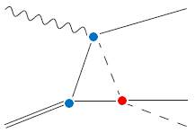
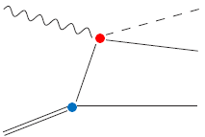
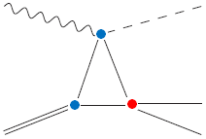
FSI and γ d→π –p p γ n →π ⁻p [V. Tarasov, A. Kudryavtsev, W. Briscoe, H. Gao, & IS, Phys Rev C 84, 035203 (2011)]
• FSI plays a critical role in the state-of-the-art analysis
• Effect: 5% – 60% It depends on (E,θ)
Input: SAID γN→πN, πN, NN amplitudes
for 3 leading terms
DWF: Bonn Pot.
πN-fsi vertex
NN-fsi
vertex
IA
Dominant
Fermi motion of nucleons included
ATHOS2012, Camogli, Italy, June 2012

Slide 13
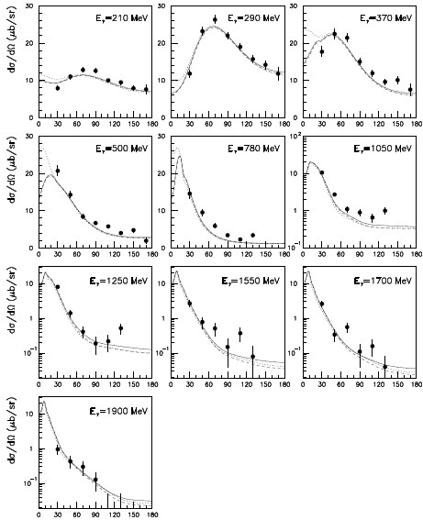
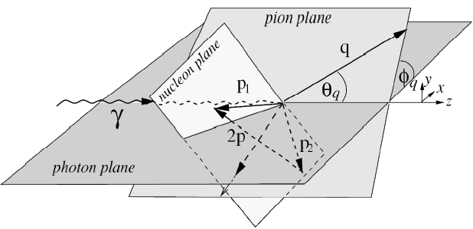
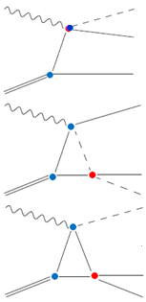
γ d→π ⁻pp [V. Tarasov, A. Kudryavtsev, W. Briscoe, H. Gao, & IS, Phys Rev C 84, 035203 (2011)]
.
No fit to the data
.
θ(πγ−LS)
….. IA - - - IA + NN_{fsi}
___ IA + (NN+πN)_{fsi}
• DESY [Bubble Chamber data]:
P. Benz, et al,Nucl Phys B65, 158 (1973)
ATHOS2012, Camogli, Italy, June 2012

Slide 14
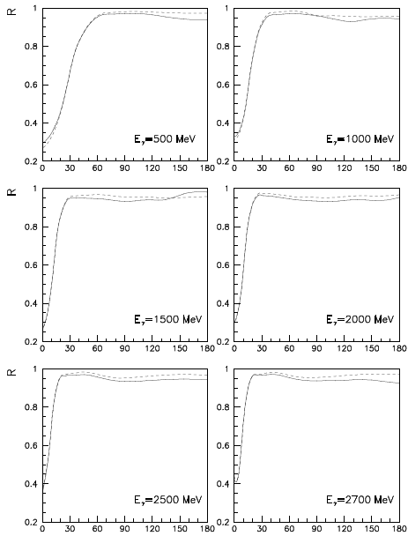
FSI for CLAS γ n→π ⁻p [V. Tarasov, A. Kudryavtsev, W. Briscoe, H. Gao, & IS, Phys Rev C 84, 035203 (2011)]
.
• For CLAS data
• The FSI correction factor R < 1
• The behavior is smooth vs. θ
• The effect (1 - R) < 10%
Cuts:
p_{s} > 200 MeV/c
p_{f} > 200 MeV/c
CLAS data:
E > 1 GeV
θ > 32 deg
• There is no large sensitivity to cuts
• There is a sizeable FSI effect
from S-wave part of pp-FSI
at small angles.
.
• This region narrows as the
E_{γ} increases.
• Our estimation of the Glaber FSI
corrections gives the value of 5%.
Previous estimations gave the
order of 15-30%.
- - [IA + NN_{fsi}] / IA
___ [IA + (NN+πN)_{fsi}] / IA
θ(πp−CM)
ATHOS2012, Camogli, Italy, June 2012

Slide 15
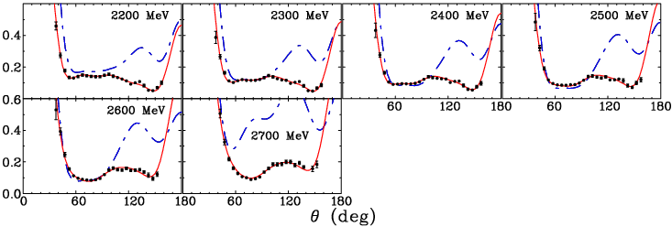
CLAS for γ n→π ⁻p [W. Chen, et al, arXiv:1203.4412 [hep-ph]
Systematics:
Exp: 6-9%
FSI: 2-3%
MAID07
GB12
χ²/dp = 45636/626 = 72.9 [SN11 – no fit]
χ²/dp = 1580/626 = 2.5 [GB12 – fit ]
SN11
• CLAS data appear to have fewer
angular structures than the
earlier fits.
ATHOS2012, Camogli, Italy, June 2012

Slide 16
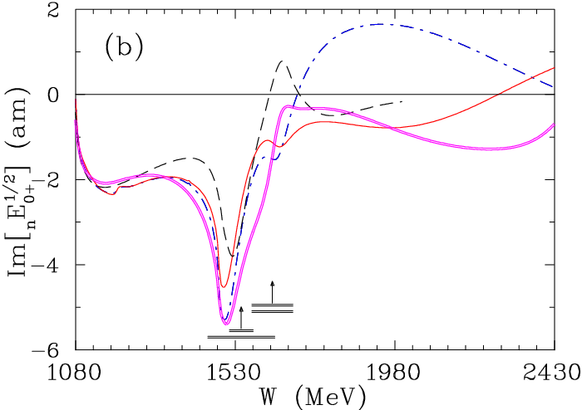
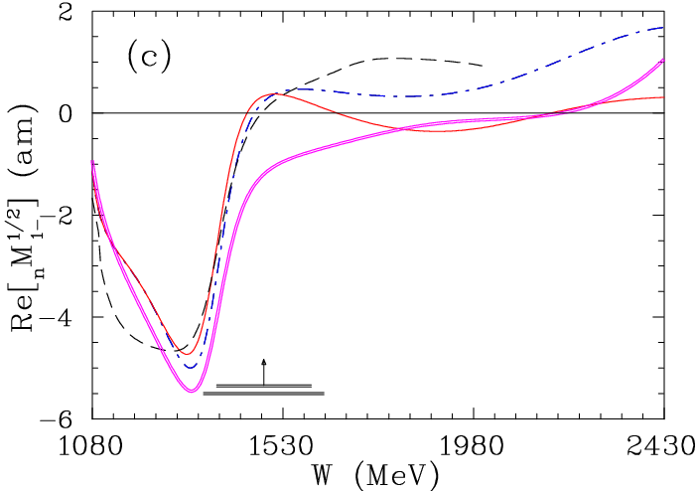
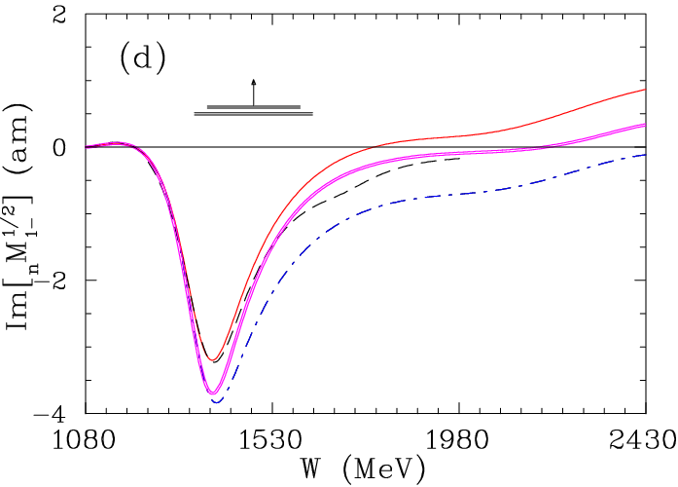
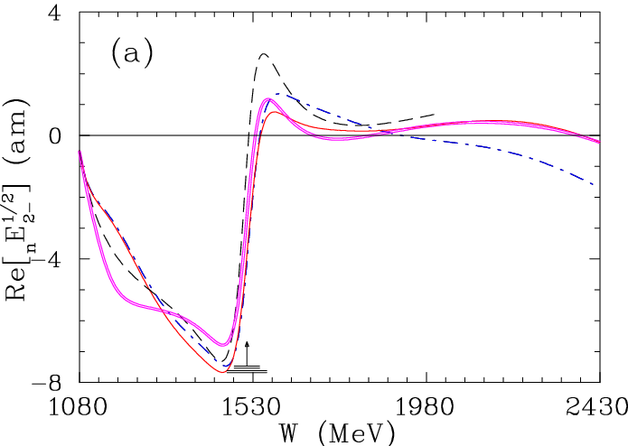
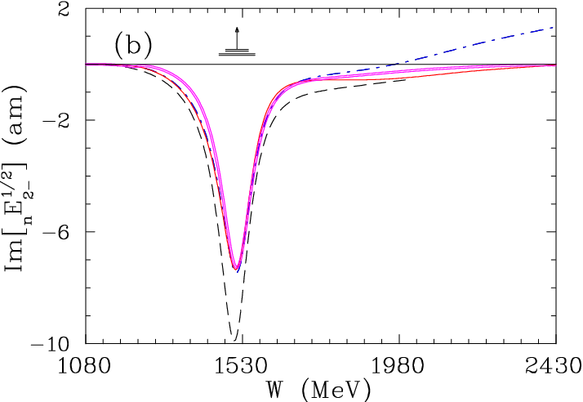
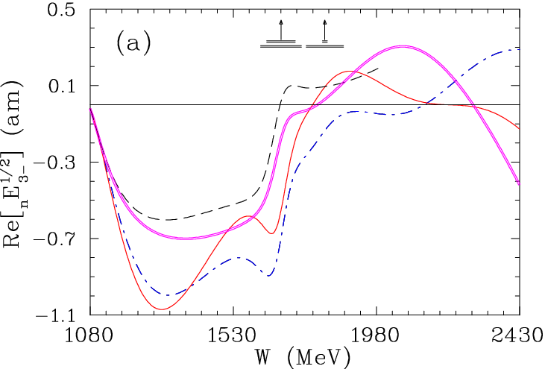
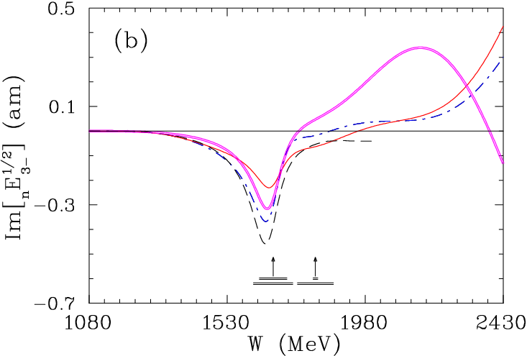
Neutron Multipoles from GB12 [W. Chen, et al, arXiv:1203.4412 [hep-ph]
• Overall: the difference between MAID07 and SAID-GB12 is rather small but…
Resonances may be essentially different
MAID07
GB12
SN11
BW for πN SP06
S₁₁
A_{1/2} = −58± 6 [−51]
A_{1/2} = −40±10 [ 9]
P₁₁
A_{1/2} = 48±4 [54]
GZ12
D₁₃
A_{1/2} = −46±6 [ −77]
A_{1/2} = −115±5 [−154]
F₁₅
A_{1/2} = 26±4 [ 28]
A_{3/2} = −29±2 [−38]
• Significant changes have occurred at high energies
• Comparisons to earlier SAID fits and fit from the Mainz
group show that the new GB12 solution is much more
satisfactory at higher energies
MAID07
MAID07: D. Drechsel, et al, Eur Phys J A 34, 69 (2007)
ATHOS2012, Camogli, Italy, June 2012

Slide 17
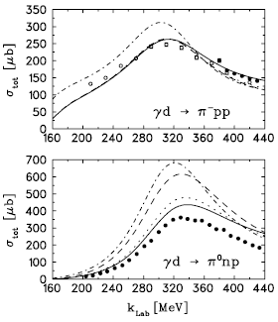
Next Step is γ n→π ⁰n
[M. Schwamb, Phys Rep 485, 109 (2010) ]
• For the Δ-region
IA contribution for
γd→π⁰np is much larger
than for γd→π⁻pp
IA
ο INS, Tokyo:
[M. Asai ea Phys Rev C 42, 837 (1990)]
• DESY [Bubble Chamber data]:
[P. Benz ea Nucl Phys B65, 158 (1973)]
IA
• MAMI-B:
[B. Krusche ea Eur Phys J A 6, 309 (1999)]
Forum for MAX-IV Ring, Lund, Nov 2011
ATHOS2012, Camogli, Italy, June 2012

Slide 18
Summary and Prospects
• Pion Photo Prod measurements on the ‘neutron’ target are necessary to determine neutron couplings at Q² = 0 GeV²
• Future experiments on the reactions γd→πNN are welcome,
especially at small angles θ < 30⁰, where data are absent
• JLab HD-ICE, CB@MAMI-C, LEPS II, CB-ELSA, & MAX-lab
data could yield surprises
• Complete experiment would make possible a direct reconstruction of helicity amplitudes for Pseudo-Scalar Meson Photo Prod
• Pion Electro Prod measurements on the ‘neutron’ target are necessary to determine neutron couplings at Q² > 0 GeV²
• Any meson Photo Prod treatment on the ‘neutron’ target
requires a FSI study
.
ATHOS2012, Camogli, Italy, June 2012

Slide 19
T H A N K S
igor@gwu.edu
ATHOS2012, Camogli, Italy, June 2012

Slide 20
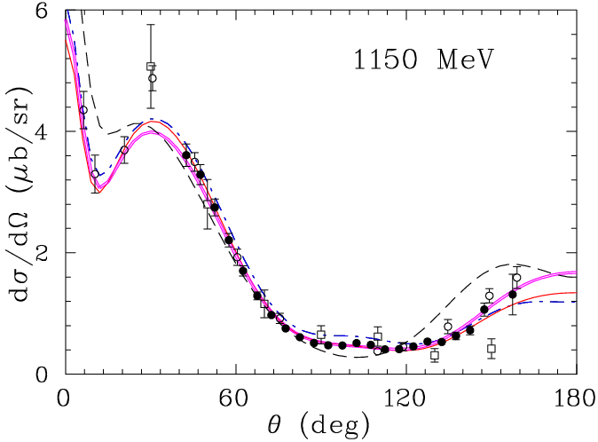
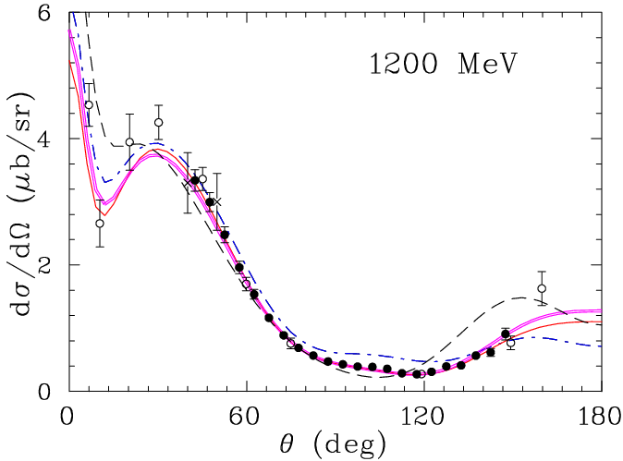
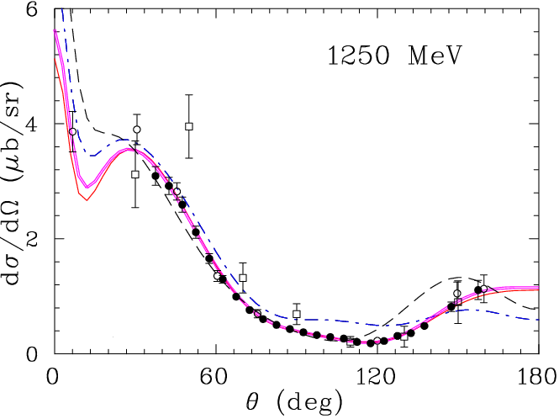
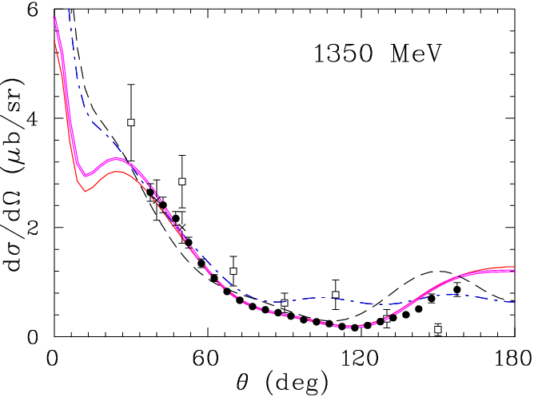
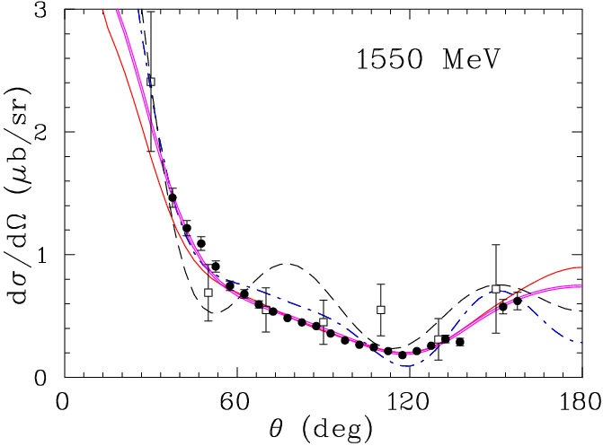
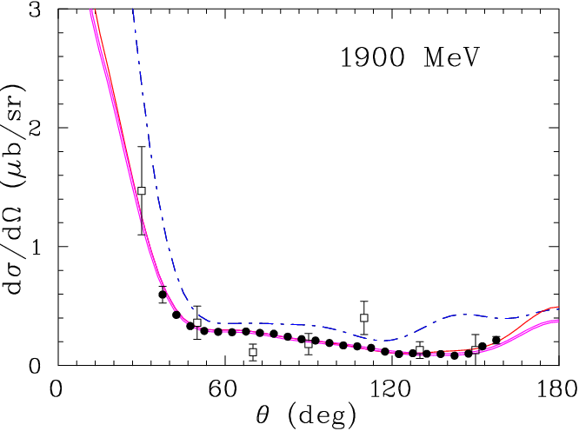
CLAS data vs previous Brem Measurements
[W. Chen, et al, arXiv:1203.4412 [hep-ph]
• Principal π⁻ experiments below 1 GeV were done at Meson Factories: LAMPF, TRIUMF, & PSI
• − CLAS
o − SLAC
Ÿ − DESY
x − Yerevan
GB12
• Previous measurements used a modified Glauber approach and the procedure of unfolding the Fermi motion of the `neutron’ target.
.
GZ12
SN11
MAID07
ATHOS2012, Camogli, Italy, June 2012

Slide 21
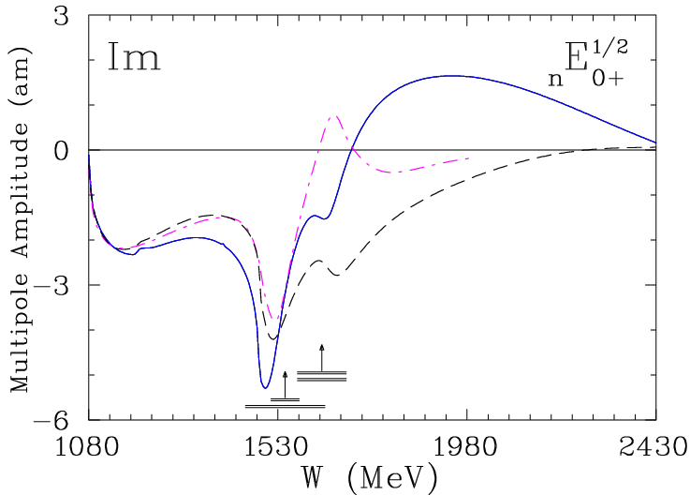
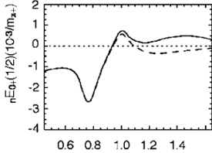
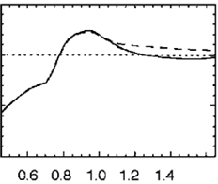
E₀+ Neutron Multipole
[R. Workman, et al , Phys Rev C 85, 025201 (2012)]
No new CLAS
π⁻p dσ/dΩ
[R. Di Salvo, et al ,Eur Phys J A 42, 151 (2009)]
MAID07
SN11
MAID07
Im
Modified
MAID07
SP09
• The difference
between
SN11 & SP09 is
visible above
E = 400 MeV
• Modified MAID07
is different above
E = 1000 MeV
Re
S₁₁
η−cusp is more pronounced for SN11
BW for πN SP06
ATHOS2012, Camogli, Italy, June 2012

