Slide 1
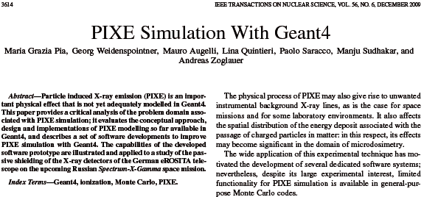
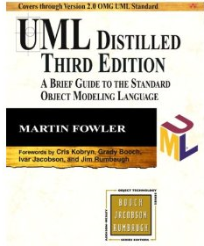
IEEE TNS, vol. 56, no. 6, pp. 3614-3649, Dec. 2009
Max-Planck-Institut für extraterrestrische Physik and Halbleiterlabor, Germany
Space Sciences Lab., UC Berkeley, USA
CNES, Toulouse, France
INFN Genova and INFN LNF, Italy
Developed in response to requirements of the experimental community
(existing) Geant4 Atomic Relaxation
+
Ionisation client
PIXE component
+
Compliant with G4VContinuousDiscreteProcess
30 March 2010: requested its release at Geant4 Technical Forum
17 June 2010: contacted for a “technical evaluation” of our code
too late for June 2010 Geant4 9.4-beta release
28 June 2010: we provided material for evaluation and clarifications
RD44 made the whole Geant4 in 4 years
In September 2010 we are still talking about releasing code
developed, validated and used in real-life in 2008,
needed by experimentalists (who invested resources into its development)

Slide 2
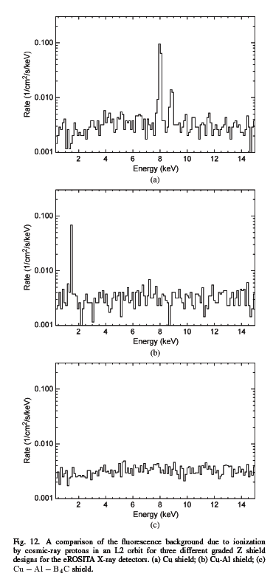
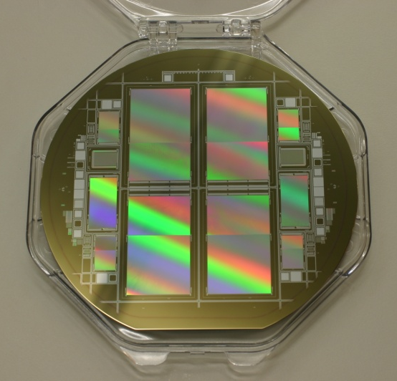
eROSITA PIXE application
Software applied to a real-life problem
Astronomical X-ray full-sky survey mission eROSITA
on-board the Spectrum-X-Gamma space mission
launch planned for end of 2012
Cu
You may want to add other experimental motivations for interest in PIXE simulation
Cu + Al
Wafer including 4 eROSITA PNCCDs
Cu + Al + B₄C
Detectors sensitive to 0.1-15 keV
Is a graded shield Cu-Al-B₄C really necessary?
Constraints for a satellite:
background noise
very limited telemetry
manufacturing effort
mass limits

Slide 3
Other developments in the meantime
Improved accuracy of XRF generation
  Resulting from significant investment in a large-scale validation project
  Geant4 accuracy compared to other Monte Carlo codes (not the best!)
New developments and large-scale validation for accurate simulation of low energy electrons
  Relevant background for future missions
  By-product: estimated accuracy of current Geant4 (not the best!)
Significant performance improvement in physics data management
We request all these developments to be released in a dedicated package (along with PIXE developments)
We also request to maintain the original “Livermore” processes and related software in future Geant4 releases
We gratefully acknowledge CERN’s support in this R&D

Slide 4
To emphasize
Significant investment of the astro-community in the whole software development process
Fruitful collaboration between experimental community and Geant4 members
  An example to follow!
Critical requirement of the astro-community
Software already in use by the astro-community (MPI-MPE etc.), need it in Geant4
  Geant4 toolkit, multiple options, the astro-community wants this one
Need high quality software for critical applications (detector shielding in space)
Outlook: further extensions/improvements related to experimental issues

