Slide 1


Conceptual challenges and computational progress in X-ray simulation
Maria Grazia Pia
INFN Genova, Italy
Maria Grazia Pia¹, Mauro Augelli², Marcia Begalli³, Chan-Hyeung Kim⁴,
Lina Quintieri⁵, Paolo Saracco¹, Hee Seo⁴, Manju Sudhakar¹,
Georg Weidenspointner⁶, Andreas Zoglauer⁷
¹ INFN Sezione di Genova, Italy – ² CNES, France
³ State University Rio de Janeiro, Brazil – ⁴ Hanyang University, Korea –
⁵ INFN Laboratori Nazionali di Frascati, Italy – ⁶ MPE and MPI Halbleiterlabor, Germany – ⁷ University of California at Berkeley, USA
SNA + MC 2010
Joint International Conference on
Supercomputing in Nuclear Applications + Monte Carlo 2010

Slide 2
X-ray simulation
Relevant to various experimental domains
  Material analysis
  Astrophysics and planetary science
  Precision dosimetry
  etc.
General purpose Monte Carlo codes regard this domain with different priorities
Significant effort invested by Geant4 into this domain since the late ‘90s
Ongoing activity by the original group that “created” Geant4 low energy electromagnetic physics
  Motivated by concrete experimental requirements
  Collaborative common effort with the experimental community
Modeling + assessment of validity and accuracy

Slide 3
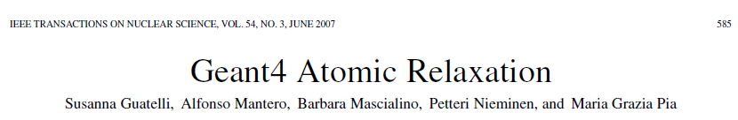
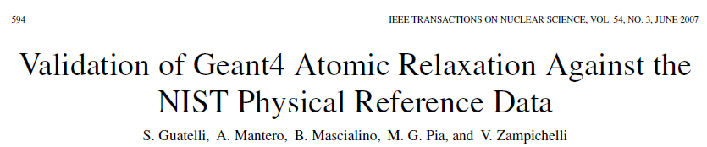
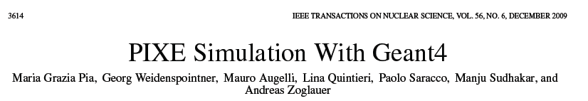
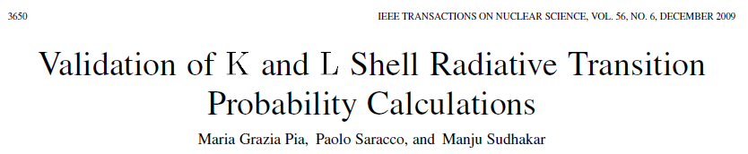
9 pages
10 pages
36 pages
12 pages
+ further ongoing activity and results

Slide 4
Geant4 X-ray fluorescence
Producing processes: photoionisation
electron impact ionisation
Data-driven
Based on EADL (Evaluated Atomic Data Library)
Geant4 X-ray fluorescence simulation is as good as EADL
(it can be worse…)
How good is EADL?

Slide 5
How good is EADL?
S. T. Perkin, et al.,Tables and Graphs of Atomic Subshell and Relaxation Data Derived from the LLNL Evaluated Atomic Data Library (EADL), Z = 1-100, UCRL-50400, Vol. 30, LLNL (1991)
“By comparing subshell parameters from a number of different sources, it can be seen that there is still a disagreement of about 1%. […]
The K and L shell radiative rates from Scofield’s calculations are accurate to about 10%. For outer subshells with transitions under 100 eV, inaccuracies of 30% would not be surprising.
Limited evidence of EADL validation in the literature
Ongoing effort
  to evaluate EADL accuracy quantitatively
  to evaluate alternative data sources
  to identify more accurate calculation methods

Slide 6
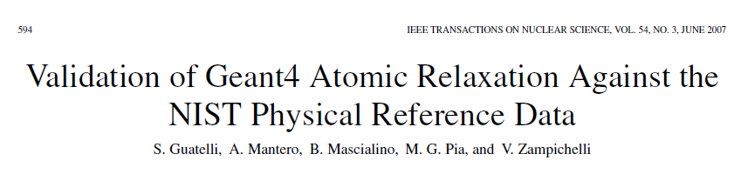
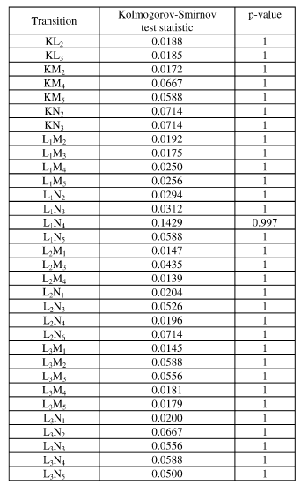
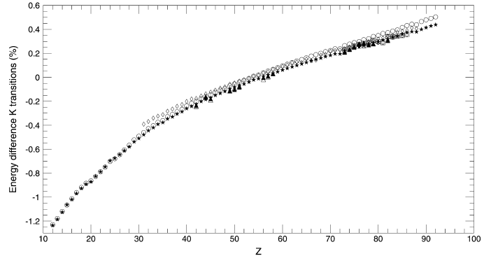
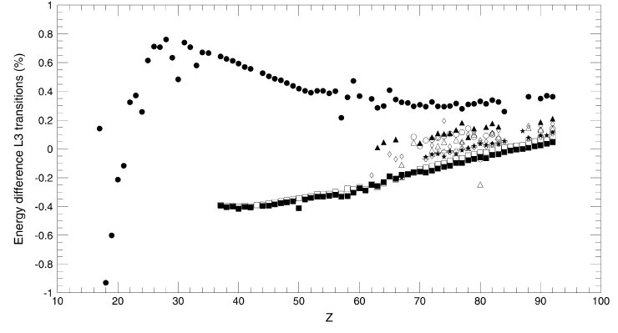
First evaluation of EADL binding energies
K, L transition energies
Goodness-of-fit test
DesLattes et al. (2003)
K shell
1%
L₃ subshell
-1%

Slide 7
All what glitters is not gold
KL₂ transition
Full set of results in a forthcoming publication

Slide 8
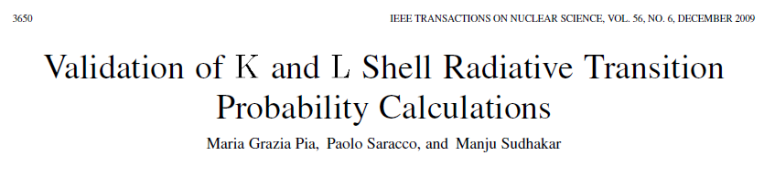
EADL radiative transition probabilities
Calculations based on Hartree-Slater method by Scofield
Calculations based on Hartree-Fock method
  Stronger theoretical background
  Some tabulations by Scofield are available in the literature
Limited and controversial documentation of their accuracy
  Rests on indirect measurements in most cases (X-ray yields)
  Mainly qualitative appraisal
Validation of both calculations w.r.t. experimental data
Salem’s bibliographical collection of experimental data
  K and L transitions
  Experimental data span several decades
  Data quality is largely variable
  Original experimental data retrieved from the literature

Slide 9
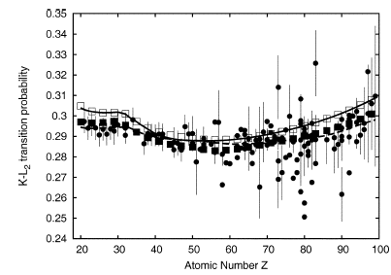
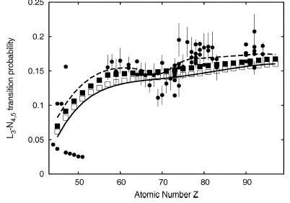
Radiative transition probabilities
KL₂
Prior (blind) evaluation of experimental data
Outliers, inconsistent measurements
L₃N_{4,5}
One can draw sound conclusions only based on rigorous statistical analysis

Slide 10
Data analysis
GoF tests of individual transition data
  χ², when experimental errors are known
  Kolmogorov-Smirnov, Anderson-Darling, Cramer- von Mises tests
Contingency table to evaluate the significance of Hartree-Slater/Hartree-Fock different accuracy
  Fisher’s exact test, χ² test with Yates continuity correction
  Distinct analyses to evaluate systematic
    Excluding/including reference transitions
    Data with/without experimental errors
Subject to comparison with experimental data
  Hartree-Slater calculations
  Hartree-Fock calculations
  EADL (nominally the same as Hartree-Slater calculations)

Slide 11
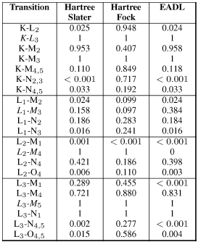
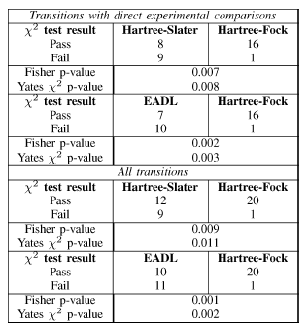
Results: radiative transition probabilities
Contingency tables
Hartree-Fock method produces significantly more accurate results

Slide 12
Foreseen activities
What is the experimental impact of EADL’s inaccuracy?
  Evaluations in concrete experimental use cases
Can we do better?
Improving EADL is far from trivial
  Are Hartree-Fock transition probabilities available for all transitions?
  Does it make any sense to mix Hartree-Slater and Hartree-Fock values?
  How do non-radiative transition probabilities affect the overall accuracy?
  Are alternative binding energy compilations adequate?
    Unresolved lines
Collaborative common effort in the Monte Carlo and experimental community would contribute to better X-ray simulation tools

Slide 13
PIXE (Particle Induced X-ray Emission)
Long-standing effort dating back to ~10 years ago to introduce PIXE simulation capabilities in a general purpose Monte Carlo system (Geant4)
PIXE: protons, α particles
  Experimental applications of IBA for elemental composition analysis
Similar process: electron impact ionisation
Conceptual similarities
  Coupling processes subject to different transport schemes in “conventional” Monte Carlo systems
    Ionisation: condensed(+discrete) transport scheme
    Atomic relaxation: discrete process
Different practical constraints
  Status of ionisation cross sections calculation is more advanced for electrons than for heavier particles

Slide 14
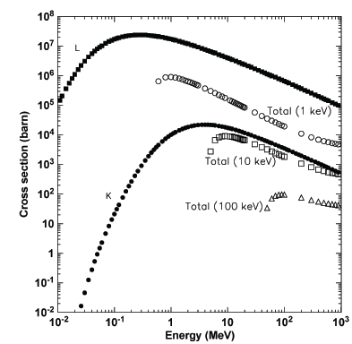
Part is bigger than whole
Si
δ-ray production cross section in Geant4
Cross section for ionizing inner shells

Slide 15
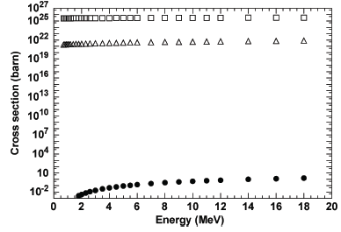
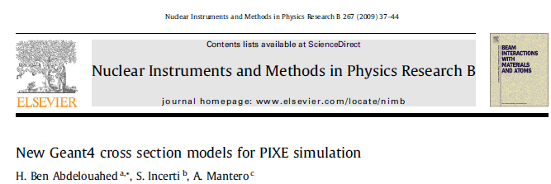
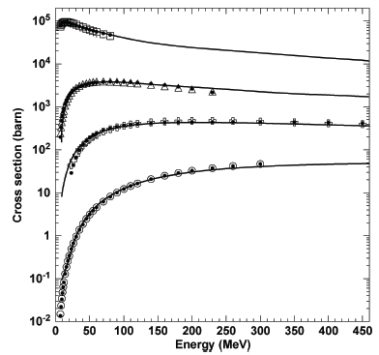
Mishaps of Geant4 PIXE…
1st development cycle
Gryzinski implementations
New low energy group’s development
K shell ionisation, Au
Paul & Sacher
Released in Geant4 9.2
Si
Cu
Several drawbacks
several flaws documented in
Pia et al., TNS 56(6), 3614-3649, 2003
(and more…)
Cd
Au
Correctly implemented empirical (Paul&Bolik) cross sections for α incorrectly documented as Paul&Sacher cross sections for p
PIXE simulation is a challenge indeed!

Slide 16
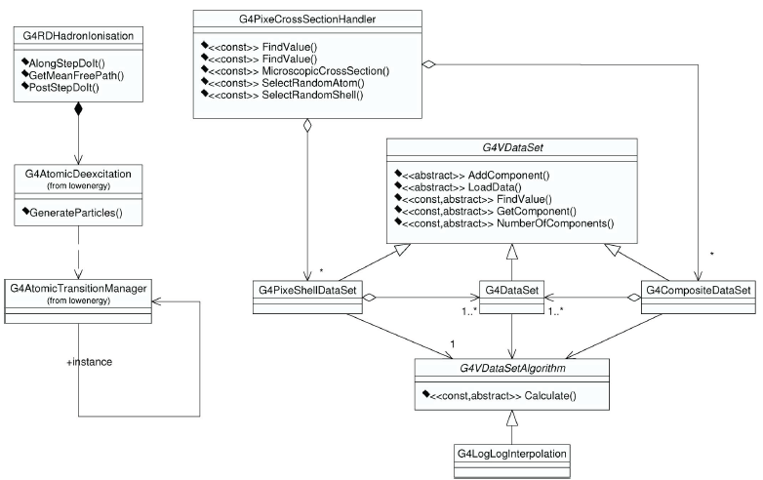
2nd development cycle
Triggered by critical experimental requirements

Slide 17
The “beast”
Critical evaluation of conceptual challenges of PIXE simulation
Wide collection of ionisation cross section models
Validation and comparative evaluation of theoretical and empirical cross sections
Final state generator (using Geant4 atomic relaxation)
Verification tests
Concrete experimental application

Slide 18
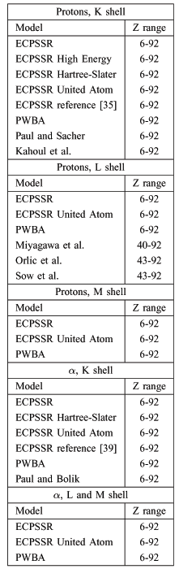
Implemented models

Slide 19
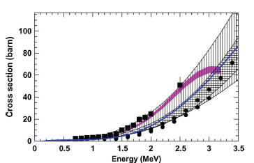
PIXE – ionization cross sections
Experimental collections for validation
C
Paul & Sacher
Orlic et al.
Sokhi and Crumpton
K
W
L₁
Small set of experimental data for high energy PIXE validation

Slide 20
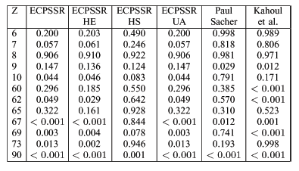
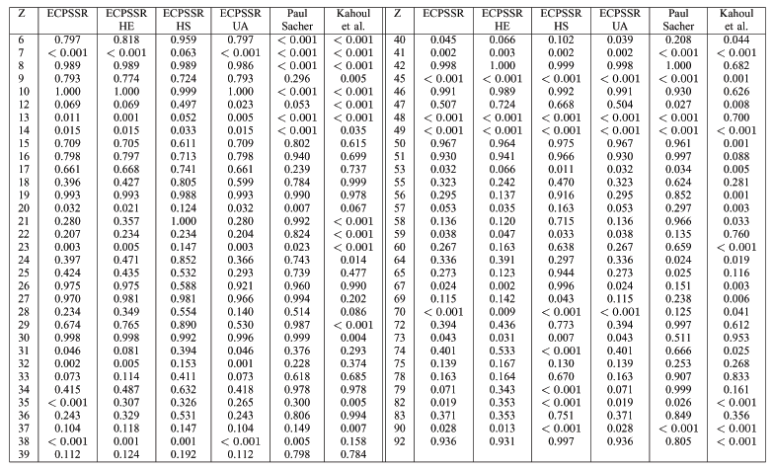
Cross section analysis
Goodness of fit tests to estimate compatibility with experimental data quantitatively

Slide 21
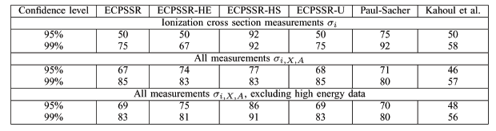
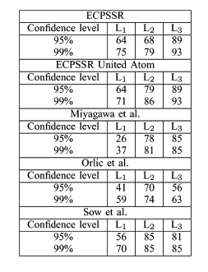
Individual model evaluation
Fraction of test cases where compatibility with experimental data has been established at a given confidence level

Slide 22
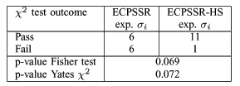
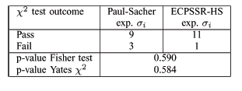
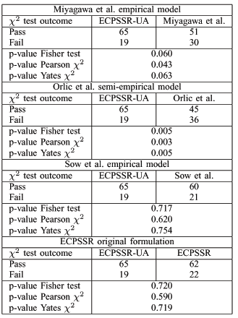
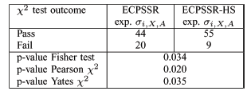
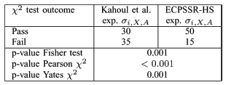
Comparative evaluation of models
Categorical analysis based on contingency tables
K shell
up to ~10 MeV
ECPSSR model with Hartree-Slater correction
at higher energies
“plain” ECPSSR model, Paul and Sacher model
L shell
ECPSSR model with “united atom” approximation

Slide 23
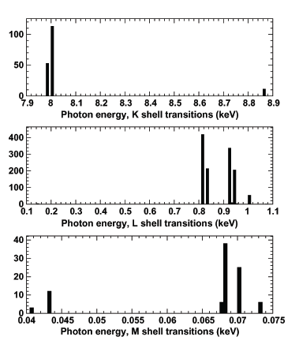
X-ray generator
Once a vacancy has been generated, Geant4 atomic relaxation is responsible for the generation of secondary X-rays (and Auger electrons)
K
L
Atomic relaxation is independent from the process which generated the vacancy
M
Results:
as good as EADL
(as bad as EADL)
X-ray generation from Cu

Slide 24
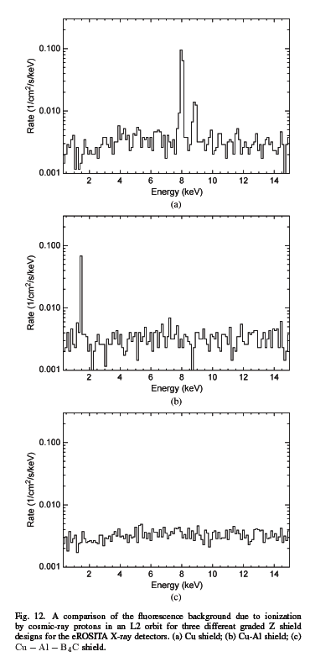
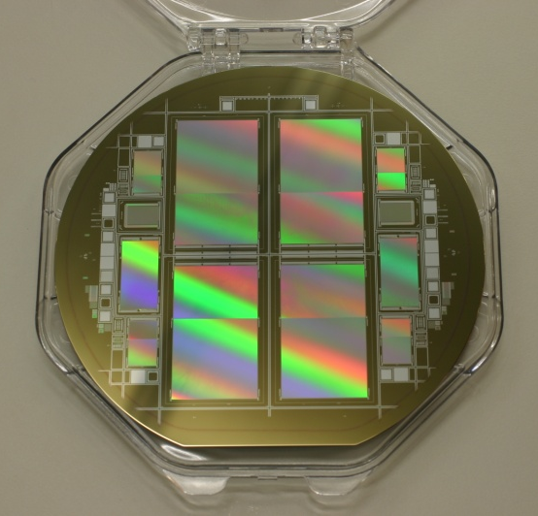
eROSITA PIXE application
Software applied to a real-life problem
Astronomical X-ray full-sky survey mission eROSITA
on-board the Spectrum-X-Gamma space mission
launch planned for end of 2012
Cu
Cu + Al
Courtesy R. Andritschke, MPI-MPE Halbleiterlabor
Wafer including 4 eROSITA PNCCDs
Cu + Al + B₄C
Detectors sensitive to 0.1-15 keV
Is a graded shield Cu-Al-B₄C really necessary?
Constraints for a satellite:
background noise
very limited telemetry
manufacturing effort
mass limits

Slide 25
Conclusions
Significant effort devoted to X-ray simulation in Geant4
Developments
  Atomic relaxation
  PIXE
  Electron impact ionisation
Validation w.r.t. experimental data
  EADL
  Cross sections
Experimental applications
  Fruitful collaboration with experimental community
  Motivation and feedback
Ongoing activities… Monte Carlo 2015!

