Slide 1


New Physics Data Libraries for Monte Carlo Transport
Maria Grazia Pia¹, Lina Quintieri^{2,} Mauro Augelli³, Steffen Hauf⁴,
Markus Kuster⁵, Mincheol Han⁶, Chan-Hyeung Kim⁶, Hee Seo⁶,
Paolo Saracco¹
¹ INFN Sezione di Genova, Italy, ² INFN Laboratori Nazionali di Frascati, Italy
³ CNES,France -⁴ Technische Universität Darmstadt, Germany, XFEL GmbH, Hamburg, Germany, ⁶Hanyang University, Korea

Slide 2
Data libraries
Compilations of evaluated theoretical or experimental data tabulations
Essential tool for Monte Carlo simulation
  Simulation results are as good as the data on which they are based
  well, sometimes they can be worse…
Largely shared across different Monte Carlo codes
Can be a powerful instrument for the community
  to study modeling systematic
  to exchange physics knowledge across Monte Carlo codes
  to facilitate the assessment of the building blocks of Monte Carlo physics models

Slide 3
Ongoing activities
See talks
On Atomic parameters N04-5
On Electron ionisation N04-3
On Data management tools N04-7
New data libraries
  Proton and α ionisation cross sections
    relevant to PIXE simulation
  Electron ionisation cross sections
Validation of existing data libraries
  EADL (Evaluated Atomic Data Library)
  EEDL (Evaluated Electron Data Library)
  ENSDF (Radioactive decay data)
Evaluation of improvements to these data libraries
Evaluation of atomic parameter compilations
  Available in the literature
Software tools for data library management

Slide 4
PIXE (Particle Induced X-ray Emission)
PIXE: protons, α particles
  X-ray emission following ionisation by heavy charged particle impact
Relevant to various experimental domains
  Material analysis
  Astrophysics and planetary science
  Precision dosimetry
  etc.
Limited consideration so far in general purpose Monte Carlo systems
Conceptually similar to electron impact ionisation
  Coupling processes subject to different transport schemes
    Ionisation: condensed (+ discrete) transport scheme
    Atomic relaxation: discrete process
Different practical constraints
  Status of ionisation cross sections calculation is more advanced for electrons than for heavier particles

Slide 5
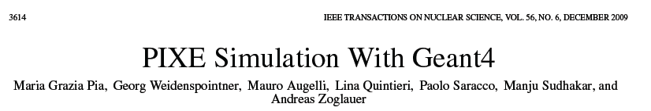
Recent scientific activity
Critical evaluation of conceptual challenges of PIXE simulation
Wide collection of ionisation cross section models
Validation and comparative evaluation of theoretical and empirical cross sections
Final state generator (using Geant4 atomic relaxation)
Verification tests of X-ray generation
Concrete experimental application
Note: software for p/α ionisation cross sections released in Geant4 9.2-9.3 is flawed
A.B. Abdelwahed, S. Incerti, A. Mantero, New Geant4 cross section models for PIXE simulation, NIM B 267 (2009) 37–44

Slide 6
Cross section models
Theoretical models
PWBA: historically 1st approach to cross section calculation
  Inadequate at low energies
ECPSSR (Brandt & Lapicki, 1981)
  “standard model” for cross section calculation
ECPSSR variants and improvements
  Hartree-Slater correction (ref., year)
  United Atom approximation
  High energy PIXE generation

Slide 7
Cross section models
Empirical models
Based on fits to experimental data
K-shell ionisation
  Paul & Sacher (year), proton impact
  Paul & Bolik (1993), α impact
  Kahoul et al. (2008), proton impact
L-shell ionisation (proton impact)
  Miyagawa et al. (year)
  Orlic et al.
  Sow et al.

Slide 8
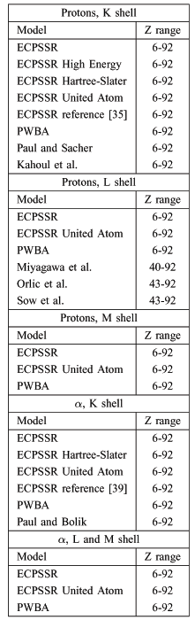
Cross section models
Implemented for PIXE simulation with Geant4
Tabulations released as a data library

Slide 9
Origin of tabulations
ECPSSR
  Tabulated by means of ISICS code (ref. Liu & Cipolla)
  Freely available through CPC Software Library
  Improved version of ISICS obtained directly from S. Cipolla (thank you!)
    Including recent developments for high energy PIXE (Lapicki 2008)
Paul & Sacher, Paul & Bolik
  Published in At. Data Nucl. Data Tables
  H. Paul’s web site: http://www.exphys.jku.at/K-shells/
Other empirical cross section models
  We developed ad hoc software to tabulate cross sections based on fitting functions documented in the literature

Slide 10
Comparison of cross section models
The various cross section models exhibit different behaviour
Subject to comparison with experimental data to assess their validity and accuracy
The data library is complemented by quantitative validation of its content
Example: K shell ionization by proton impact on Cu

Slide 11
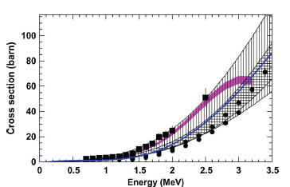
Cross section validation
Experimental collections for validation
Paul & Sacher Orlic et al. Sokhi and Crumpton
Small set of experimental data for high energy PIXE validation
C target
W target
K shell
L₁ shell

Slide 12
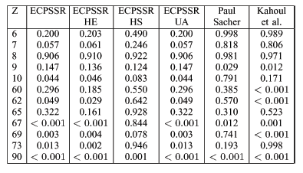
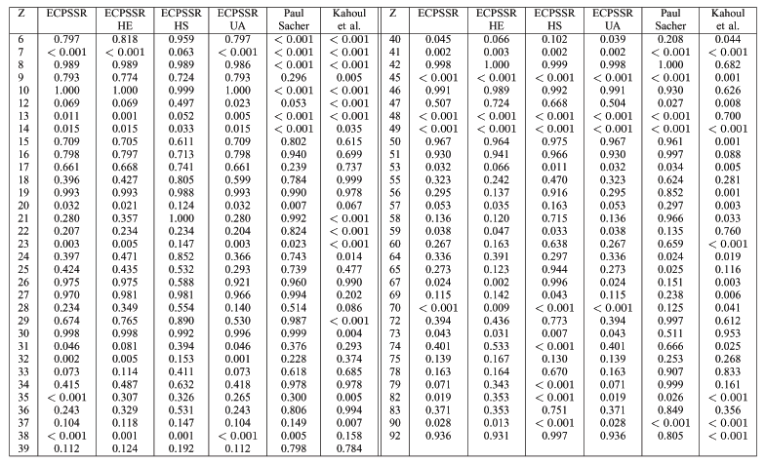
Cross section analysis
Goodness of fit tests to estimate compatibility with experimental data quantitatively

Slide 13
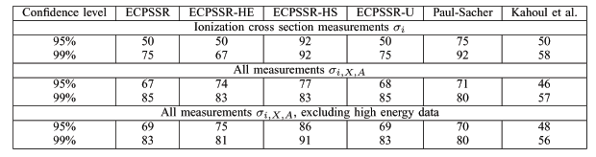
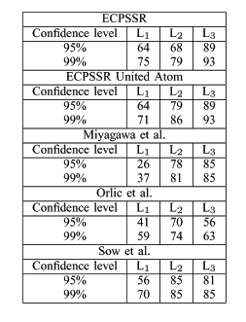
Individual model evaluation
Fraction of test cases where compatibility with experimental data has been established at a given confidence level

Slide 14
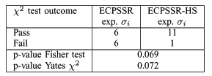
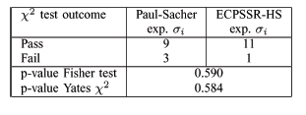
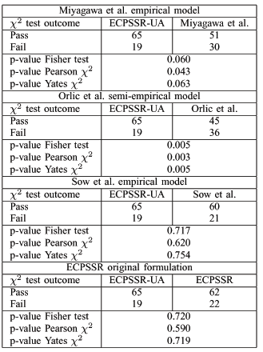
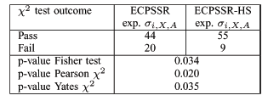
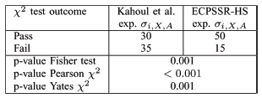
Comparative evaluation of models
Categorical analysis based on contingency tables
K shell
up to ~10 MeV
ECPSSR model with Hartree-Slater correction
at higher energies
“plain” ECPSSR model, Paul and Sacher model
L shell
ECPSSR model with “united atom” approximation
More details in the paper

Slide 15
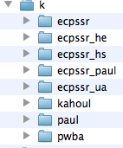
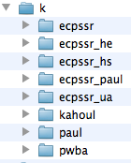
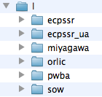


New data library for proton/α ionisation cross sections
proton
PIXE Data Library
alpha
For all elements
k
l
m
k
l
m

Slide 16
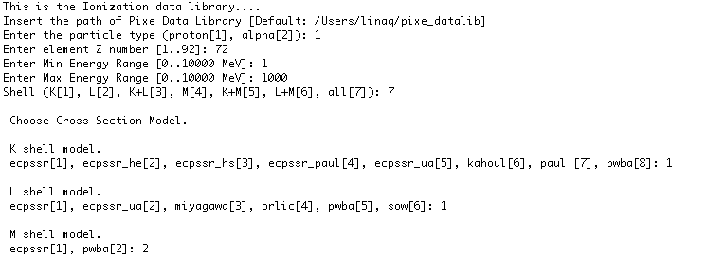
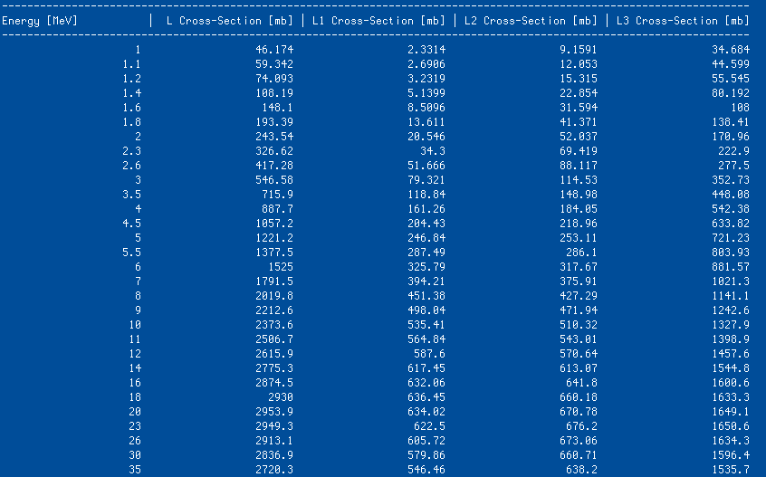
Ionxsec code
Ionxsec: C++ code for printout and explain how to access the data
Snapshot of printout of M cross sections

Slide 17
PIXE DL documentation
All information on data library: applicability, scope, validation of data etc have been extensively documented, according
ORNL_RSICC standard for public distribution
All the required material and documentation have been submitted to RSICC
28 October 2010 !!
This is the first public data library providing a wide collection of proton/alpha ionisation
Cross section.
GUPIX database is non public available
RSICC’s collaboration is kindly acknowledged

Slide 18
New data library for electron ionisation cross sections
New data library in progress
Electron impact ionisation cross sections at low energies (<1 keV)
  For all elements: Z=1-100
Tabulations of total, single ionisation cross sections
  Binary-Encounter-Bethe (BEB) model
  Deutsch-Märk (DM) model
  Same energy binning as EEDL
Further extensions foreseen at a later stage
  Cross sections for individual shells
  Multiple ionization

Slide 19
Quality of tabulated data
Supported by extensive experimental validation
  Same validation method as for PIXE data library: individual GoF tests + contingency tables
  181 experimental data sets for 57 elements
Comparison with EEDL tabulations for E < 1 keV
Further details in
  N04-3: Low Energy Electrons and Photons: Design, development and validation of electron ionisation models for nano-scale simulation
  Paper in preparation
Example of data library values
compared to EEDL and Penelope electron impact cross sections

Slide 20
By-product of the validation of the new data library
% elements for which EEDL is compatible at 95% CL
with at least one data set
First validation of EEDL
ionisation cross sections
below 1 keV
DM model is more accurate than EEDL
below 1 keV

Slide 21
EADL Evaluated Atomic Data Library
To date, the most complete collection of atomic parameters relevant to Monte Carlo transport
For Z = 1-100, all subshells:
Subshell data
  Number of electrons
  Binding and kinetic energies
  Average radius
  Level widths
  Average number and energies of released electrons and X-rays
  Average energy left to residual atom
Radiative and non-radiative transition probabilities
S. T. Perkin, et al.,Tables and Graphs of Atomic Subshell and Relaxation Data Derived from the LLNL Evaluated Atomic Data Library (EADL), Z = 1-100, UCRL-50400, Vol. 30, LLNL (1991)
See talk of S.Hauf et al N44-3

Slide 22
EADL improvement
The current version of EADL dates back to 1991
It would profit from some rejuvenation
State-of-the-art binding energies
  Other data collections exhibit better accuracy w.r.t. experimental data
  Are they complete?
  What effect on other electromagnetic calculations?
State-of-the-art radiative transition probabilities
  Based on Hartree-Fock calculations
  We could retrieve Hartree-Fock calculations in the literature only for a small set of transitions
  Are further theoretical calculations needed?
V&V prior to release

Slide 23
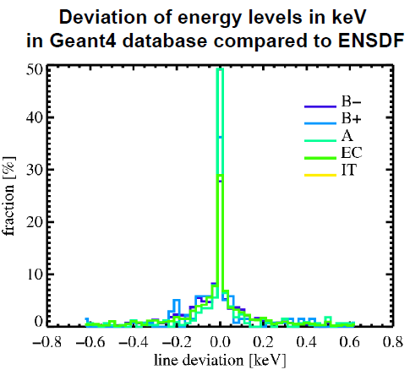
Review of radioactive decay data
ENSDF Evaluated Nuclear Structure Data Files
  half lives
  decay branches
  energy levels and level intensities
of the decaying nucleus
The current database used by Geant4 does not include references to the origin of the individual datasets or their actuality
Work in progress to compare Geant4 radioactive decay datasets and the current version of ENSDF
Further experimental activity to validate the results
Further details in F4: Monte Carlo Applications III (Others)
Radioactive decay simulation with Geant4: experimental benchmarks and developments for X-ray astronomy applications

Slide 24
Conclusions
Significant investment in
  validating
  Improving
  creating
physics data libraries for Monte Carlo simulatio
The Monte Carlo community would profit from a collaborative common effort
  to review existing data libraries
  to create new data libraries, to facilitate exchanges of physics models across Monte Carlo codes

