Slide 1

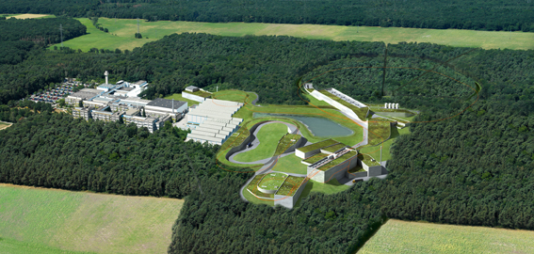

PHYSICS @
The FAIR project
The Antiproton Physics Program

Slide 2
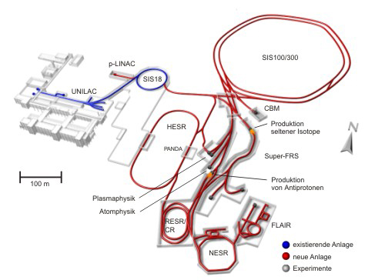
FAIR Facility
Primary Beams
²³⁸U²⁸⁺ 1.5 GeV/u; 10¹²/s ions/pulse
30 GeV protons; 2.5x10¹³/s
²³⁸U⁷³⁺ up to 25 (- 35) GeV/u 10¹⁰/s
Antiproton production
Linac: 50MeV H-
SIS18: 5∙10¹² protons / cycle
SIS100: 2-2.5∙10¹³ protons / cycle
Production target: 29 GeV protons
bunch compressed to 50nsec
2∙10⁷/s (7∙10¹⁰/h) antiprotons
Secondary Beams
Broad range of radioactive beams up to
1.5 - 2 GeV/u
Antiprotons 3 (0) - 30 GeV

Slide 3
HESR - High Energy Antiproton ring
For commissioning protons can be injected from:
• RESR at reversed field polarities
• SIS 18 at 12.7 Tm with same field polarity, but opposite direction
Experiment Mode | High Resolution Mode | High Luminosity Mode
Target | Pellet Target with 4∙10¹⁵ cm⁻²
rms-emittance | 1 mm mrad
Momentum range | 1.5 – 8.9 GeV/c | 1.5 – 15.0 GeV/c
Intensity | 1∙10¹⁰ p | 1∙10¹¹ p
Luminosity | 2∙10³¹cm⁻²s⁻¹ | 2∙10³²cm⁻²s⁻¹
rms-momentum resolution | 10⁻⁵ | 10⁻⁴
Internal Target
H₂ (ρ=0.08 g/cm²)
p
d = 1 mm
from RESR
The p -beam is injected from RESR at 3.8 GeV/c

Slide 4

PANDA playground
p Momentum [GeV/c]
Meson spectroscopy
  light mesons
  charmonium
  exotic states
    glueballs
    hybrids
    molecules/multiquarks
  open charm
Baryon/antibaryon production
Charm in nuclei
Strangeness physics
  Hyperatoms
  S = -2 nuclear system
    Ξ⁻ nuclei
    ΛΛ hyepernuclei
e.m. processes
0
2
4
6
8
10
12
15
ΛΛ
ΣΣ
ΞΞ
ΩΩ
DD
Λ_{c}Λ_{c}
Σ_{c}Σ_{c}
Ξ_{c}Ξ_{c}
Ω_{c}Ω_{c}
D_{s}D_{s}
qqqq
ccqq
nng,ssg
ccg
nng,ssg
ccg
ggg,gg
ggg
light qq
π,ρ,ω,f₂,K,K*
cc
J/ψ, η_{c}, χ_{cJ}
1
2
3
4
5
6
Mass [GeV/c²]

Slide 5
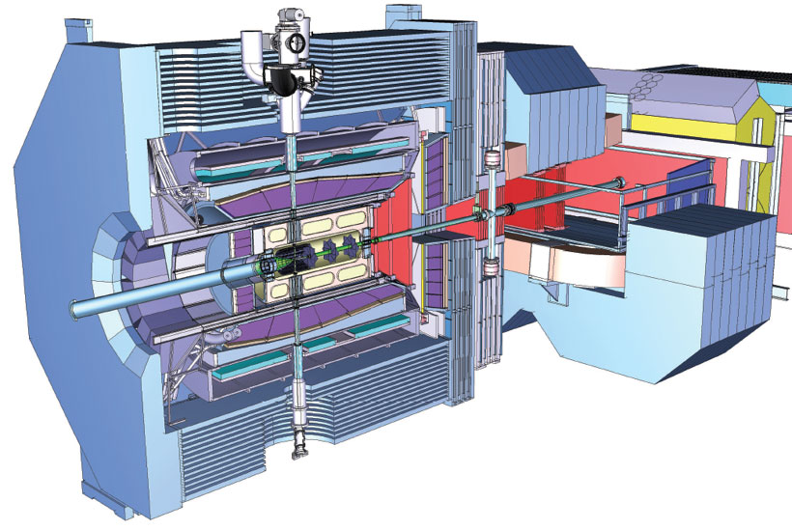
PANDA Scientific program
Charmonium/Open Charm States
  Precise Spectroscopy
  Investigation of Confinement Potential
  X, Y, Z, D_{sJ} States up to 5.5 GeV
Exotic Matter
  Search for Glueballs and Hybrids
Hadrons in Media
  In-medium Modification of Hadrons
Nucleon-Structure
  Generalized Parton Distributions
  Timelike Form Factor of the Proton
  Drell-Yan Processes
Double-Strange Systems
  Ξ-atoms and Nuclei
  ΛΛ-hypernuclei

Slide 6
Experimental Techniques
e⁺e⁻ collisions
direct formation
two-photon production
initial state radiation (ISR)
B meson decay
(BaBar, Belle, BES, CLEO(-c), LEP ...)
+ low hadronic background
+ high discovery potential
− direct formation limited to vector states
− limited mass and width resolution
for non vector states
pp annihiliation
(LEAR, Fermilab E760/E835, PANDA)
− high hadronic background
+ high discovery potential
+ direct formation for all (non-exotic) states
+ excellent mass and width
resolution for all states
Hadroproduction
(CDF, D0, LHC)
Electroproduction
(HERA)

Slide 7
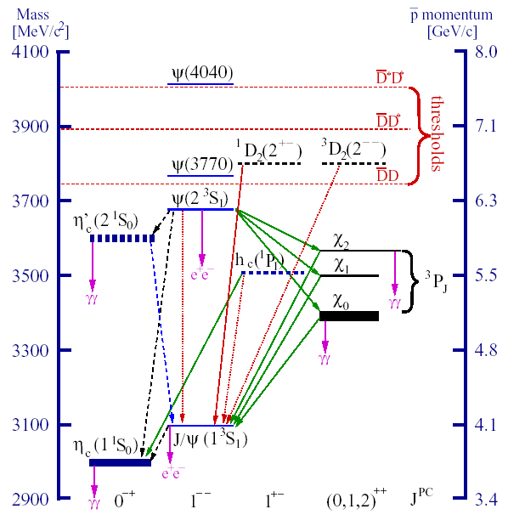
Charmonium spectroscopy
Charmonium spectrum
is nowadays more clear…
new precise measurements
of η_{c} mass
η’_{c} unambiguously
seen. Width 14±7 keV
h_{1c} seen but in only one channel
Open questions…
States above DD thr.
are not well established

Slide 8
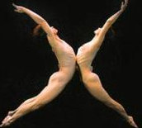

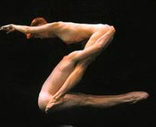
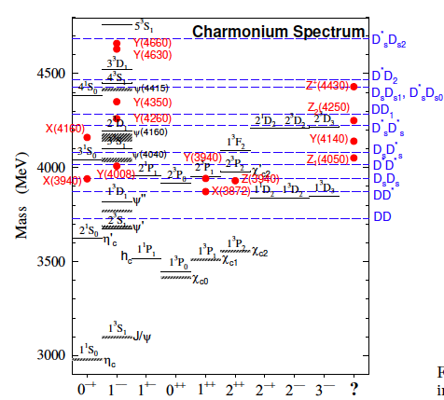
Mesons
Without entering into the details of each state some general consideration can be drawn.
masses are barely known;
often widths are just upper limits;
few final states have been studied;
statistics are poor;
quantum number assignment is possible for few states;
some resonances need confirmation…
There are problems of compatibility Theory - Experiment
Arxiv:09010.3409v2 [hep-th]

Slide 9
OpenCharm states
For the states c(u/d) theory and experiment were in agreement.
The quark model describes the spectrum of heavy-light systems and it was expected to be able to predict unobserved excited D_{S}(cs) mesons with good accuracy
D_{SJ}(3040)
D_{S}(2860)
D_{S}(2710)
D_{S2}
D_{S1}
D_{S}(2460)
The discovery of the new D_{SJ} states has brought into question potential models
D_{S}(2317)
*
D_{S}
Nowadays, there is a problem to reconcile Theory and Experimental results
D_{S}

Slide 10
Charmonium spectroscopy
e⁺e⁻ → ψ’
→ γχ_{1,2}
p p→ χ_{1,2}
→ γγJ/ψ
→ γJ/ψ
→ γγe⁺e⁻
→ γe⁺e⁻
e⁺e⁻ interactions:
  - Only 1⁻⁻ states are formed
  Other states only by secondary
  decays (moderate mass resolution)
100
CBall
E835
χ_{c1}
1000
CBall ev./2 MeV
pp reactions:
E 835 ev./pb
  All states directly formed
  (very good mass resolution)
3500
3510
3520 MeV
E_{CM}
Br(pp → η_{c}) = 1.2 10⁻³
Br(e⁺e⁻ → ψ) ·Br(ψ → γη_{c}) = 2.5 10⁻⁵

Slide 11
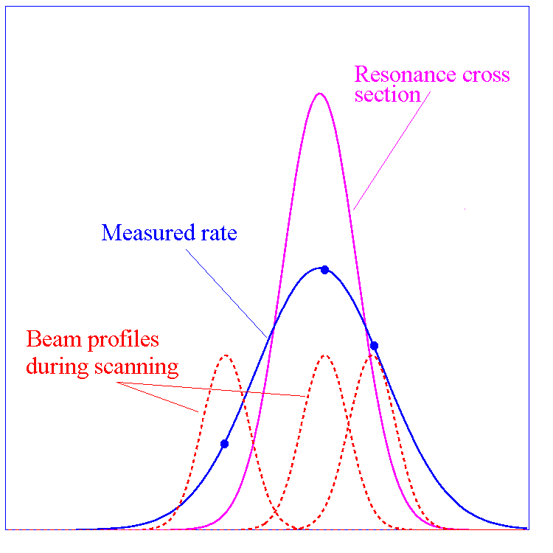
Charmonium spectroscopy
The cross section for the process:
pp→cc→final state
is given by the Breit-Wigner formula:
The production rate ν is a convolution of the
BW cross section and the beam energy distribution function f(E,ΔE):
The resonance mass M_{R}, total width Γ_{R} and product of branching ratios
into the initial and final state B_{in}B_{out} can be extracted by measuring the
formation rate for that resonance as a function of the cm energy E.

Slide 12

What PANDA can do for charmonium physics?
States below DD threshold
  The study of the h_{c} remains of very high priority. The width can be determined precisely with an energy scan of the resonance
  The study of the η′_{c} is just started. Small splitting from the ψ′ have to be understood. Width and decay modes must be measured.
The energy region above open charm threshold is the most interesting for the future and will have to be explored in great detail:
  find all missing states, measure their properties.
  explain nature of existing states (X(3872), Y(3940) ...)
  study radiative and strong decays, e.g. ψ(4040)→D*D* and ψ(4160)→D*D* , multi amplitude modes which can test the mechanisms of the open-charm decay.

Slide 13
What PANDA can do for charmonium physics?
At 2×10³²cm⁻²s⁻¹ accumulate 8 pb⁻¹/day (assuming 50 % overall efficiency) ⇒ 10⁴÷10⁷ (cc) states/day.
Total integrated luminosity 1.5 fb⁻¹/year (at 2×10³²cm⁻²s⁻¹, assuming 6 months/year data taking).
Improvements with respect to Fermilab E760/E835:
  Up to ten times higher instantaneous luminosity.
  Better beam momentum resolution Δp/p = 10⁻⁵ (FAIR) vs 2×10⁻⁴ (FNAL)
  Better detector (higher angular coverage, magnetic field, ability to detect hadronic decay modes).

Slide 14
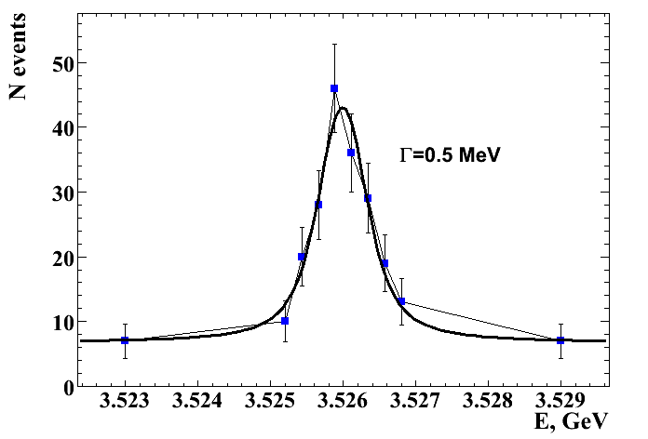
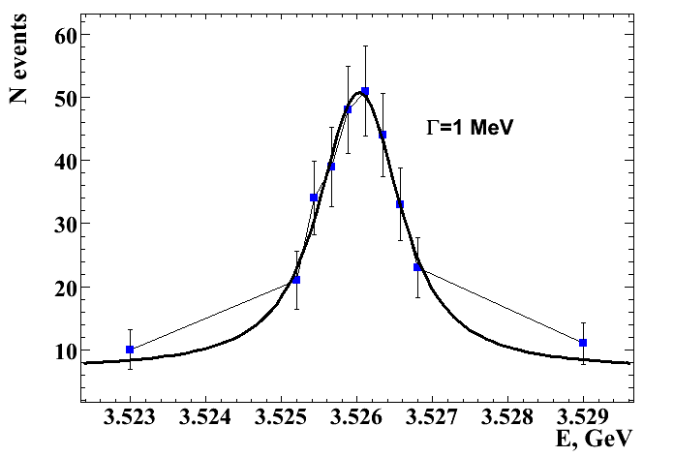
Charmonium states width
Thanks to the precise HESR momentum definition, widths of known states can be precisely measured with an energy scan.
Energy scan of 10 values around the h_{c} mass, width upper limit is 1MeV;
each point represents a 5 day data taking in high luminosity mode, module 5 available, for the channel: h_{c}⟶η_{c}γ⟶φφγ⟶4Kγ
with a S/B 8:1
This holds for all known states in the charmonium region
δp/p 10⁻⁴ ⟶ Γ 100 KeV
δp/p 10⁻⁵ ⟶ Γ 10 KeV
Γ _{R,MC}[MeV] | Γ _{R,reco}[MeV] | ΔΓ_{R}[MeV]
1 | 0.92 | 0.24
0.75 | 0.72 | 0.18
0.5 | 0.52 | 0.14
Sensitivity

Slide 15

The X(3872) state
A charmonium(-like) state found in e⁺ e⁻
X(3872) → J/ψ π⁺π⁻
e⁻
J/ψ
X
Not found in formation in e⁺e⁻ collision
→ Not J^{PC} = 1⁻⁻
Observation of decay into J/ψ γ
→ C=+1
Mass of X(3872) → D⁰D*⁰ shifted by ~3 MeV/c²
→ S-wave molecular state?
Width is unknown lower limit Γ < 2.3 MeV/c² (Belle)
Helicity amplitude analysis from CDF
→ E.g. J^{PC} = 1⁺⁺ or 2⁻⁺
γ∗
π
e⁺
π
p
c
p
c
0⁺⁺, 1⁺⁺ 2++
(L=0)
0⁻⁺, 2⁻⁺
(L=1)
3 gluons: 1⁻⁻, 1⁺⁻
2 gluons:
p
c
p
c
Quantum numbers can be determined by studying angular distributions

Slide 16
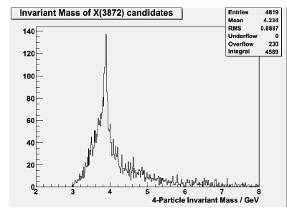
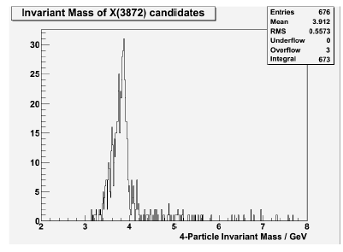
X(3872) → J/ψ π⁺π⁻ simulation
4-particle invariant mass
Formation
Either neutral and charged pions!
It is interesting to check breaks isospin in the decays
J/ψρ(->π⁺ π⁻), J/ψω(->π⁺ π⁻ π⁰)
→ is it charmonium?
Simulation at √s = 3872 MeV/c²
p_{beam}=6.99100 GeV/c
Baseline assumption: σ_{peak} = 50 nb
J/ψ → e⁺e⁻ or μ⁺μ⁻
Selection of inv. J/ψ-mass
Combination with π⁺π⁻
Efficiency: 72%
RMS: 8.3 MeV/c²
S/B: 2
p
J/ψ
π
X(3872)
p
X
π
with
PID
Notes:
J/psi pi0 pi0 è un canale unico per PANDA

Slide 17
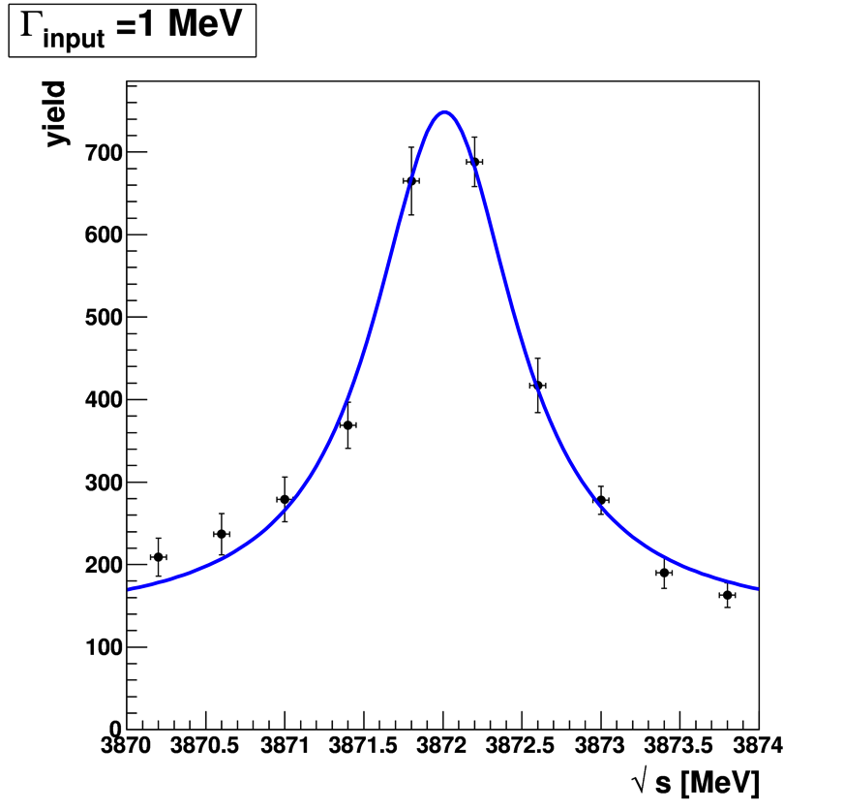
Measurement of X(3872) width
m = 3872.01 ± 0.03 MeV/c²
Γ = 1.11 ± 0.08 MeV/c²
→ Unfolding beam profile
(Δp/p = 3 · 10⁻⁵)
Mass resolution ~ 50 keV/c²
Width precision ~ 10%
each data point 2 days data taking
10 steps a 400 keV/c²
3870.2 – 3873.8 MeV/c²
Δp/p = 3 · 10⁻⁵

Slide 18
Heavy-light D_{sJ} systems
Up to now the widths of the new discovered D_{sJ} state are only constrained by upper limits of few MeV due to detector resolution.
the p momentum spread in the HESR is sufficiently small to allow the measurement of the D_{sJ} widths in a threshold scan of the reaction
pp → D_{s} D_{sJ}
Fit of the excitation function obtained from the reconstructed signal events

Slide 19
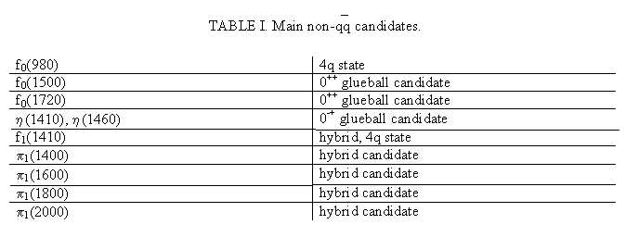
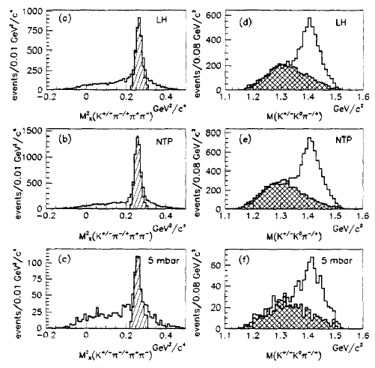
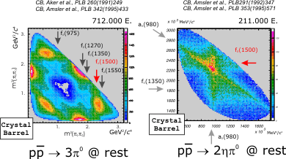
Exotic hadrons
In the light meson region, about 10 states have been classified as “Exotics”. Almost all of them have been seen in pp…
OBELIX
A.Bertin et al.,Physics Letters B361, (1995), 187.
Crystal Barrel
A.Bertin et al.,Physics Letters B385, (1996), 493.
A.Bertin et al.,Physics Letters B400, (1997), 226.
F.Nichitiu et al.,Physics Letters B545, (2002), 261.

Slide 20
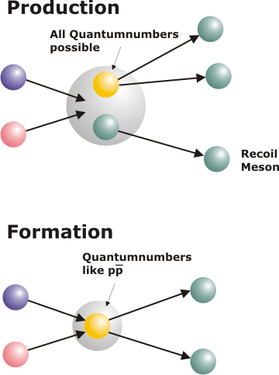
Spectroscopy with antiprotons
Two are the mechanisms to access particular final states:
p
G
p
H
p
H
Production
_
_
_
p
M
p
M
p
M
all J^{PC} available
Even exotic quantum numbers
can be reached σ ~100 pb
Exotic states are produced with rates similar to qq
conventional systems
All ordinary quantum numbers
can be reached σ ~1 μb
Formation
p
p
p
_
G
_
H
_
H
p
p
p
only selected J^{PC}

Slide 21
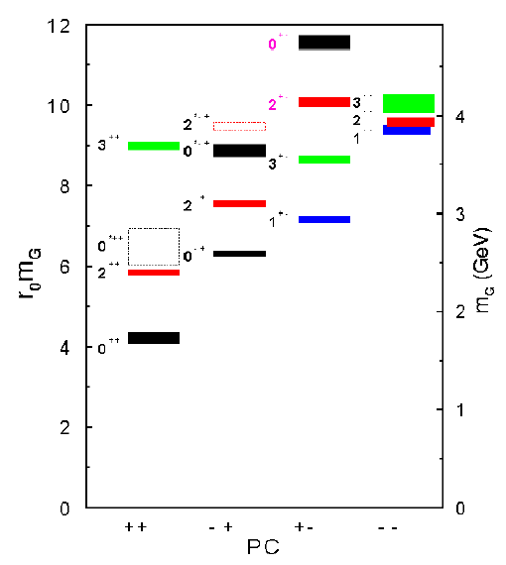
Glueballs
Light gg/ggg-systems are
complicated to be identified
Oddballs:exotic heavy glueballs
  m(0+-) = 4740(50)(200) MeV
  m(2+-) = 4340(70)(230) MeV
Glueballs decays most favourable to PANDA are:
  ΦΦ or Φη if mass < 3.6 GeV/c²
  J/ψη or J/ψΦ if mass > 3.6 GeV/c²
  heavy oddballs (4-5GeV/c²) DD*η/π⁰,
Same run period as hybrids
Morningstar und Peardon, PRD60 (1999) 034509

Slide 22
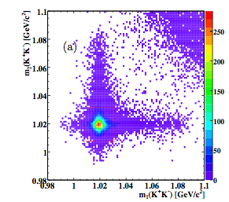
pp → f₂(2000-2500)→ φφ
The primary goal of this study is to test our capability of reconstructing φφ final states which are expected to be good for exotics (glueball) searching.
This is the region where the BES experiment found an evidence for a tensor (J^{PC} = 2⁺⁺) glueball candidate ξ(2230).
The detection of a possible resonant signal require an energy scan around the central energy value in order to measure the dynamic behavior of the cross-section.
The analysis consists in 3 steps:
reconstruction of the signal;
evaluation of the background level;
simulation of the energy scan.
We generated 50 •10³ signal events and 10⁶
bck events.
4C fit: efficiency 25%

Slide 23
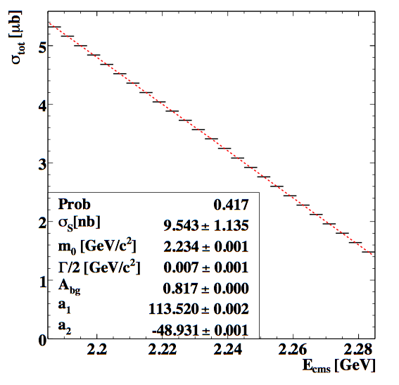
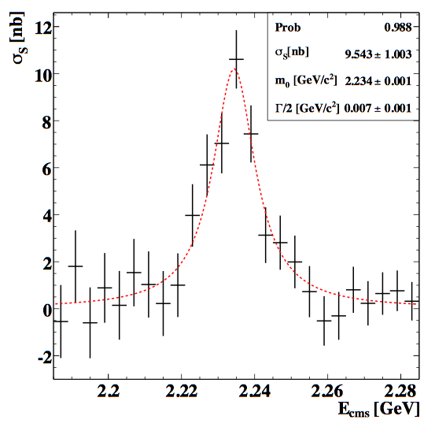
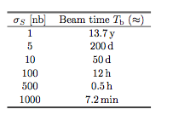
f₂(2235) energy scan
We made the assumption of a mass value of 2235 MeV/c² and a widths
of 15 MeV/c²
Fit of the total cross section and the derived signal cross-section
For a scan width of 10 nb
Needed beam time to achieve
a 10σ significance

Slide 24
QCD dynamics
In the quark picture hyperon pair production either involves the creation of a quark-antiquark pair or the knock out of such pairs out of the nucleon sea.
Hence, the iimportance of quark degrees of freedom with respect to the hadronic ones can be studied by measuring the reactions of the type pp →YY

Slide 25
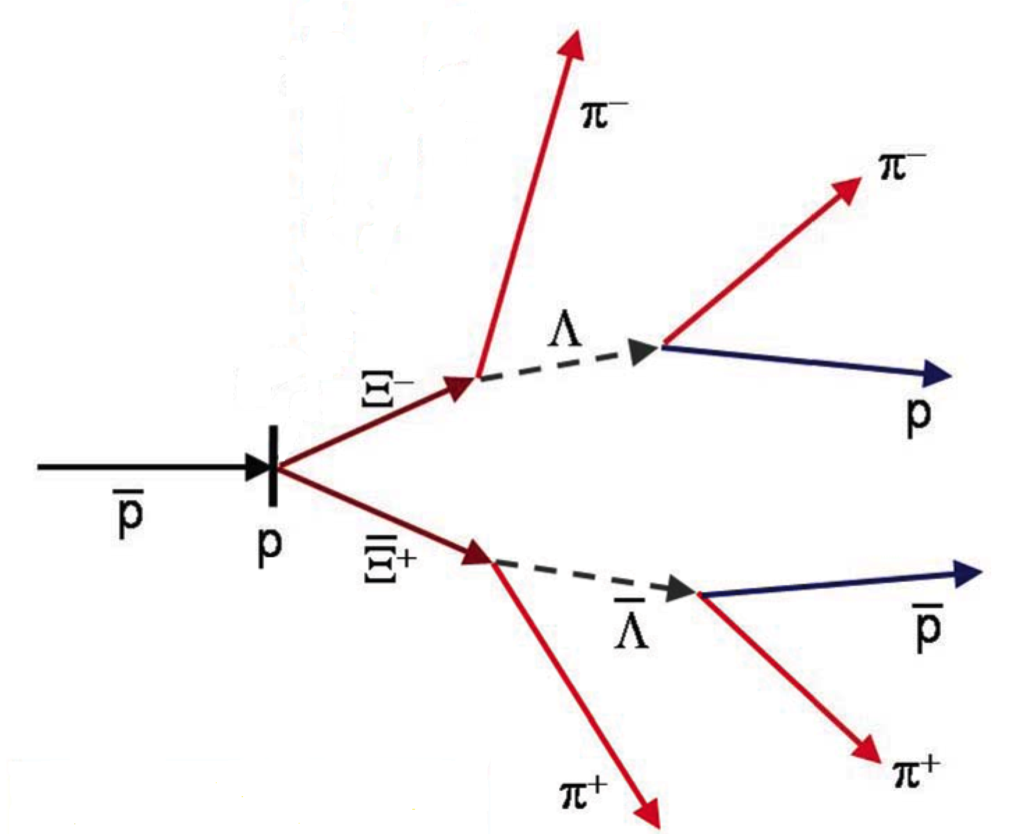
QCD dynamics
The experimental data set available is far from being complete. All strange hyperons and single charmed hyperons are energetically accessible in pp collisions at PANDA.
In PANDA pp → ΛΛ, ΛΞ, ΛΞ, ΞΞ , ΣΣ, ΩΩ, Λ_{c}Λ_{c}, Σ_{c}Σ_{c}, Ω_{c}Ω_{c}
can be produced allowing the study of the dependences on spin observables.
By comparing several reactions involving different quark flavours the OZI rule and its possible violation, can be tested

Slide 26
Double Strange Systems (DDS)
3 different systems containing double strangeness (S=-2)
Ξ⁻ hypernuclei:
n
p
Ξ⁻
Interaction: Ξ⁻N
p
n
From Ξ⁻hypernucleus to ΛΛ hypernucleus: Ξ⁻N-ΛΛ coupling
n
Double Λ-hypernuclei:
Λ
p
p
Λ
Interactions: Λ-Λ
n
e⁻
Exotic hyperatoms:
n
p
p
n
Interactions: Ξ⁻-nucleus: interplay between
the Coulomb and nuclear potential
Ξ⁻

Slide 27




DSS production in PANDA
π
_{bar} +N →K_{bar}+ K_{bar} +p + … [ ⁻ production tag]
1
Target
K
p
Ξ
K
N
P_{bar} +N→ Ξ⁻ + Ξ_{bar} : σ = 2 μb;
p_{bar} (3GeV/c) below π production
Ξ
Elastic scattering in nucleus:
strong slowing down (a challenge)
slowing down in matter
(with decay)
γ (28 MeV)
2Tar
get
π
Λ
⁻ N →☹☹ conversion + ☹☹ sticking
⁻ capture into atomic levels and hyperatomic cascade
Λ
Xray
Capture into nucleus: Strong and Coulomb forces
N
☹☹ decay (MWD,NMWD… )

Slide 28
Ξ⁻ rates
Ξ⁻ rates & target sizes vs bunch contents
(for different p_{bar} production, satisfying background constraints)
Stopped Ξ⁻/day(x100)
Remarks:
target sizes can be very small
thickness of 3 μm is under test
mechanical and thermal properties
to be evaluated
W_{th} ·W_{w} [μm²]
2x10⁷/s
1.5x10⁷/s
1x10⁷/s
Result: 1400 ÷ 2700 stopped Ξ⁻/day expected
At J-PARC 5800 are expected

Slide 29
Nucleon structure
In 50 years of activity eN scattering experiments succeeded in describing Nucleon structure

Slide 30
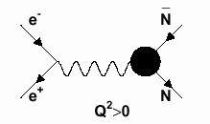
Nucleon form factor
The simplest structure function the Nucleon form-factor was considered well understood with the Rosenbluth approach (1γ exch.)
p
e⁺
e⁻
θ*
p
time-like q² >0
space-like q² <0
Most experiments could not determine |G_{M}| and |G_{E}| separately from the analysis of the angular distributions, but extracted |G_{M}| using the (arbitrary) assumption |G_{E}| = |G_{M}|.

Slide 31
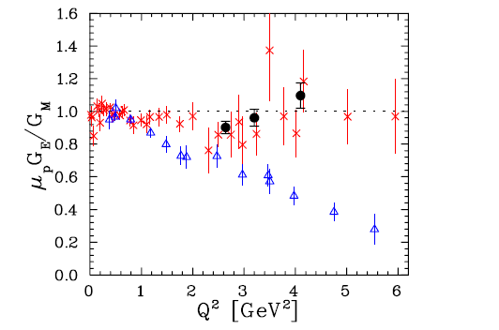
Nucleon ff in the space-like region
Data on the ratio G_{E}/G_{M} for the proton including the older Rosenbluth separation data (crosses), most recent JLab Rosenbluth separation data (filled circles),
and polarization transfer data (triangles)
New Jlab data have been obtained with the recoil polarization method
stating that:
PRL 94 142301 (2005)
The old assumption seems no more valid

Slide 32
Nucleon ff in the time-like region
|G_{E}| and |G_{M}| in the Time-Like region can be determined by the reactions
pp ↔ e⁺e⁻
Presently statistics is limited → no real separation |G_{E}|/ |G_{M}|
|G_{M}| extracted assuming |G_{E}| = |G_{M}| (true at threshold)
G_{E} in Time-Like region is today unknown
Recent data from BaBar → extraction of the ratio R = |G_{E}|/ |G_{M}| through the ISR method (e⁺e⁻ → γpp) (q²<7 (GeV/c)²)

Slide 33
PANDA plans for the ff
Separate measurement of |G_{E}| et |G_{M}|
Precisions on the ratio R=|G_{E}|/|G_{M}| and σ_{R}
  ΔR/R <1% at low Q²
  ΔR/R = 10% at Q²=10 (GeV/c)²
  Separation possible up to Q²=15 (GeV/c)²
Test of the 1 γ hypothesis (symmetry of the angular distribution)
Measure |G_{M}| up to Q²=25 (GeV/c)²

Slide 34
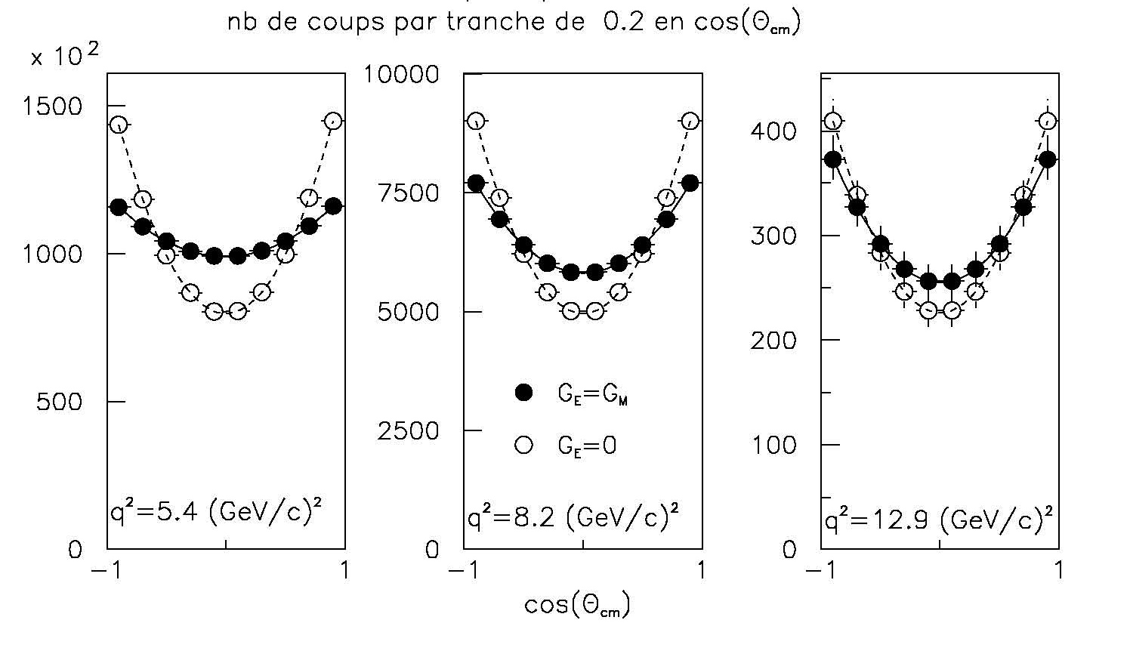
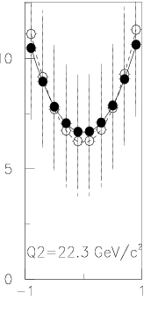
PANDA plans for the ff
~100 days, L = 2. 10³² cm⁻²s⁻¹
dσ/dΩ ∝ [ |G_{M}(q²)|²(1+cos²θ)+4m_{N}²/q² |G_{E}(q²)|² sin²θ)]
-
-
Nb of counts for pp→e⁺e⁻
Nb of counts for pp→e⁺e⁻
Nb of counts for pp→e⁺e⁻
en 10 ⁷ s
10
B. Ramstein
J. Van de Wiele
6 10⁴ counts
5
6 10⁴ counts
10⁶ counts
3000 counts
10⁶ counts
3000 counts
80 counts
Q²=22.3 (GeV/c)²
cos(θ_{cm})
R=|GE|/|GM|
cosθ
E_{lab}=1 GeV E_{lab}=2.5 GeV E_{lab}=5 GeV E_{lab}=10 GeV
s=q²=5.4 (GeV/c)² q²= 8.2 (GeV/c)² q²=12.9 (GeV/c)² q²=22.3 (GeV/c)²
N_{tot}=10⁶ N_{tot}=66000 N_{tot}=2750 N_{tot}=82
ΔR=0.6% ΔR=3% ΔR=25% ΔR= 100%

Slide 35
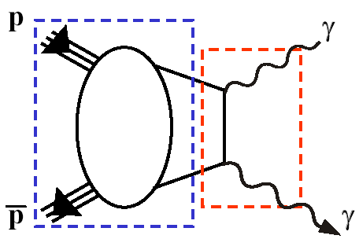
Generalized Parton Distributions
perturbative QCD
γ*
γ
Wide angle Compton scattering
factorisation into hard amplitude
(calculable in perturbative QCD)
and soft amplitude
(information on parton distributions)
H, E(x, ξ, t)
H, E(x, ξ, t)
~ ~
Identical diagram
reversed
non-perturbative QCD
Reversed Deeply Virtual Compton Scattering
pp → γγ
clear experimental signature
both baryons in ground state
σ ≈ 2.5pb @ s ≈10 GeV²
L = 2·10³² cm⁻² s⁻¹→ 10³ events per month

Slide 36
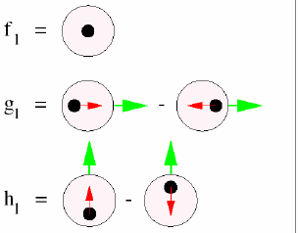
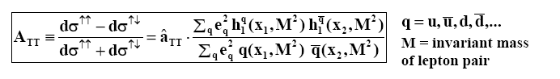
Transversity
In the QCD description of the partonic structure of the nucleon
last leading-twist missing piece is transversity
q(x,Q²) unpolarized quark distribution
Δq(x,Q²) helicity distribution
h₁^{q}(x,Q²) transversity distribution
In deep-inelastic lepton scattering transversity distribution folded with fragmentation functions
transversity distribution directly accessible via the double
transverse spin asymmetry (A_{TT}) in Drell-Yan production of lepton pairs

Slide 37














PANDA Collaboration
• At present a group of 500 physicists from
64 institutions and 17 countries
Austria – Belaruz – China – France – Germany – India – Italy – The Netherlands – Poland – Romania – Russia – Spain – Sweden – Switzerland – Thailand - U.K. – U.S.A.
AMU Aligarh, Basel, Beijing, BITS Pillani, Bochum, IIT Bombay, Bonn, Brescia, IFIN Bucharest, IIT Chicago, AGH-UST Cracow, JGU Cracow, IFJ PAN Cracow, Cracow UT, Edinburgh, Erlangen, FAIR, Ferrara, Frankfurt, Gauhati, Genova, Giessen, Glasgow, BIT Goa, GSI, FZ Jülich, JINR Dubna, Katowice, KVI Groningen, Lanzhou, LNL, LNF, Lund, Mainz, Minsk, ITEP Moscow, MPEI Moscow, TU München, Münster, BARC Mumbai, Northwestern, BINP Novosibirsk, IPN Orsay, Pavia, IHEP Protvino, PNPI St.Petersburg, South Gujarat Univ, SVNIT Surat, Sadar Patel Univ, KTH Stockholm, Stockholm, FH Südwestfalen, Suranaree UoT, Dep. A. Avogadro Torino, Dep. Fis. Sperimentale Torino, Torino Politecnico, Trieste, TSL Uppsala, Tübingen, Uppsala, Valencia, NCBJ Warsaw, TU Warsaw, AAS Wien
http://www-panda.gsi.de/
Spokesperson: Jim Ritman (FZ Jülich)

Slide 38
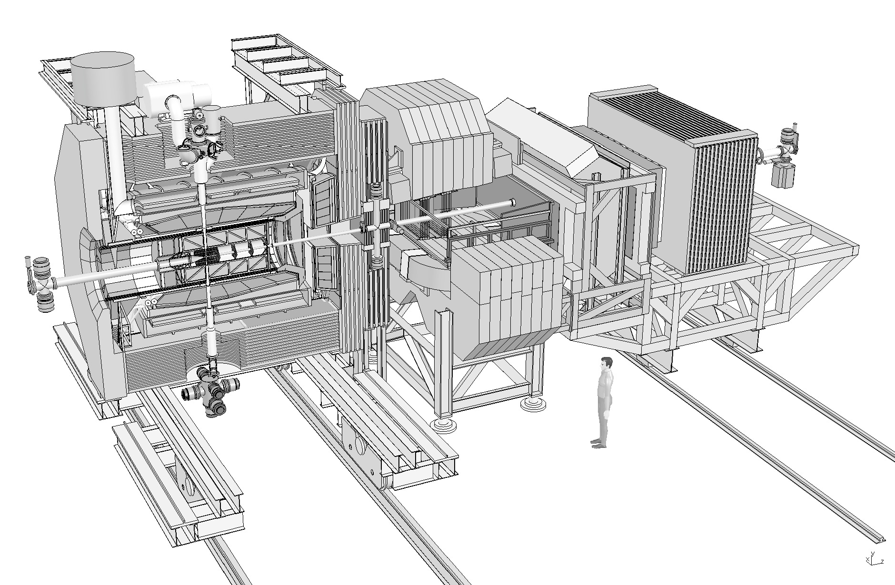
General Purpose Detector
Detector requirements:
nearly 4π solid angle (partial wave analysis)
high rate capability (2·10⁷ annihilations/s)
good PID (γ, e, μ, π, K, p)
momentum resolution (~1%)
vertex info for D, K⁰_{S}, Λ (c_{τ} = 317 μm for D±)
efficient trigger (e, μ, K, D, Λ)
modular design (Hypernuclei experiments)

Slide 39
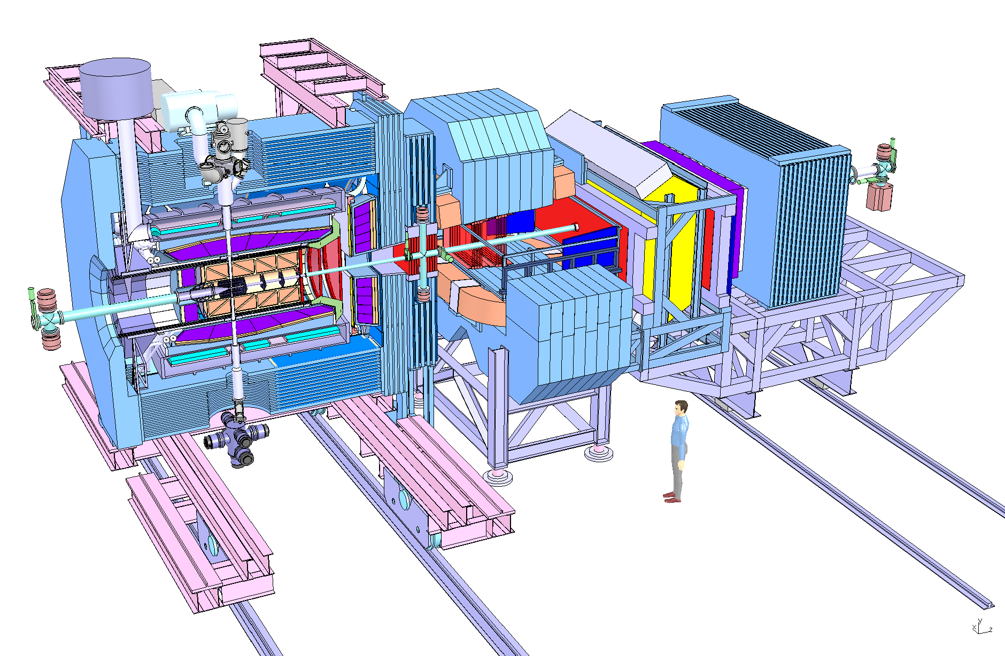
Pellet or cluster-jet target
2T Superconducting solenoid
for high p_{t} particles
2Tm Dipole for forward tracks

Slide 40
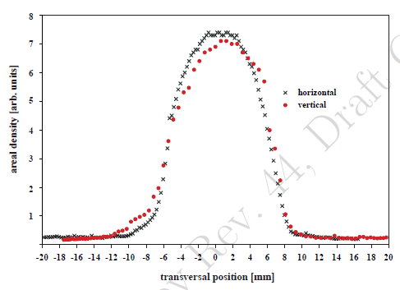
Target system
N₂
H₂
Requirements
  Proton Target
  5 x 10¹⁵ cm⁻² for
  maximum luminosity
Pellet Target
  Frozen droplets ∅ 20μm
  also possible: D₂, N₂, Ne, ...
  Status: ρ ∼ 5 x 10¹⁵
Cluster Jet Target
  Dense gas jet
  also D₂, N₂, Ne, ...
  Status: ρ ∼ 8 x 10¹⁴
Cluster beam after nozzle
areal density [a.u.]
-20
-10
0
10
20
transverse position[mm]

Slide 41
Central Tracker
Silicon Microvertex detector
Forward Chambers

Slide 42
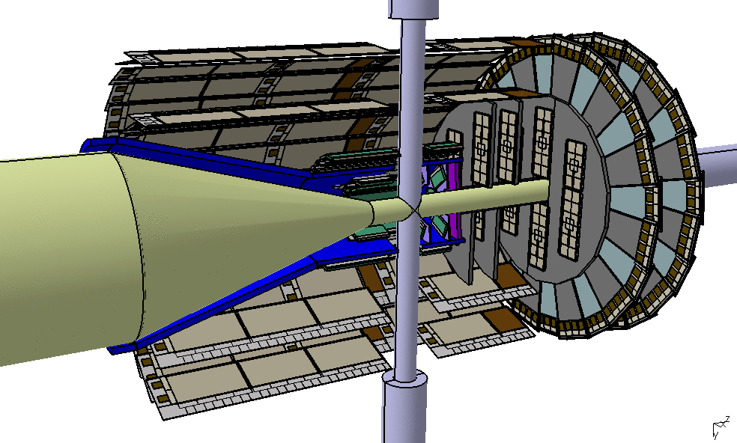
Silicon Micro Vertex Detector
Micro Vertex Detector
4 barrels and 6 disks
Inner layers:
hybrid pixels (100x100 µm²)
  140 module, 12M channels
Outer layers:
silicon strip detectors
  double sided strips
  400 modules, 200k channels
Mixed forward disks
Continuous readout
Requirements
cτ(D±) ∼ 312 μm
cτ(D_{s}±) ∼ 147 μm
Vertex resolution ∼ 50 μm

Slide 43
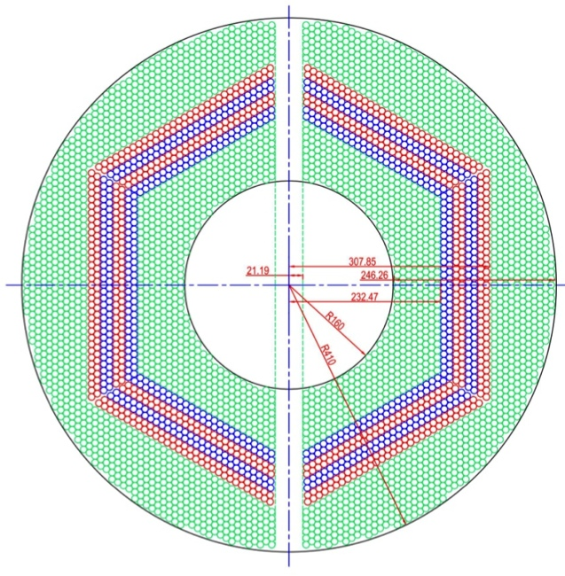
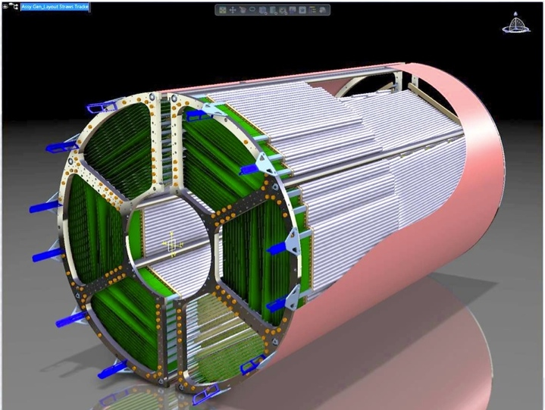
Central STT Layout
4636 Straw tubes in 2 semi-barrels around beam/target cross-pipe
23-27 planar layers in 6 hexagonal sectors
  15-19 axial layers (green) in beam direction
  4 stereo double-layers for 3D reconstr.,
  with ±2.89° skew angle (blue / red)
Time readout (isochrone radius)
Amplitude readout (energy loss)
s_{rΦ} ~ 150(100) µm , s_{z}~ 3.0(2.0) mm (single hit)
σ_{E} /E < 8% for π/K identification
σ_{p} /p ~ 1 - 2% at B=2 Tesla
X/X₀ ~ 1.2% (²/₃ tube wall + ¹/₃ gas)
R_{in}/R_{out}: 150 / 418 mm
Length: 1500mm + 150mm (RO upstream)

Slide 44
Muon Detectors
Forward RICH
Barrel DIRC
Barrel TOF
Forward TOF
Endcap DIRC

Slide 45
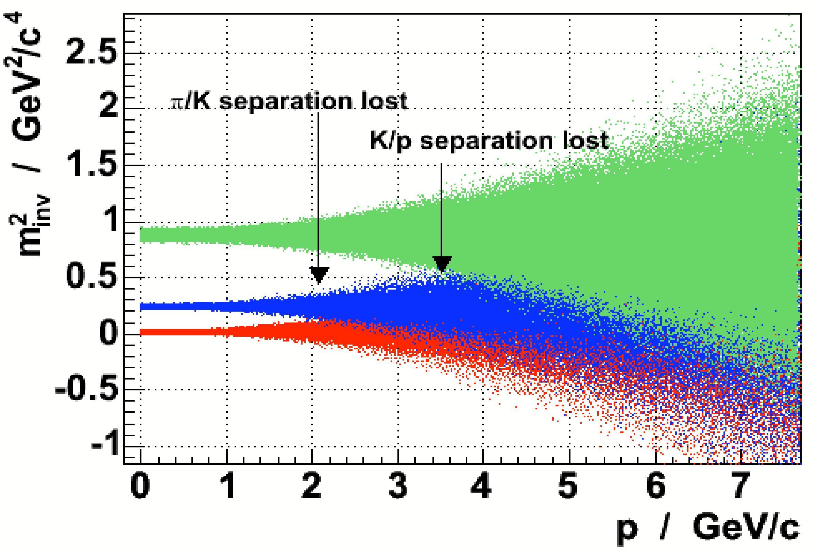
PANDA PID Requirements
Energy Loss in STT
Particle identification essential tool
Momentum range 200 MeV/c–10 GeV/c
Different processes for PID needed
PID Processes
Čerenkov radiation: p > 1 GeV
Radiators: quartz, aerogel, C₄F₁₀
Energy loss: p < 1 GeV
10% accuracy with STT,
Time of flight:
needs a start detector
Electromagnetic showers:
EMC for e and γ
Forward ToF

Slide 46
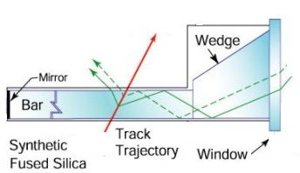
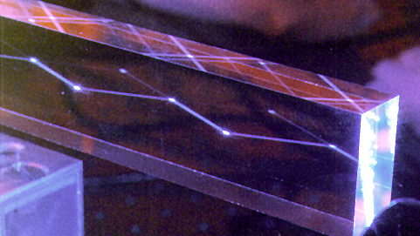
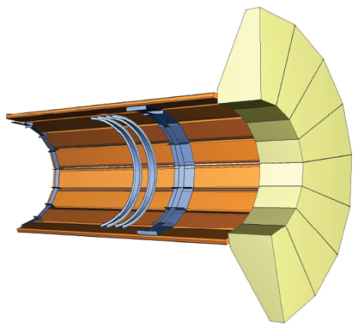
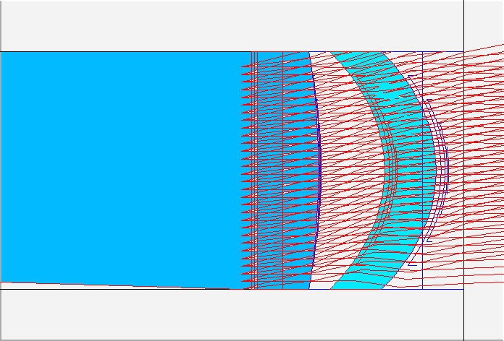
DIRC
PANDA DIRC
Lens focussing
shorter radiator
no water tank
compact pixel readout
(CP-PMTs or APDs)
Lens Focussing
beam

Slide 47
PWO EMC
Forward Shashlyk EMC
Hadron Calorimeter

Slide 48
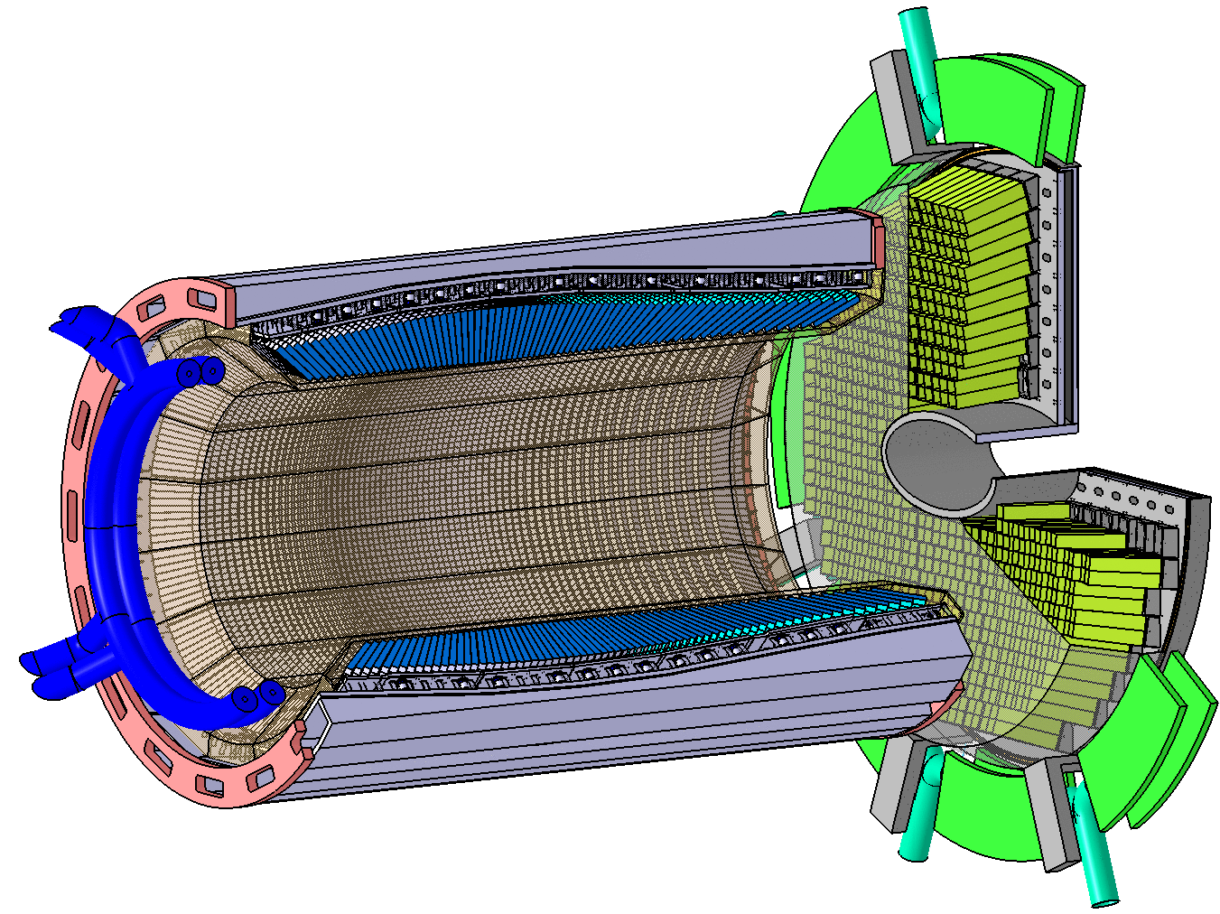
PANDA PWO Calorimeters
PWO is dense and fast
Increase light yield:
  improved PWO II
  operation at -25°C
Challenges:
  temperature stable to 0.1°C
  control radiation damage
  low noise electronics
Delivery of crystals started
Forward Endcap
4000 PWO crystals
High occupancy in center
LAAPD readout
Barrel Calorimeter
11000 PWO Crystals
LAAPD readout, 2 x 1cm²
σ(E)/E∼1.5%/√E + const.

Slide 49
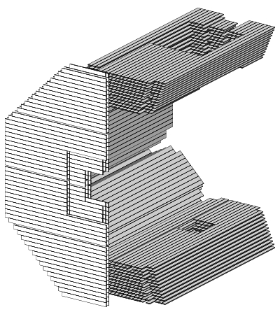
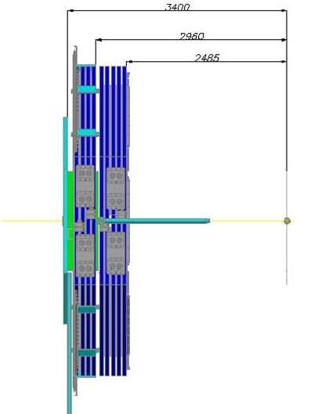
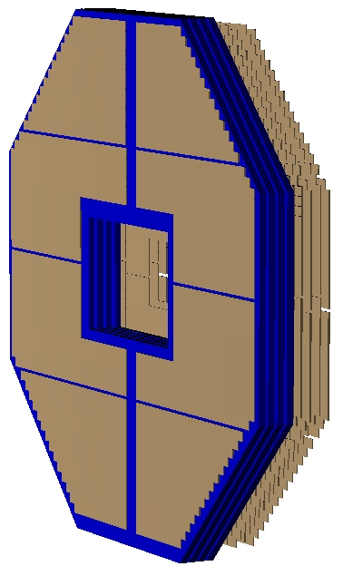
Muon Detector
Inside the solenoid
Barrel: 12 layers inside the yoke + 1 bi-layer (“zero” bi-layer) in before iron
Endcap: 5 layers + “zero” bi-layer before iron
Outside the solenoid
“Muon Filter”, 4 layers
Barrel, inside solenoid
12 layers of MDT + “zero” bi-layer
Muon Filter, outside solenoid
4 x (60mm/Fe + 30mm/MDT)
Endcap, inside solenoid
5 layers of MDT
beam
beam
beam direction
Proportional tubes : anode signal and induction signal on 1 cm strips

Slide 50
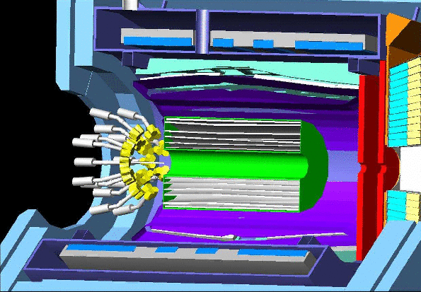
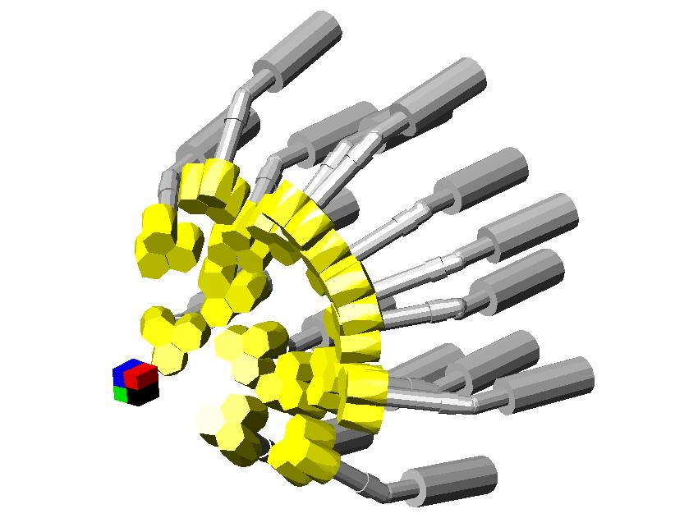
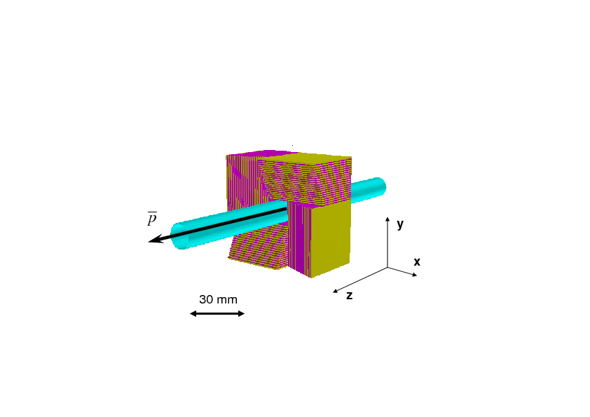
Hypernuclear
Detector
Internal C target to produce ΞΞ
Active silicon target to stop the Ξ and
detect the hypenuclei decay products
beam
Germanium γ array detector, with 15
clusters of 3 gemanium
Germanium array
Forseen 2 KeV γ enery resolution,
1.3 MeV π energy resolution
active target

