Slide 1
Status of Semi-inclusive Pion Electroproduction Analysis for E1-F
W. Gohn, K.Joo, M.Ungaro
University of Connecticut
H. Avakian
Jefferson Lab
CLAS12 European Workshop
Feb. 27, 2009

Slide 2
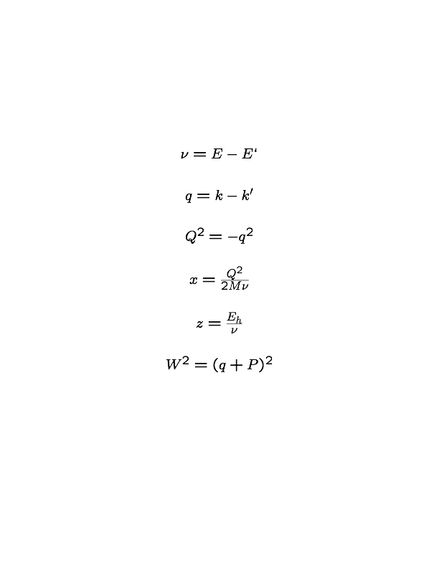
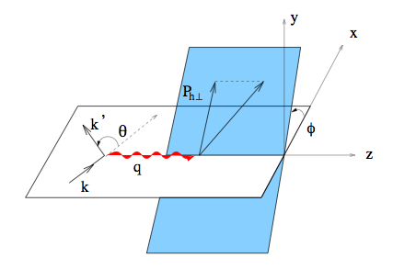
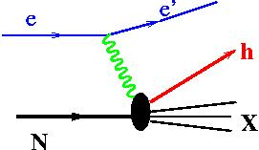
SIDIS Kinematics
Requires:
P

Slide 3
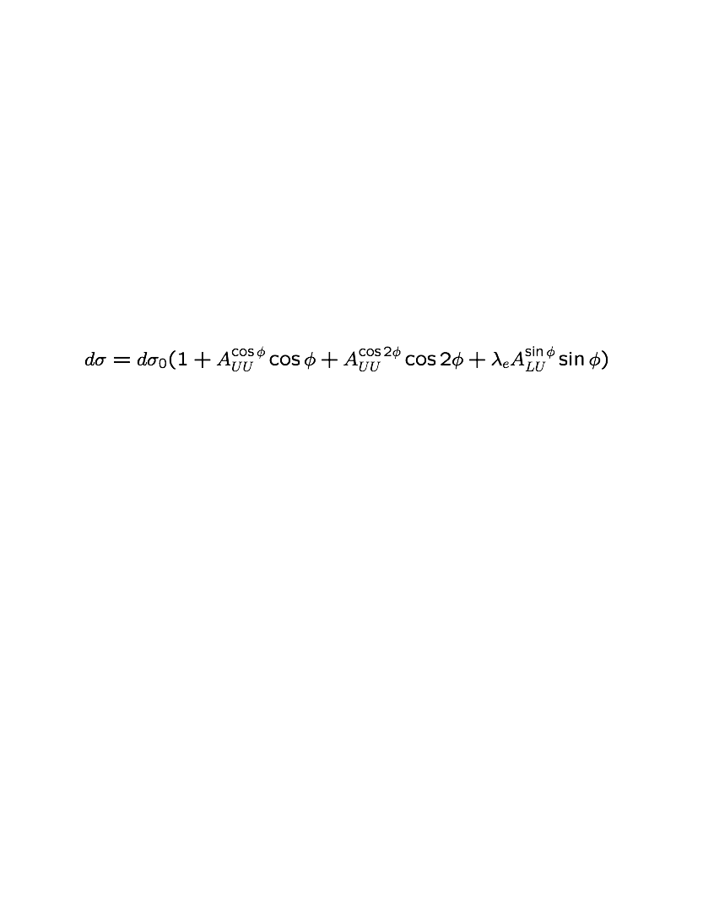
Motivation for Measurement of Beam-Spin Asymmetry
SIDIS Cross Section (tree-level expression with factorization assumed):
Measuring all three coefficients.
Started with beam-spin asymmetry (BSA), because BSA has much lower sensitivity to CLAS acceptance..
The LU term is due to the imaginary part of the interference between longitudinal and transverse photon amplitudes.
The BSA is twist-3, providing access to information on quark-gluon-quark correlations.
These higher-twist effects can partly be related to the average transverse force acting on quarks just after interaction with the virtual photon in the collision (M. Burkardt, 2008, 0807.2599)
3

Slide 4
Motivation for Measurement of Beam-Spin Asymmetry
The beam-SSA provides important information about nucleon structure.
A. Bacchetta, M. Diehl, K. Goeke, P. Mulders, & M. Schlegel,
hep-ph/0611265v2, 2007
4

Slide 5
Motivation for Measurements of cos φ and cos2 φ Moments
Ths cosф moment is associated with the Cahn effect.
The cos2ф moment can provide direct access to the Boer-Mulders function and the Collins function.
R.N. Cahn, Phys. Lett. B78 (1978) 269
D.Boer and P.J.Mulders, hep-ph/9711485 (1998)
J.C.Collins, hep-ph/0608048 (1993)

Slide 6
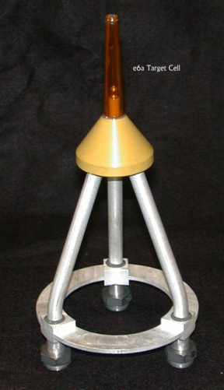
E1F Run Period Information
Data for e1f run period taken between April and July of 2003.
Torus magnet lowered to 60% of full current to maximize charged pion acceptance.
Longitudinally polarized electron beam at 5.496 GeV. The average beam polarization was 75.1±0.2%.
Unpolarized Liquid Hydrogen Target
Measuring the following SIDIS processes:
(6.4M events)
(1.5M events)
(1.2M events)
6

Slide 7
Determination of Good Run List

Slide 8
Sector Comparison

Slide 9
Helicity Determination
Red points are transitions in helicity definition.

Slide 10
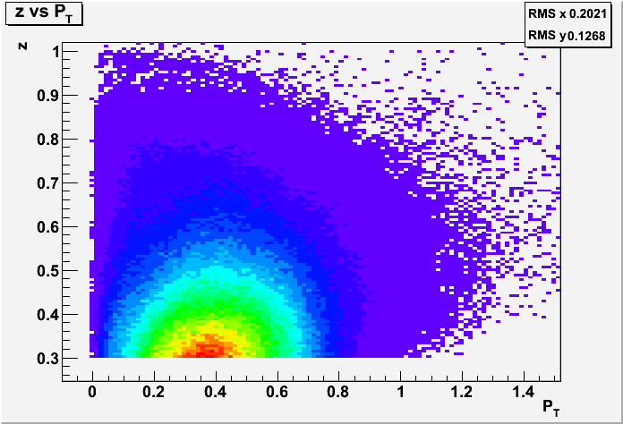
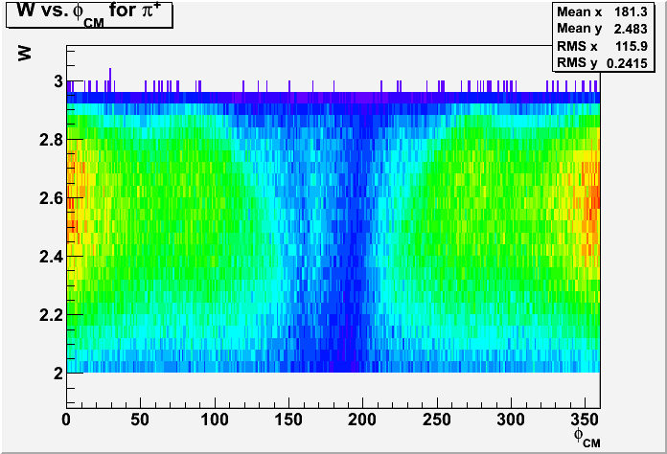
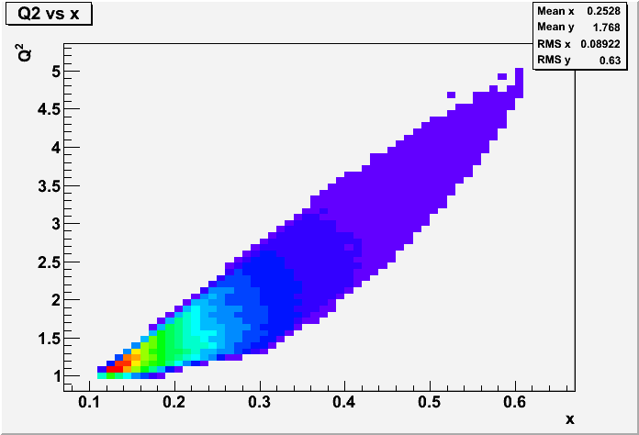
Kinematic Coverage
Binning is in z, P_{T}, and φ.
Coverage shown here for π⁺. π ⁻ and π⁰ are similar.
Also intend to look at dependence on Q² and x.

Slide 11
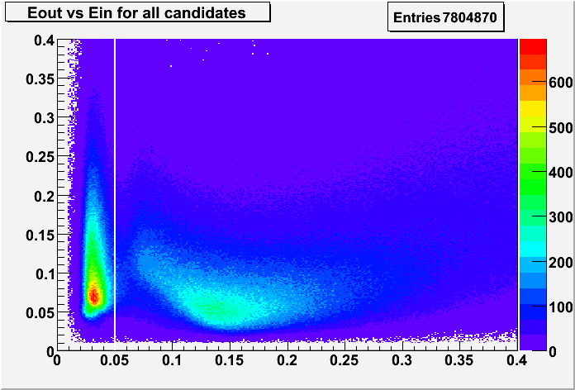
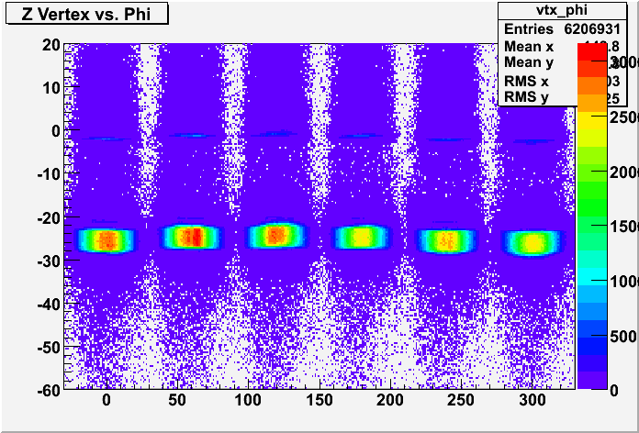
Electron Identification
Electrons are identified by a coincidence of signals in the EC and CC.
EC energy cut
Vertex Cut
[cm]
Candidates to the left of the white line are eliminated. Negative pions may be misidentified as electrons, but can be cut because electrons deposit more energy in the inner part of the EC due to shower conformation.
Must eliminate candidates that did not originate at the interaction vertex. Cut is implemented individually for each sector.
11

Slide 12
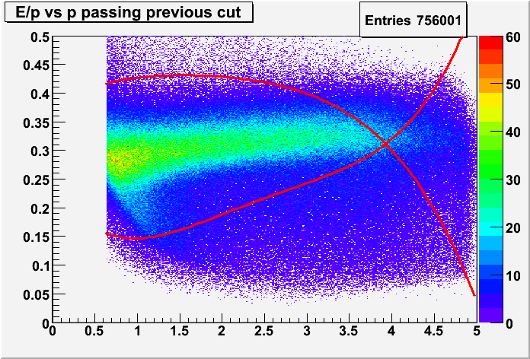
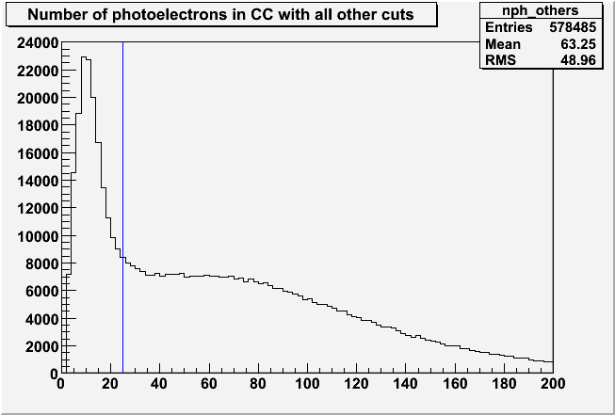
Electron ID
p
npe*10
E/p should be constant in p for very fast electrons. Hence, all candidates outside of the red curves are cut.
Electrons will leave many photoelectrons in the CC, so those candidates to the left of the blue line are cut to eliminate electric noise.
12

Slide 13
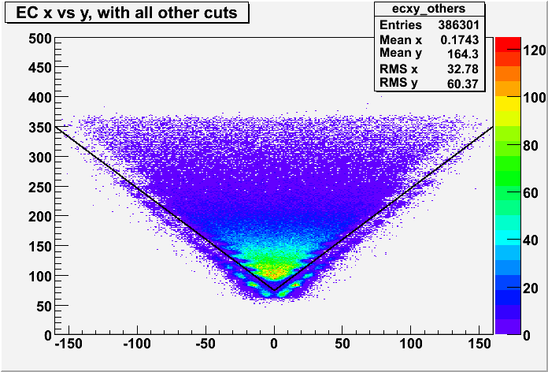
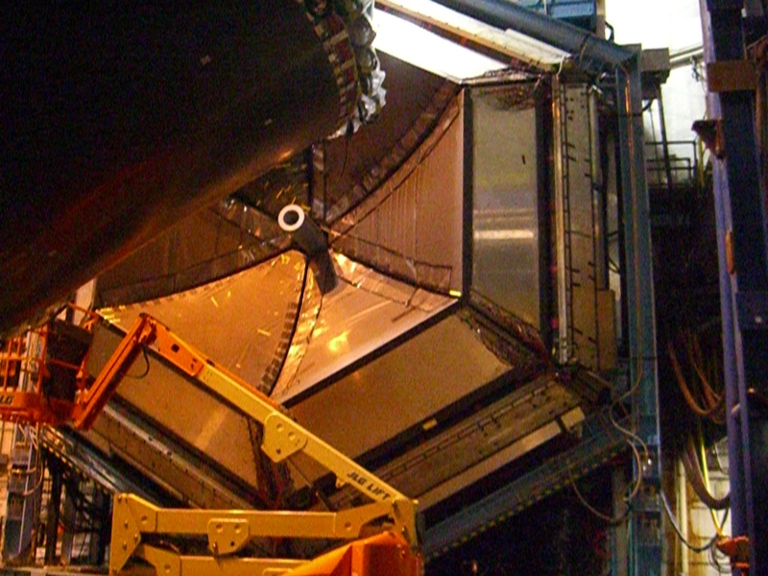
Geometric Cut
x [cm]
Pattern along edges reflects the efficiency of the CC.
y [cm]
The EC is unreliable near its edges, so tracks that hit too close to the edge are also cut. The CC is involved in the electron trigger, so the cut also accounts for the complicated geometry of the CC.
13

Slide 14
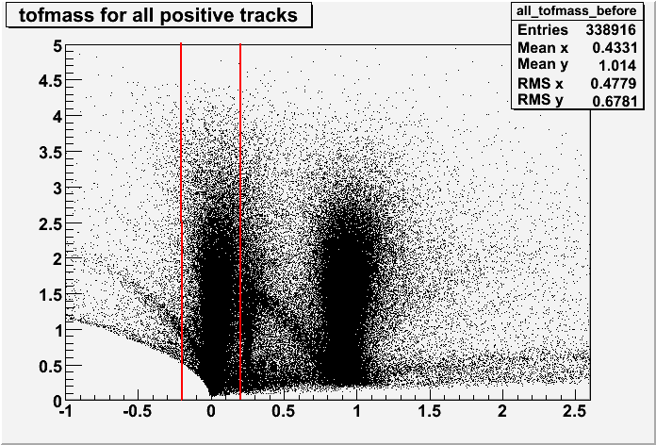
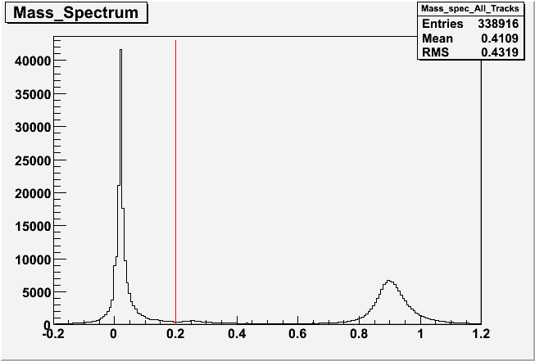
Charged Pion Identification
Here positive pions are shown as an example. The plots for negative pions are similar.
p [GeV/c]
M² [GeV²]
A cut is placed on mass-squared of 0.2, as determined by the time-of-flight system.
M² [GeV²]
14

Slide 15
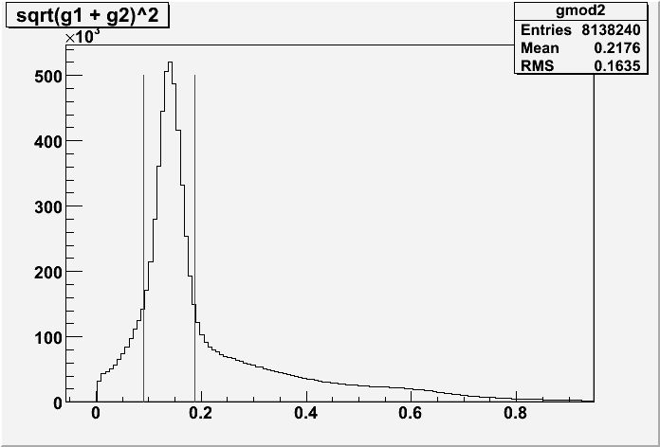
π⁰ Identification
Pions are selected from two-photon events in the EC. No internal calorimeter (IC) is used. Therefore we see a different kinematic range than do those experiments using an IC to detect neutral pions.
Neutral pions are selected by putting a cut around the pion mass in the two-photon invariant mass spectrum
Only photons with energy > 0.2 GeV are used.
IM [GeV]
15

Slide 16
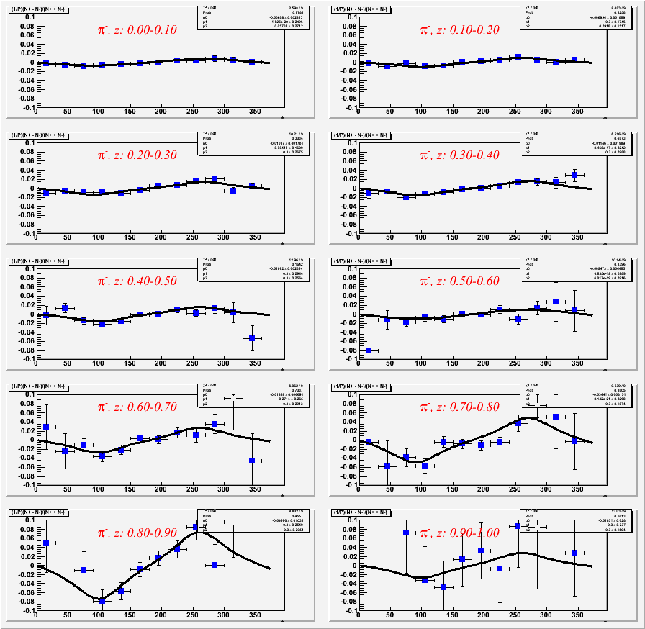
Beam-Spin Asymmetries Fitting Procedure
Error bars are statistical only.
Ten bins in z and twelve in φ.
Semi-inclusive range is expected to be for 0.4<z<0.7 for CLAS kinematics.
Compared fits with
and

Slide 17
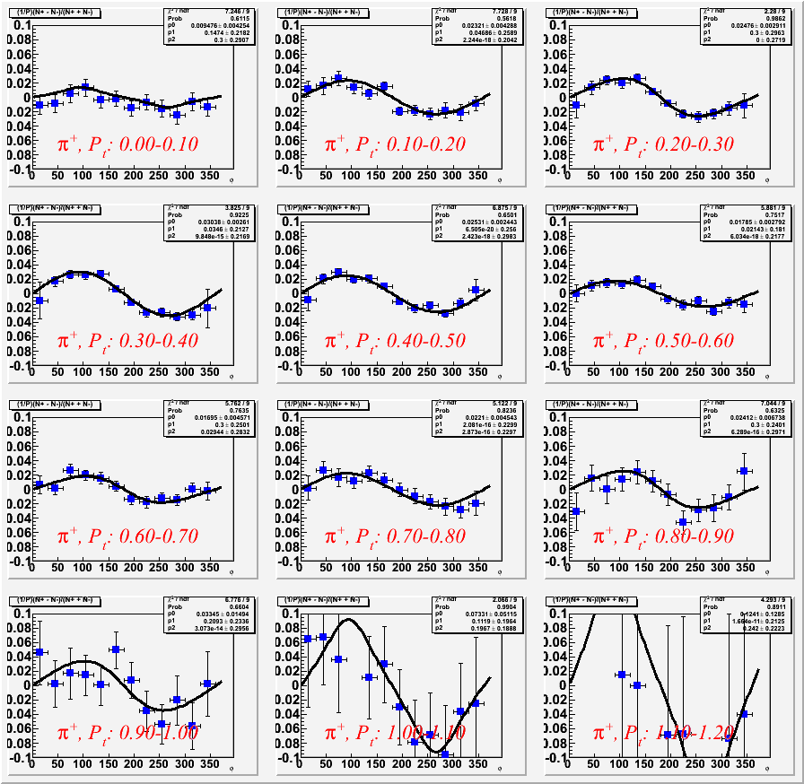
P_{T} Binning
Error bars are statistical only.
12 bins in P_{T} and 12 in φ.
Cut around 0.4<z<0.7 for SIDIS range.
and

Slide 18
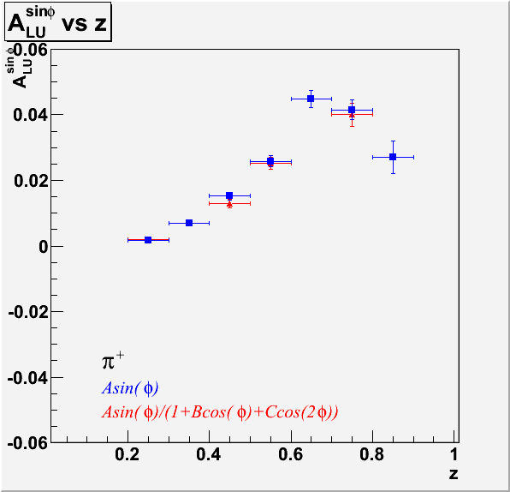
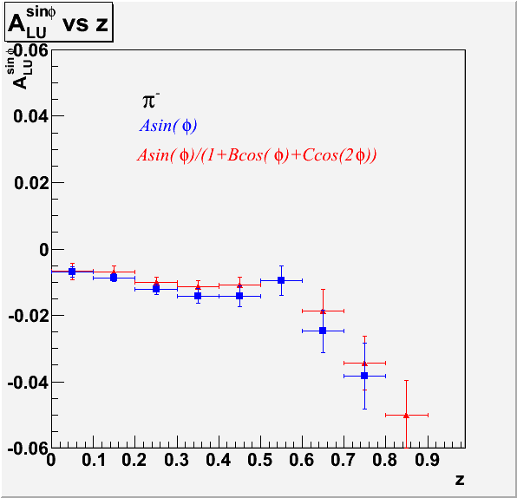
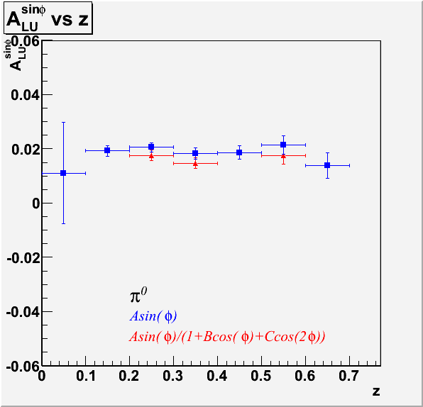
Sinφ Moments z-dependence
Isospin symmetry says π⁰ will give weighted average of charged pion results.
Opposite deflections in current fragmentation region.
^{Preliminary}
z-dependence of π⁰ could be related to g|.
Charged π z-dependence has been shown to be related to Collins function.

Slide 19
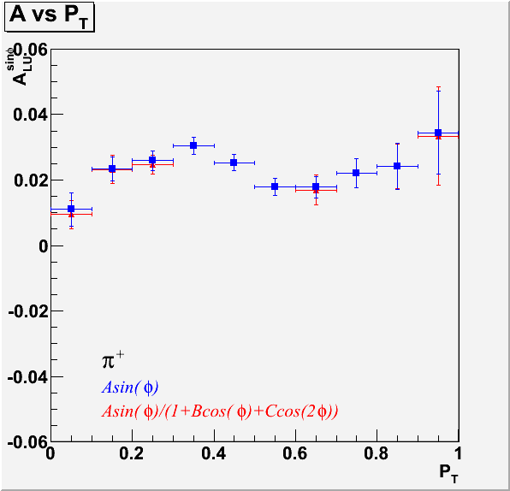
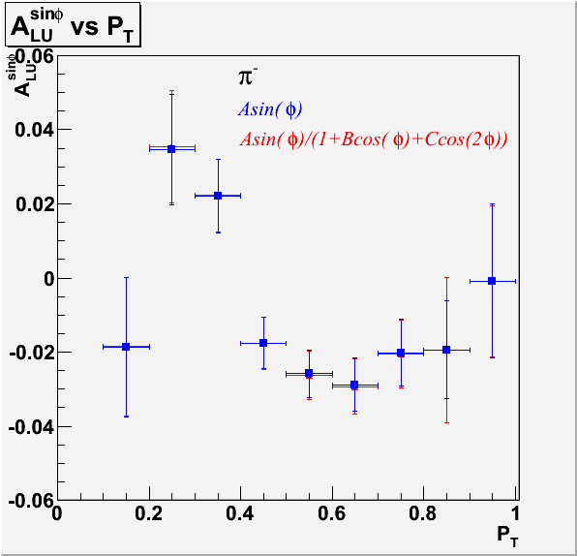
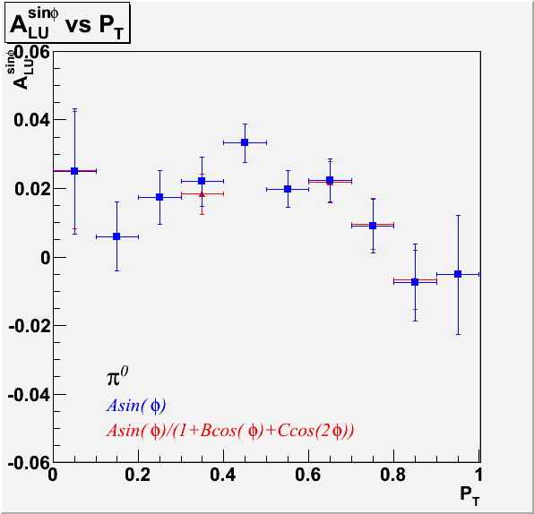
Sinφ Moments P_{T} Dependence
^{Preliminary}
It is possible that these results could illustrate a Gaussian dependence of A_{LU} on P_{T}.

Slide 20
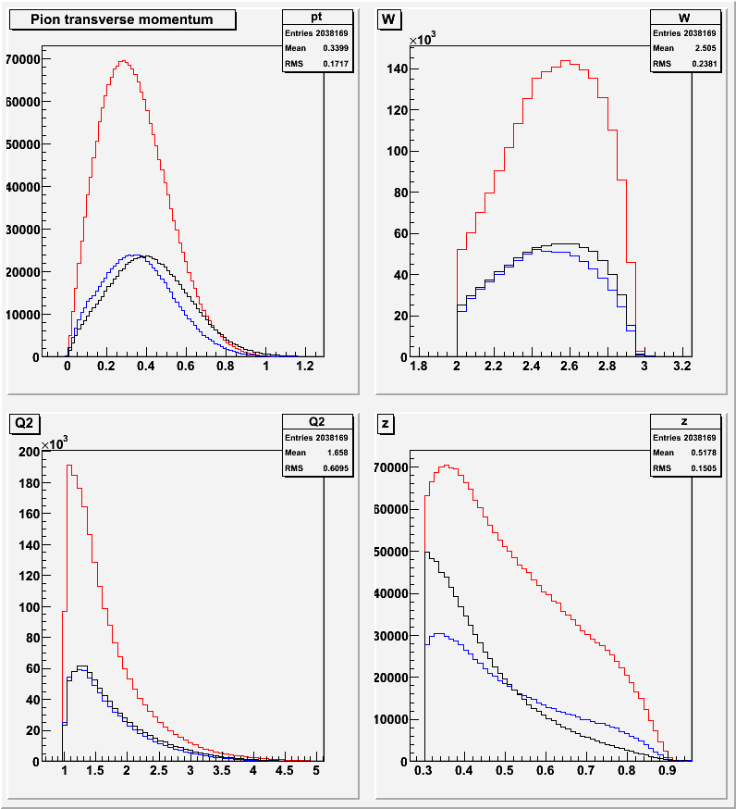
Monte Carlo Simulation
MC data is generated with the clasDIS event generator.
Gsim is used to simulate detector systems for each generated event.
Gpp smears the simulated data in the EC and SC to make the results more realistic.
Simulated data is cooked, and this reconstructed data is analyzed in the same way as the real data to determine CLAS acceptances.
Generated / Reconstructed / Data

Slide 21
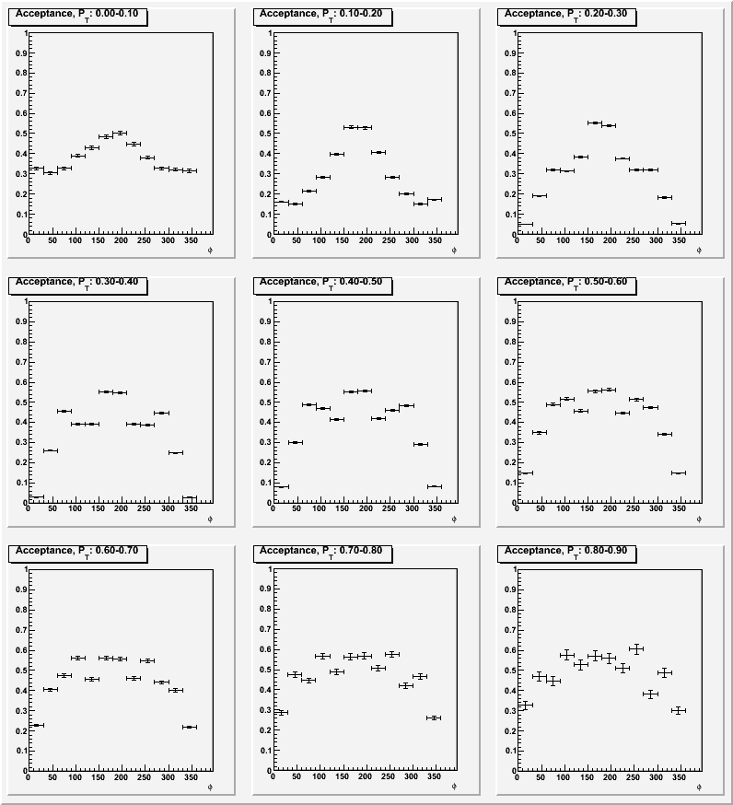
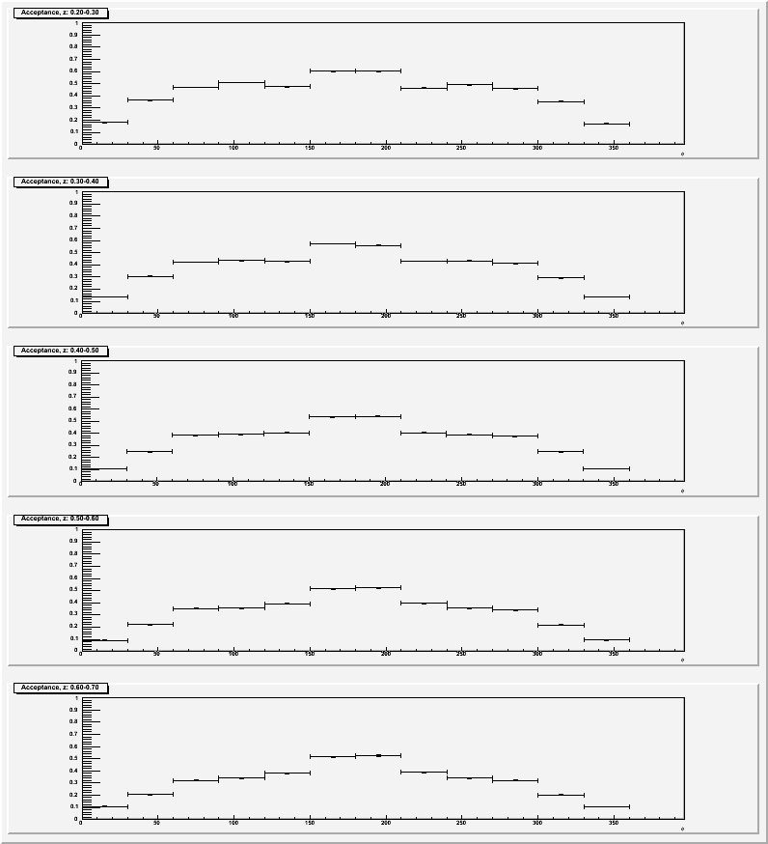
Acceptance
z-binning
P_{T}-binning

Slide 22
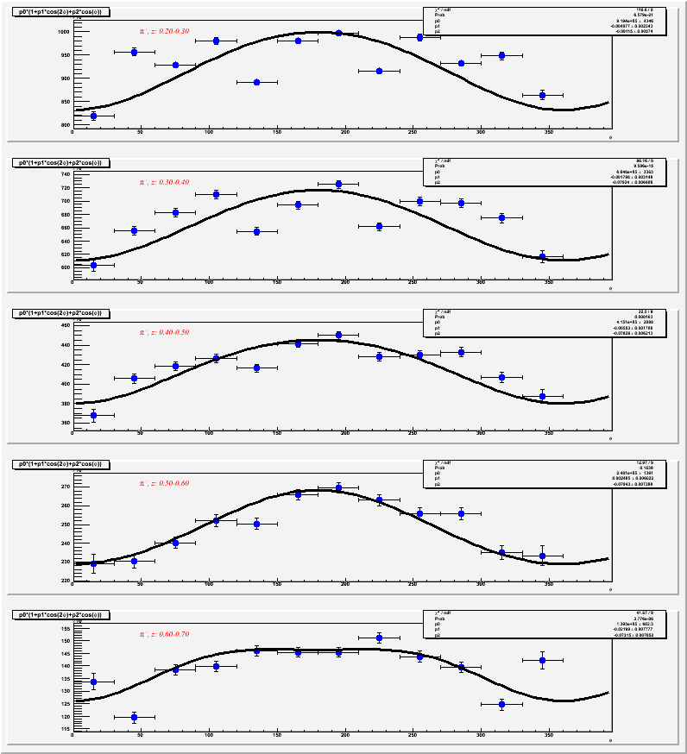
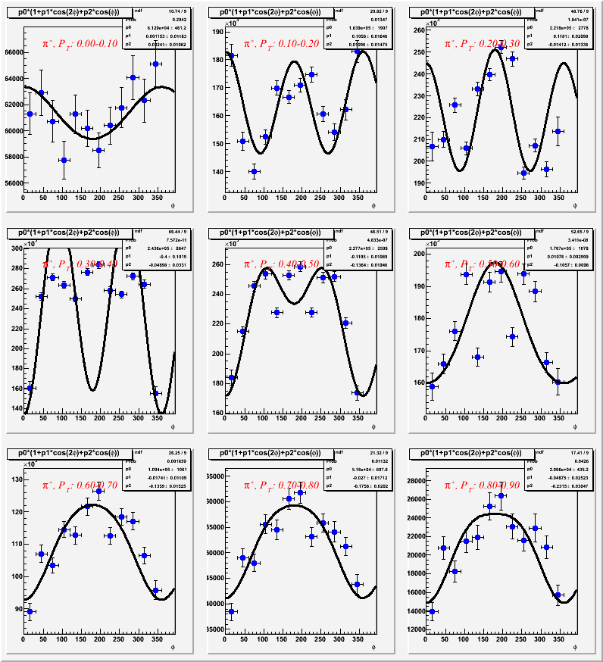
Fits
z-binning
P_{T}-binning

Slide 23
Future Prospectus
Cosφ and cos2φ analysis will be refined and then repeated for π⁻ channel.
Will improve particle ID for electrons and pions. In particular, identification of π⁺’s will be improved by accounting for small time discrepancies in the TOF system.
Will implement more sophisticated sector-by-sector fiducial cuts and momentum corrections for electrons and pions.
Parameters of Monte Carlo simulation will be refined to give a better simulation of real data.
A multidimensional acceptance table will be prepared to give more precise results.

Slide 24
Conclusions
Analysis of Beam-spin asymmetries for all three pion channels is nearly complete.
Analysis of cosφ and cos2φ moments is underway.
These results will provide insight into quark-gluon-quark dynamics in the proton, as well as serving as an important precursor to experiments that will take place with CLAS12.

Slide 25
Support Slides

Slide 26
Generated / Reconstructed

Slide 27
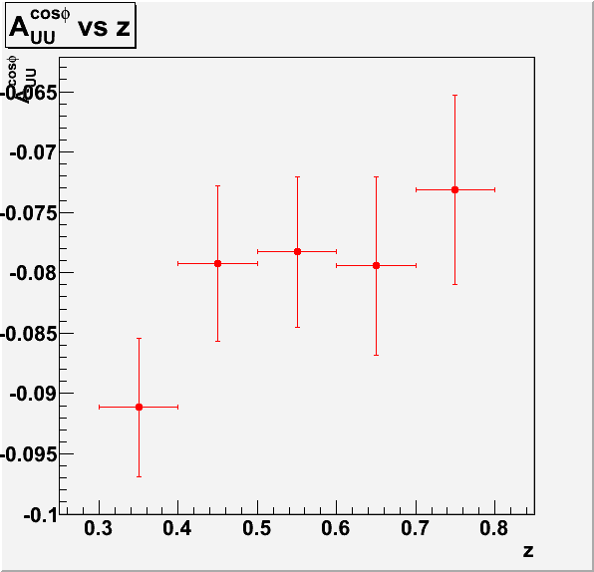
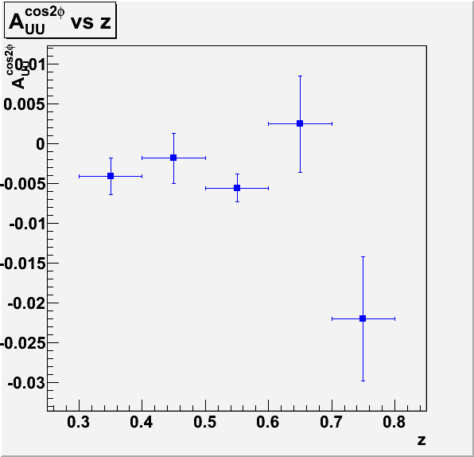
Cos φ & Cos2φ Moments z-dependence
Very Preliminary
Very Preliminary

Slide 28
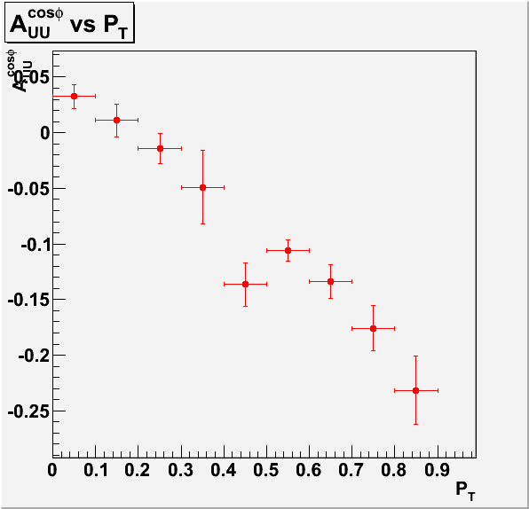
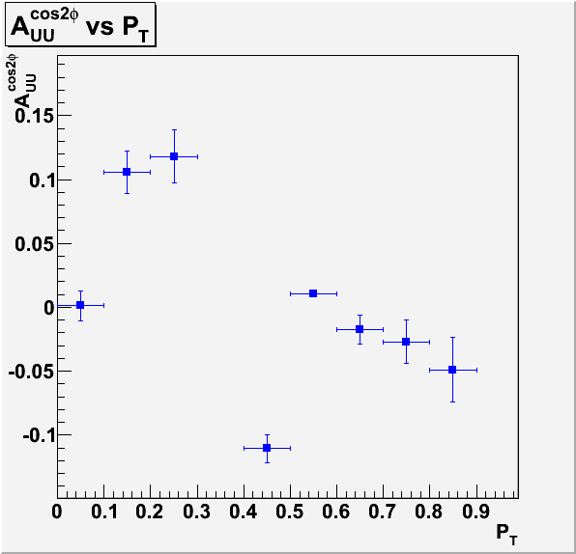
Cos φ & Cos2φ Moments P_{T}-dependence
Very Preliminary
Very Preliminary
Can approximate:
which gives the cosφ term to order 1/Q in the parton model.
M. Anselmino et al, hep-ph/0501196 (2005)

