Slide 1
CAA request :
*Timelike Compton Scattering (e1-6 & e1-f) by
R. Paremuzyan, S. Stepanyan et al.
Committee : M. Guidal, C. Hyde & F. Sabatié
12 Yes’s, 0 No’s
Approved

Slide 2
Analysis reviews under course:
*semi-inclusive π⁺,π⁰ with long. Pol. Target (eg1)
by H. Avakian et al.
Committee : A. Biselli, S. Kuhn& K. Hafidi
*semi-inclusive π⁰ (e1-dvcs) by M. Aghasyan et al.
Committee : K. Joo, F.-X. Girod & M. Osipenko
*Inclusive proton double-spin asymmetries (eg1b) by R. Fersch et al.
Committee : S. Niccolai, H. Avakian & R. DeVita
*exclusive π⁺ (e1-6) by K. Park et al.
Committee : P. Stoler, S. Procureur & M. Ungaro

Slide 3
Deep Processes Working Group Meeting
Room A502 - 5th floor of the Physics Department
14:30 - 14:55 |  | Vector Meson Production at HERMES A. Borissov (DESY)
14:55 - 15:20 |  | Vector Meson Production + DVCS et H1 L. Favart (Université Libre de Bruxelles)
15:20 - 15:40 |  | Vector Meson Production at CLAS M. Guidal (IPN Orsay)
15:40 - 16:00 |  | ρ+ Exclusive Electroproduction at CLAS (e1-dvcs) A. Fradi (IPN Orsay)
16:00 - 16:30 |  | Coffee Break
16:30 - 16:50 |  | ΔVCS at CLAS (e1-dvcs) B. Moreno (IPN Orsay)
16:50 - 17:10 |  | Near Threshold Meson Production at High Q2 and New Form Factors P. Khetarpal (Rensselaer Polytechnic Institute)
17:10 - 17:30 |  | Status of Semi-Inclusive Pion Electroproduction Analysis of e1-f W. Gohn (University of Connecticut)
17:30 - 17:45 |  | Studies of Spin Orbit Correlations with CLAS H. Avagyan (Jefferson Lab)
17:45 - 18:00 |  | E1-DVCS(2) Run Status M. Ungaro (University of Connecticut)
18:00 - 18:15 |  | Status Update on the eg1-dvcs Experiment E. Seder (University of Connecticut)
18:15 - 18:30 |  | Model calculations of the Sivers function satisfying the Burkardt Sum Rule A.Courtoy (Universidad de Valencia)

Slide 4

Many thanks to F.-X. Girod for taking charge of the meeting on the other side of the water
EVO+FX+Marco

Slide 6
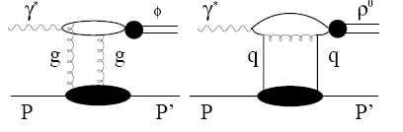

Slide 9
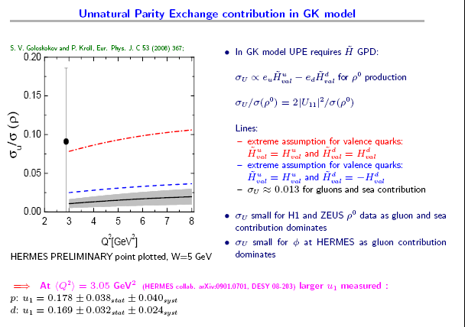

Slide 12
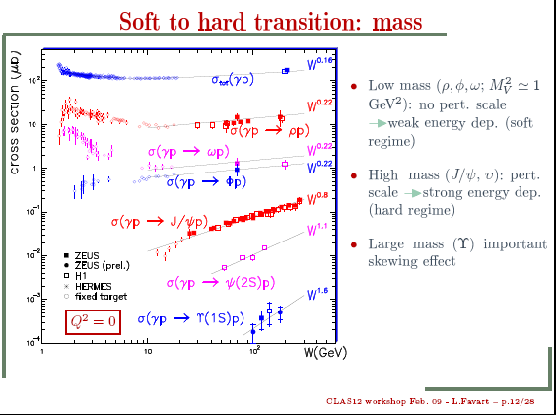

Slide 13
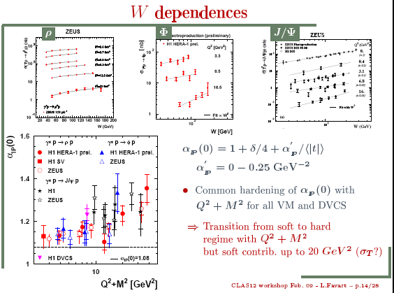

Slide 15
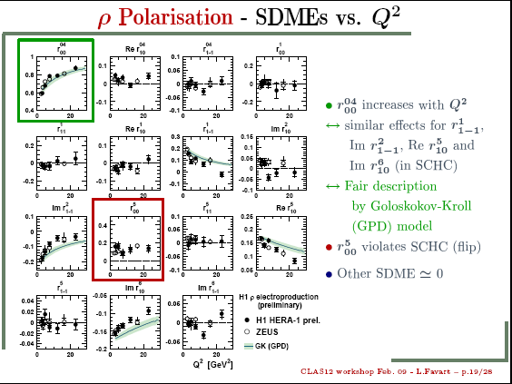

Slide 17
Exclusive ρ⁰,ω&φ electroproduction
on the proton @ CLAS
M.Garçon, M. Guidal, C. Hadjidakis,
K. Lukashin, L. Morand, S. Morrow,
J. Santoro, E. Smith
K. Lukashin, Phys.Rev.C63:065205,2001 (φ@4.2 GeV)
}
e1-b
(1999)
C. Hadjidakis et al., Phys.Lett.B605:256-264,2005 (ρ⁰@4.2 GeV)
}
L. Morand et al., Eur.Phys.J.A24:445-458,2005 (ω@5.75GeV)
J. Santoro et al., Phys.Rev.C78:025210,2008 (φ@5.75GeV)
e1-6
(2001-2002)
S. Morrow et al., Eur.Phys.J.A39:5-31,2009 (ρ⁰@5.75GeV)

Slide 18
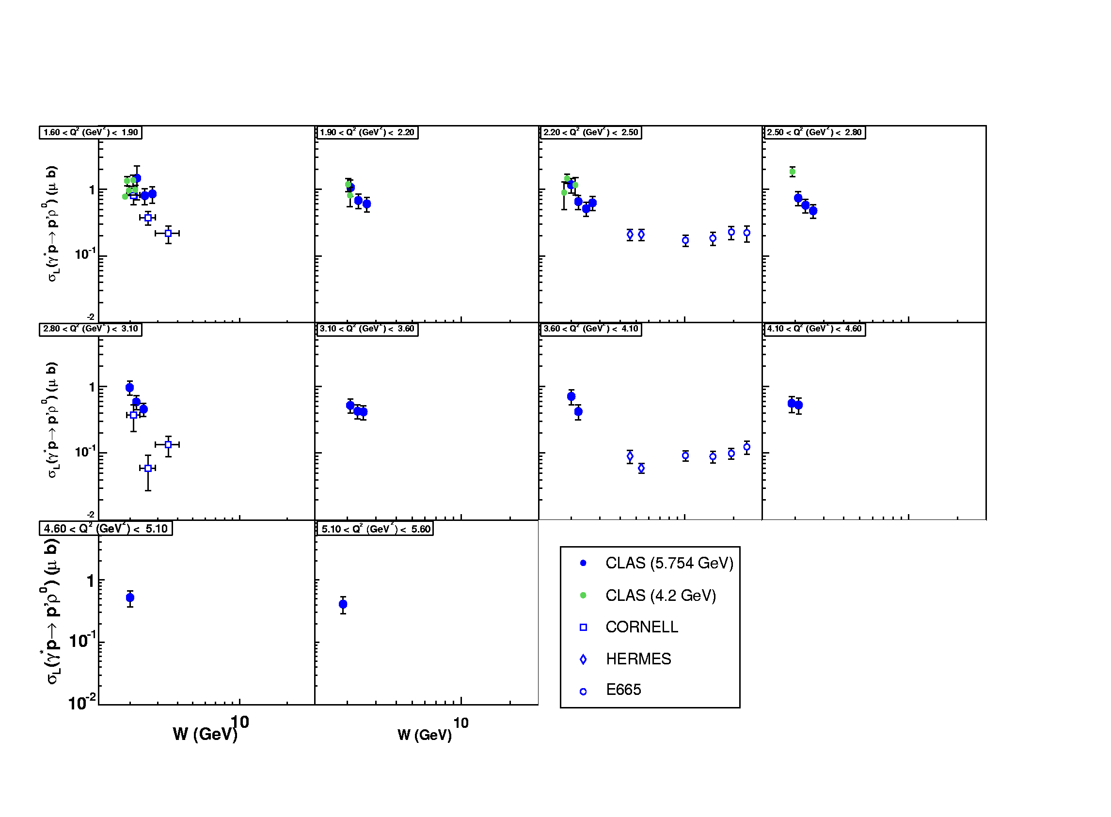
Longitudinal cross section σ_{L} (γ*_{L}p → pρ_{L}⁰)

Slide 19
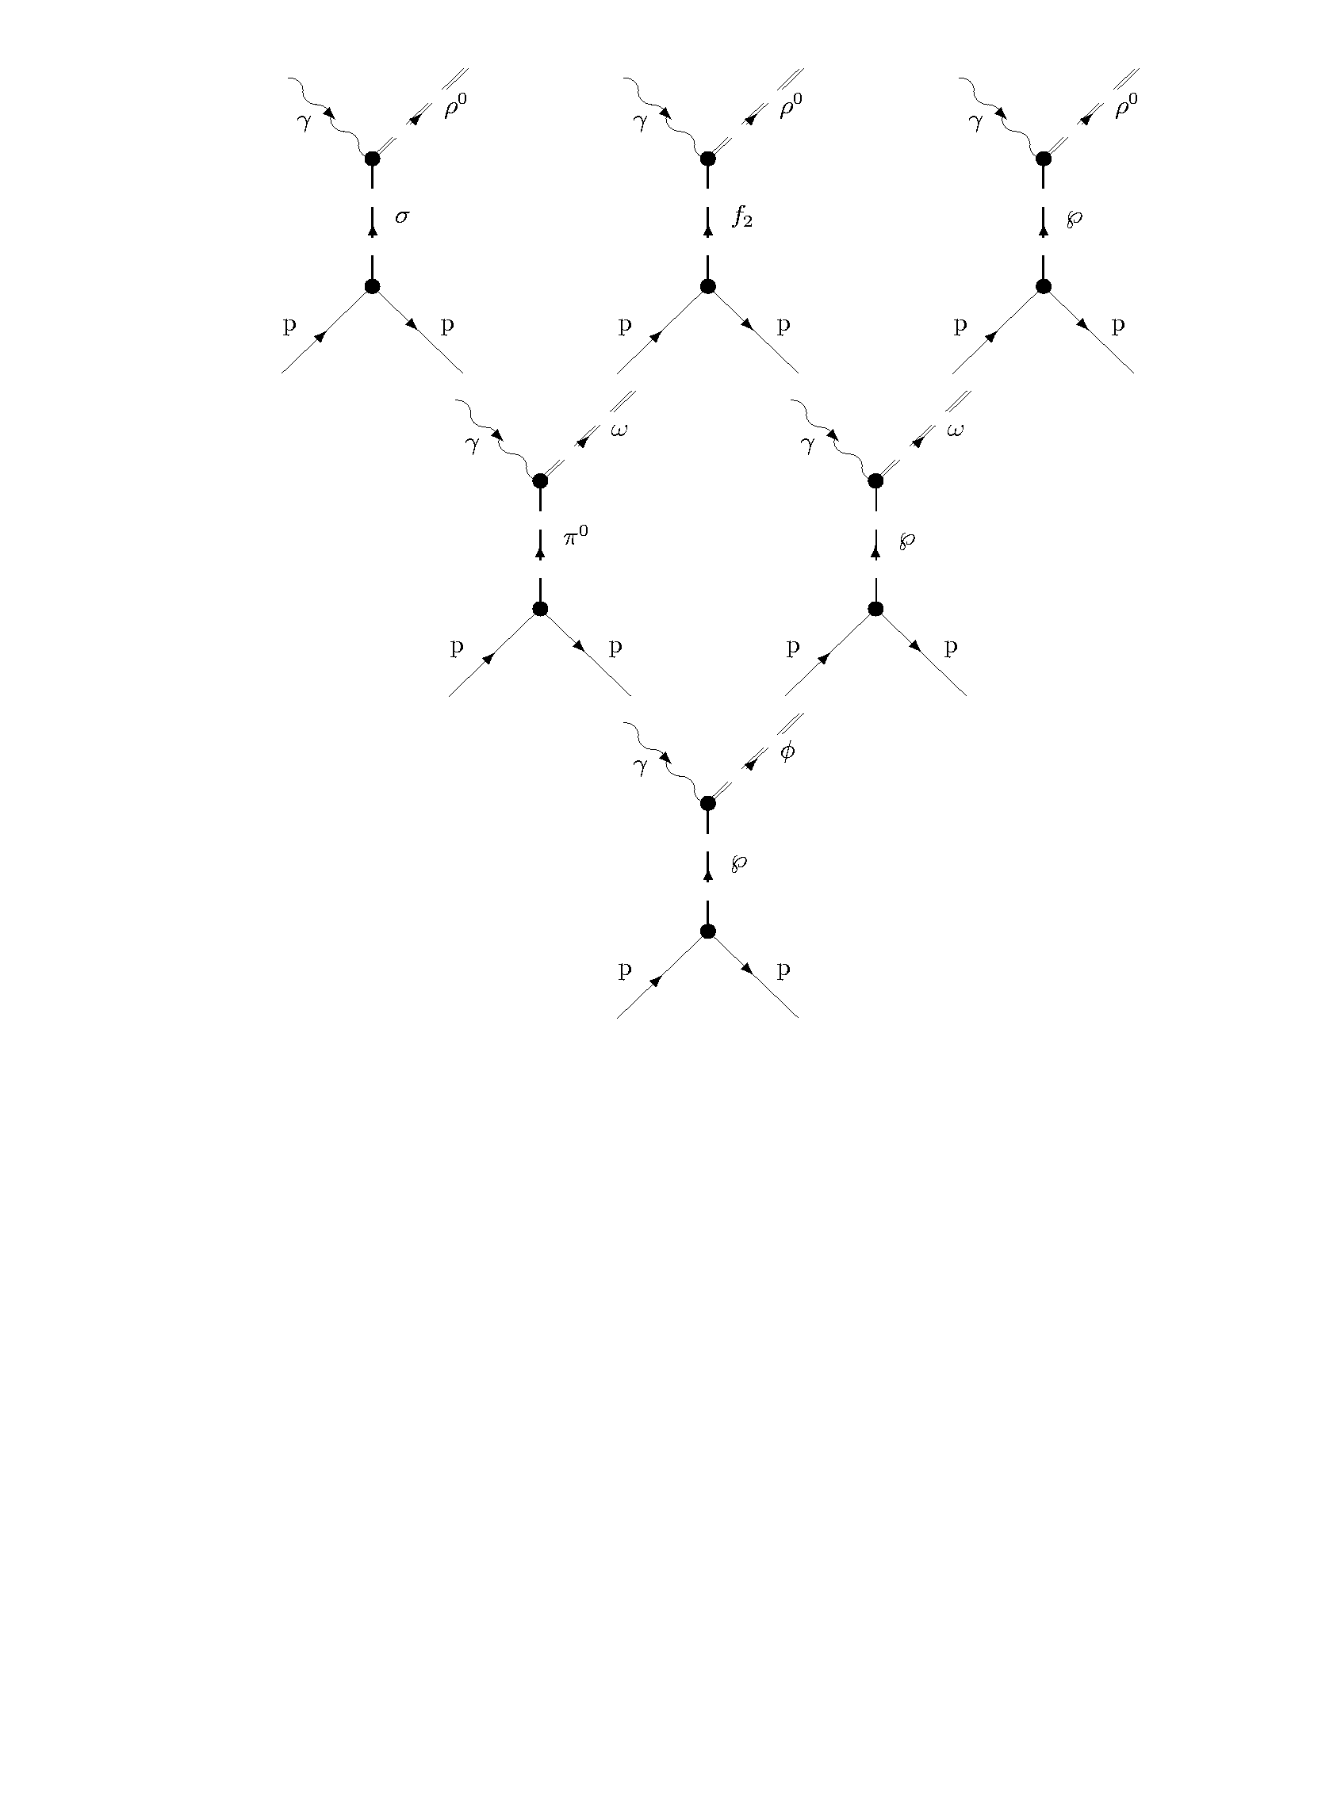
Interpretation “a la Regge” : Laget model
γ*p → pρ⁰
γ*p → pω
Free parameters:
*Hadronic coupling constants: g_{MNN}
*Mass scales of EM FFs: (1+Q²/Λ²)⁻²
γ*p → pφ

Slide 20
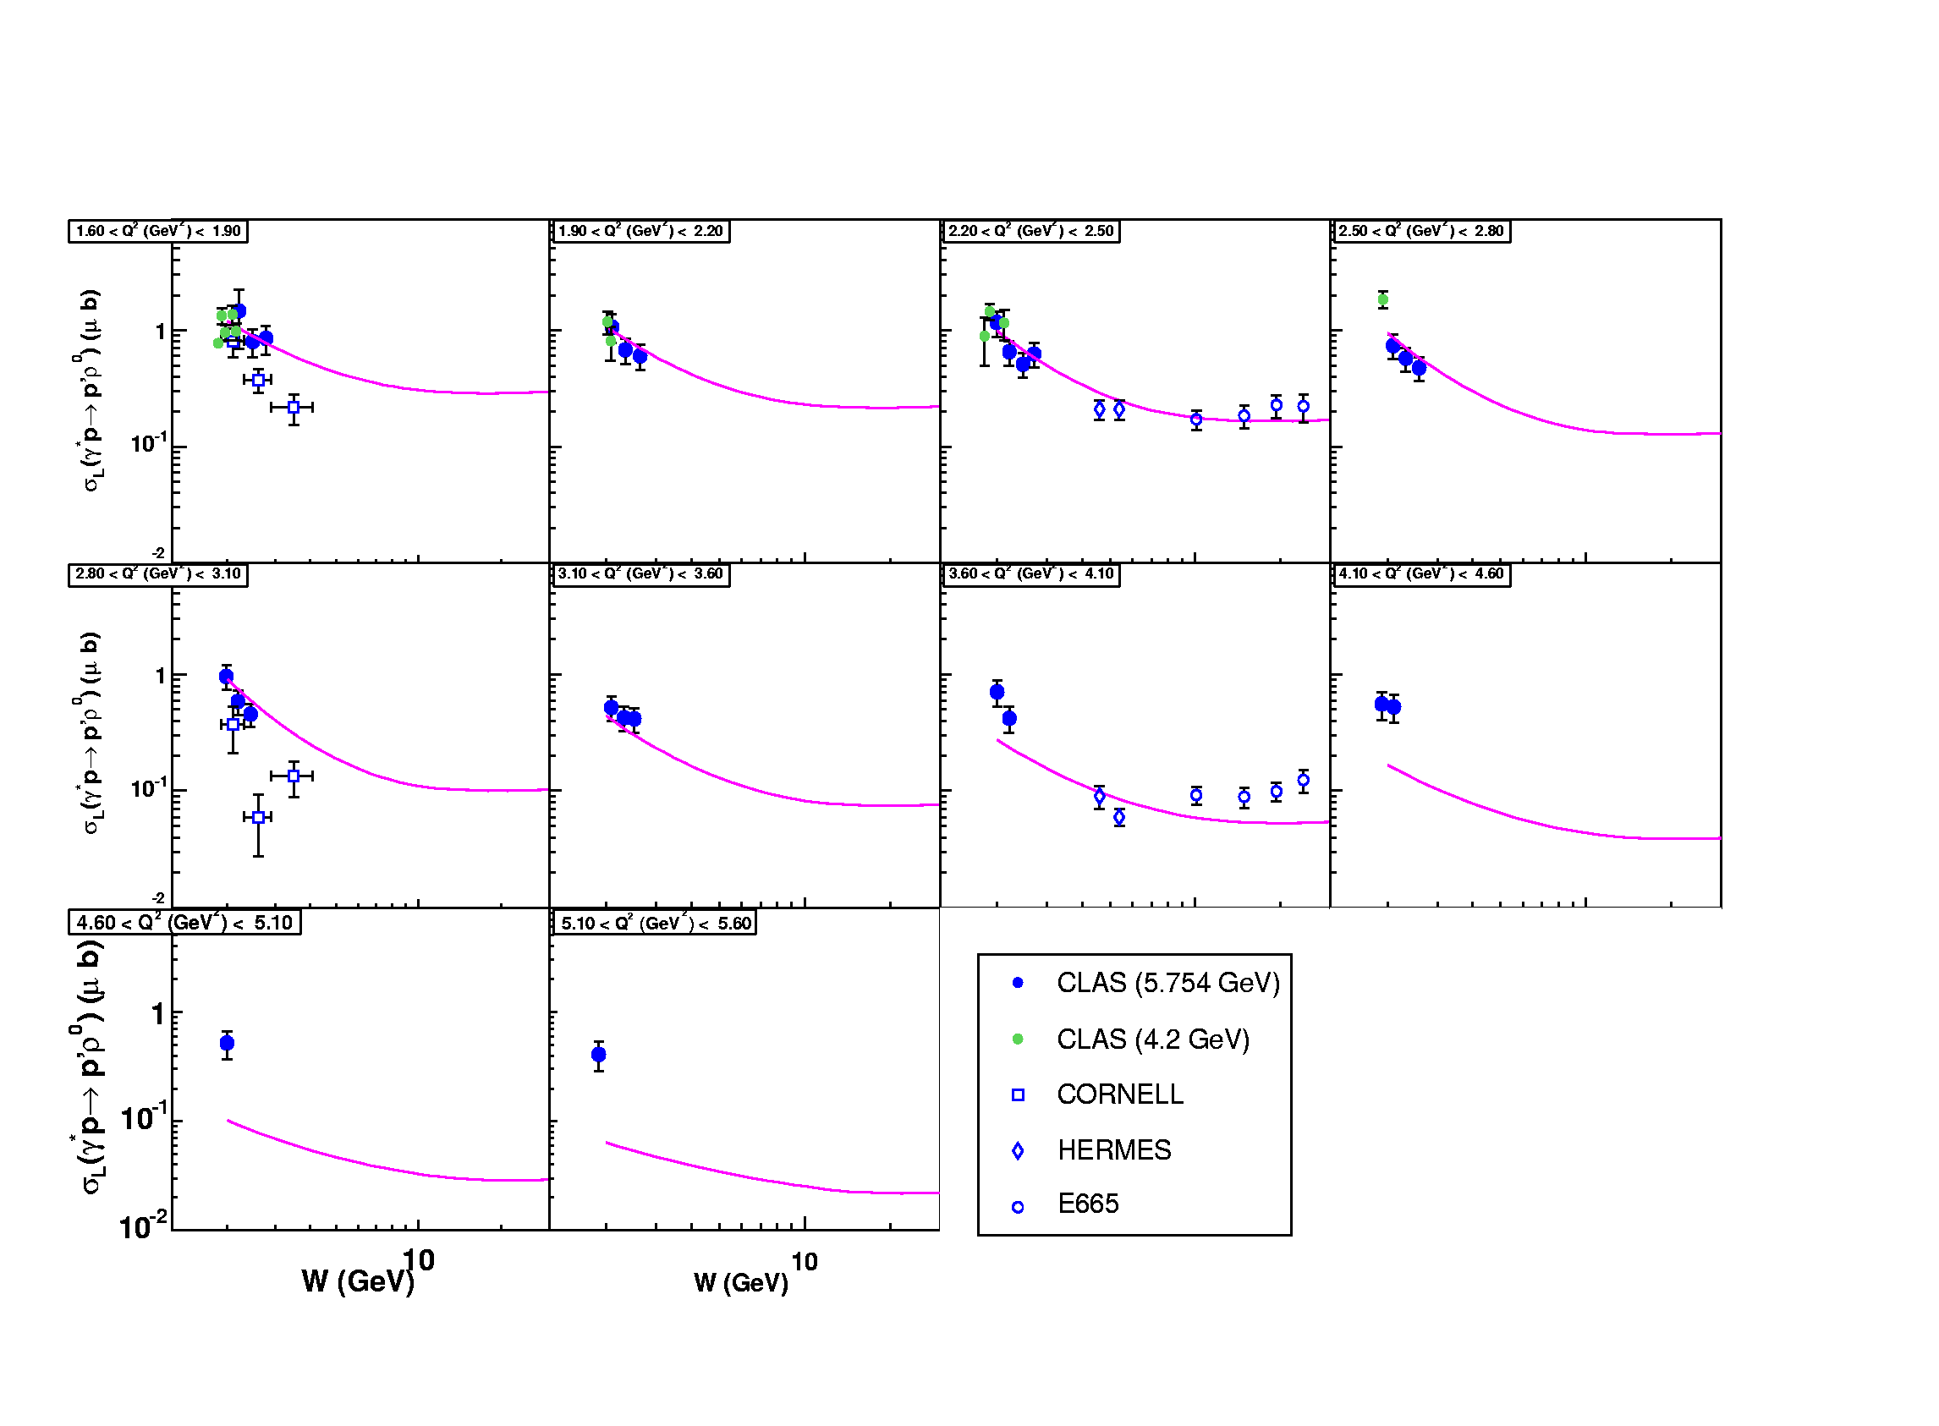
σ_{L} (γ*_{L}p → pρ_{L}⁰)
σ,f₂
Pomeron
Regge/Laget

Slide 21
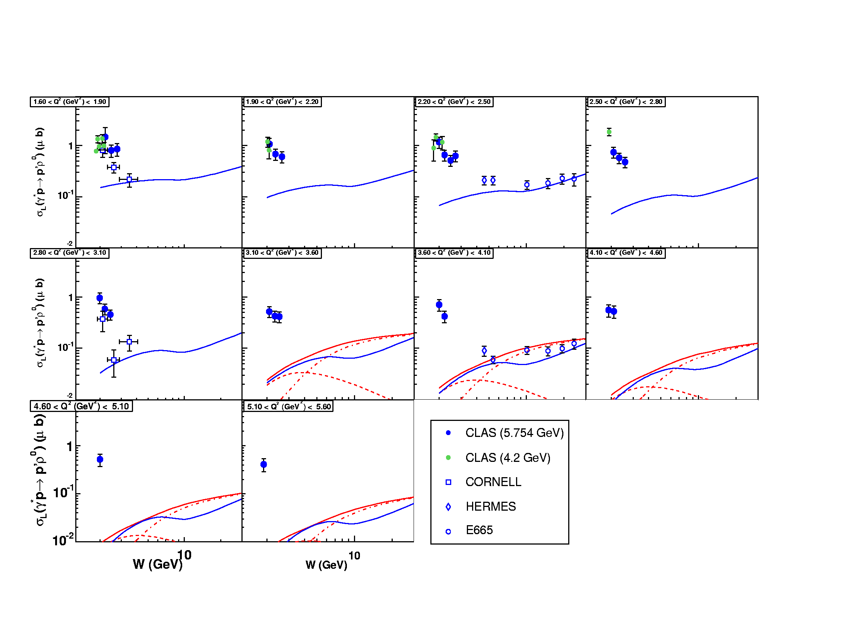
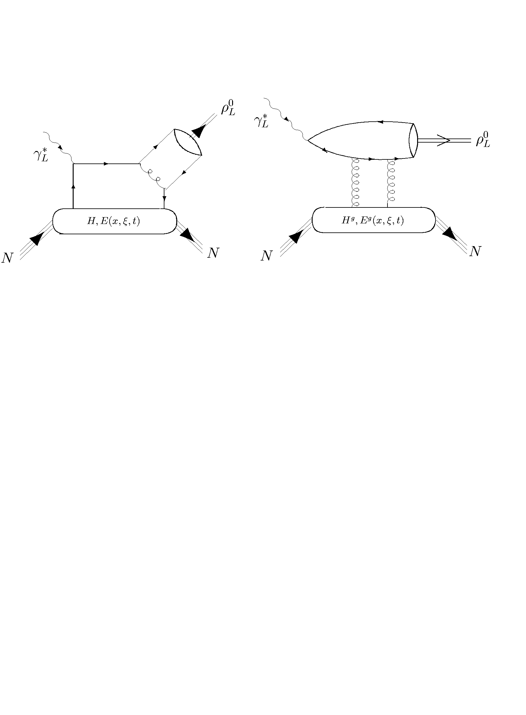
GK GPD model
VGG GPD model

Slide 22
Cross section σ(γ*p → pω)
Laget Regge model
for γ*p → pω
Laget σ_{T}+εσ_{L}
Issue with GPD approach if
π⁰ exchange dominant :
~
Laget εσ_{L}
VGG εσ_{L}
(H&E)
π⁰->E
while
~
E subleading in handbag for VM production

Slide 23
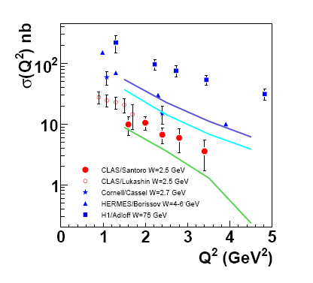
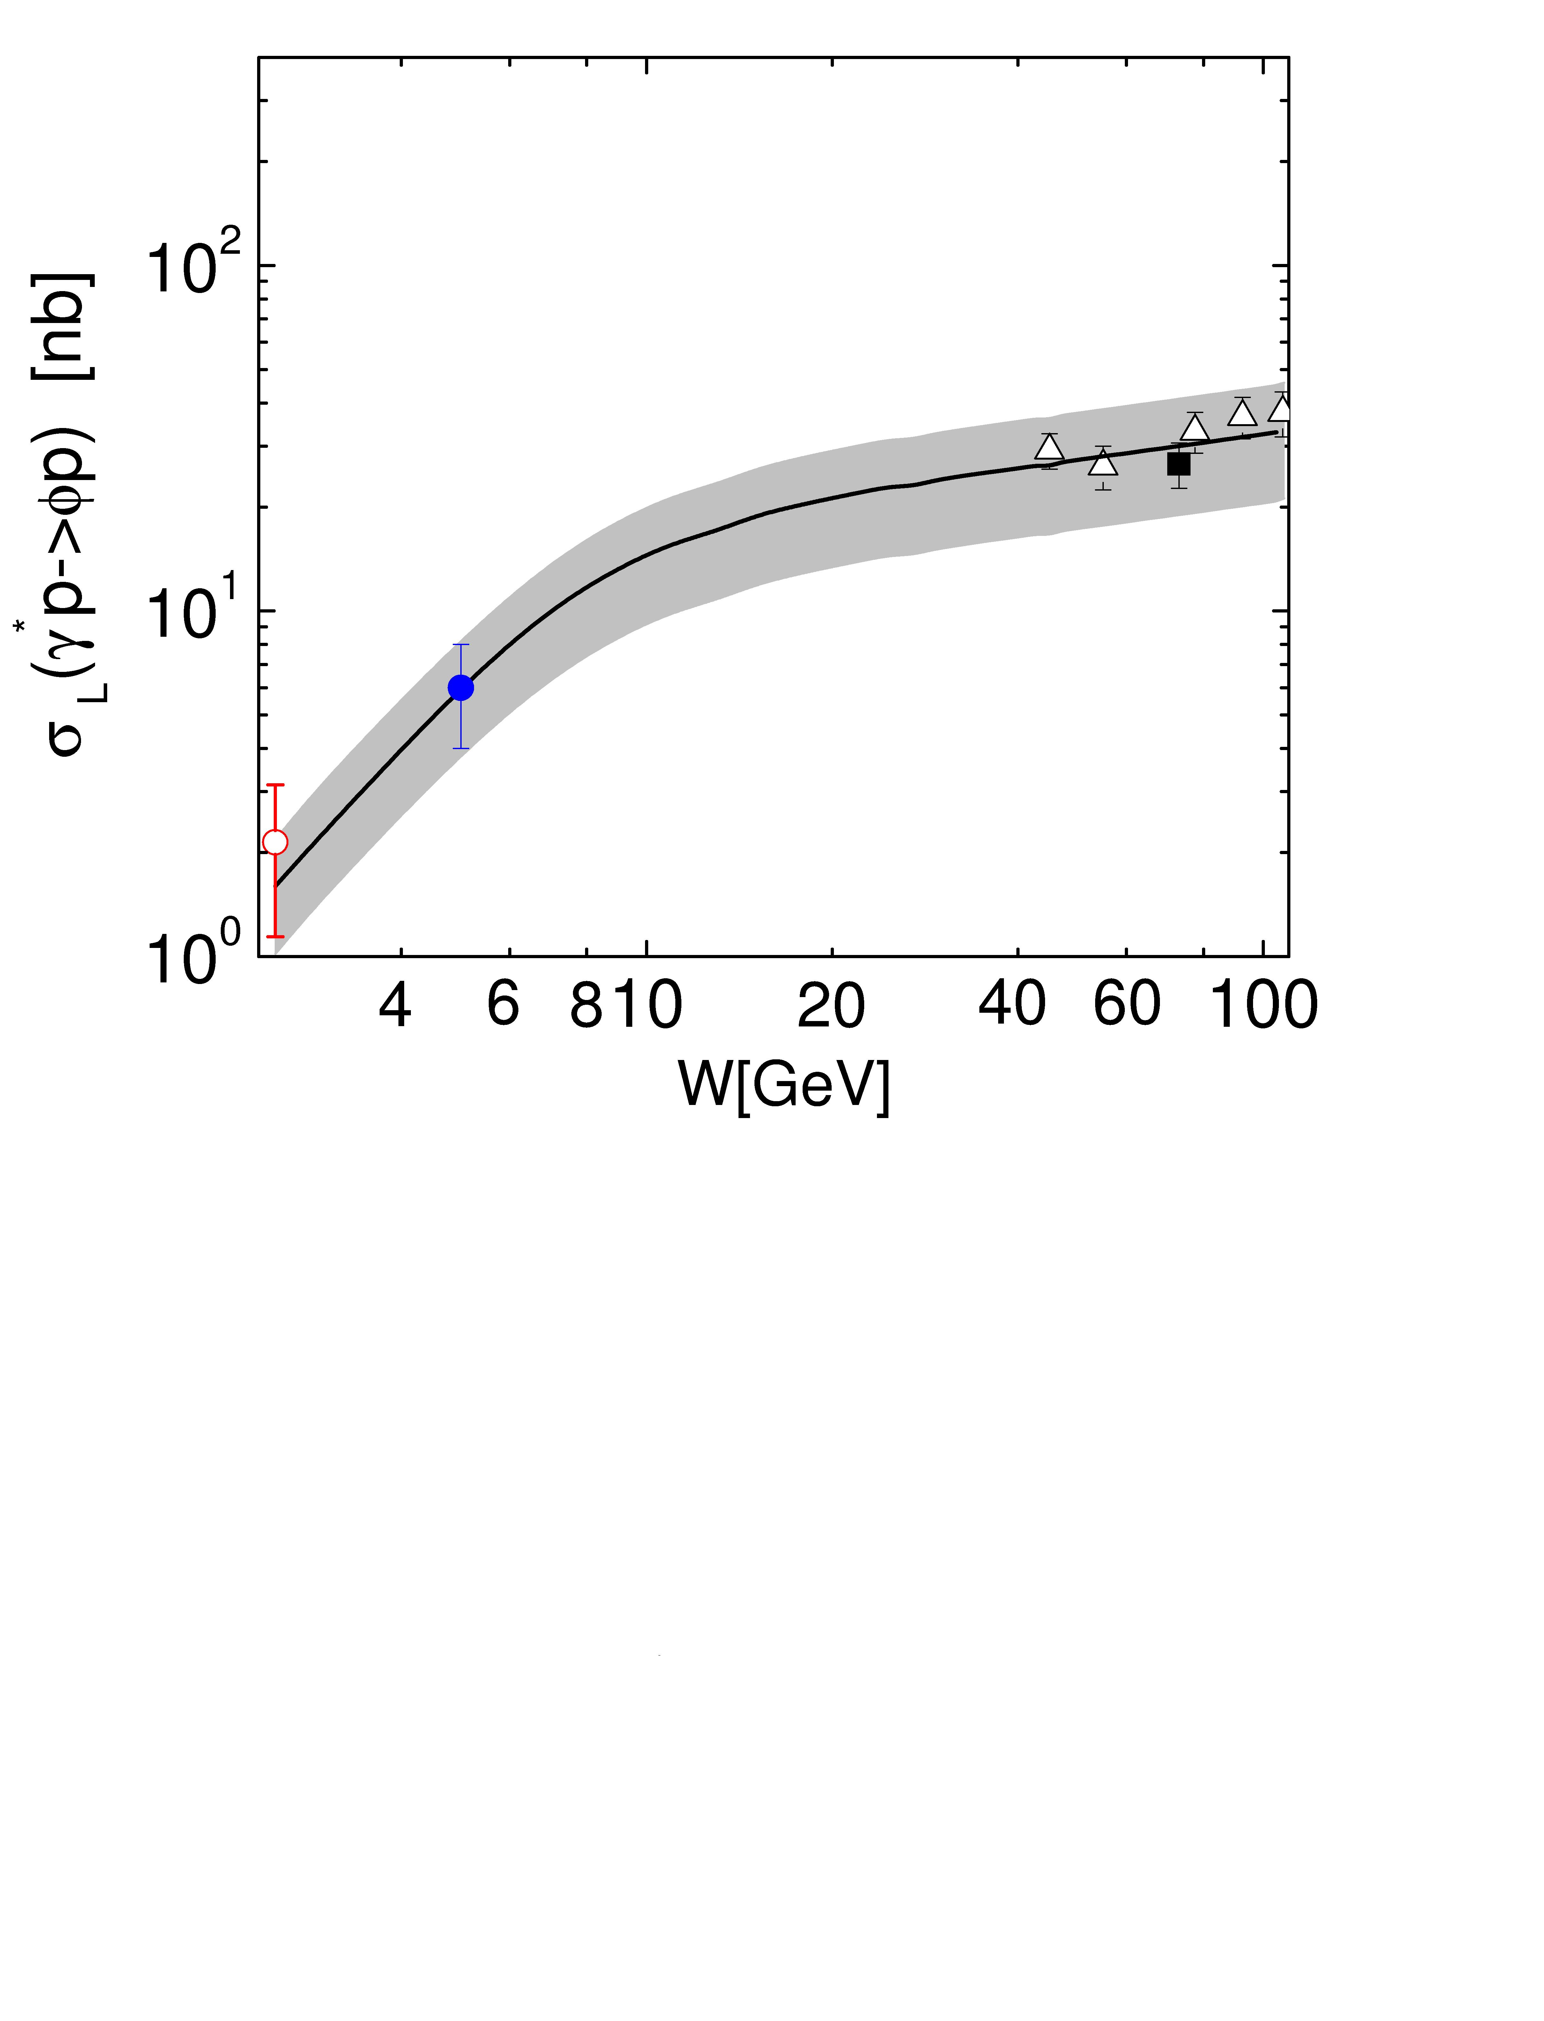
Laget σ_{T}+εσ_{L}
W=2.9 GeV
W=2.45 GeV
W=2.1 GeV
GK σ_{L}
φ_{L}

Slide 24
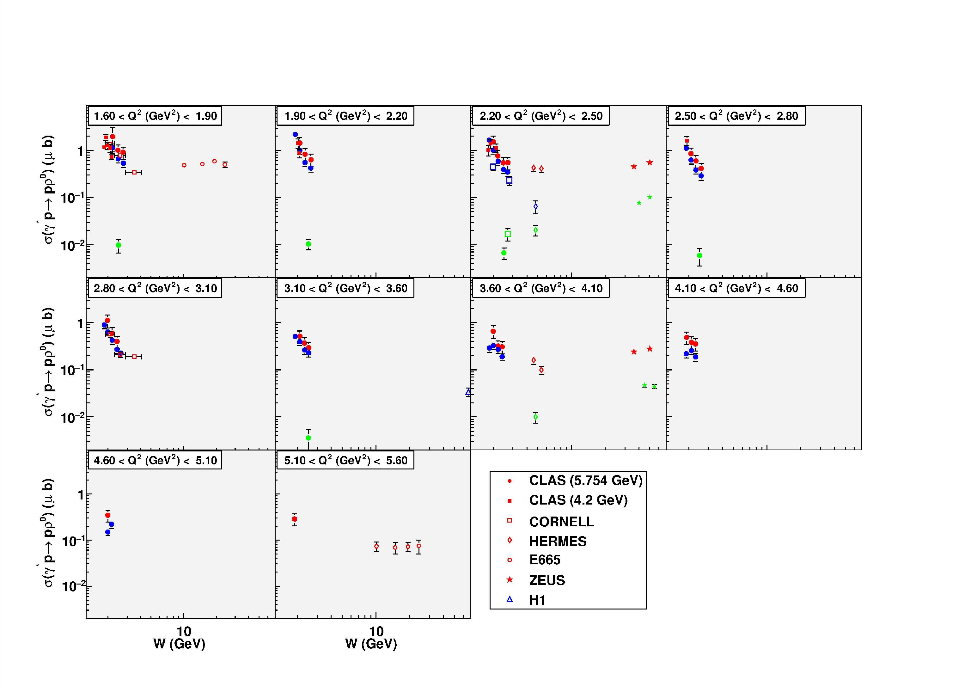
ρ
ω
φ

Slide 25
Exclusive electroproduction of the ρ⁺ on the proton at CLAS
e(5.75 GeV) p→ e n ρ⁺ → e’ n π⁺π⁰
AHMED FRADI
Institut de Physique Nucléaire d’Orsay (France)
CLAS Collaboration meeting
Genoa, 27/02/2009
Notes:
25

Slide 26
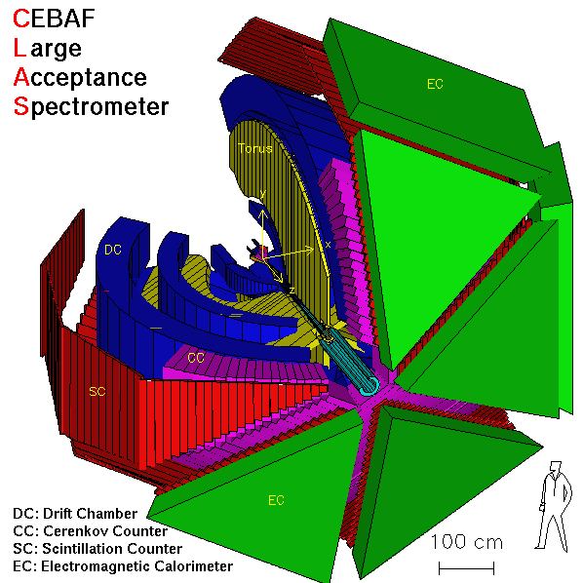
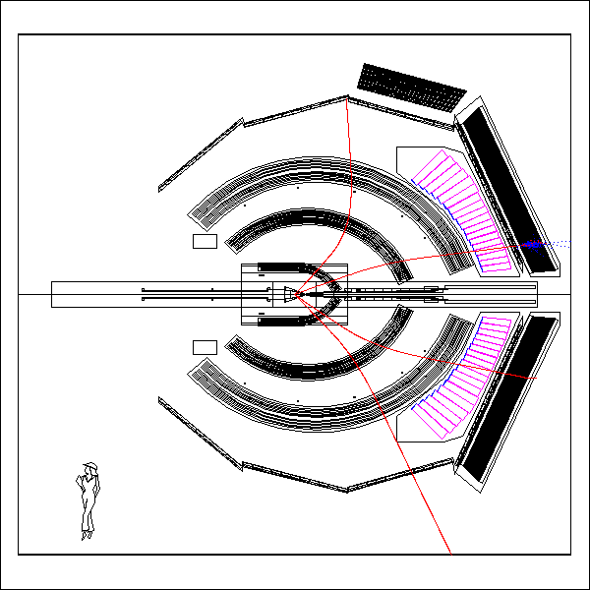
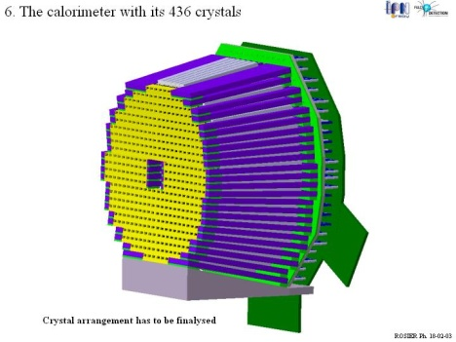
Channel selection
e p→ e’ [n] ρ⁺ → e’ [n] π⁺π⁰→ e’ [n] π⁺ γ γ
π⁺
EC
e
γ
γ
(π⁻)
(p)
An event in CLAS
IC
Notes:
26

Slide 27
“Hadronic approach”:
JML model
ρ⁺
ρ⁰

Slide 28
“Partonic approach”:
GPDs
(*)
ρ⁺
ρ⁰
VGG GPD model
GK GPD model
Notes:
28

Slide 29
2 days ago: (Peter Kroll)
μb/GeV²
?
Hint:
dσ_{L}/dt (ρ+)
?

Slide 30
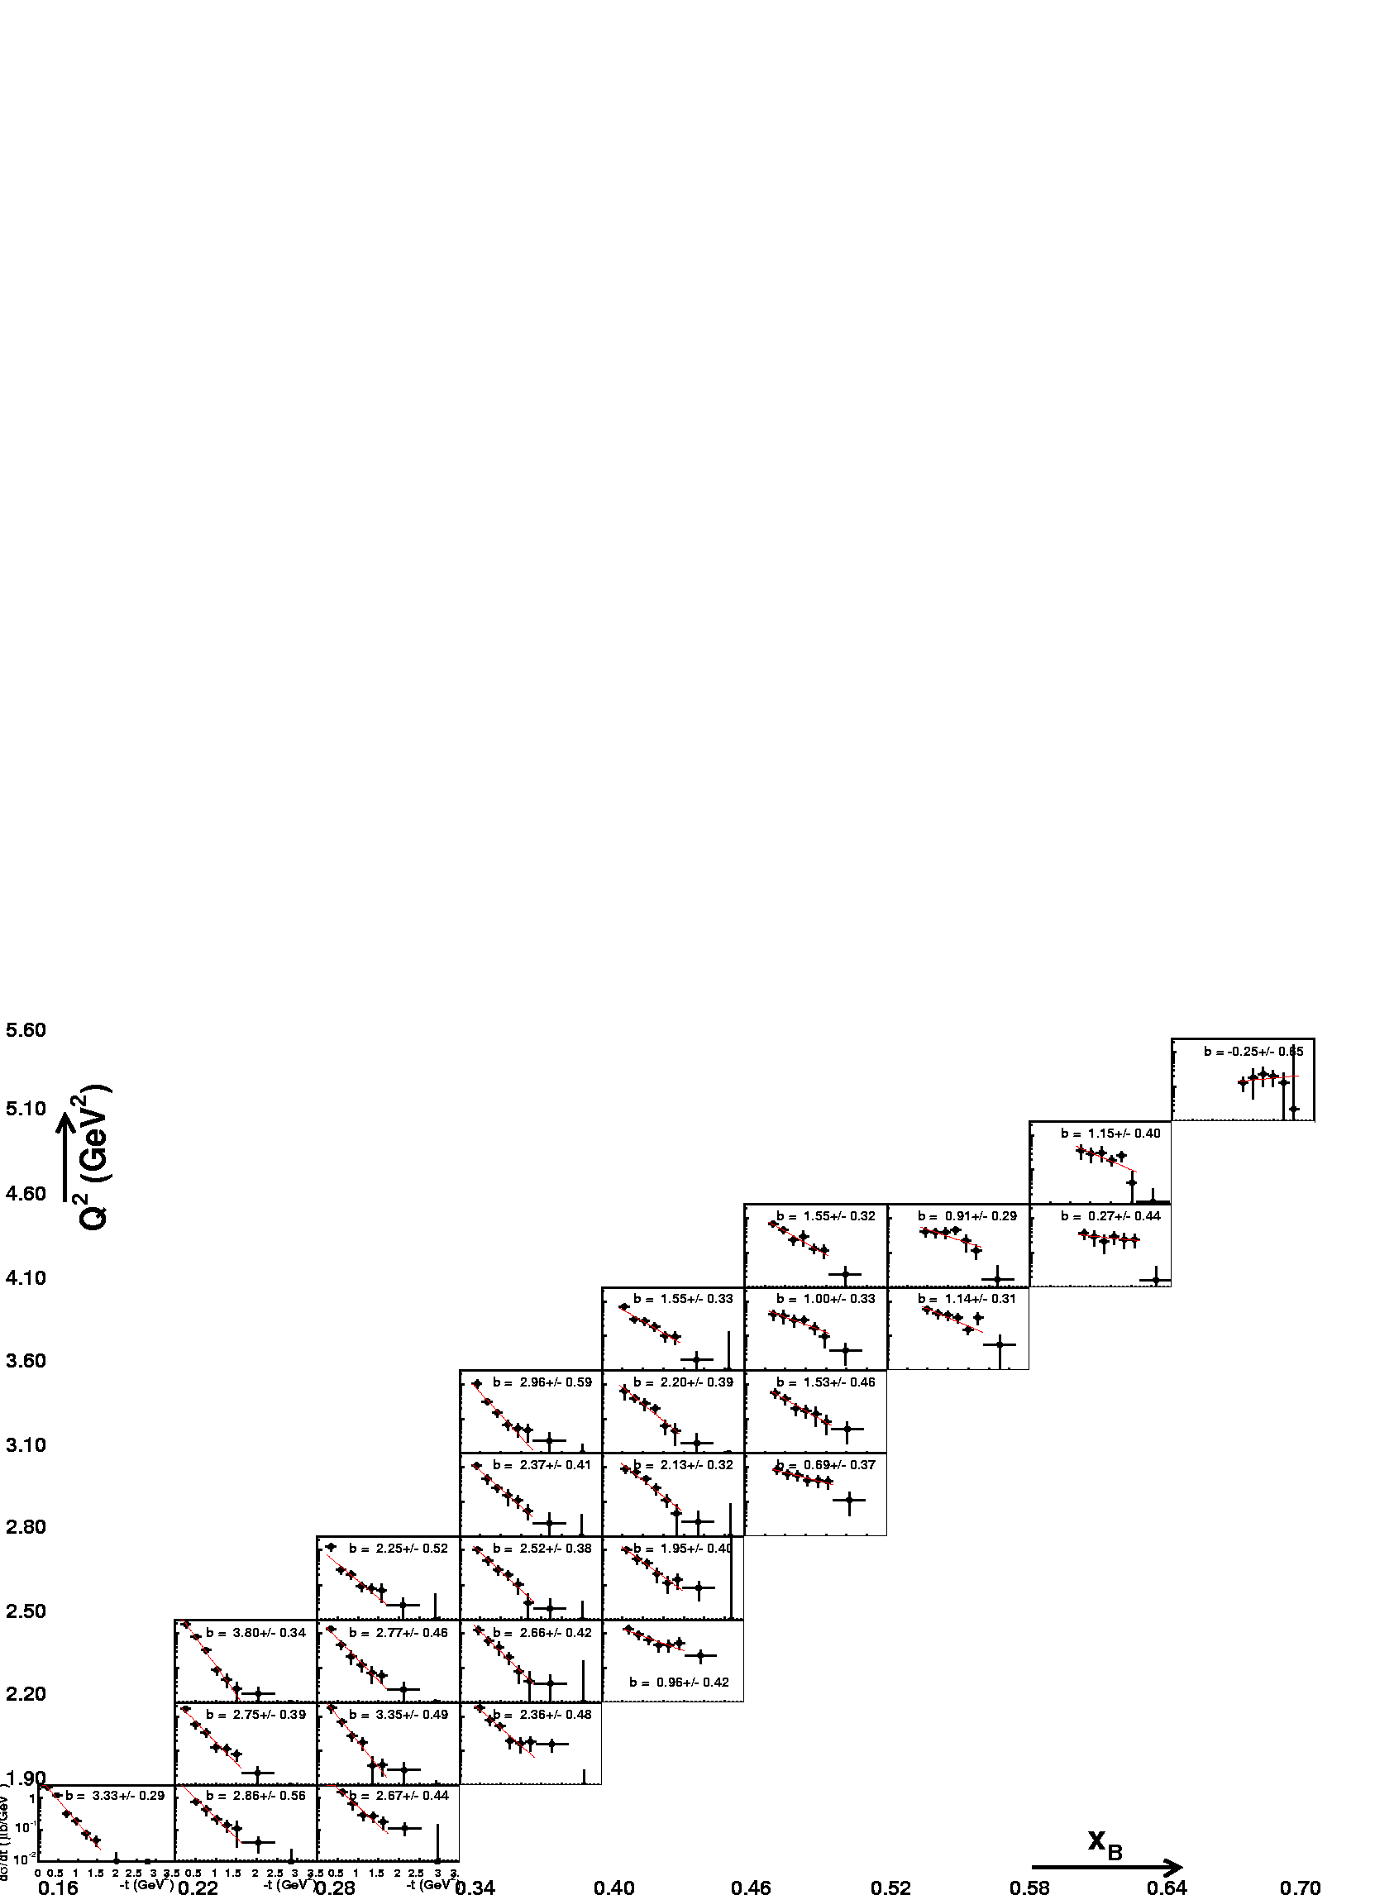
dσ_{L}/dt (ρ⁰)

Slide 31
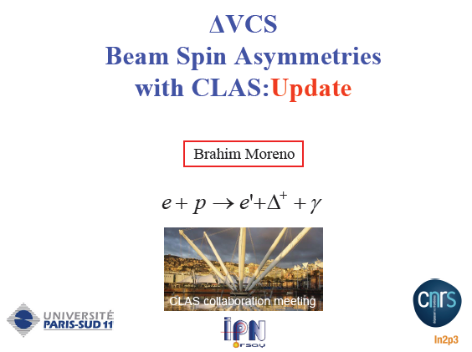

Slide 33
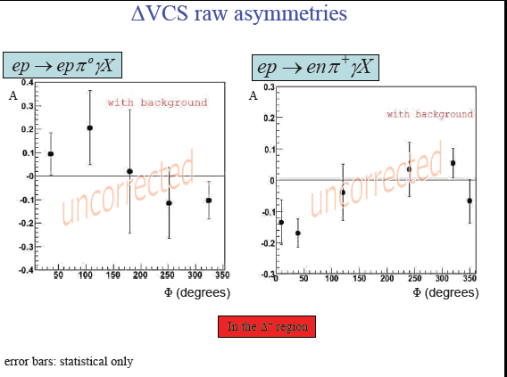

Slide 36
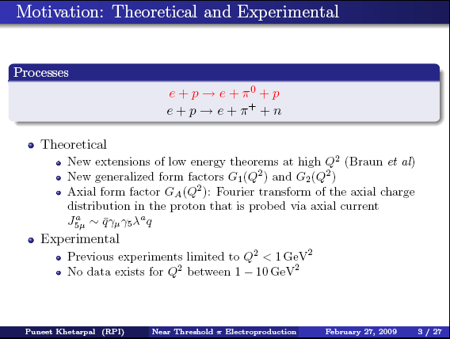

Slide 37
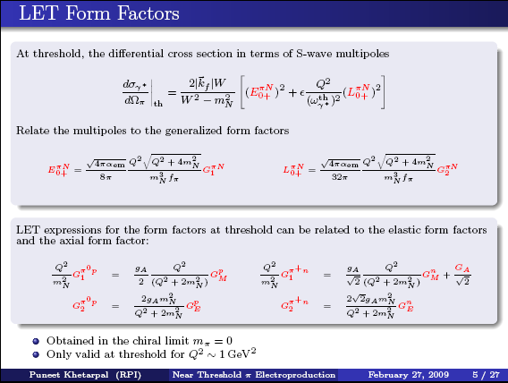

Slide 40
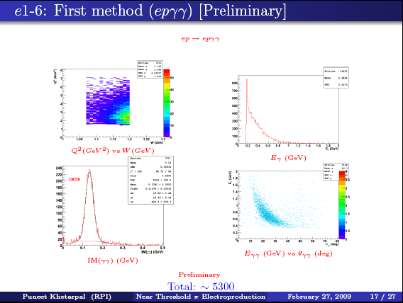

Slide 41
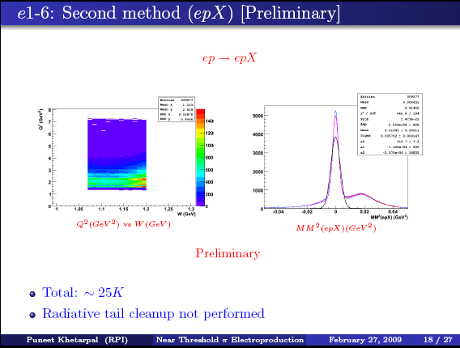

Slide 43

Status of Semi-inclusive Pion Electroproduction Analysis for E1-F
W. Gohn, K.Joo, M.Ungaro
University of Connecticut
H. Avakian
Jefferson Lab
CLAS12 European Workshop
Feb. 27, 2009

Slide 44
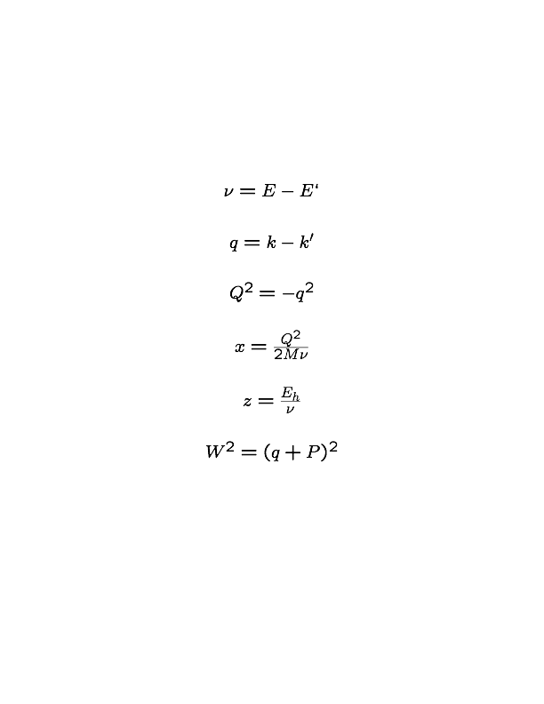
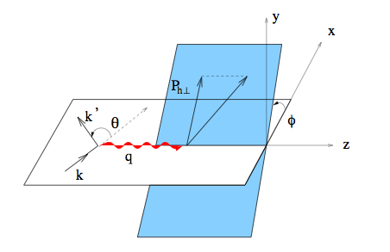
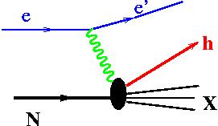

SIDIS Kinematics
Requires:
P

Slide 45
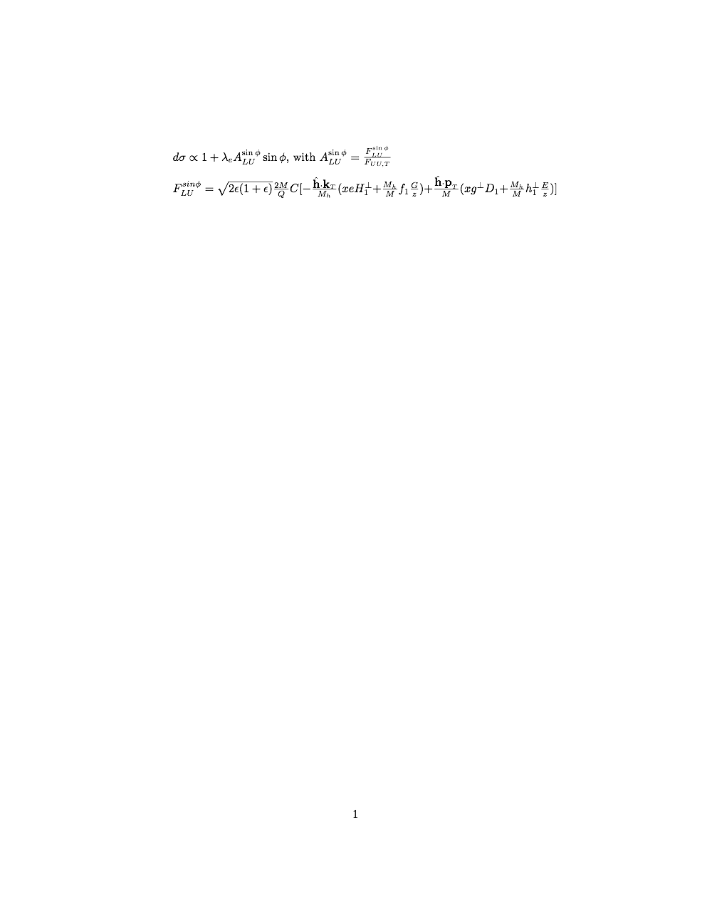
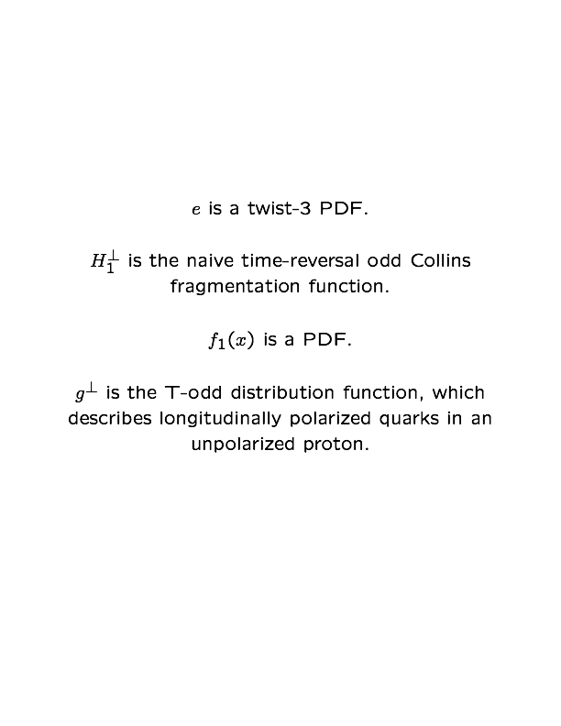
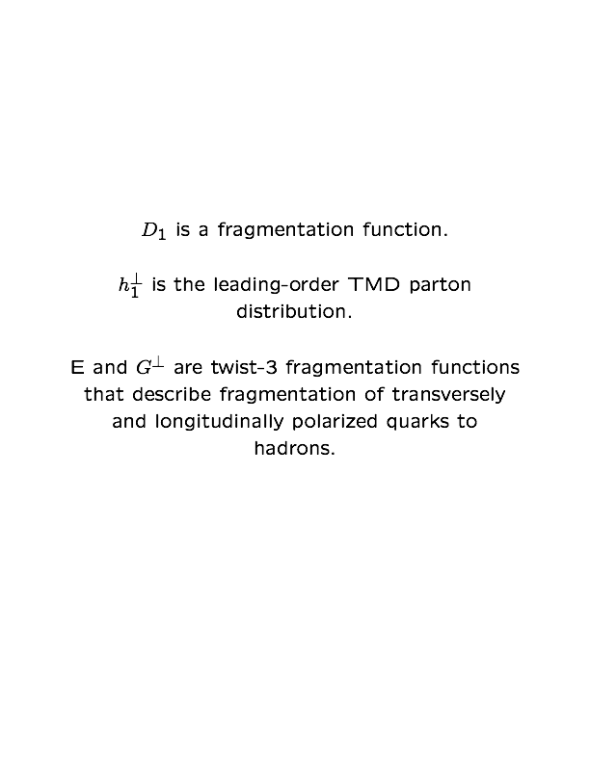

Motivation for Measurement of Beam-Spin Asymmetry
The beam-SSA provides important information about nucleon structure.
A. Bacchetta, M. Diehl, K. Goeke, P. Mulders, & M. Schlegel,
hep-ph/0611265v2, 2007
45

Slide 46
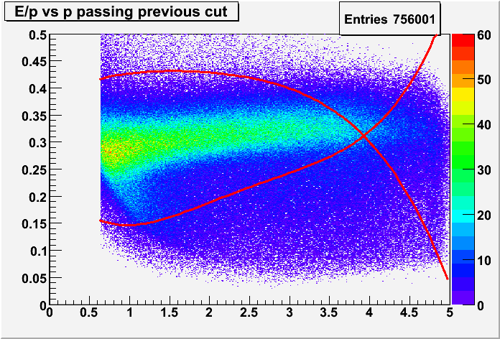
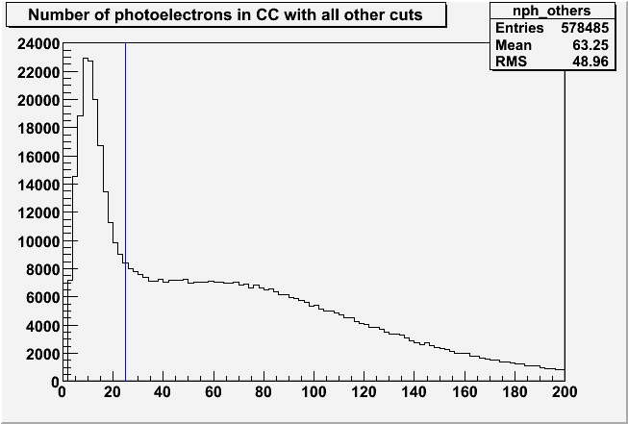
Electron ID
p
npe*10
E/p should be constant in p for very fast electrons. Hence, all candidates outside of the red curves are cut.
Electrons will leave many photoelectrons in the CC, so those candidates to the left of the blue line are cut to eliminate electric noise.
46

Slide 47
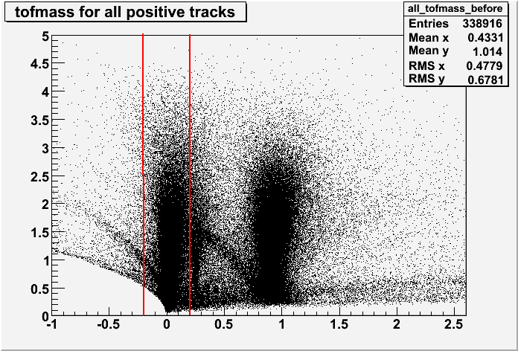
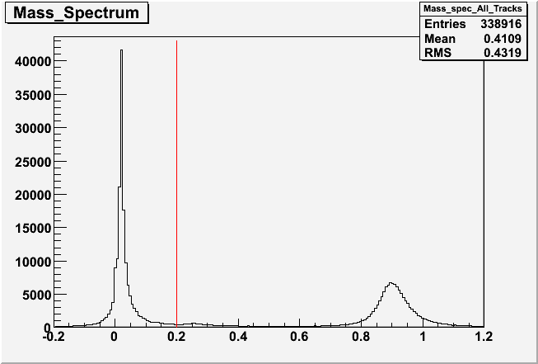
Charged Pion Identification
Here positive pions are shown as an example. The plots for negative pions are similar.
p [GeV/c]
M² [GeV²]
A cut is placed on mass-squared of 0.2, as determined by the time-of-flight system.
M² [GeV²]
47

Slide 48
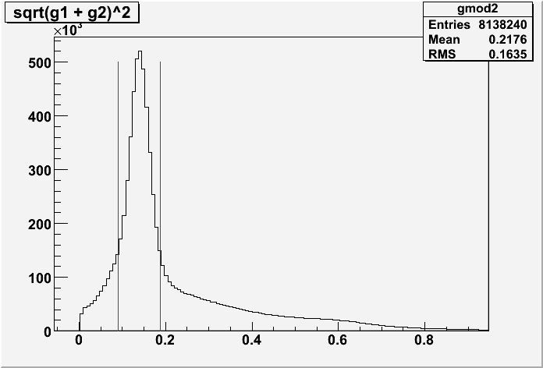
π⁰ Identification
Pions are selected from two-photon events in the EC. No internal calorimeter (IC) is used. Therefore we see a different kinematic range than do those experiments using an IC to detect neutral pions.
Neutral pions are selected by putting a cut around the pion mass in the two-photon invariant mass spectrum
Only photons with energy > 0.2 GeV are used.
IM [GeV]
48

Slide 49
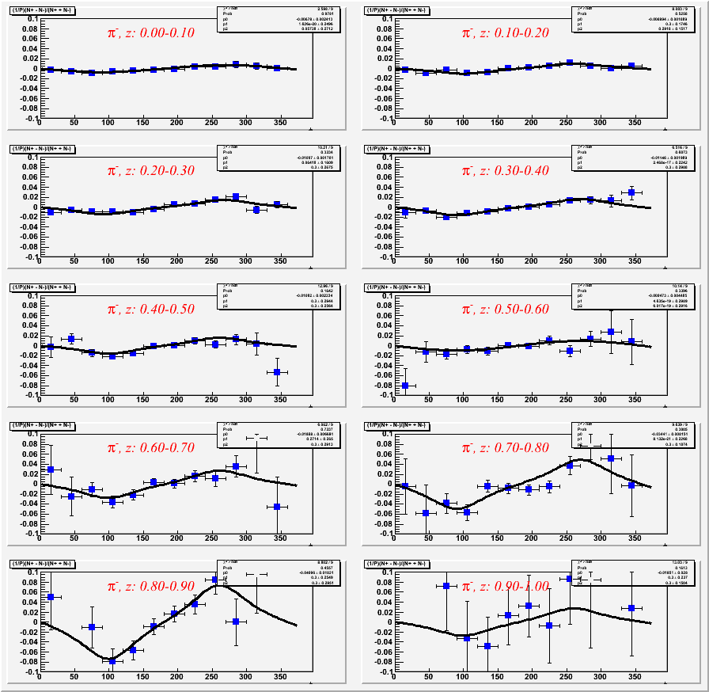

Beam-Spin Asymmetries
Fitting Procedure
Error bars are statistical only.
Ten bins in z and twelve in φ.
Semi-inclusive range is expected to be for 0.4<z<0.7 for CLAS kinematics.
Compared fits with
and

Slide 50
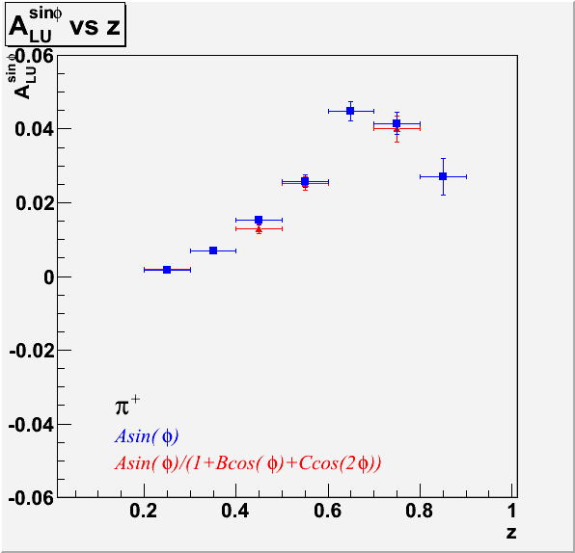
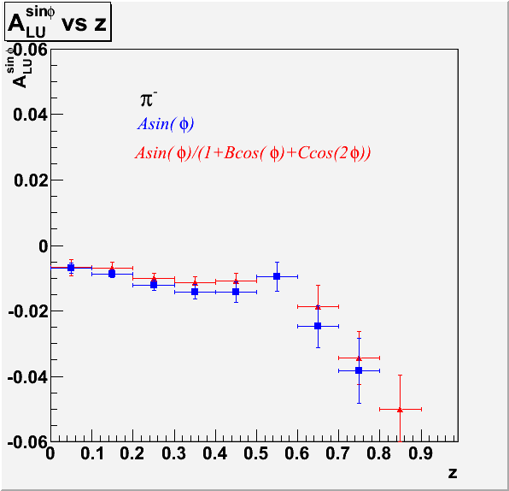
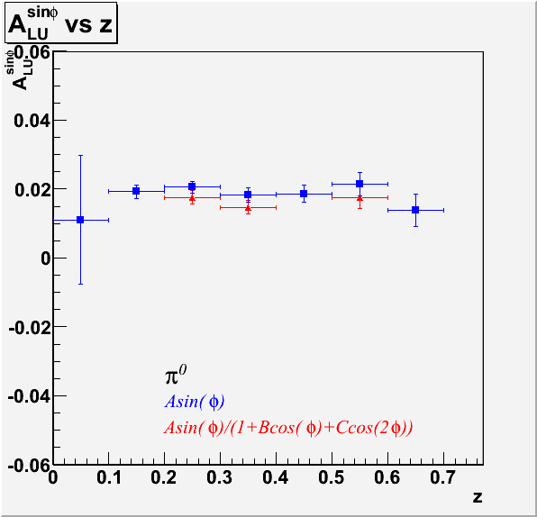
Sinφ Moments z-dependence
Isospin symmetry says π⁰ will give weighted average of charged pion results.
Opposite deflections in current fragmentation region.
^{Preliminary}
z-dependence of π⁰ could be related to g|.
Charged π z-dependence has been shown to be related to Collins function.

Slide 51
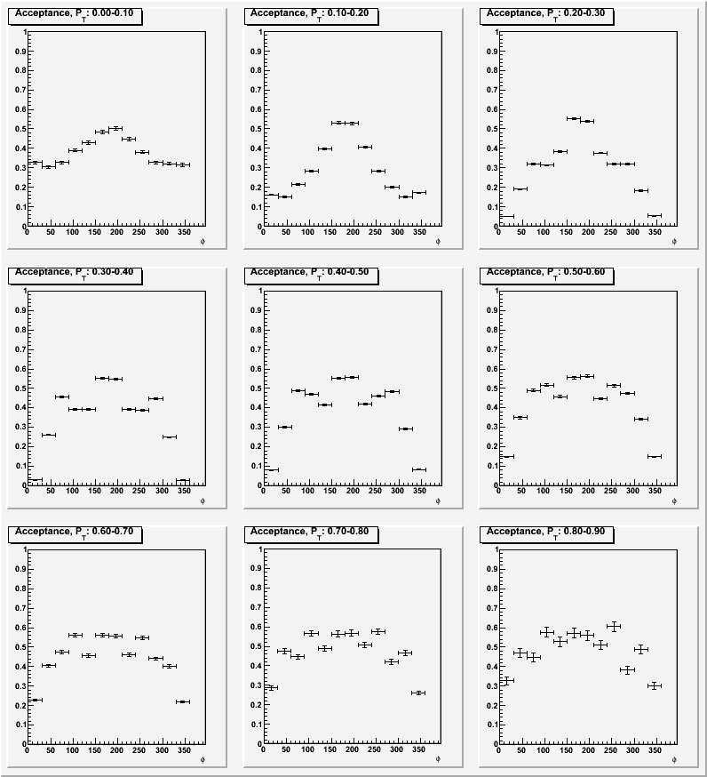
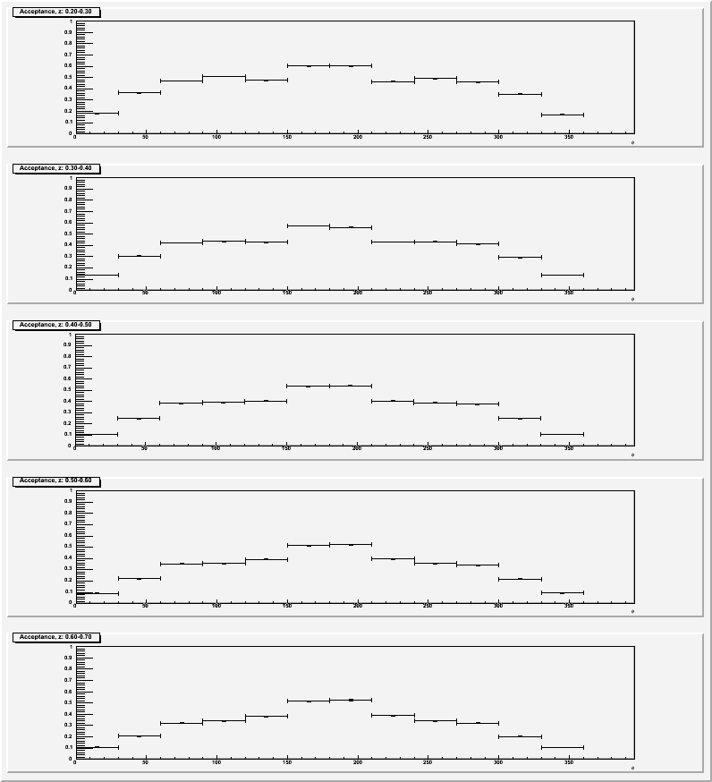
Acceptance
z-binning
P_{T}-binning

Slide 52
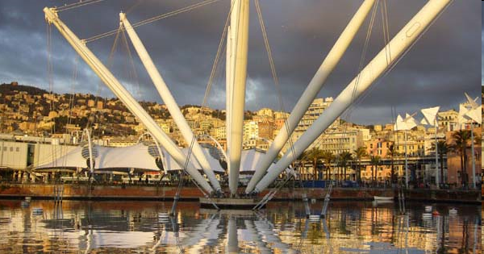
Studies of Spin-Orbit Correlations with CLAS
Harut Avakian (JLab)
Deep PWG, Genova, Feb 27

Slide 53
Outline
Physics motivation
  spin-orbit correlations and widths of PDFs
Spin asymmetries from eg1:
  A1 measurements for pions
  Extraction of g1 width from pi+ data
Summary
Notes:
After an introduction of main transverse momentum dependent parton distributions
accessible with transverse target, I’ll discuss run conditions, CLAS configurations and
Projected results. In the end I’ll present one example of extraction of the Sivers function from
Projected measurements.

Slide 54
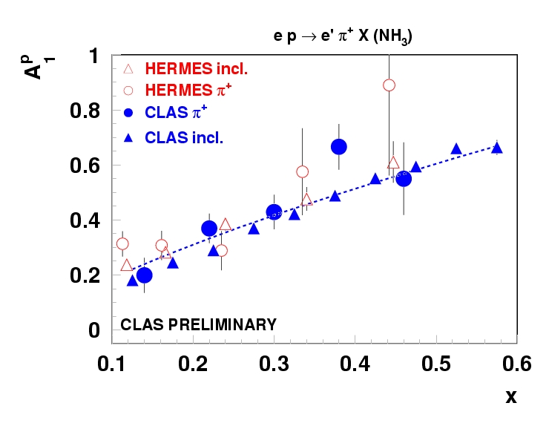
Polarized target: HERMES vs CLAS at 5.7GeV
ep → e’ π⁺ X ( E_{e} =5.7 GeV, M_{X} > 1.1)
x dependence of CLAS A₁^{p} (A┴=0) consistent with HERMES data
Δu/u from CLAS EG1 is consistent with GRV(GRVS) PDFs

Slide 55
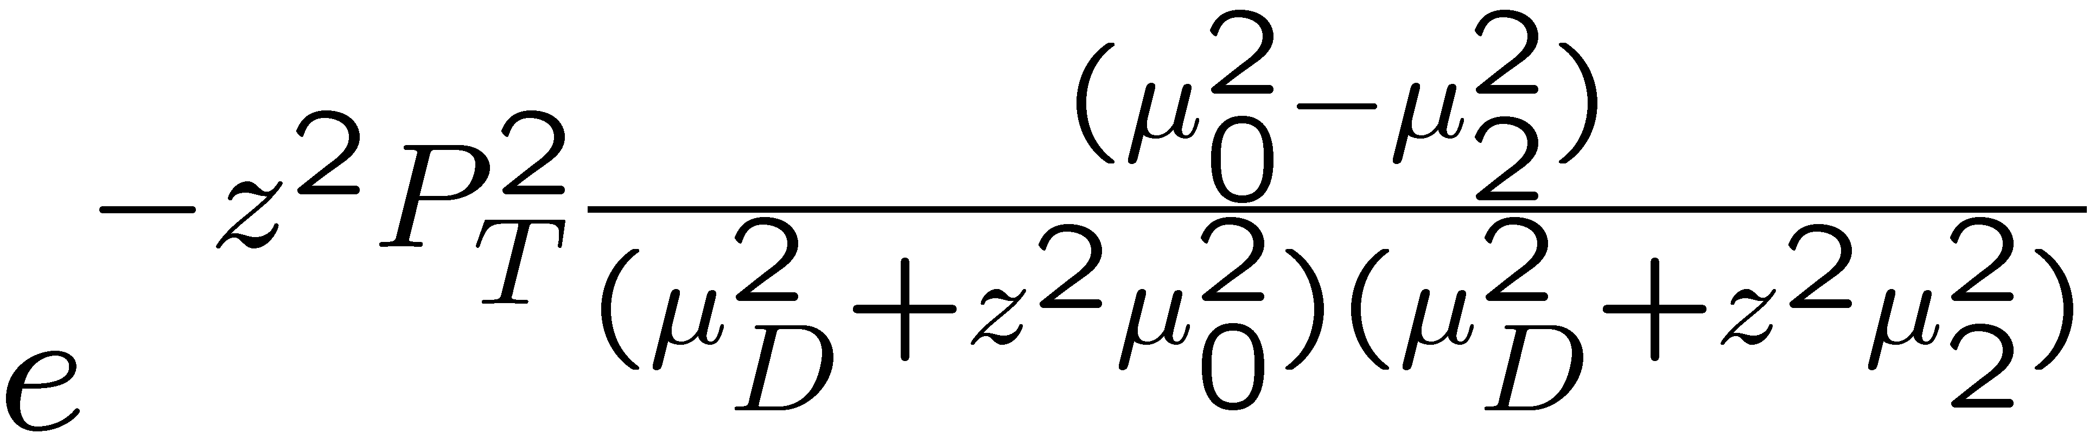
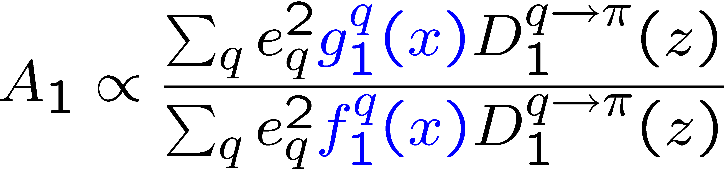
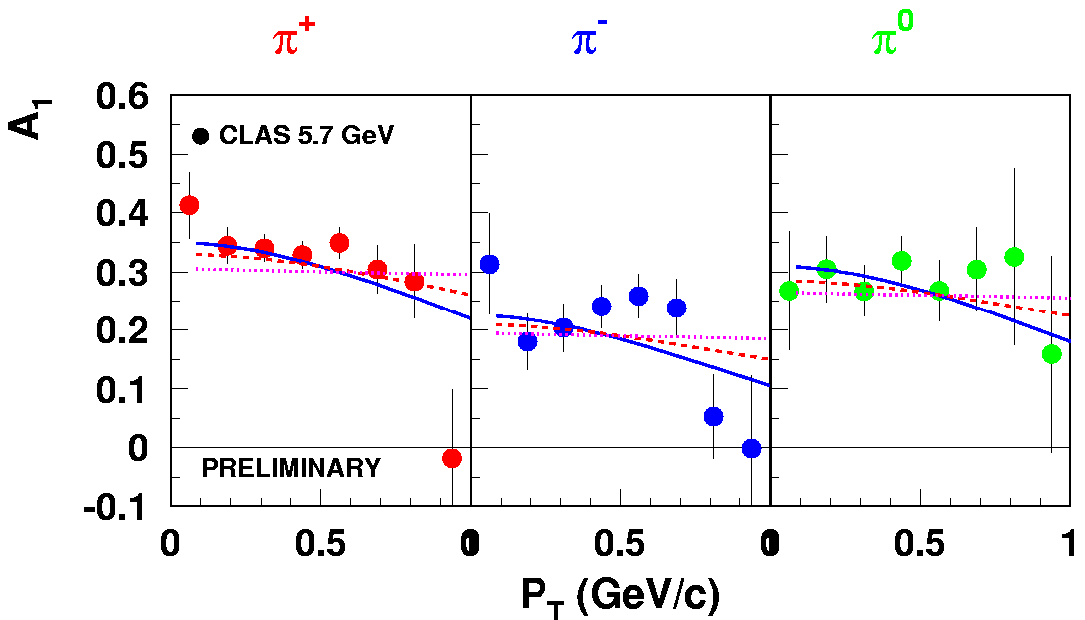
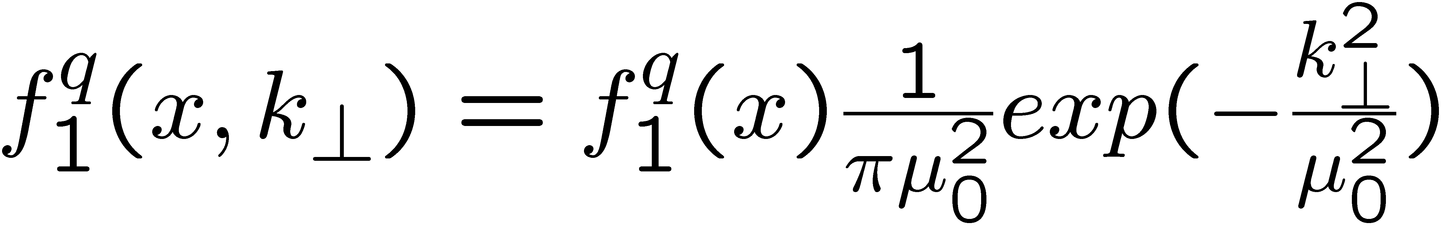
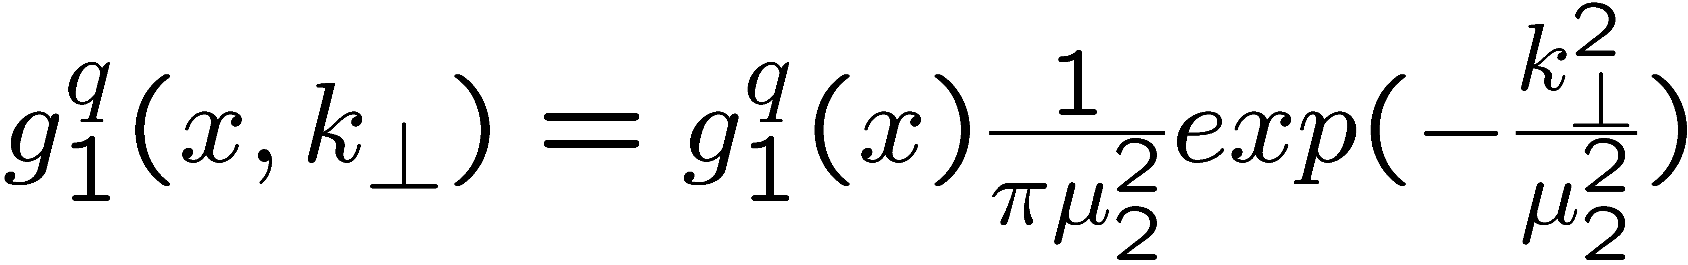
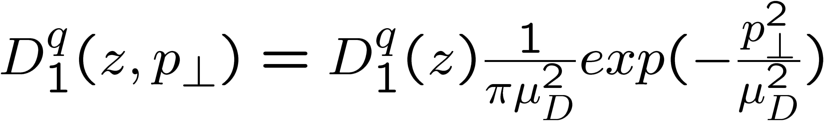
A₁ P_{T}-dependence in SIDIS
0.4<z<0.7
M.Anselmino et al hep-ph/0608048
μ₀²=0.25GeV²
μ_{D}²=0.2GeV²
more data in 2009!
π+ A₁ suggests broader k_{T} distributions for f₁ compared to g₁
π- A₁ may require non-Gaussian k_{T}-dependence for different helicities and/or flavors

Slide 56
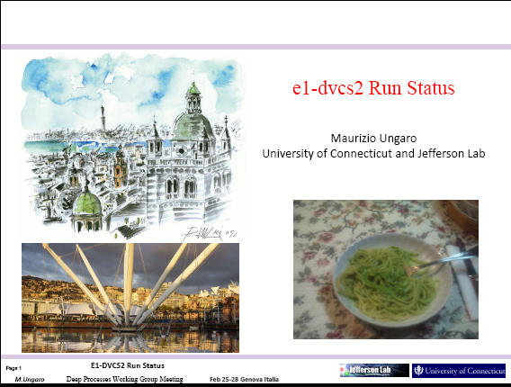

Slide 58
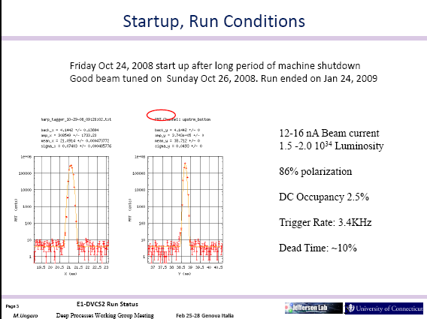

Slide 62
EG1-DVCS
Highlights and Status
Erin Seder
University of Connecticut

Slide 63
Experimental Goals
DVCS
  ep epγ
    A_{UL}
    A_{LL}
DVMP
  ep epπ⁰
    A_{UL}
    A_{LL}
  ep epη
    A_{UL}
    A_{LL}
SIDIS
  ep eπ X
    A_{UL}
    A_{LL}
0
+
-

Slide 64


NMR Monitoring
Positive
Negative
changing polarizations
139.61GHz
121.33A
μ wave frequency
139.90GHz
121.4A
Magnet current
Top
target
Bottom
target
anneal
pos
neg
neg
pos
pos
neg

Slide 65

Accumulated Charge
Beam energy = 5911 GeV
Beam current = 7 nA

Slide 66


Kinematic Plots for ep->eX
Electron PID:
dc(), cc(), sc(), ec() > 0,
dc_stat(), ec_stat(), sc_stat() > 0
EC_tot/p > 0.2,
EC_inner > 0.06,
nphe > 25,
minimum momentum cut > 1.0 GeV,
-61 < vertex(e) < -56

Slide 67


Slide 72


