Slide 1
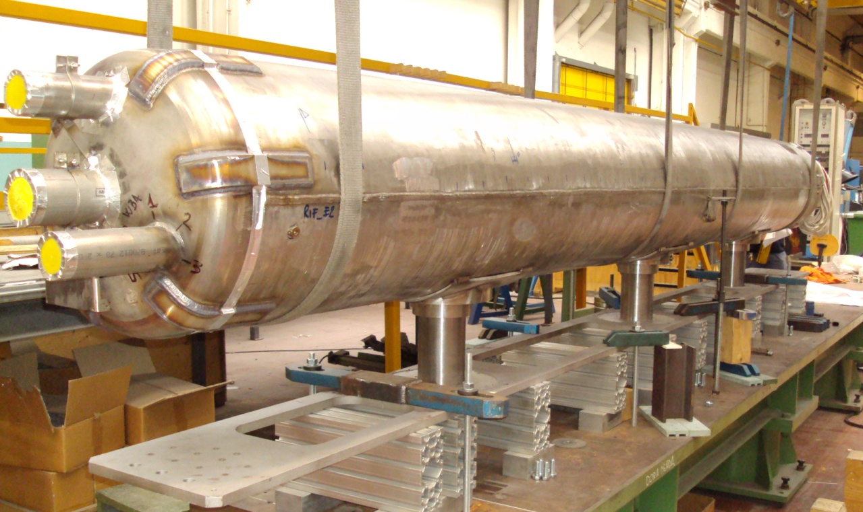
SIS300 dipole magnet
Status of project and future perspectives
P.Fabbricatore
On behalf DISCORAP collaboration

Slide 2
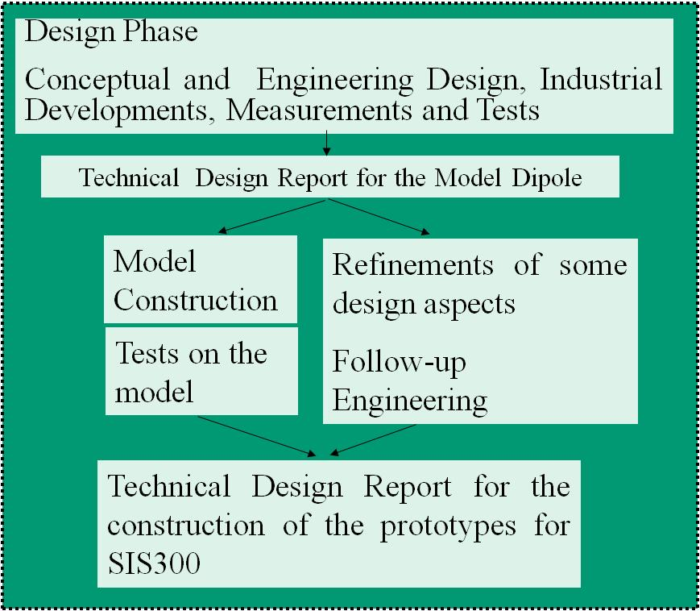
Synopsis
Review in view of the Model Construction.
Process to be ended by Dec.08
Review in view of the Prototypes Construction

Slide 3
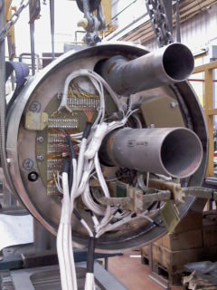
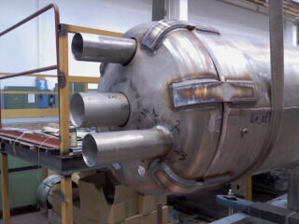

COLD MASS READY FOR CRYOTEST
The cold mass has been finished in ASG-Superconductors. We changed a bit the plan: the end caps flanges (the doomed ones) were not welded in definitive way but only with a temporary welding. The final welding will be done after the test at LASA. In this way we can correct the axial pre-stress if required.
Final welding and certification of cold mass (AD2000) after cold test.

Slide 4
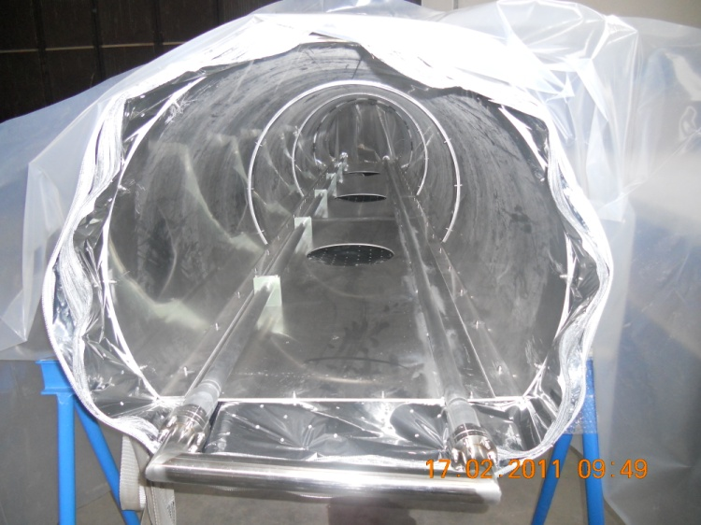
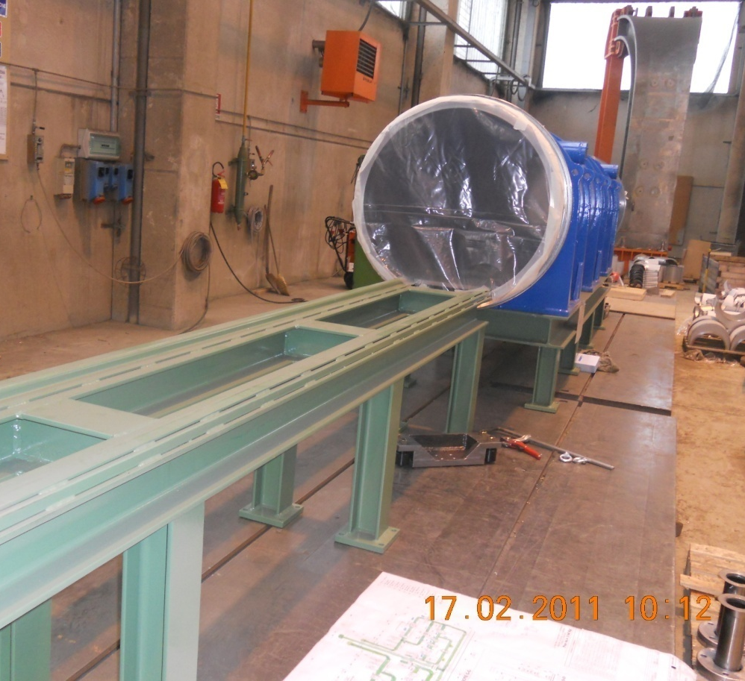
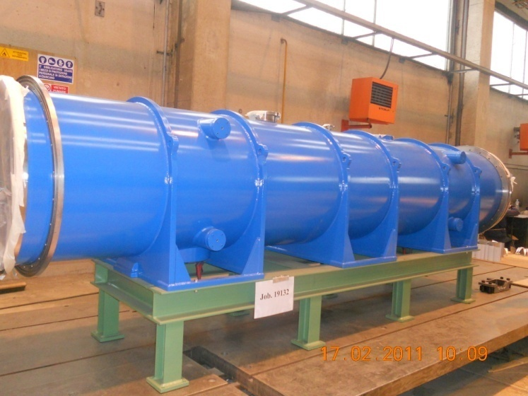
Horizontal cryostat
The cryostat is ready. Presently it is stored at SIMIC up to next summer. Then it will be delivered to ASG Superconductors for integration with cold mass

Slide 5
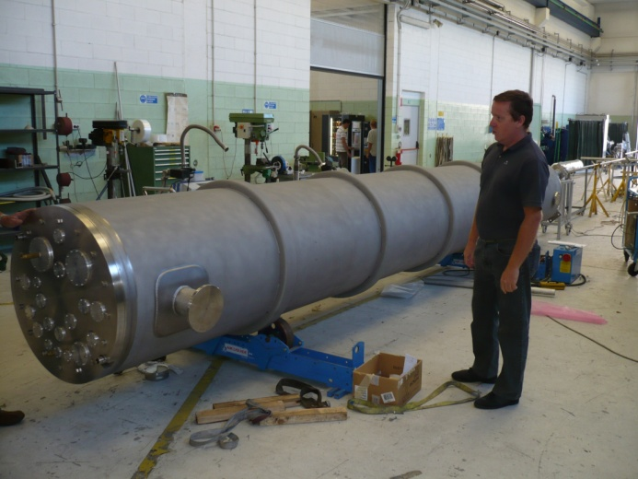
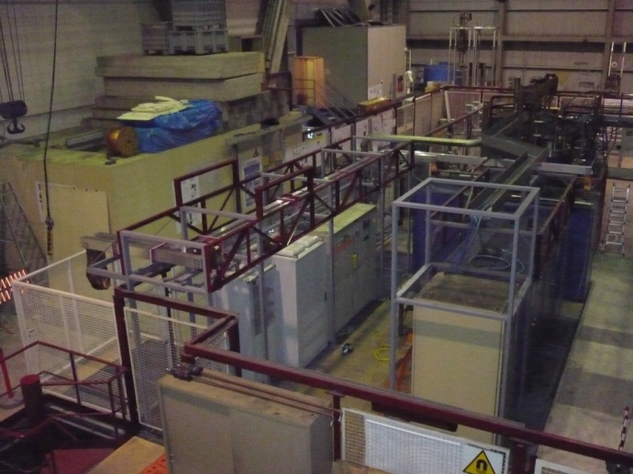
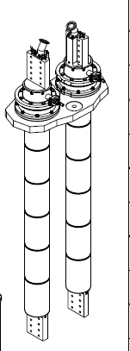
Test al LASA
The facility is ready but some time is required for certification of the new plants for cooldown and test of the dipole

Slide 6
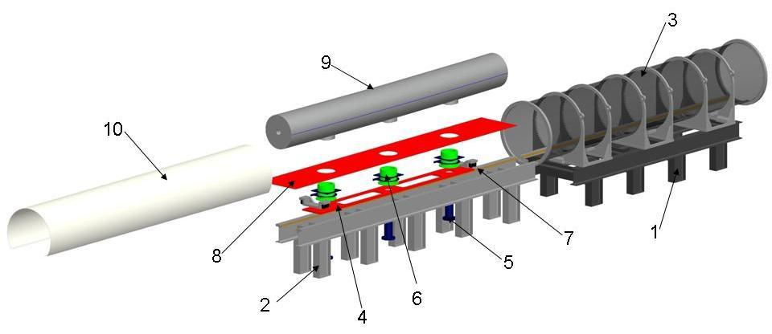
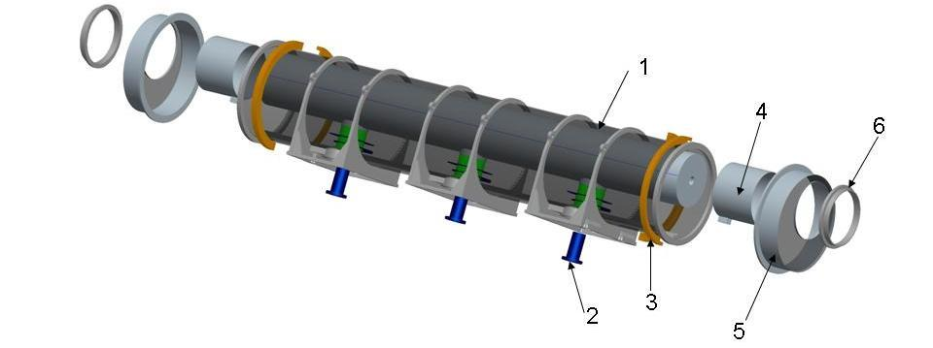
Assembly of cold mass into the cryostat

Slide 7
NEXT MILESTONES
Activity | Date (2011)
Delivery of cold mass to Milano LASA | April
Test station at LASA ready (with vertical cryostat) | May
Test in vertical cryostat | June-Sept
Delivery of cold mass to ASG for completion | Sept.
Completion and assembly in horizontal cryostat | Oct.
Delivery to GSI | Nov

Slide 8
Advanced conductor
Two lengths of advanced conductor were developed with LUVATA
Critical current 15% higher than first generation (involved in the built model)
Transverse resistivity intrawire 40% higher than first generation
Effective diameter 3- 3.5 µm
This conductor is available for the construction of the next advanced short model (unfortunately no new agreement INFN/FAIR is going on)

Slide 9
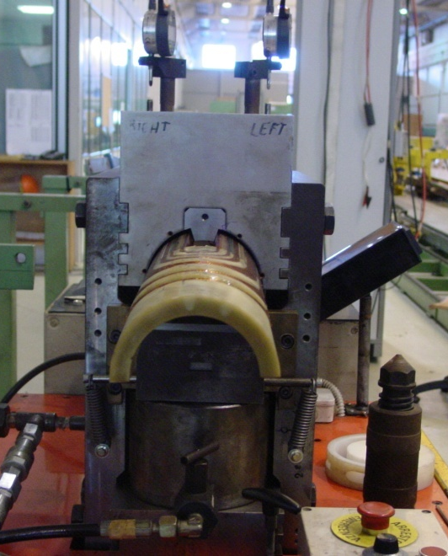
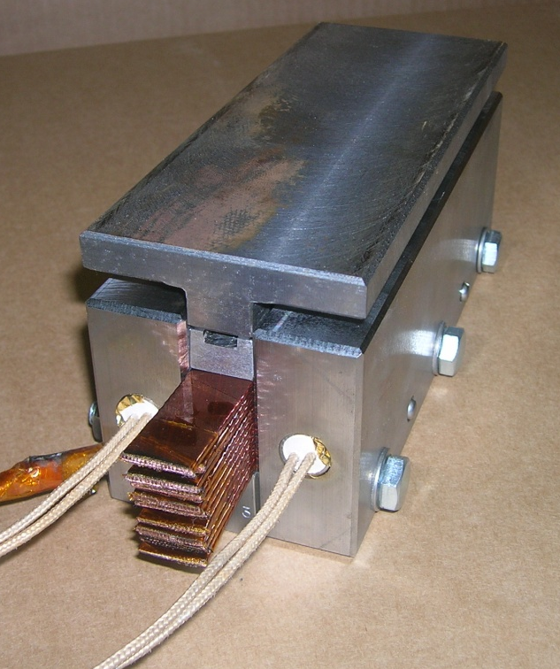
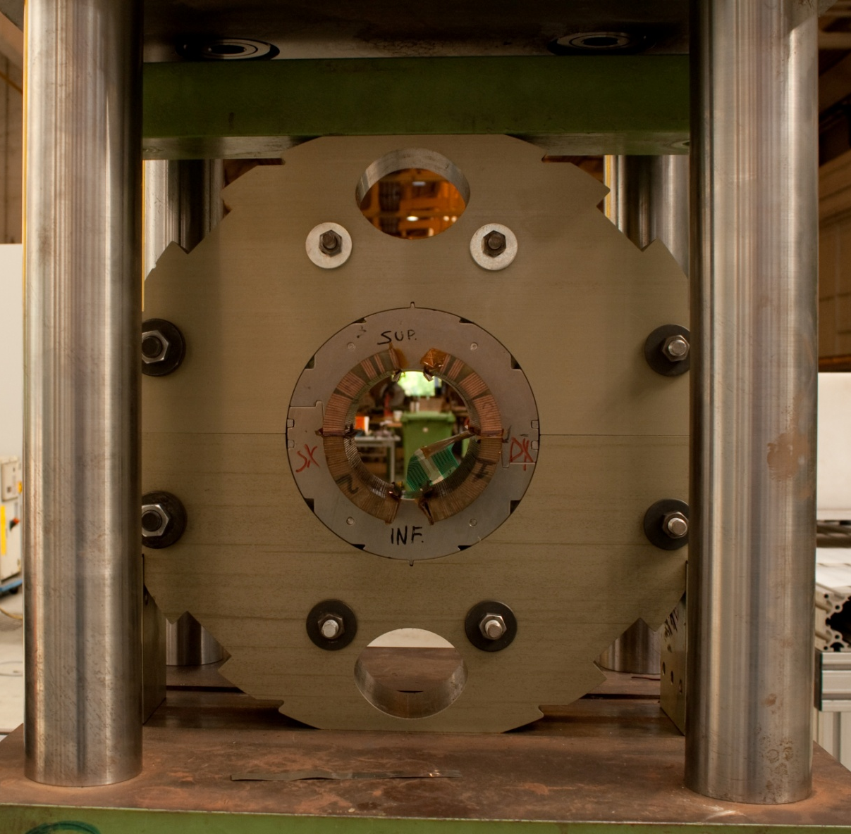
Activity finalised to TDR
During the construction of the present dipole, some mechanical aspects remained not completely clear. The collaring pressure was less than determined by calculations and tests . We decided to construct a new coil with the real cable and perform tests.
The tests are mechanical and involve: 1) Stacks of conductors, 2) Short model, 3) The new coil, 3) Collaring test.
INFN has funded the construction of this coil for mechanical tests and part of tests.
We should be able to determine the ‘real’ mechanical properties to be used in the design of next magnet

Slide 10
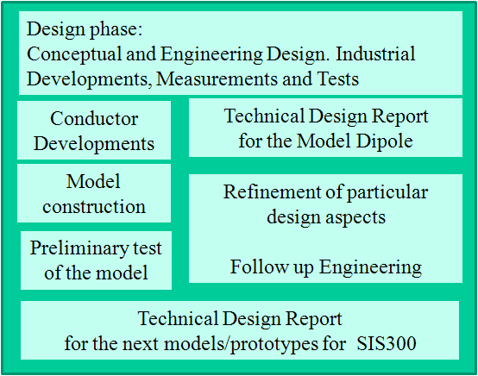
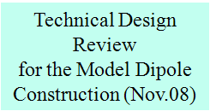
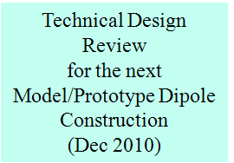
The future, as planned one year ago
Existing M.o.U (2006-2010)
Extended M.o.U. (2010-2011)
Construction of an optimized winding (2poles).
Design of a long model magnet
Procurement of basic tool (collaring press)
Construction of the second short magnet (cold mass)
Test at GSI in existing horizontal cryostat
Future M.o.U. (2012-2013)
Construction of the 3rd and 4th short magnet
(prototype cold masses)
Construction of the 1st and 2nd long magnets
(model/prototype cold masses + horizontal cryostat)

Slide 11
Next activities
(Costruction of an advanced model)
Positive facts:
1) New advanced conductor developed (two lengths)
2) Activities are still going on at ASG Superconductors for the construction of a coil for mechanical test. We did not loose contact with industry
3) If successful we could get funds (EU-FP7) for a collaring press replacing the CERN press no more available.
Negative facts:
Presently no formal contact INFN/FAIR for an MoU finalized to an advanced model (During March 2010 meeting INFN asked FAIR to fund 50% the II model). No Italian contribution to FAIR defined.
→
In the meeting of NTA committee, assigned 200k€ (sj) for next development were taken back.

Slide 12
A preliminary balance

Slide 13
CONCLUSIONS
The manufacturing activities of the short model are almost finished.
The test will start as soon as we have all formal approval for test station, presumably on June
Completion of the cold mass (doomed flange welding) on September and assembly in horizontal cryostat on October
Magnet at GSI on November
Future activity (next advanced model) could start, but the lack of an agreement between FAIR and INFN is putting it in danger.

Slide 14
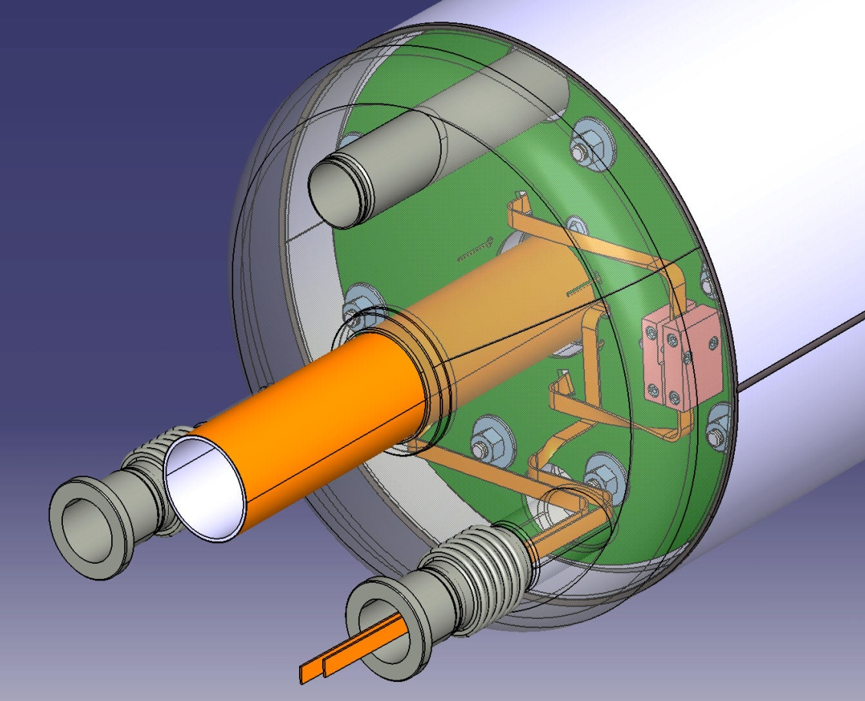
Thank you

