Slide 1
Next steps of SIS 300 Dipole R&D
P.Fabbricatore
on behalf
The DISCORAP Collaboration

Slide 2
Synopsis
Review in view of the Model Construction.
Process to be ended by Dec.08
Review in view of the Prototypes Construction

Slide 3
A new R&D program
We think that we can start now the design and the construction of a second, more optimized model magnet, even before the results of the tests at LASA (end 2010) and the final test at GSI (Spring 2011), are available. As a further (and not to be underevaluated) advantage, this program allows to continue the industrial developments without stopping the connections with industry, which could hardly re-start after one year break.
According to this R&D program the collars and the yoke will be not changed. Changes with respect the coil under construction will affect the coil (new optimised lay-out), some materials (the blocks will be done of G11 more resistant to radiations, new ground insulation), the axial pre-stress on the coil, the way to apply the mechanical shims, the external shell (thinner than present one).

Slide 4
Planning for next step of the R&D (not yet approved and funded)
May 2010 start of the re-design of the coil (number of sectors, turns lay-out and coil ends). Deadline December 2010
October 2010- Construction of two poles with present conductor (June) and extensive pre-stress campaign on short axial length
August 2010. Start the procurement of the collaring press (to be ready in March 2011)
November 2010. New lengths of low loss conductors available
April 2011. Winding of two poles
May 2011. Collaring of the coil
June 2011. Integration into the iron yoke
September 2011. Completion of the magnet
December 2011. Test at LASA

Slide 5
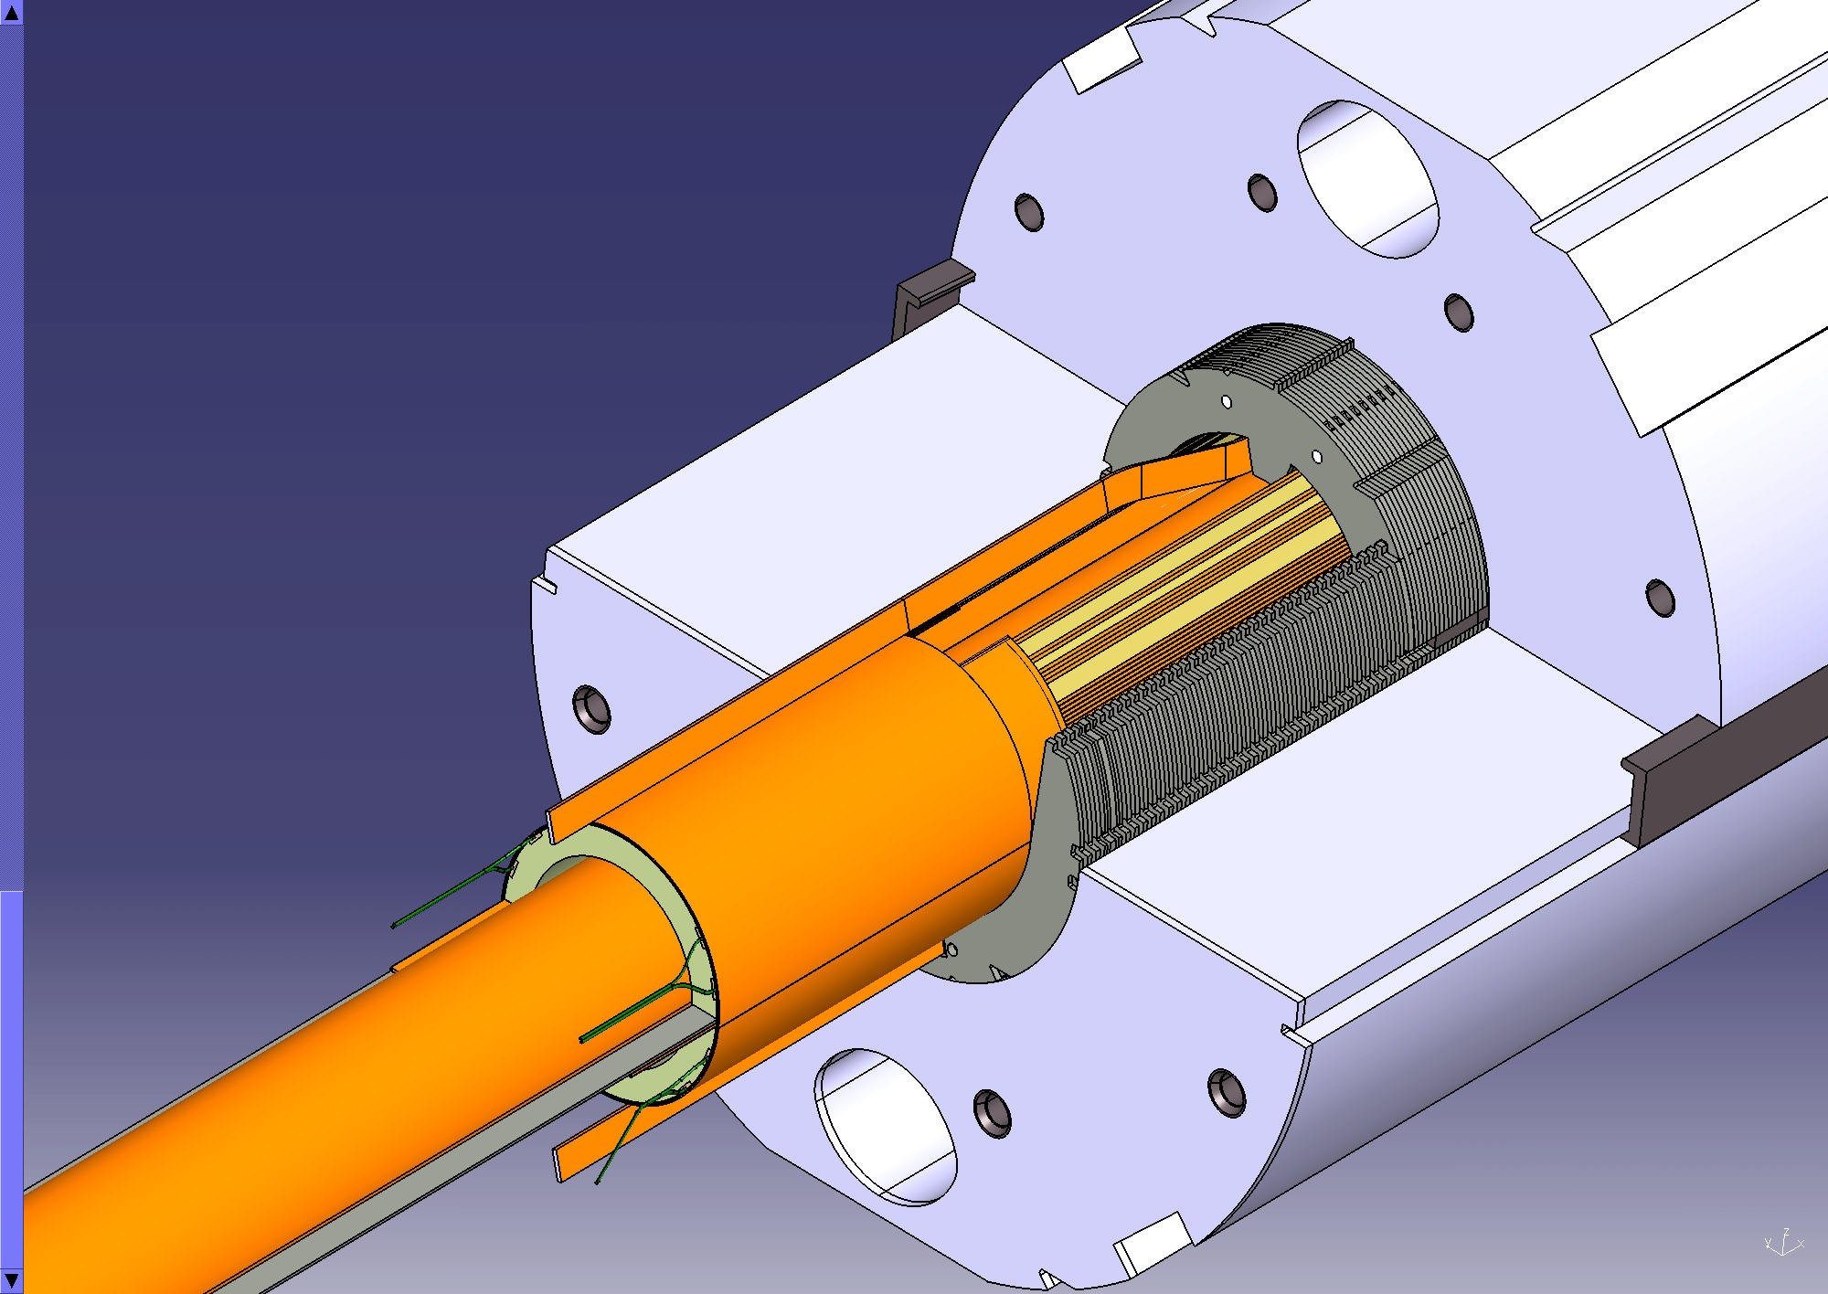
Thank you for your attention

